Slide 1
Kade made these palm cards for his speech. What information can you get from the pictures? How do you know what order to put them in? Could you give a speech about an ambulance using his cards? Have a go!!!
Transport Speech
This term we have been learning about how to organise our thoughts when we are giving a speech.
Using pictures is a great way to represent the ideas in our head.
We can draw these pictures on palm cards to guide us when we are speaking to the audience.

Slide 2
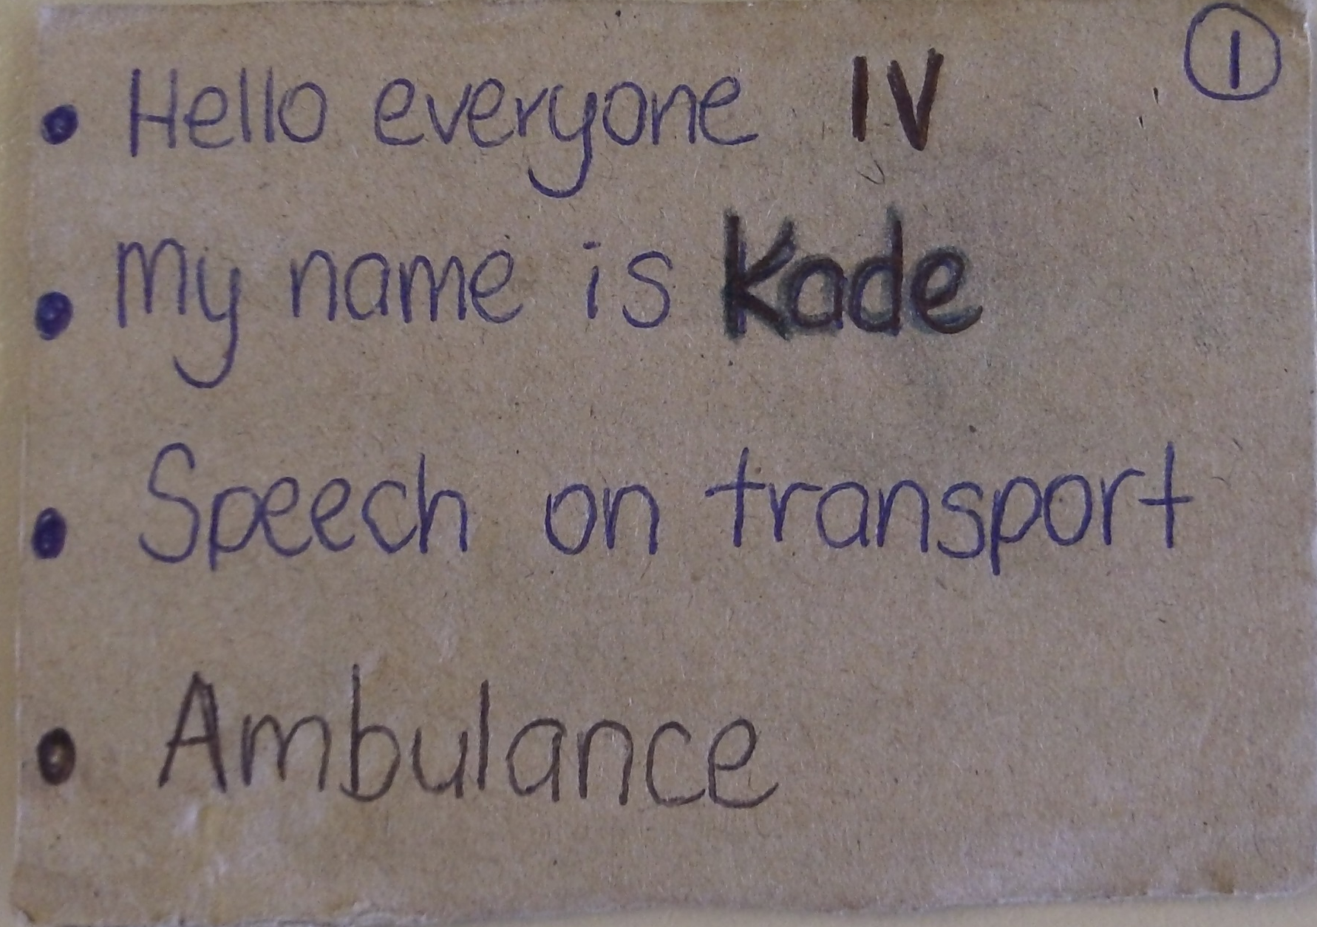

Slide 3
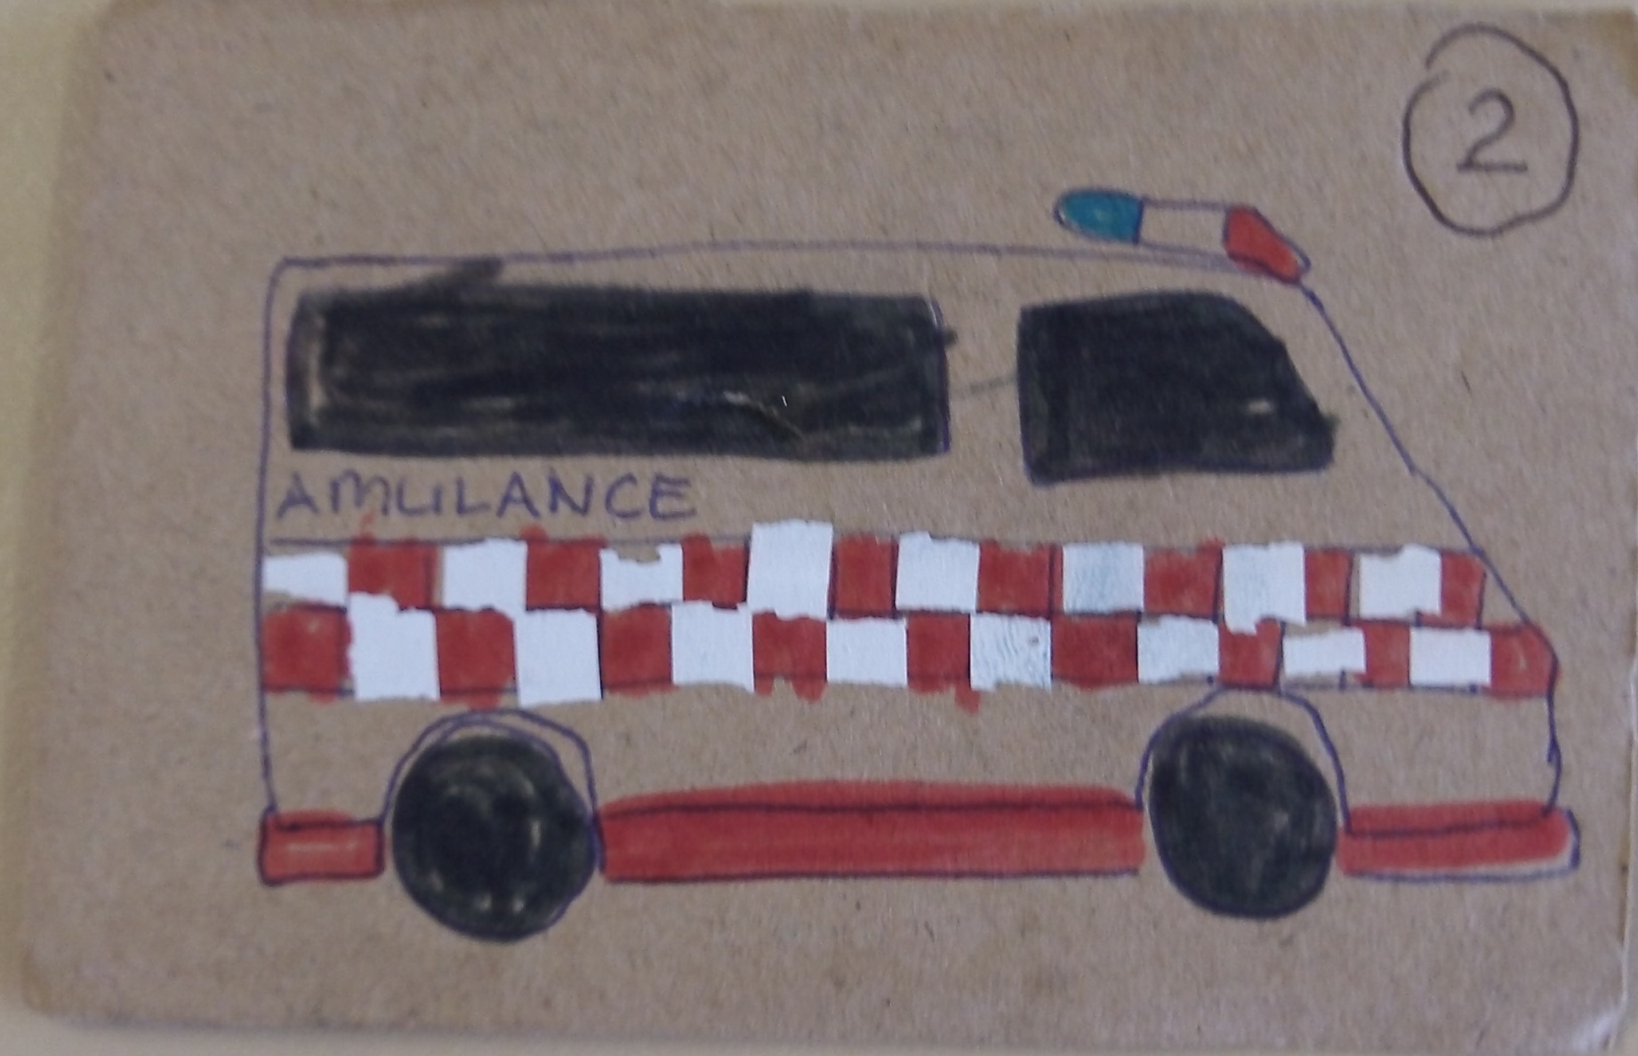

Slide 4
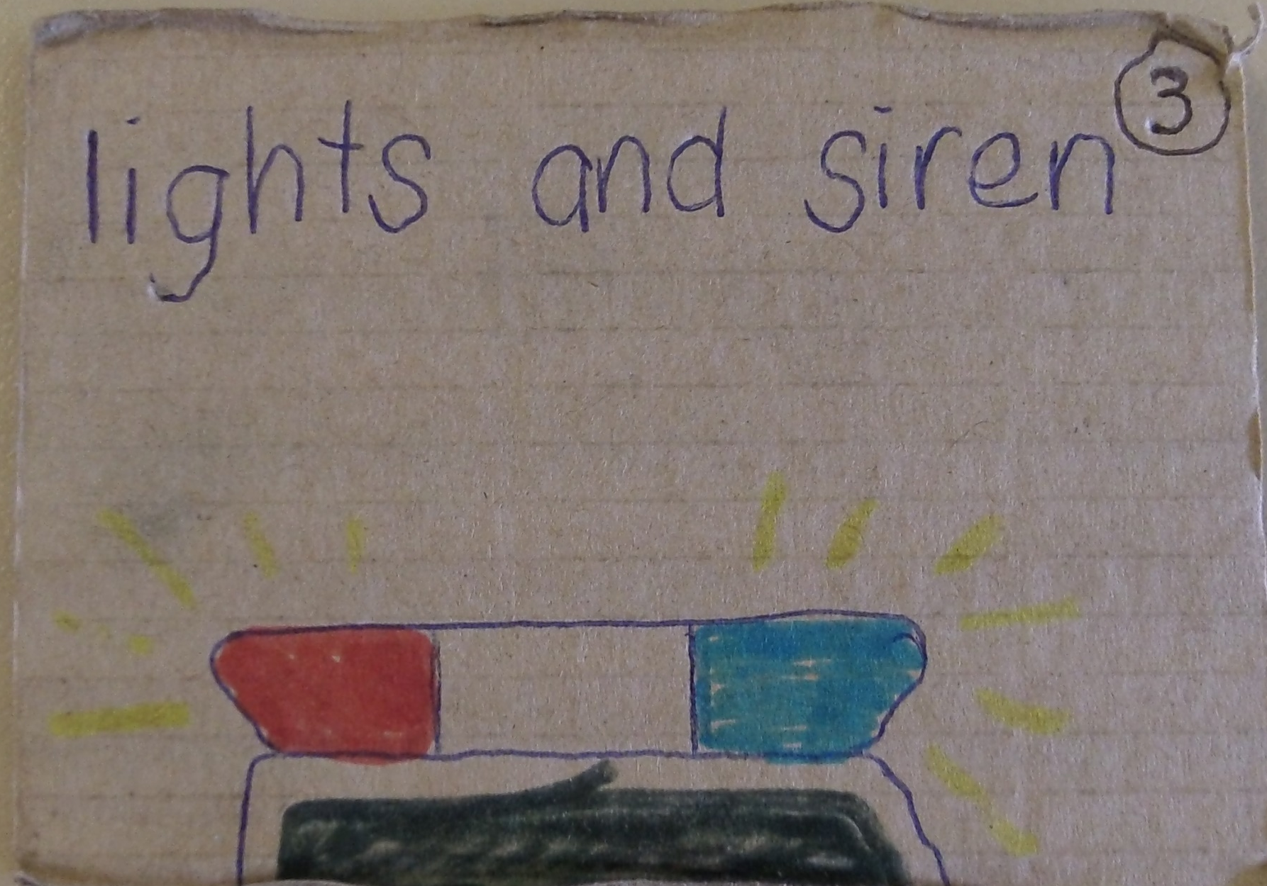

Slide 5
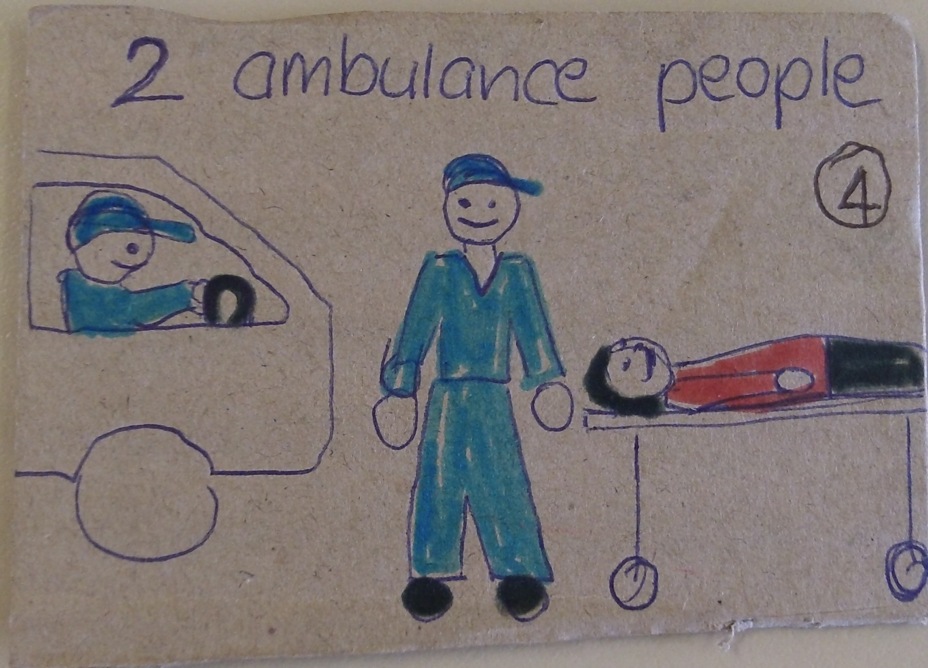

Slide 6
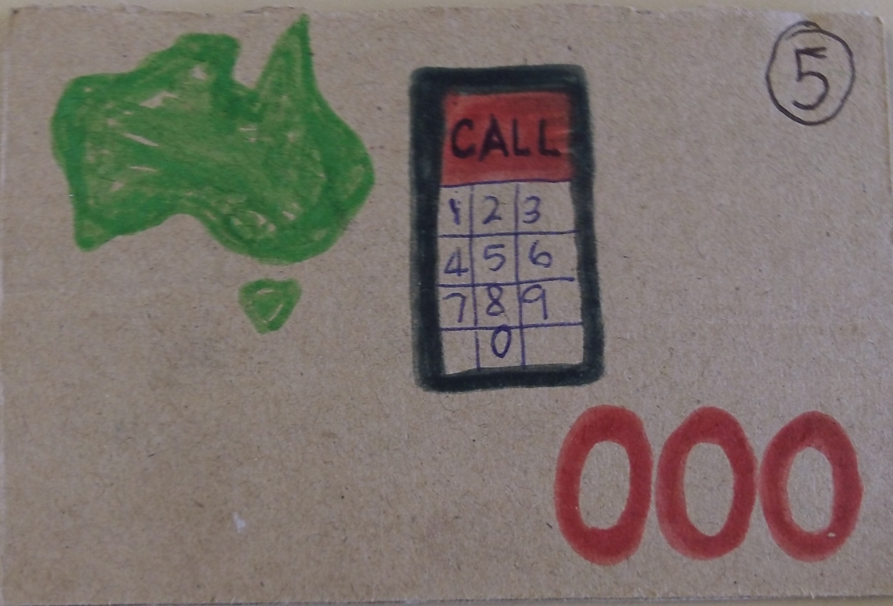

Slide 7
