Slide 1
Elizabeth
Farm
2016

Slide 2
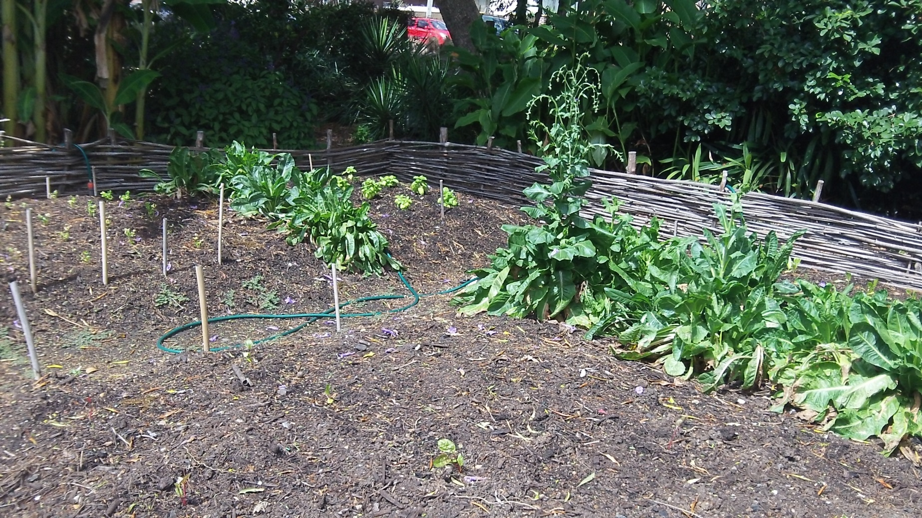
The Cottage Garden
The Europeans built the cottage garden out of stick, string and glue. They brought seeds from England so they could have food from home. In the cottage garden they grew mint, garlic, lettuce and many more vegetables.

Slide 3
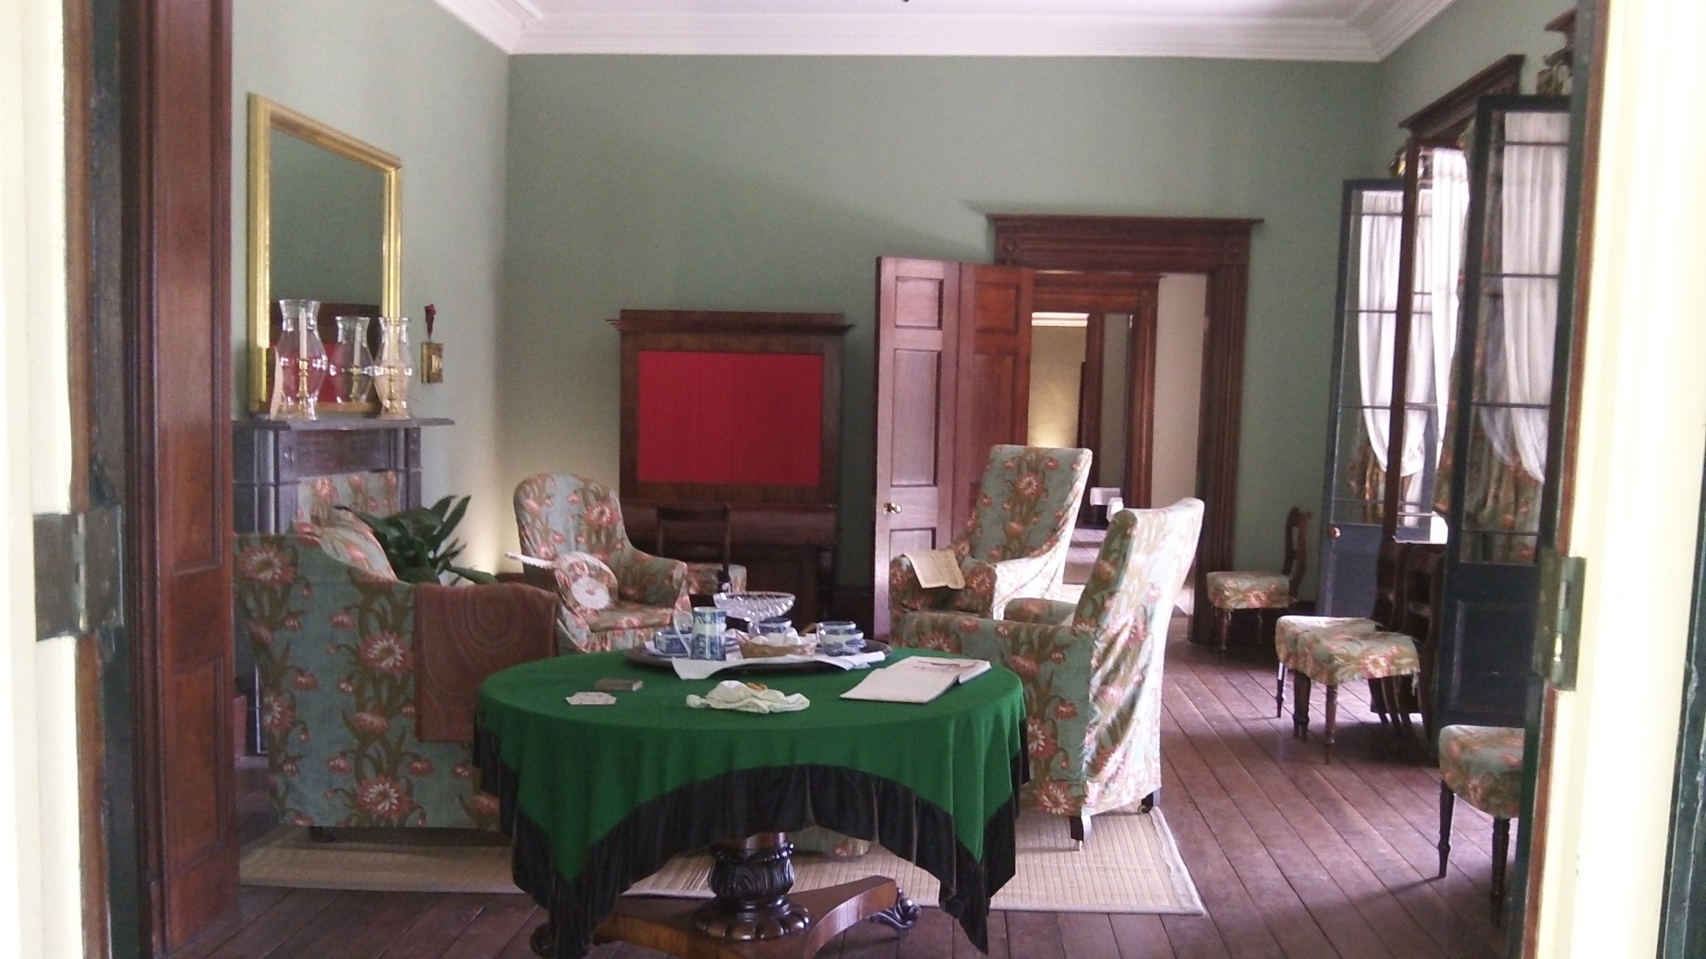
The Drawing Room
The women went into the drawing room to get away from the men.
In the drawing room they played the piano, they drew and sketched. They also drank tea, played cards and talked to each other.

Slide 4
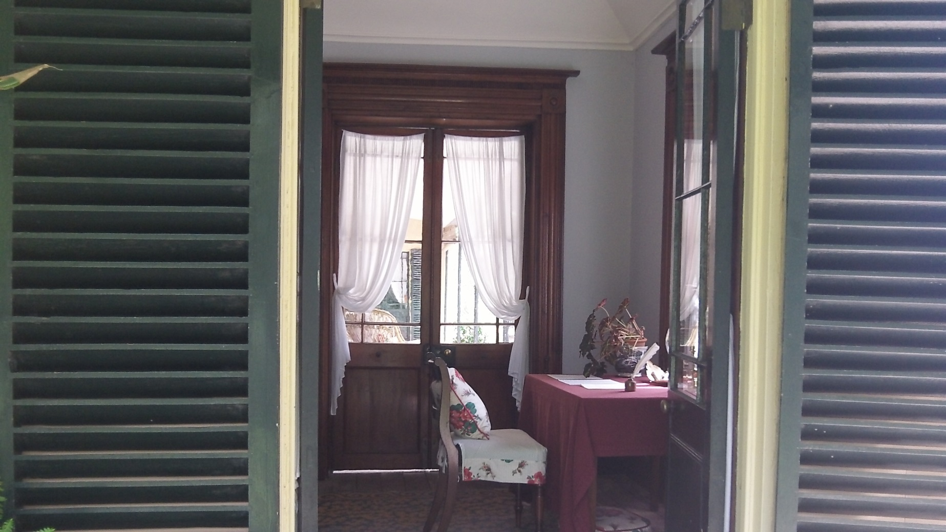
The Writing Desk
Elizabeth and John wrote letters to the friends and family. Elizabeth and John used the writing desk to communicate with each other.

Slide 5
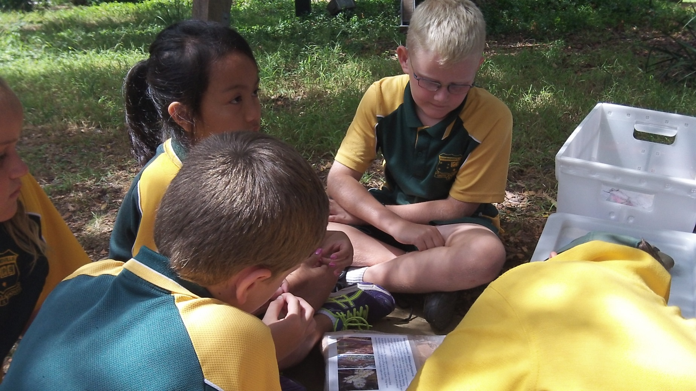
Paper Bark
Paperbark was used by the Aboriginals to wrap babies in to keep them safe. They also use it for holding water and for carrying food.

Slide 6
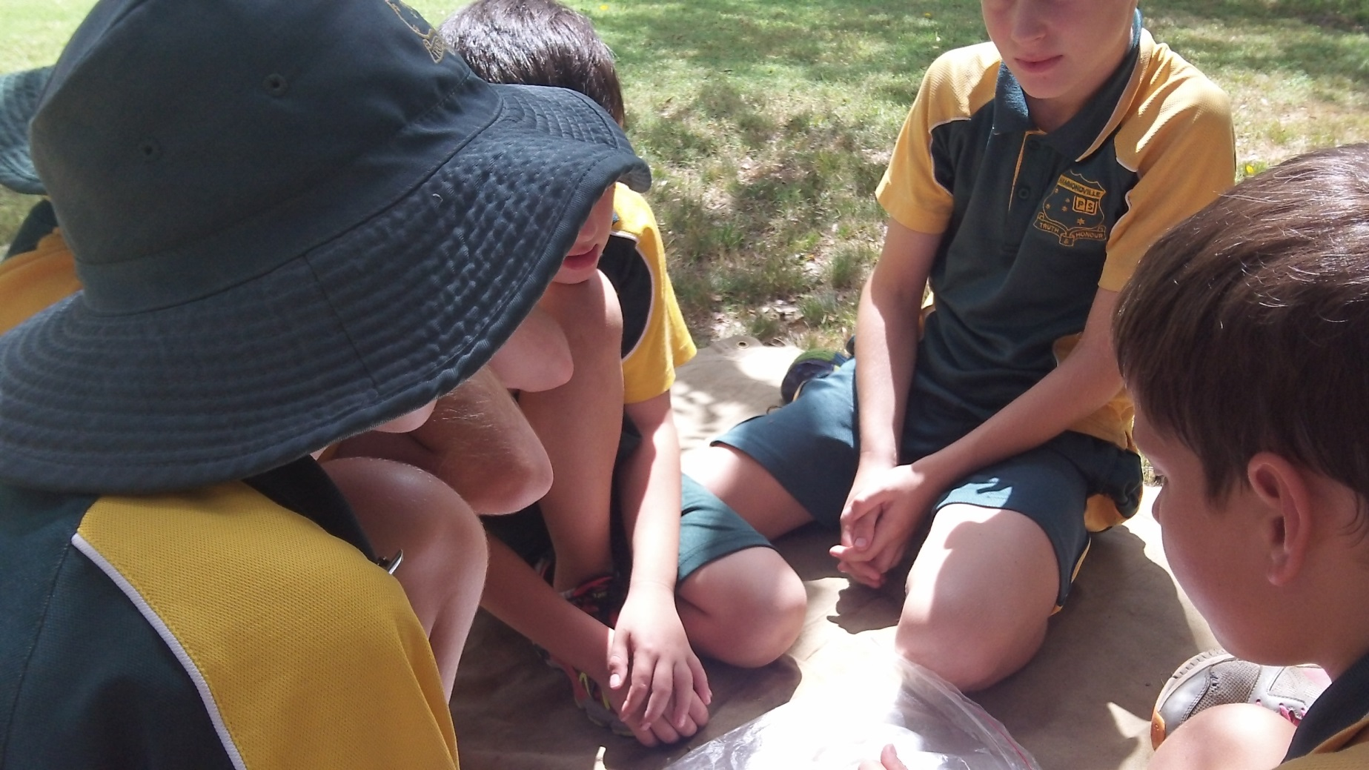
The Banksia Flower
The banksia flower was carried by the Aborigines to use as a spark so it was easier to light a fire. They would make a fire and scare animals, like kangaroos, out of the forest.

Slide 7
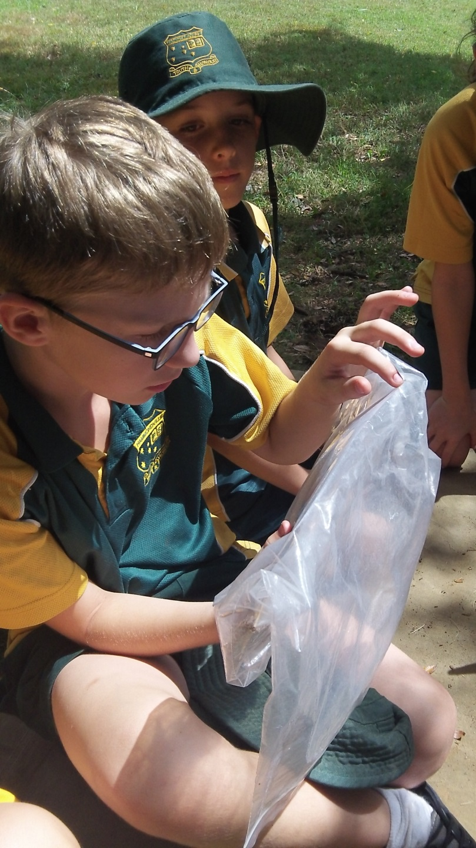
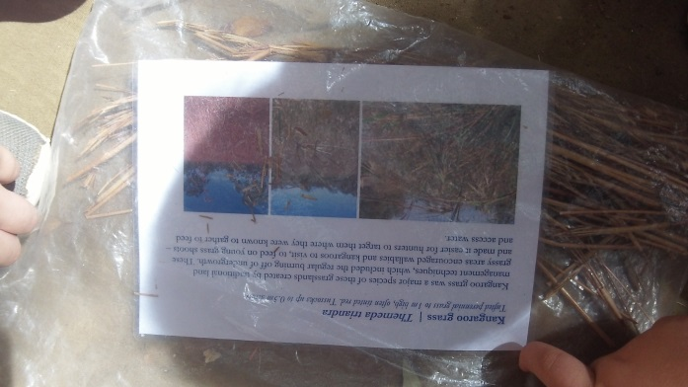
Kangaroo Grass
The Kangaroo grass was a favourite thing for the kangaroos to eat. The hunters would wait in the long grass so they could catch them.

Slide 8
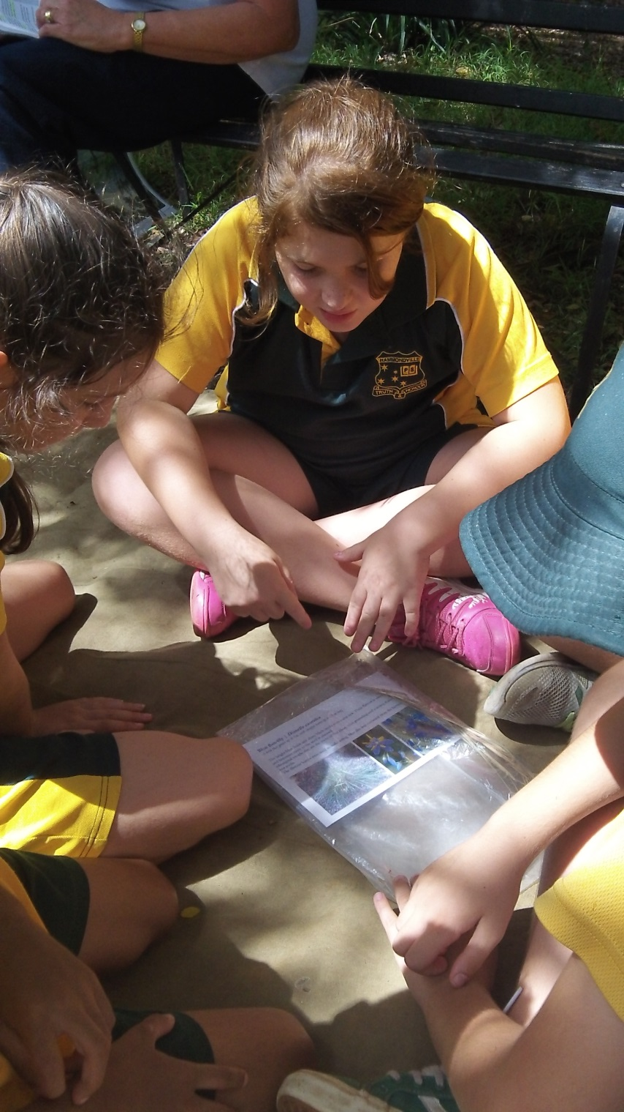
Lilly
The Aborigines would use this flower to flavour water. They would soak the petals in water to infuse the flavour.

Slide 9
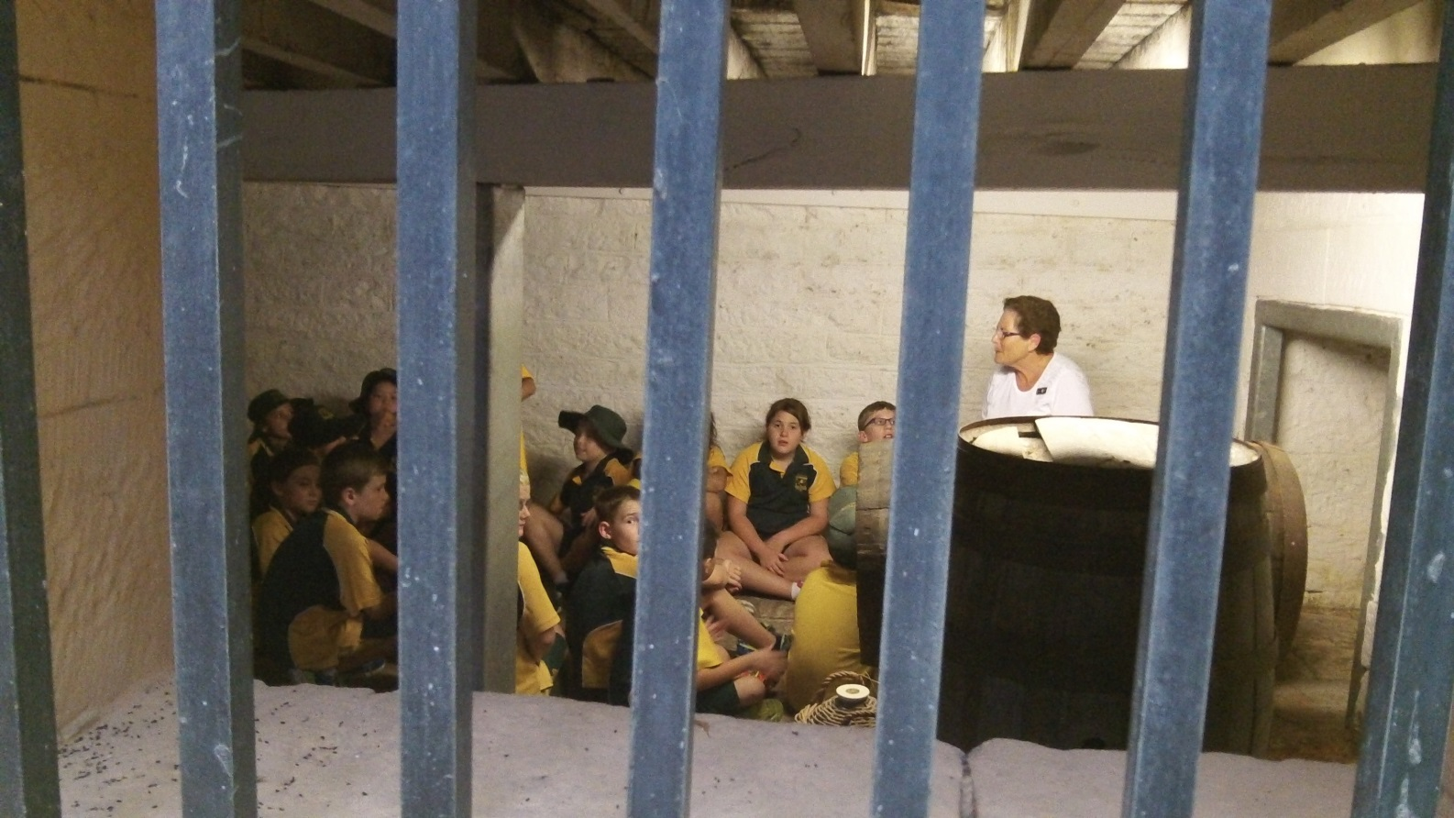
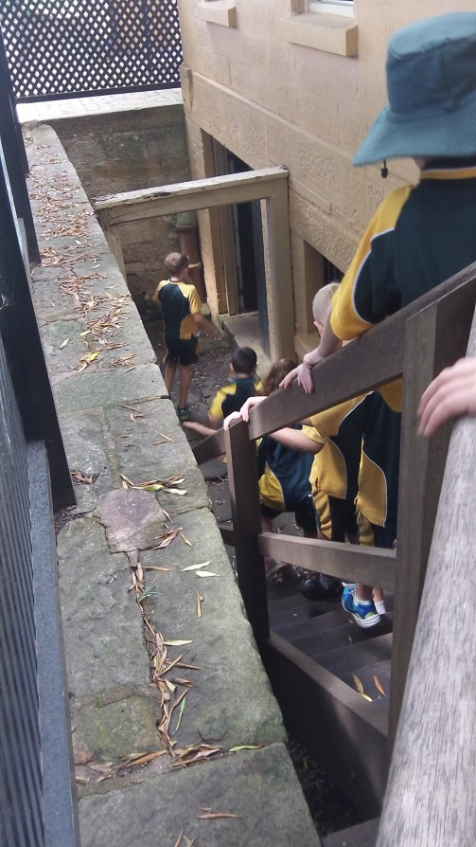
The Cellar
The cellar was where people used to store all the food. It was down under the house and made out of stone so it would be nice and cool. This would help the food last longer. They also kept it locked away so the convicts wouldn’t steal it. Food was a very precious resource.

Slide 10
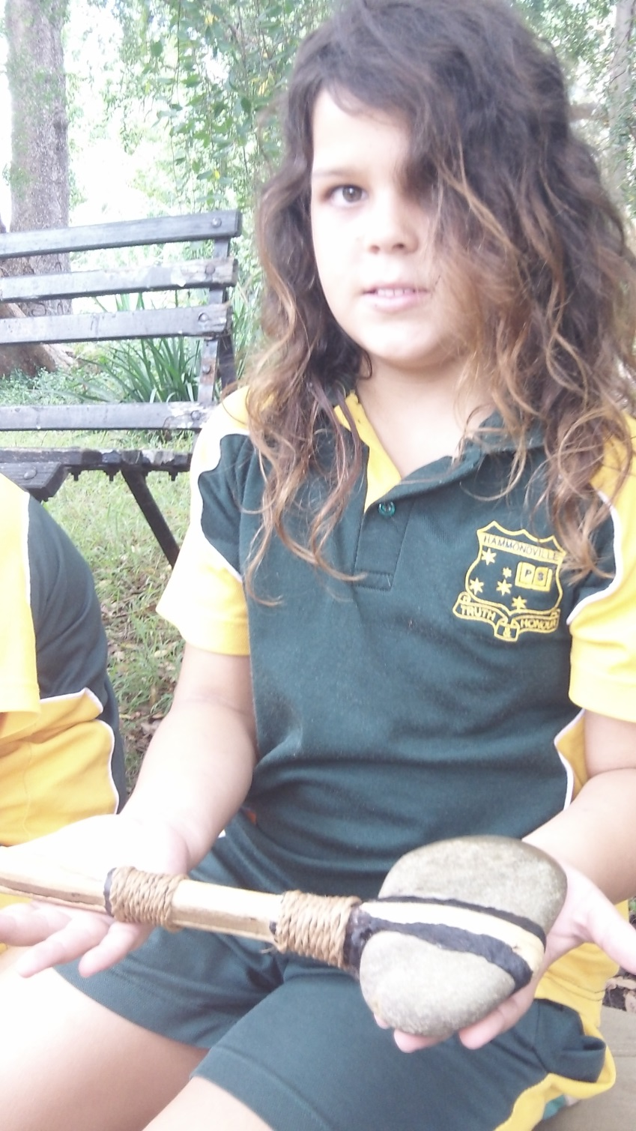
The Stone Axe
Aborigines made these tools out of wood and stone. They tied the pieces together using string they made from, grasses. They also used a type of glue they made from plants. They used it to make cuts, like foot holes, in the trees to get food from the top of them.

Slide 11
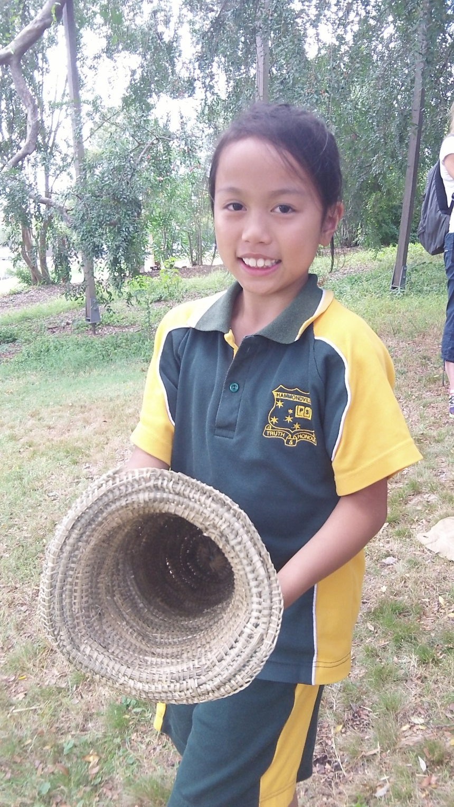
Eel Traps
The Aborigines made these traps out of plants. They would put some bait in the end and the eel would swim in to get it. The eel was captured as it was not able to turn.

