Slide 1
STAGE 1
MISS UNAL
Mrs Fleming
MS ROBINSON
MISS MORATA
MRS MAZLOUM/ MRS ENRIGHT
MISS ENRIGHT
STAGE 1
CAN YOU FIND YOUR TEACHERS NAME?
Ms Robinson
MRS FLEMING (ASSISTANT PRINCIPAL)
Miss Unal
MISS HOLDSWORTH
Mrs Mazloum
Miss Morata
Ms Holdsworth

Slide 2
Good morning
STAGE 1
MONDAY 6th SEPTEMBER 2021 – WEEK 9
Please make sure you are sending one or two work samples to your classroom teacher via dojo.

Slide 3
WHATS ON TODAY?
Morning Task 1 - spelling Task 2 - reading Crunch n’ sip Task 3 - writing Task 4 - handwriting
Middle Task 1 - Maths Grid Task 2 - Worksheet
Final Geography

Slide 4
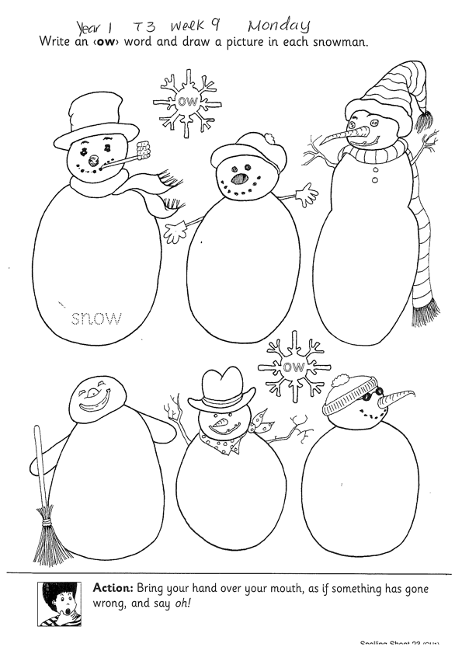
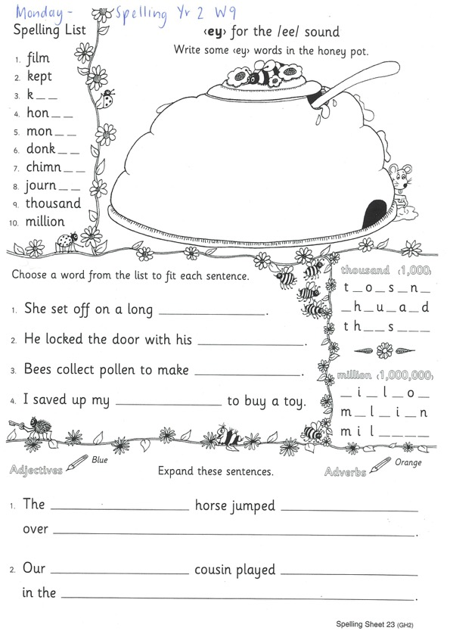
Task 1
Year 1
Year 2
Watch Mrs Warwick’s video’s for the sound of the week. Brainstorm a list of words using the sound focus of the week on a piece of paper.
Year 1
https://www.youtube.com/watch?v=YFRlPZOs_1E
Year 2
https://www.youtube.com/watch?v=oAR52j-le-k

Slide 5
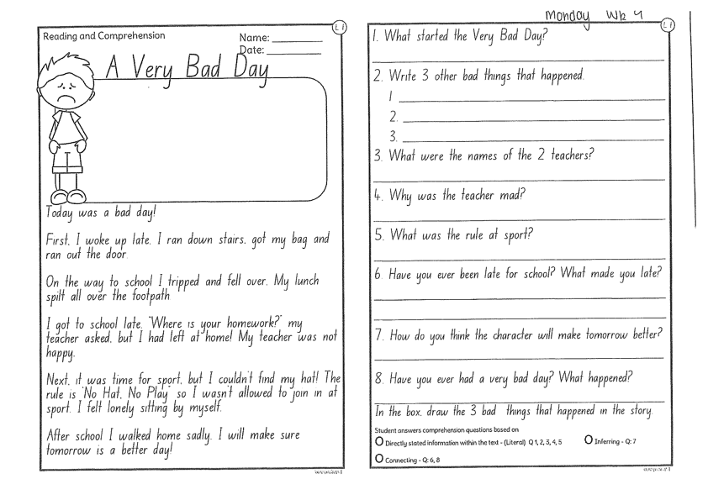
Task 2
Read or get an adult to read ‘A VERY BAD DAY’ and answer the questions.

Slide 6
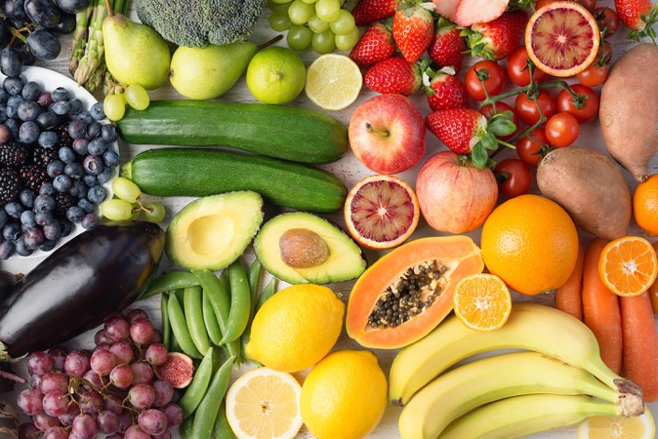
Crunch n’ sip

Slide 7
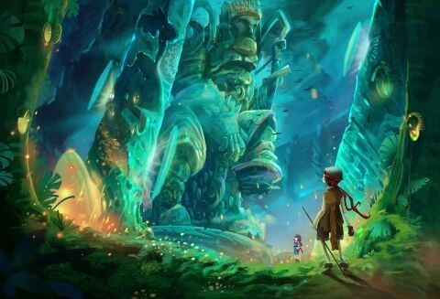
Task 3
Using the prompt, create an imaginative story of your own. Remember to tell us who is in the story, where they are, what they are doing and try to include a problem and solution!
What’s happening here?
Who is in your story?
What are they doing?
What is the problem? How is it fixed?

Slide 8
Task 4
Complete the letter “B” in your handwriting books.
Https://www.youtube.com/watch?v=fQEHWCsFSik

Slide 9
Recess break (30 minutes)

Slide 10
Mathematics
Task 1
Draw a map of your house and all of the rooms in your house. What shapes do you see in all the rooms?

Slide 11
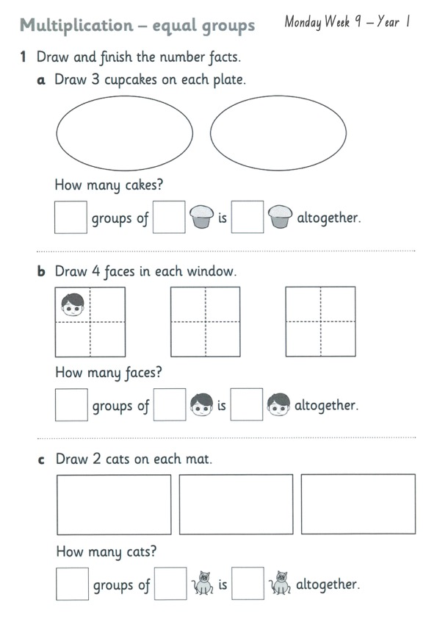
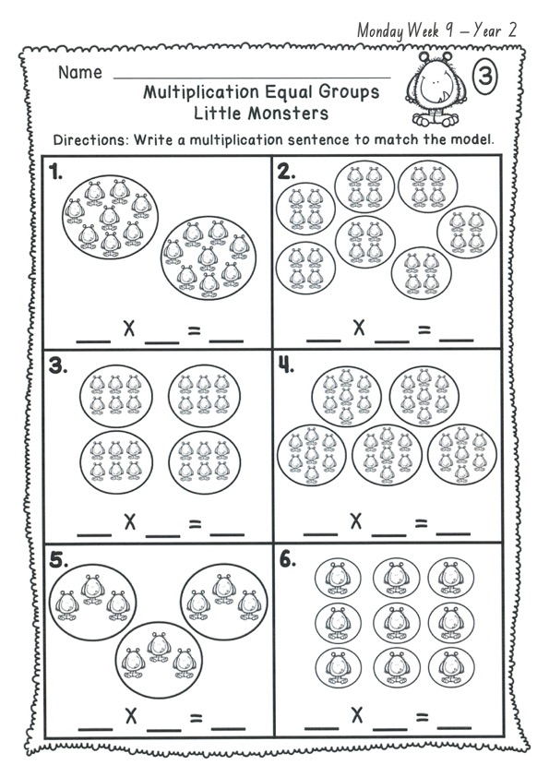
Task 2 Complete the worksheets and then do 3 activities on mathletics or studyladder.
EQUAL GROUPS

Slide 12
Lunch break (40 minutes)

Slide 13
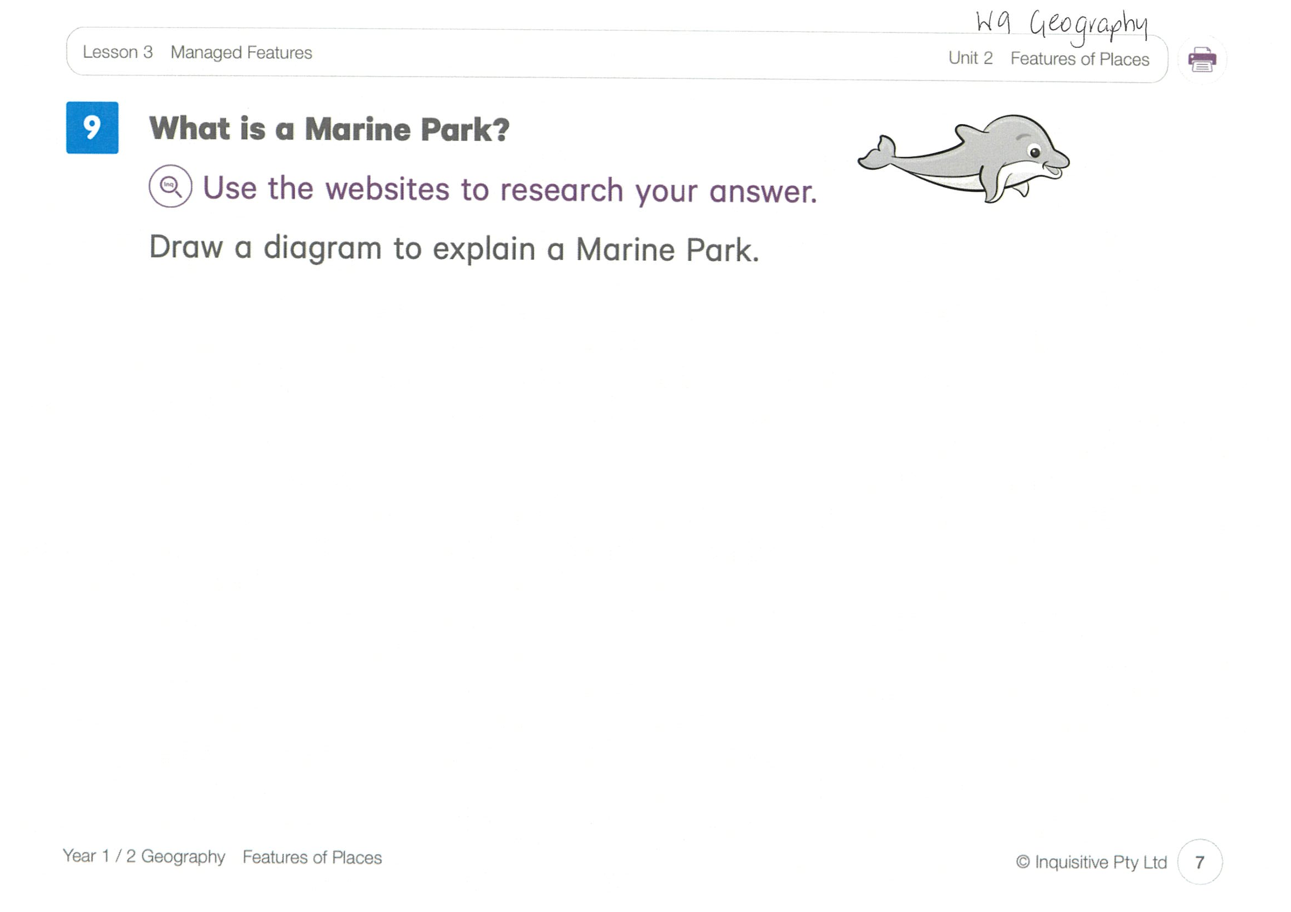
KLA - geography
Todays lesson is on Managed Features. What is a marine park?
Today you need to think and research about what a marine park is. Use the website links to help you. Draw pictures or write words in your worksheet to describe a marine park. Click the link below to take you to today’s lesson.
http://inq.co/class/9wg
Code: 9484

Slide 14
END OF DAY!
ENJOY your well-deserved break everyone!

Slide 15
Good morning
STAGE 1
TUESDAY 7TH SEPTEMBER 2021 – WEEK 9
Please make sure you are sending one or two work samples to your classroom teacher via dojo.

Slide 16
WHATS ON TODAY?
Morning Task 1 – Spelling Task 2 – Reading Crunch n’ sip Task 3 - Writing Middle Task 1 – Maths Grid
Task 2 – Activity Worksheet
Final Library

Slide 17
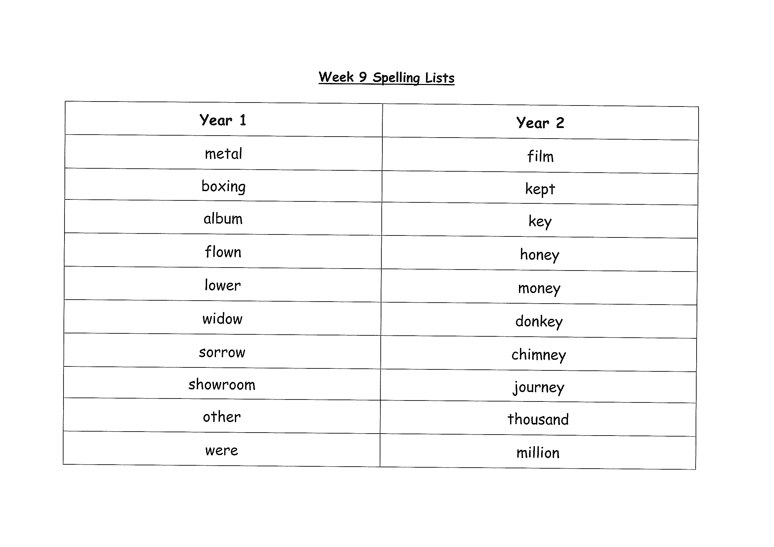
Task 1
Complete the Look, Cover, Write, Check worksheet (on a piece of paper). Write some sentences. Circle any nouns in your sentences.
Then complete your tricky word!

Slide 18
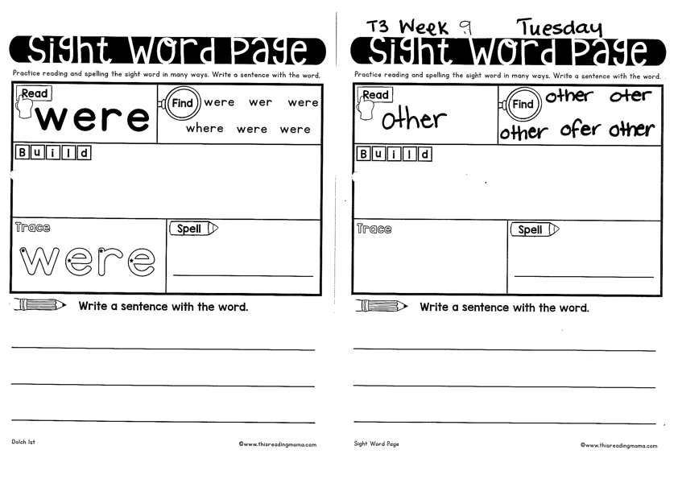
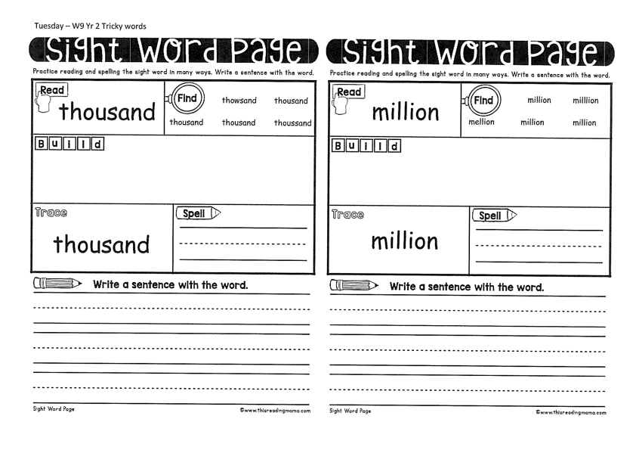
Year 1
Year 2

Slide 19
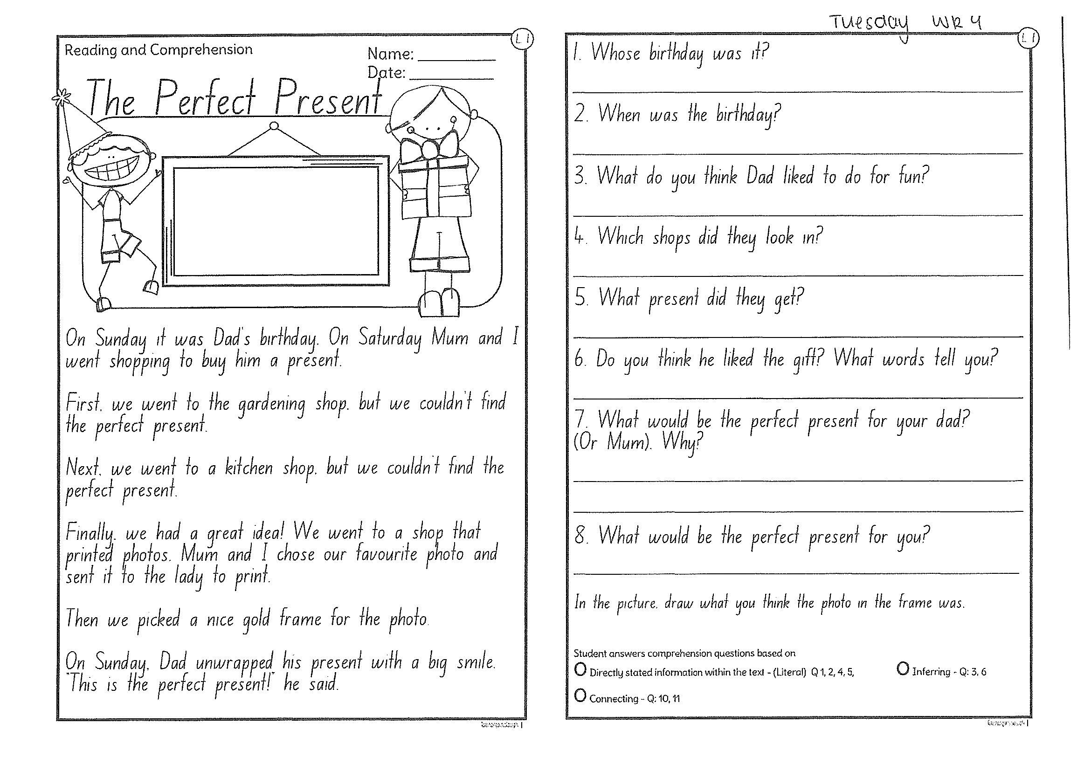
Task 2
Read or get an adult to read “The Perfect Present” and answer the questions.

Slide 20
Crunch n’ sip

Slide 21
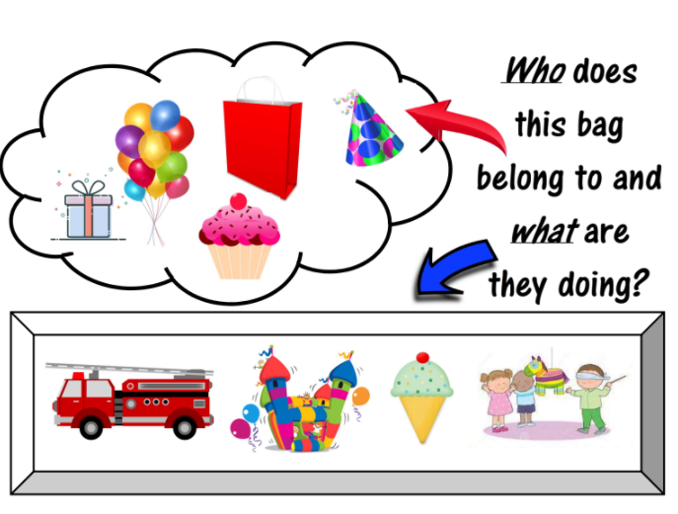
Task 3
Writing – who does this bag belong to?
Look at the questions in your learning pack guide.

Slide 22
Recess break (30 minutes)

Slide 23
Mathematics
M o n e y
Task 1
Count how many windows your house has in total?

Slide 24
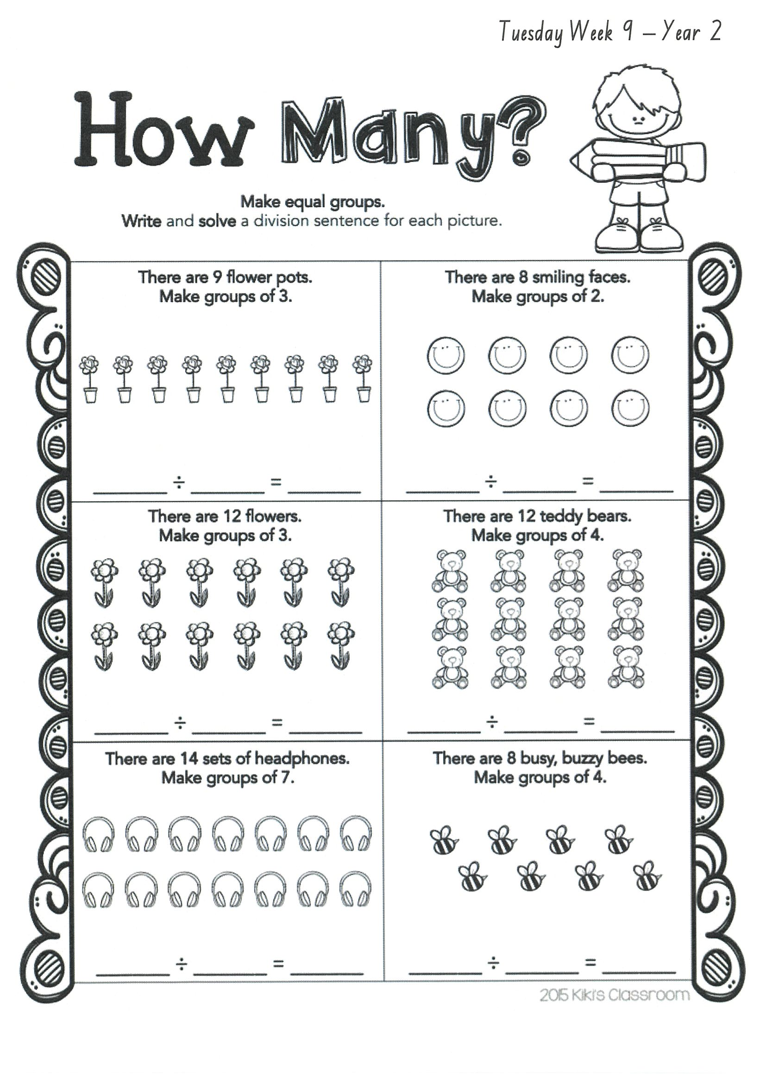
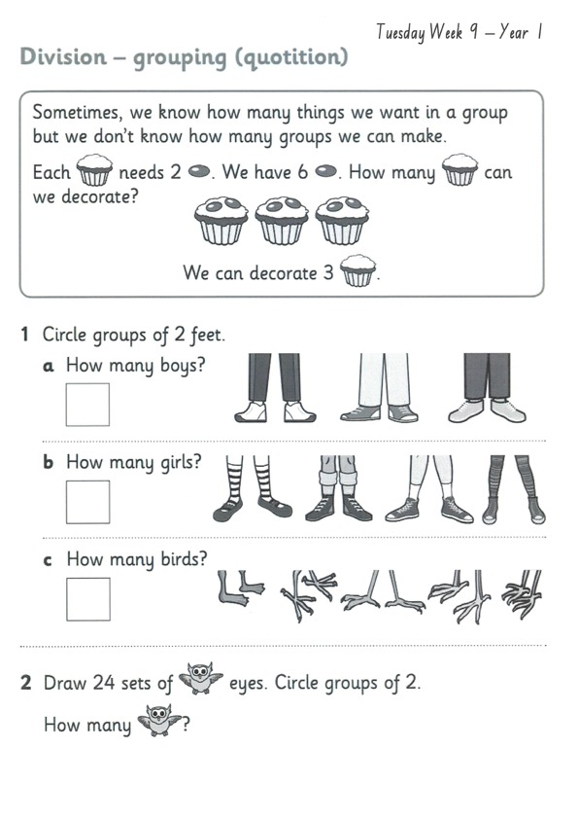
Task 2 Then complete 3 activities on studyladder or mathletic.
3d s h a p e s

Slide 25
Lunch break (40 minutes)

Slide 26
library
Silent reading
Choose one or two activities to complete each week from the NEW library activity grid.

Slide 27
END OF DAY!
ENJOY your well-deserved break everyone!

Slide 28
Good morning
STAGE 1
WEDNESDAY 8th SEPTEMBER 2021 – WEEK 9
Please make sure you are sending one or two work samples to your classroom teacher via dojo.

Slide 29
WHATS ON TODAY?
Morning Task 1 – Spelling Task 2 – Reading Crunch n’ sip Task 3 - WUSHKA
Task 4 - Handwriting Middle Task 1 – Maths Grid Task 2 – Worksheet
Task 3 – Fitness
Final Science

Slide 30
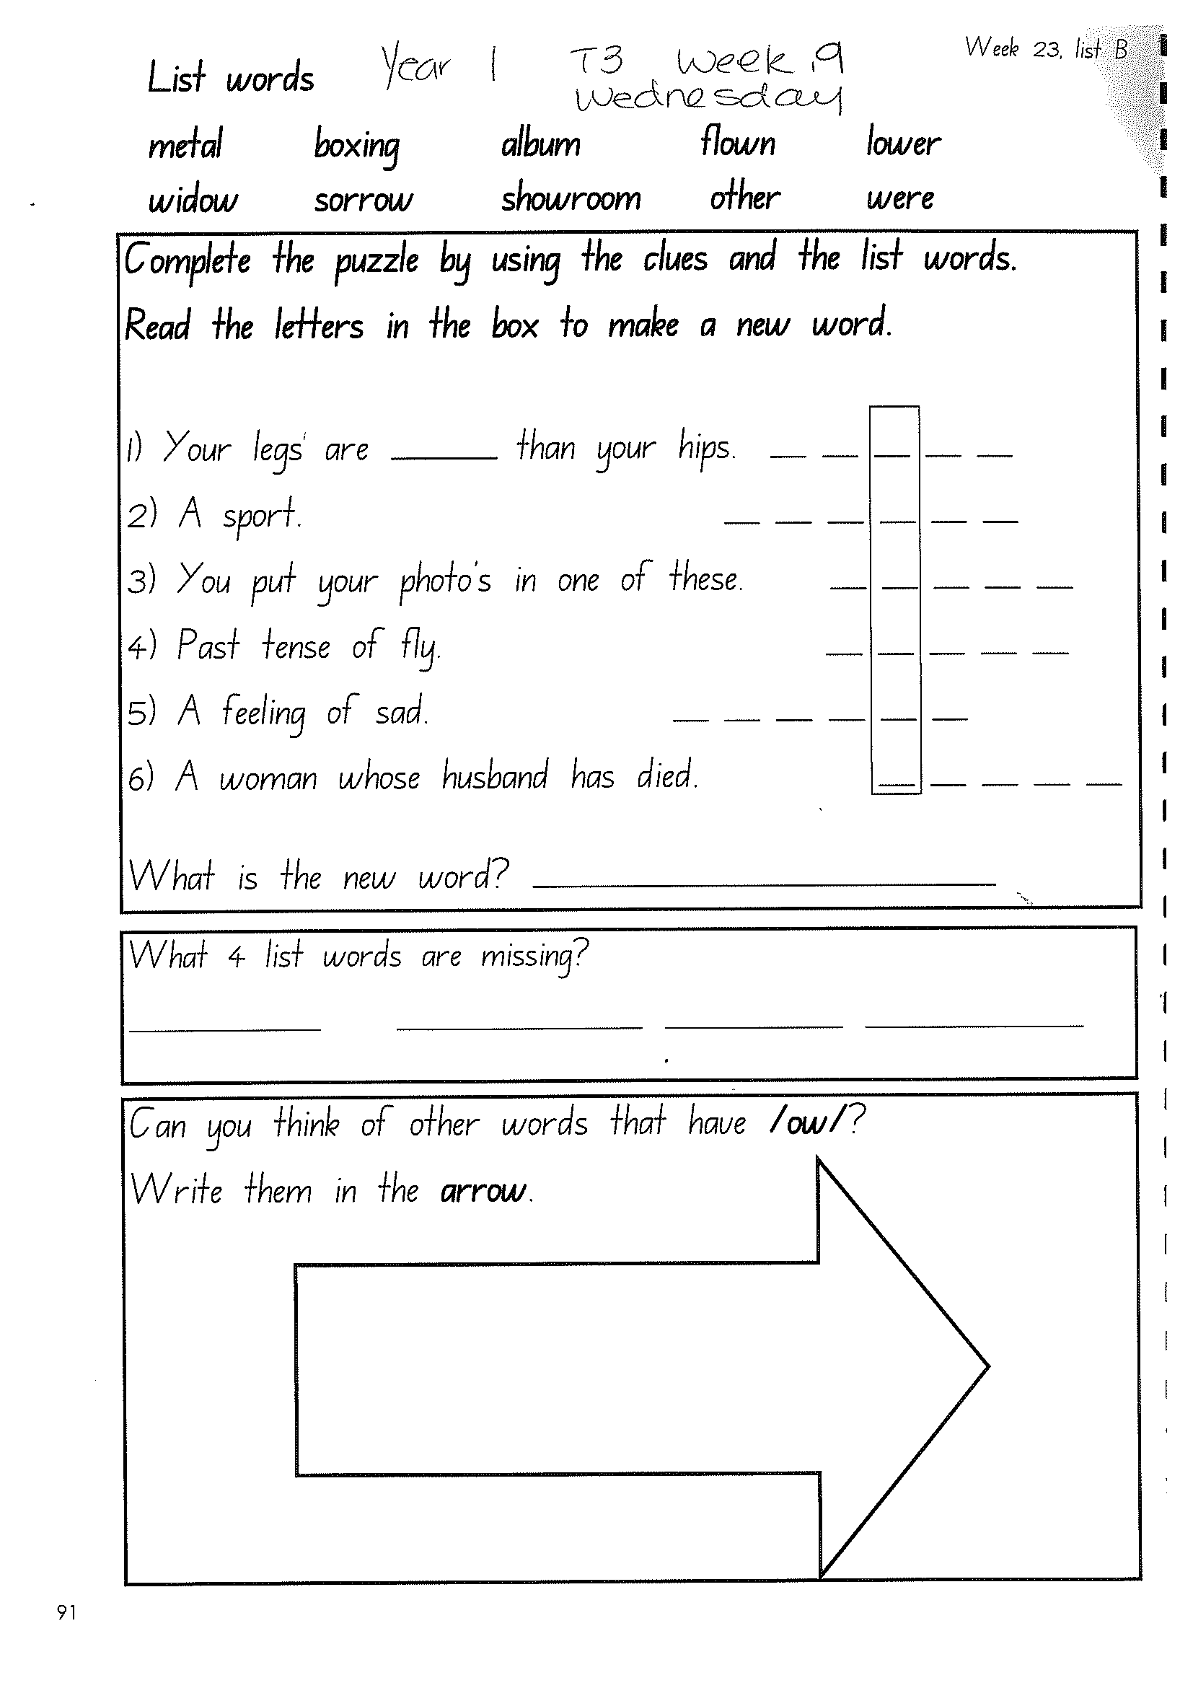
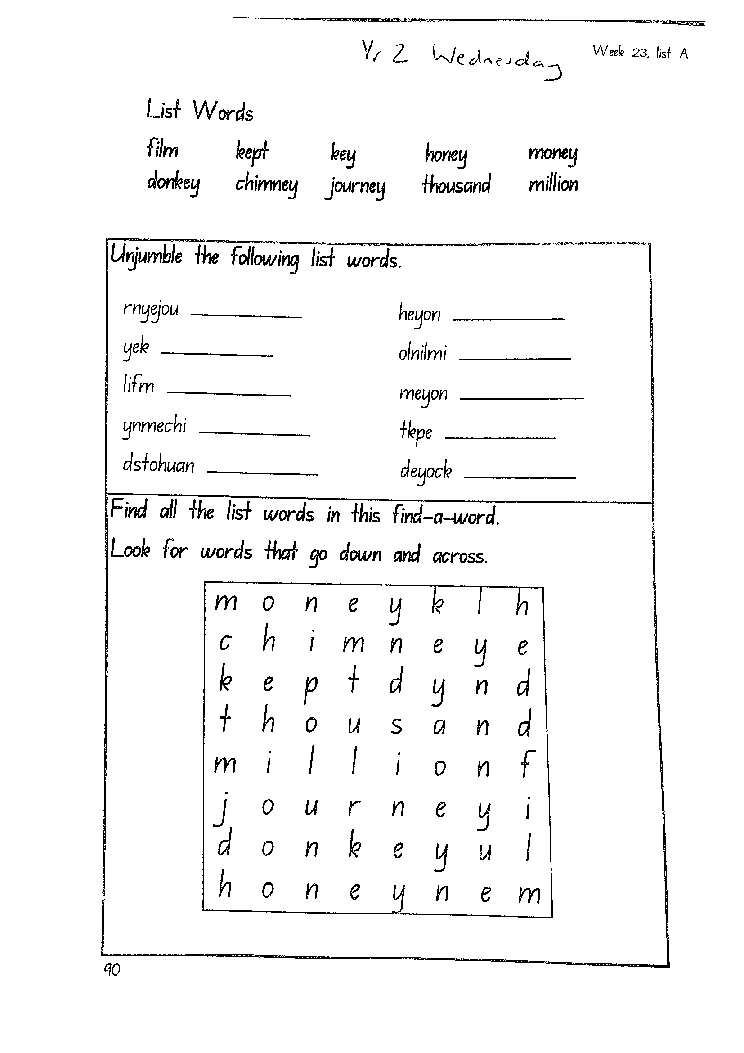
Task 1
Write down your spelling words and dot, dash, dive them on a piece of paper..
Video will be posted on dojo! Complete spelling tasks.

Slide 31
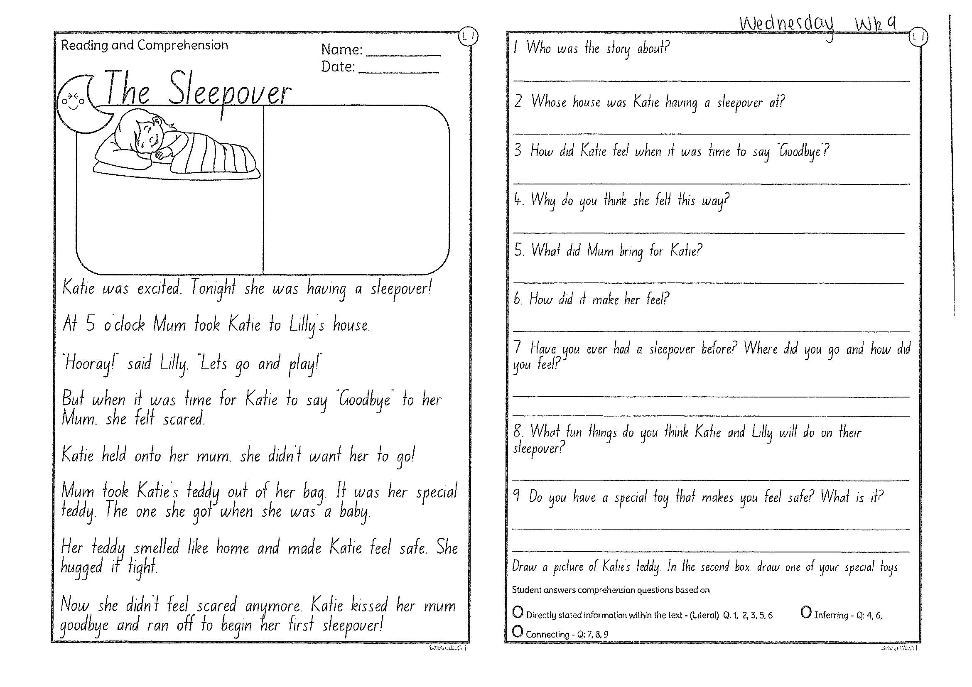
Task 2
Read or get an adult to read ”The Sleepover” and answer the questions.

Slide 32
Crunch n’ sip

Slide 33
Task 3
Wushka - Log into WUSHKA and do some reading.

Slide 34
Task 4
Complete the letter “z” in your handwriting books.
Https://www.youtube.com/watch?v=67diGNRVhms

Slide 35
Recess break (30 minutes)

Slide 36
Mathematics
Task 1
How many steps does your house have?

Slide 37
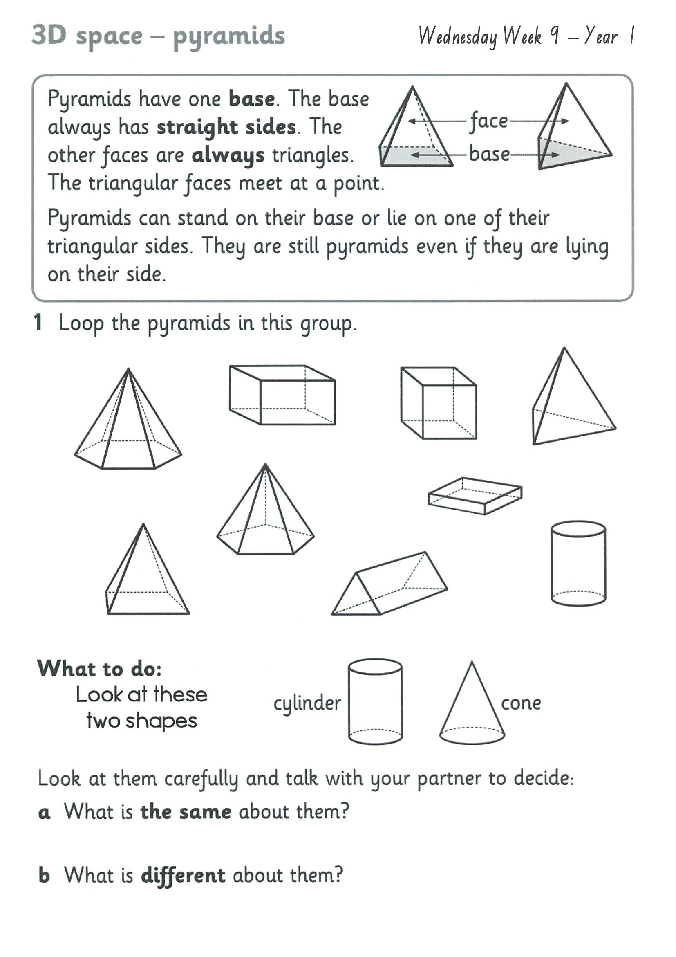
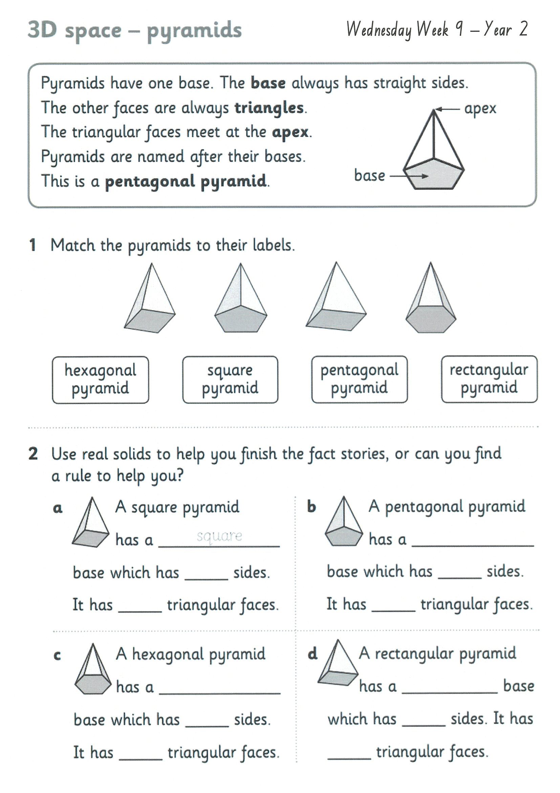
Task 2
A D D I T I O N
Year 1
Year 2

Slide 38
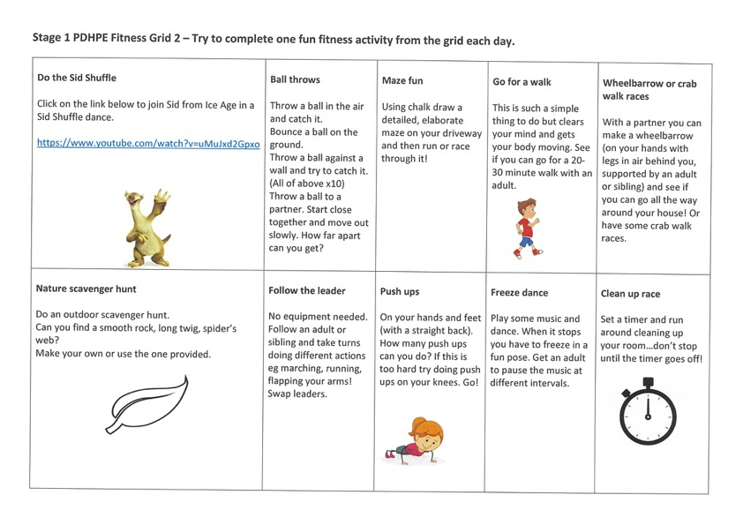
fitness
Choose an activity from the fitness grid to complete.
Not this one
(in your packs)

Slide 39
Lunch break (40 minutes)

Slide 40
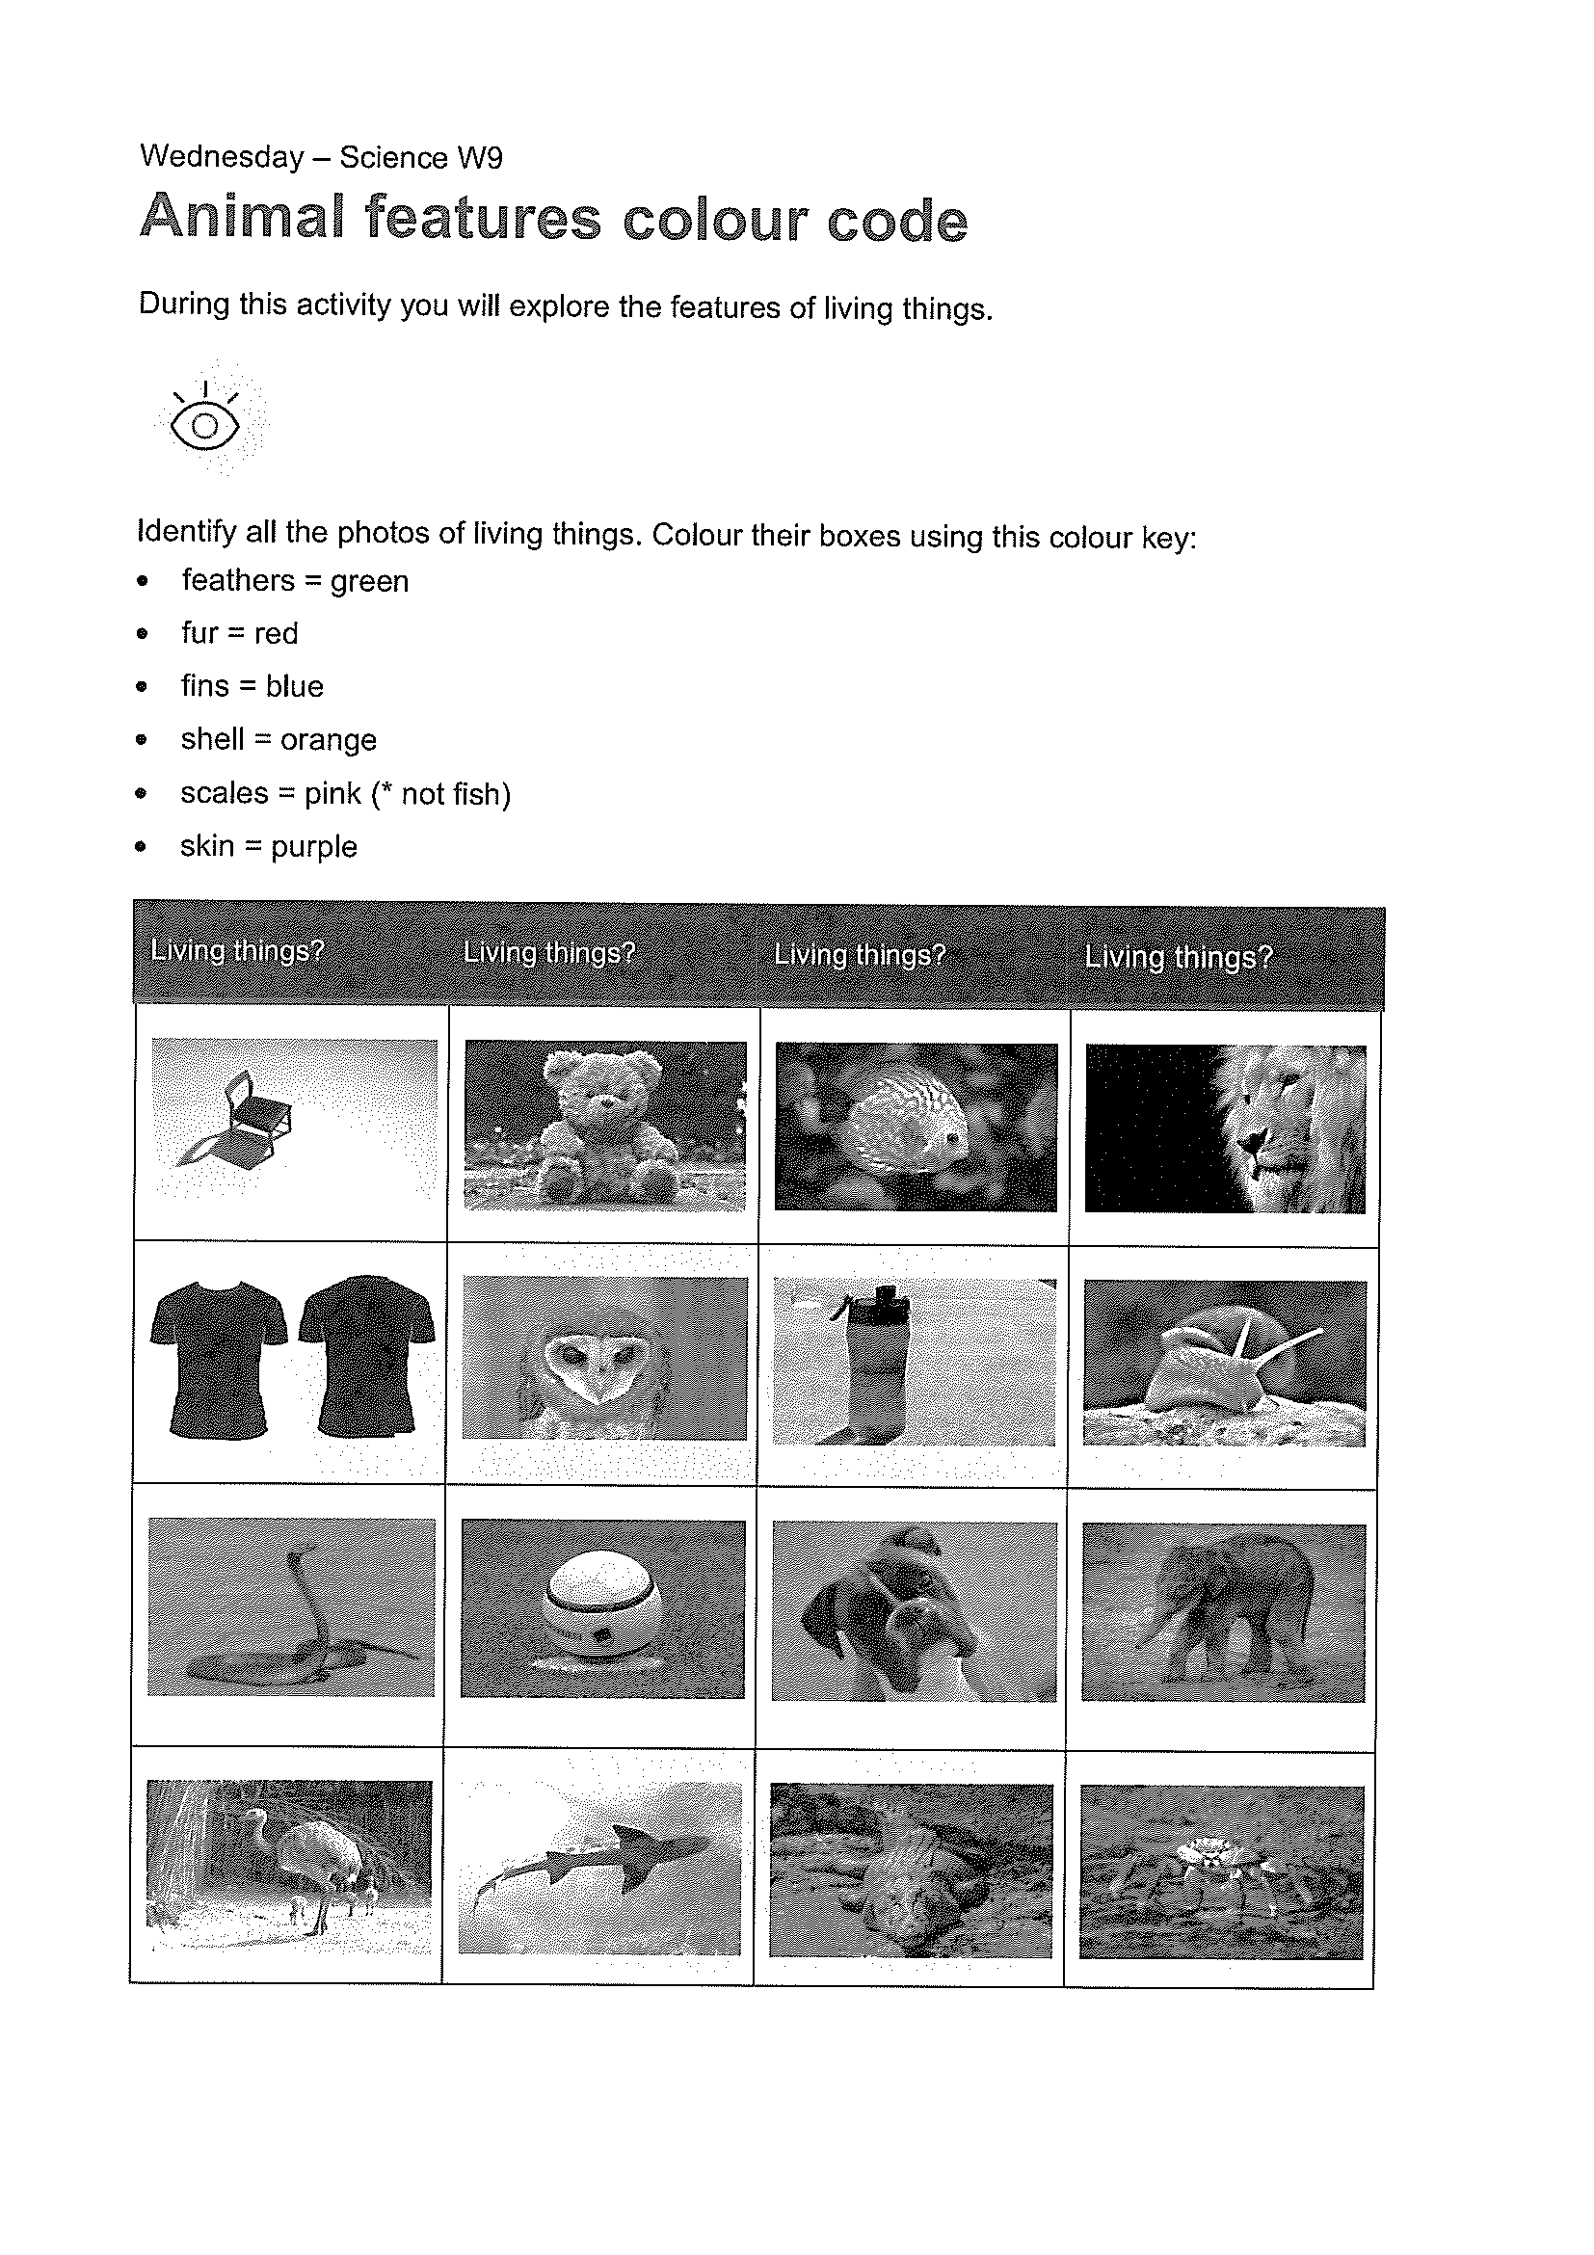
KLA - SCIENCE
Watch the video about fur, feathers, scales or skin:
Https://www.youtube.com/watch?v=dkjFa9uoGEk
Look at the different images of animals and using the codes, colour in the images that describe the features of the living tings.

Slide 41
END OF DAY!
ENJOY your well-deserved break everyone!

Slide 42
Good morning
STAGE 1
THURSDAY 9th SEPTEMBER 2021 – WEEK 9
Please make sure you are sending one or two work samples to your classroom teacher via dojo.

Slide 43
WHATS ON TODAY?
Morning Task 1 – GRAMMAR Task 2 – Reading Crunch n’ sip Task 3 - Writing Middle Task 1 – Maths Grid
Task 2 – Maths Worksheets
Final PDHPE

Slide 44
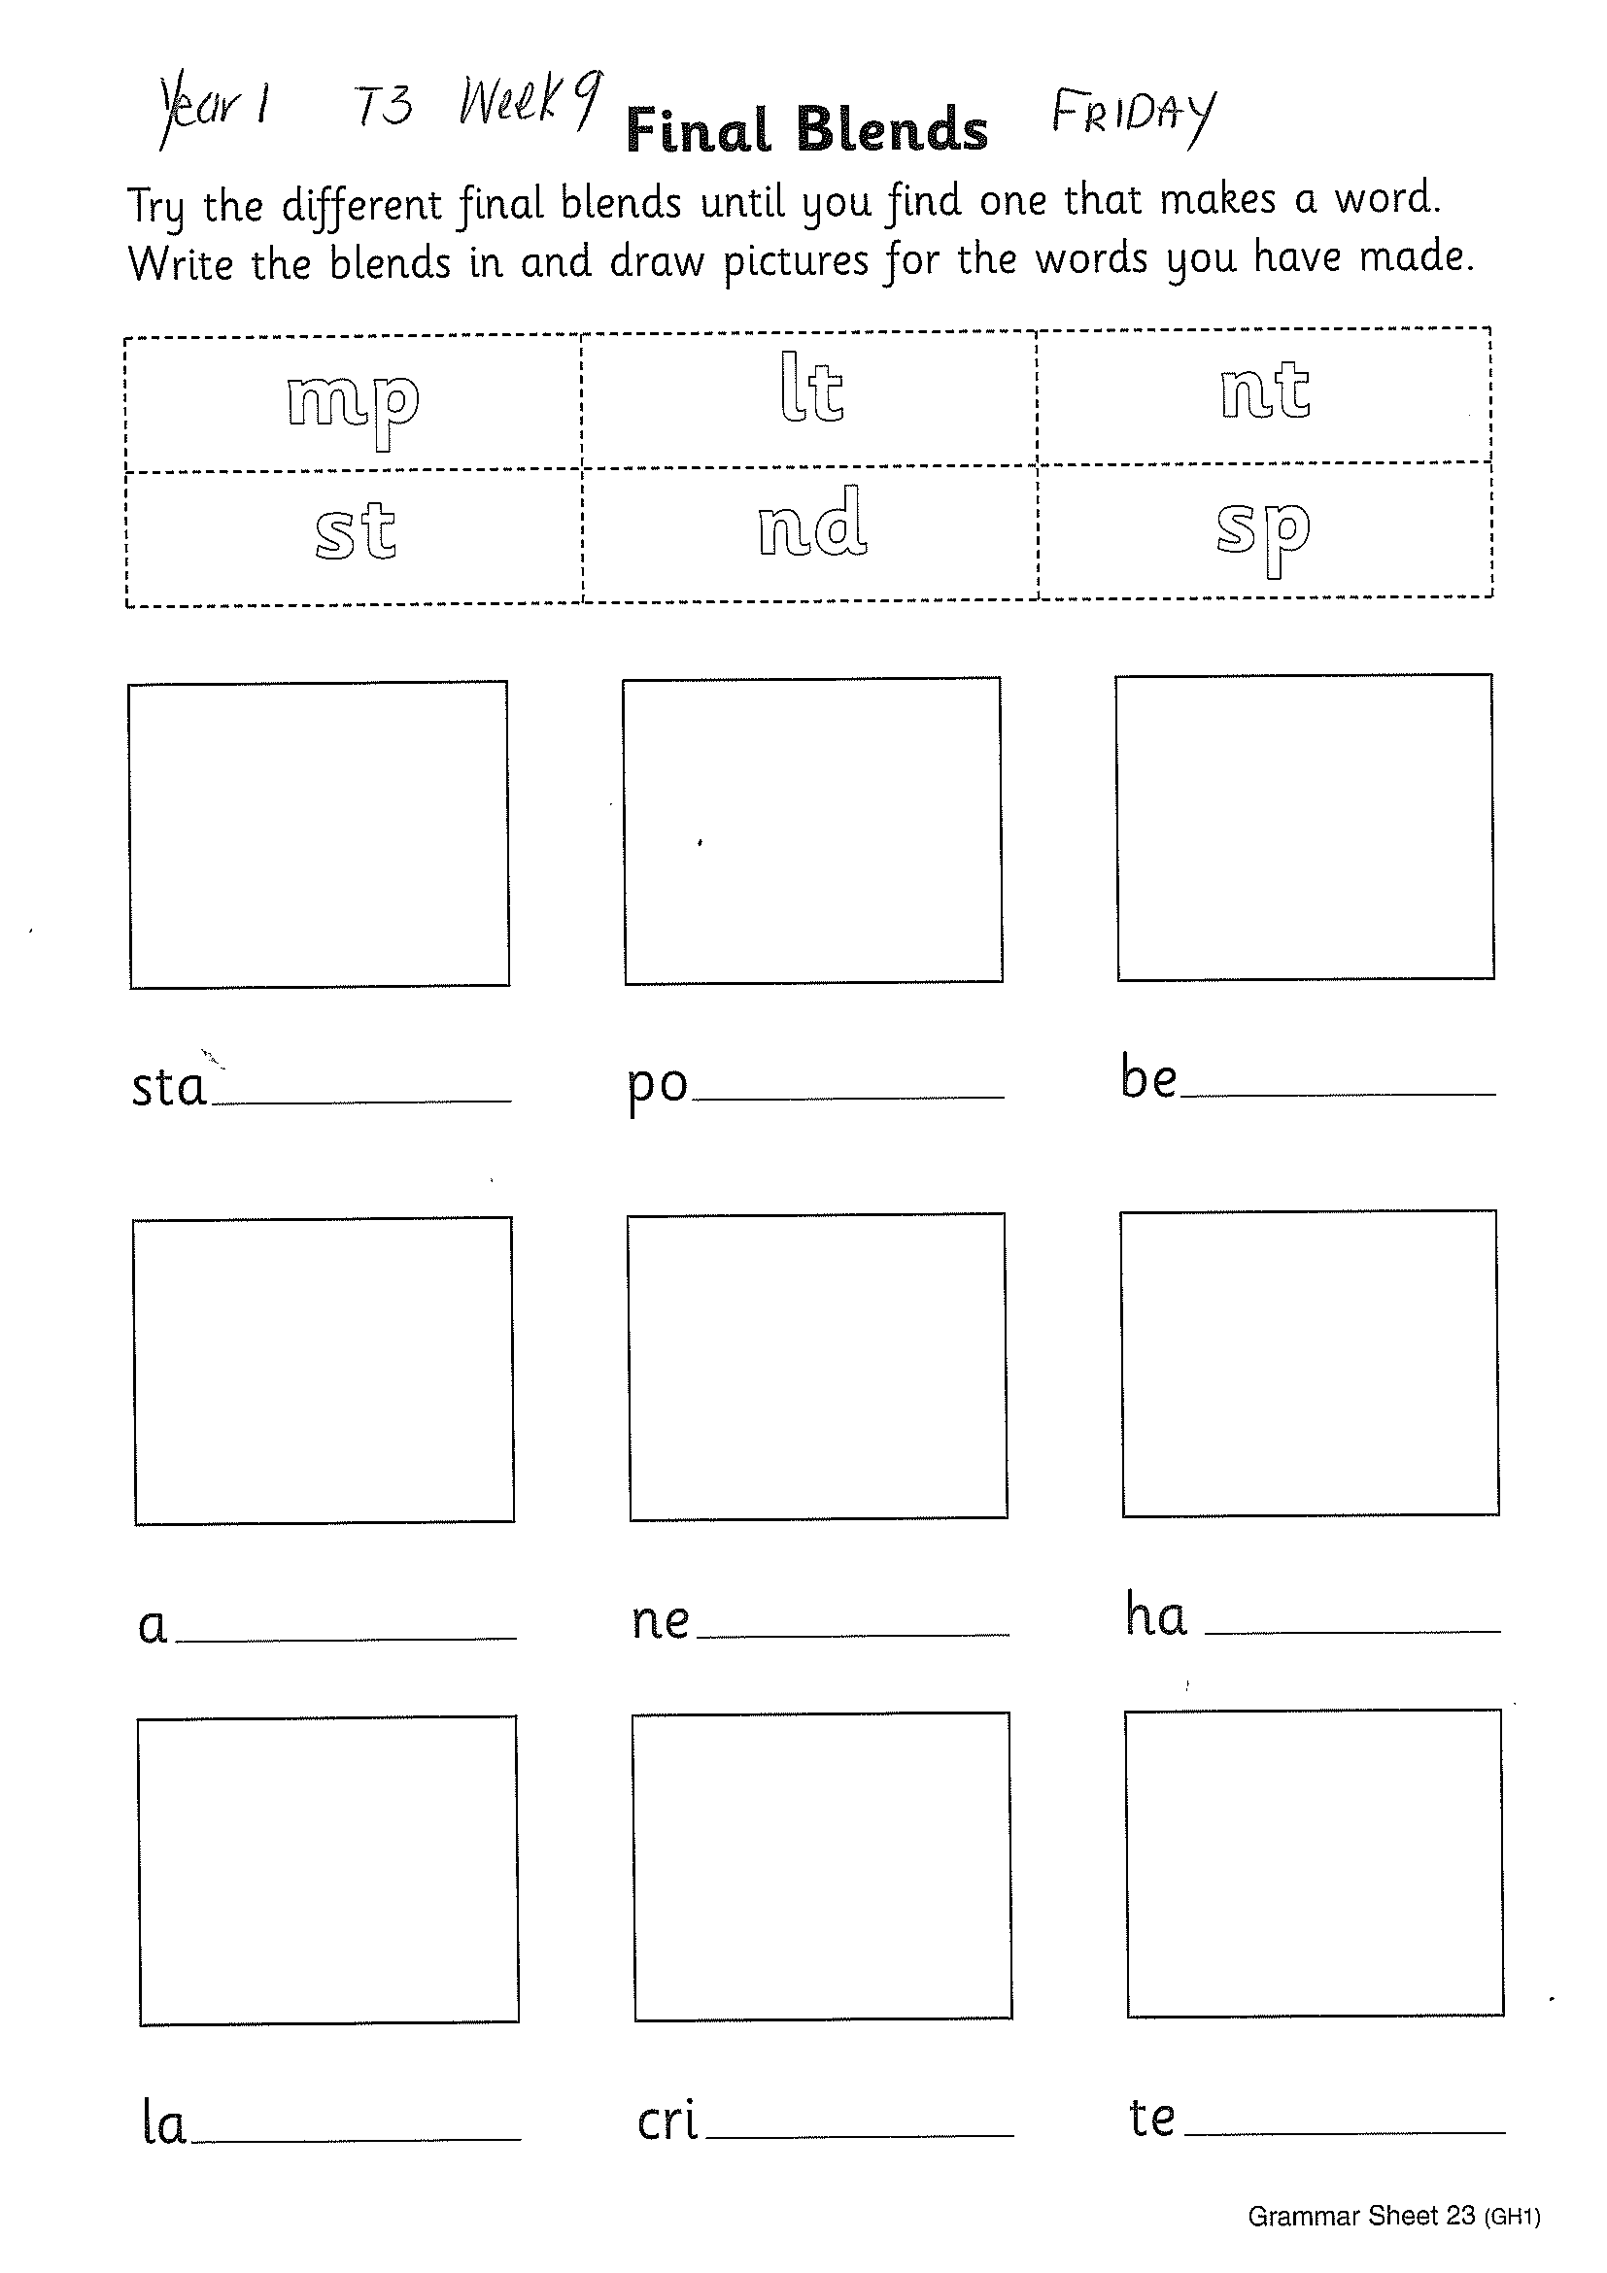
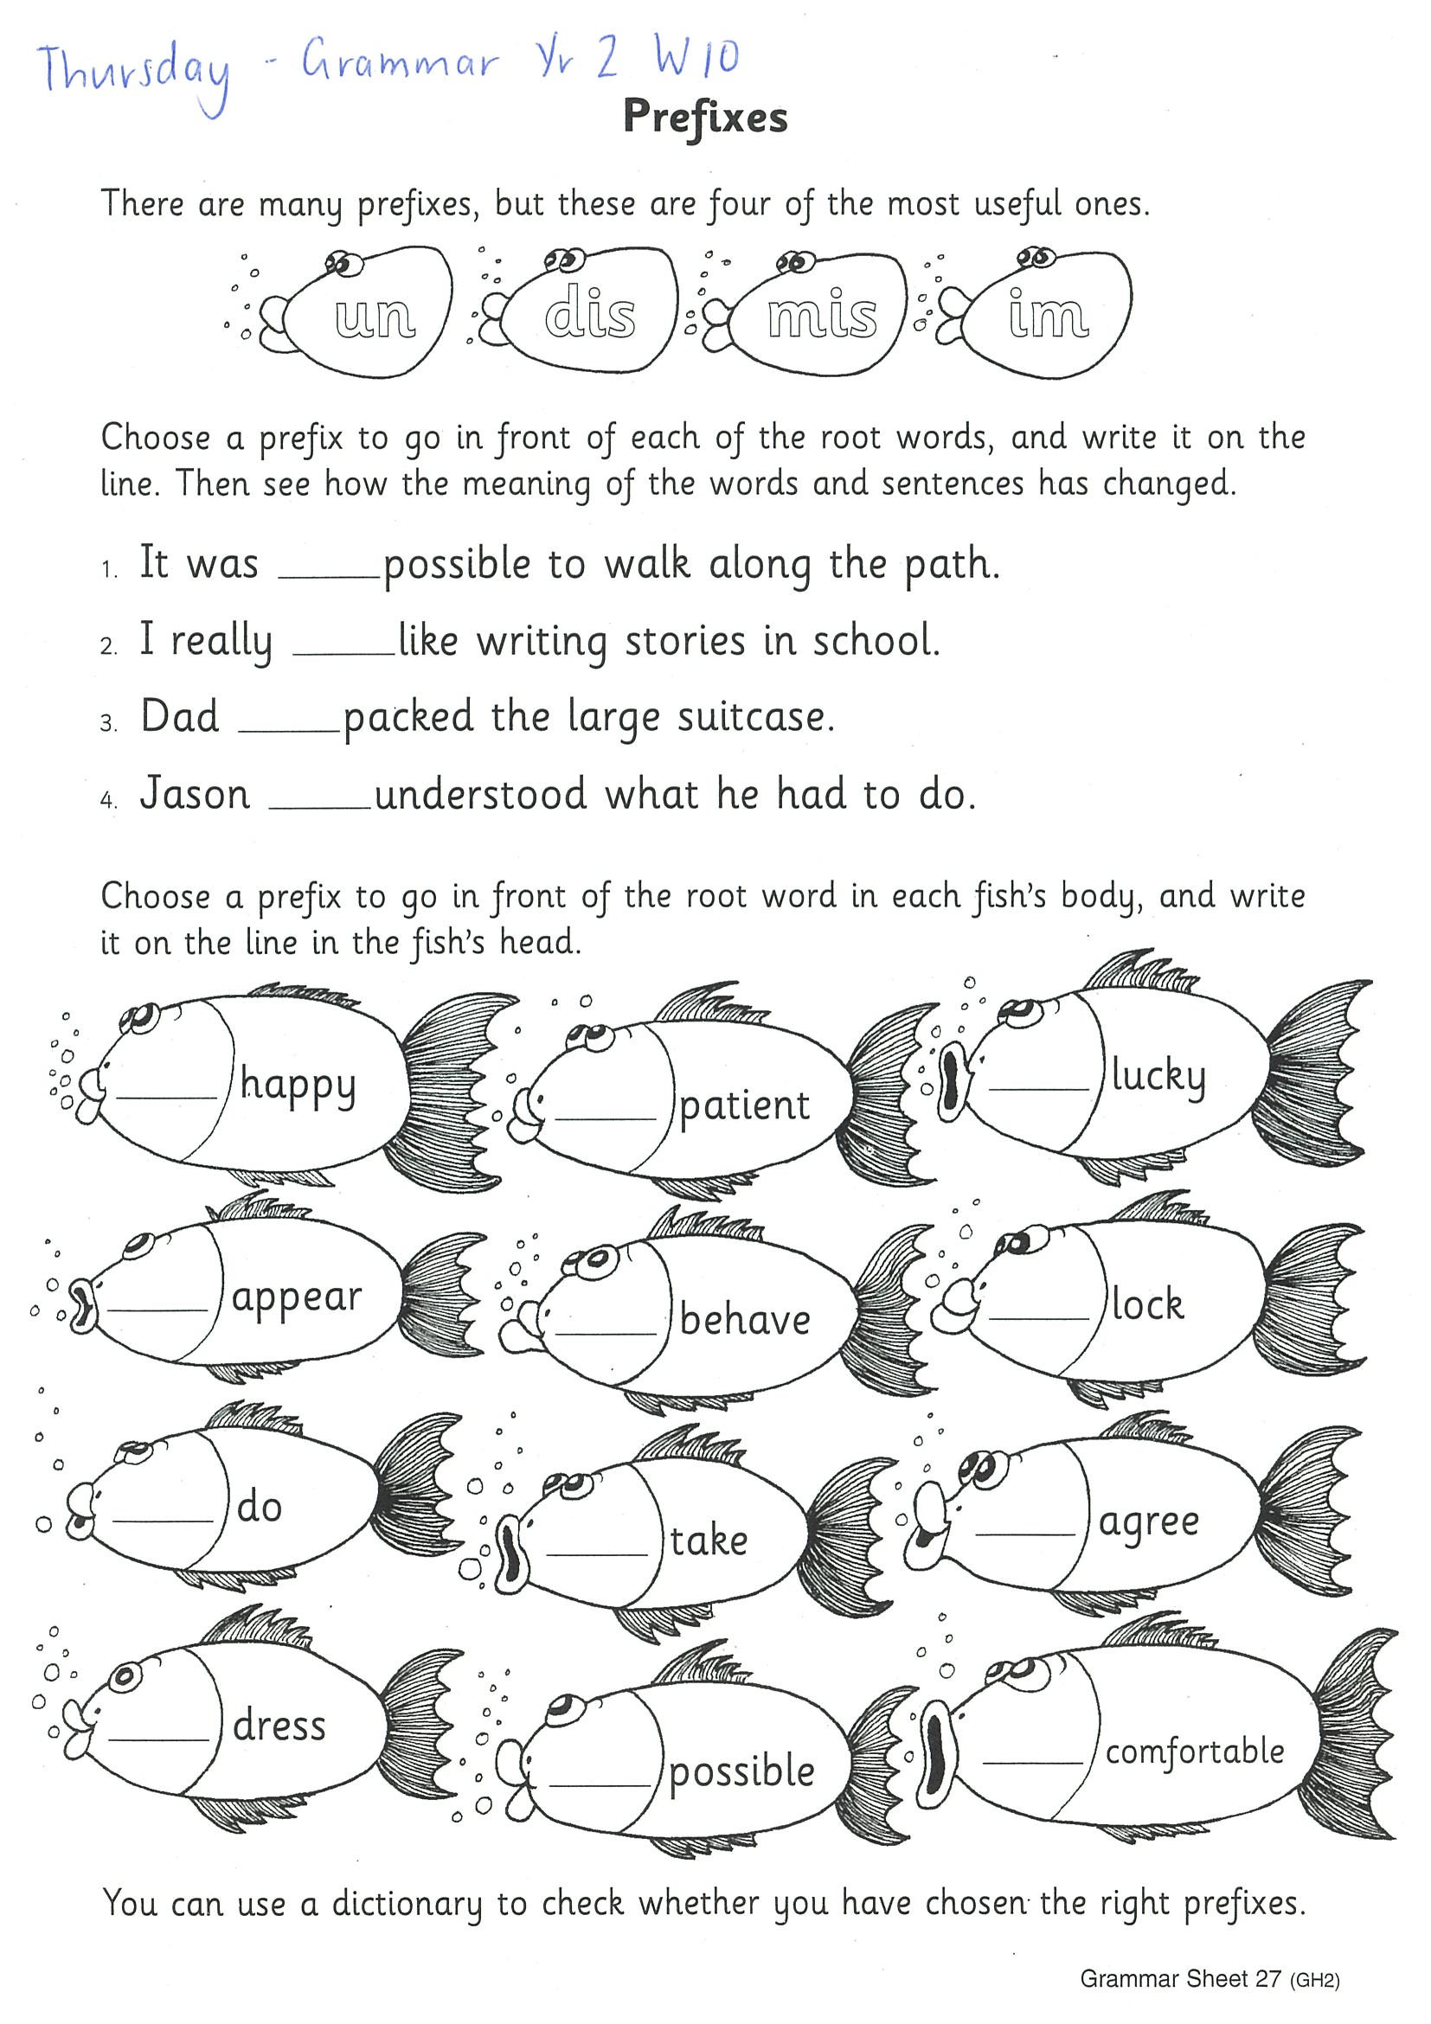
Task 1
The children read the outline final blends and write inside them. Then they read the unfinished words and try adding the final blends to each of them. They try each final blend and in turn until they find one which completes the word:
<be> and <mp> makes “bemp”, which is not a real word, whereas <be> and <lt> makes “belt”, which is. Once they have found a blend to complete the word, the children write it in and draw a picture for the word. As long as the children have made real words, their answers are right, so <sta> could be made into either “stamp” or “Stand” by adding <mp> or <nd>.

Slide 45
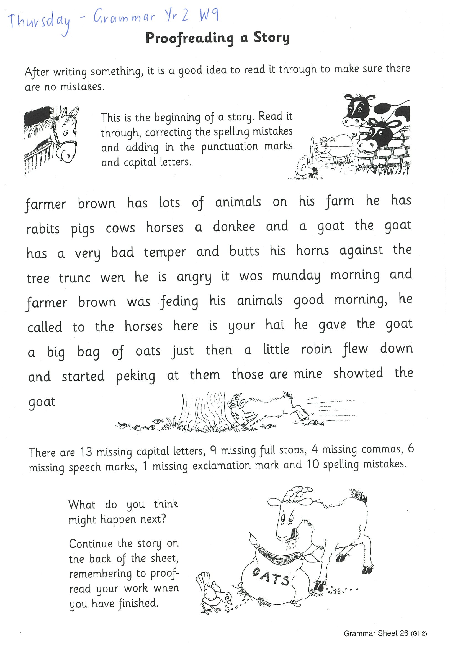
Year 2
Read the story on the grammar worksheet. Do the sentences have capital letters, full stops, excalamation marks, question marks, commas or speech marks? Are the words spelt correctly? Using a coloured pencil fix any errors found in each sentence. Write any misspelt words above the word.

Slide 46
Crunch n’ sip

Slide 47
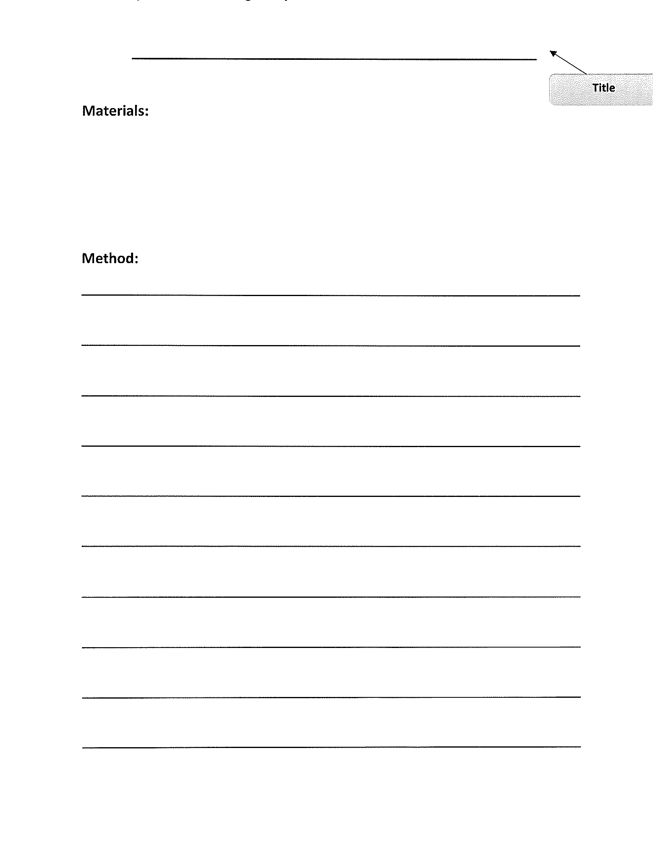
Task 3
Watch this video:
Https://www.youtube.com/watch?v=LPxkHgMoKK8
On a piece of paper, write a procedural text telling us how you would make your own pizza. Be creative with the ingredients! Remember a title, list of materials and step by step instructions. Start each step with a verb!

Slide 48
Recess break (30 minutes)

Slide 49
KLA – capa (dance)
SALSA Dance Lesson 2 and 3
Https://www.youtube.com/watch?v=moDuehwe5wk&list=RDCMUCsJbboljkvAkxbnEu6w3nyg&index=5
Https://www.youtube.com/watch?v=St7srbRbXGM

Slide 50
Mathematics
Task 1
Complete an activity from the maths activity grid

Slide 51
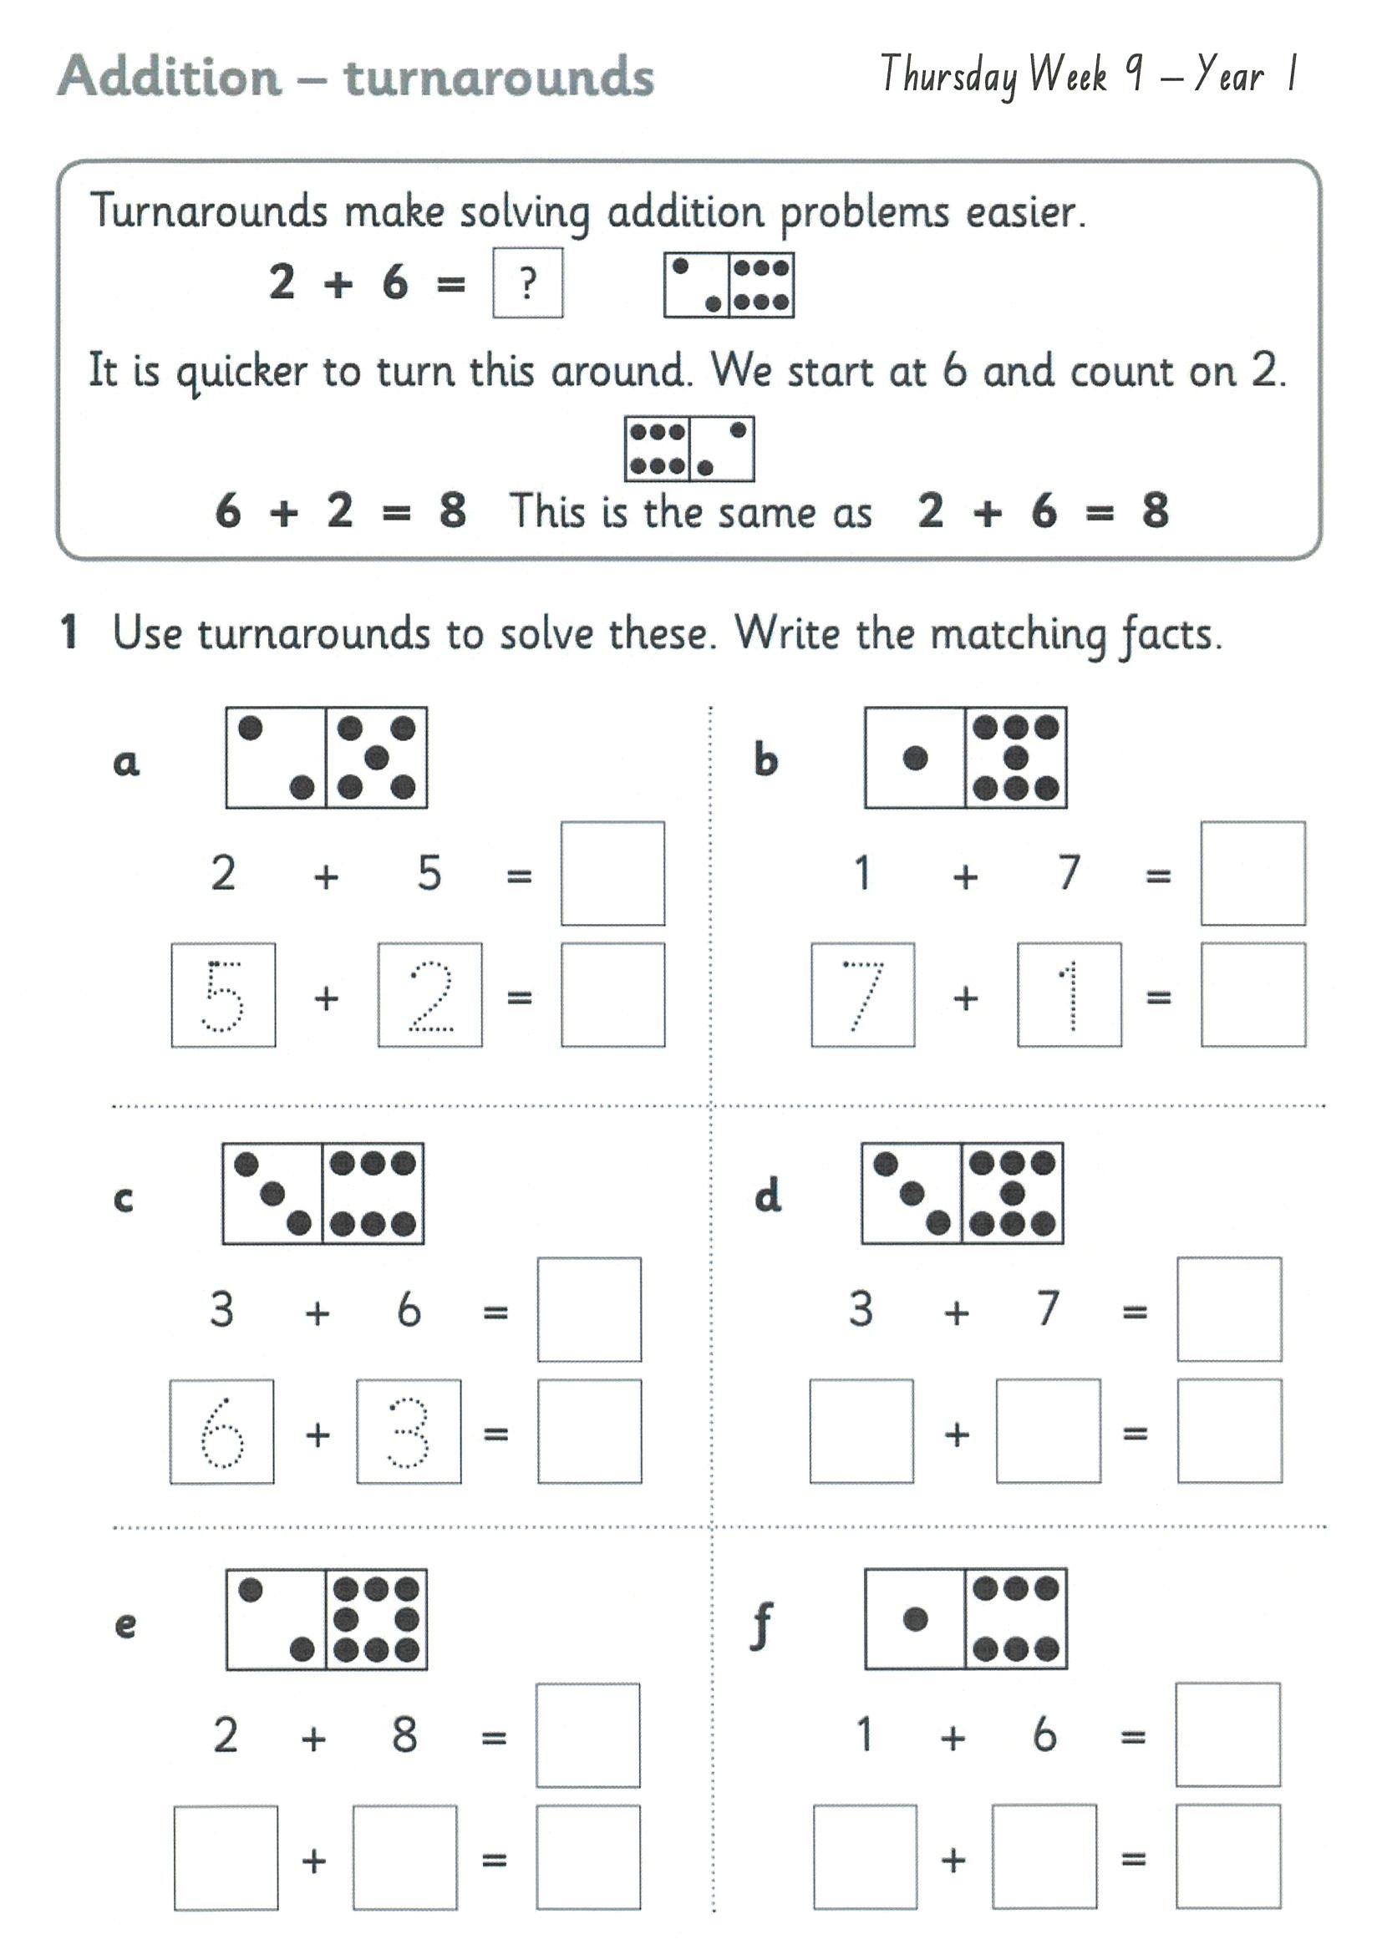
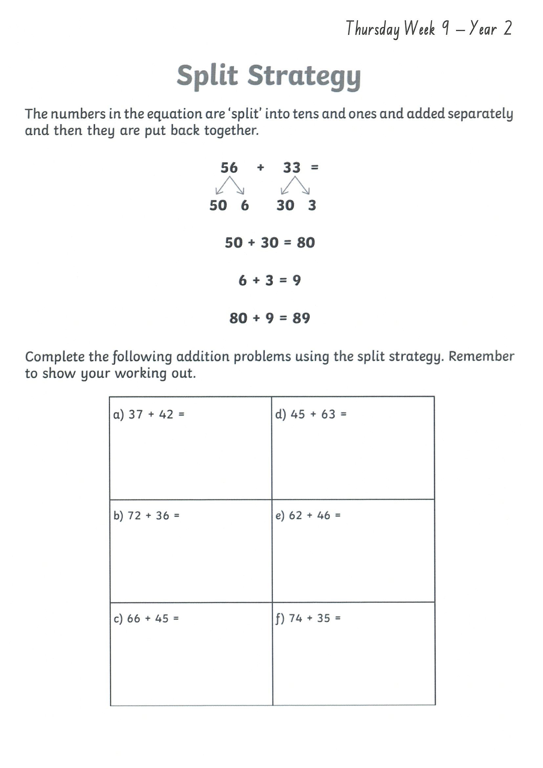
Task 2 Then complete 3 studyladder or mathletics activities
addition
Year 1
Year 2

Slide 52
Lunch break (40 minutes)

Slide 53
KLA - PDHPE
Water Safety at Home
Pools can be a fun place to play when the weather is hot but it is important to keep yourself safe and follow the rules when around the pool. Watch the following video about pool safety and complete the activities.
Https://www.youtube.com/watch?v=lpWjaZafyuM

Slide 54
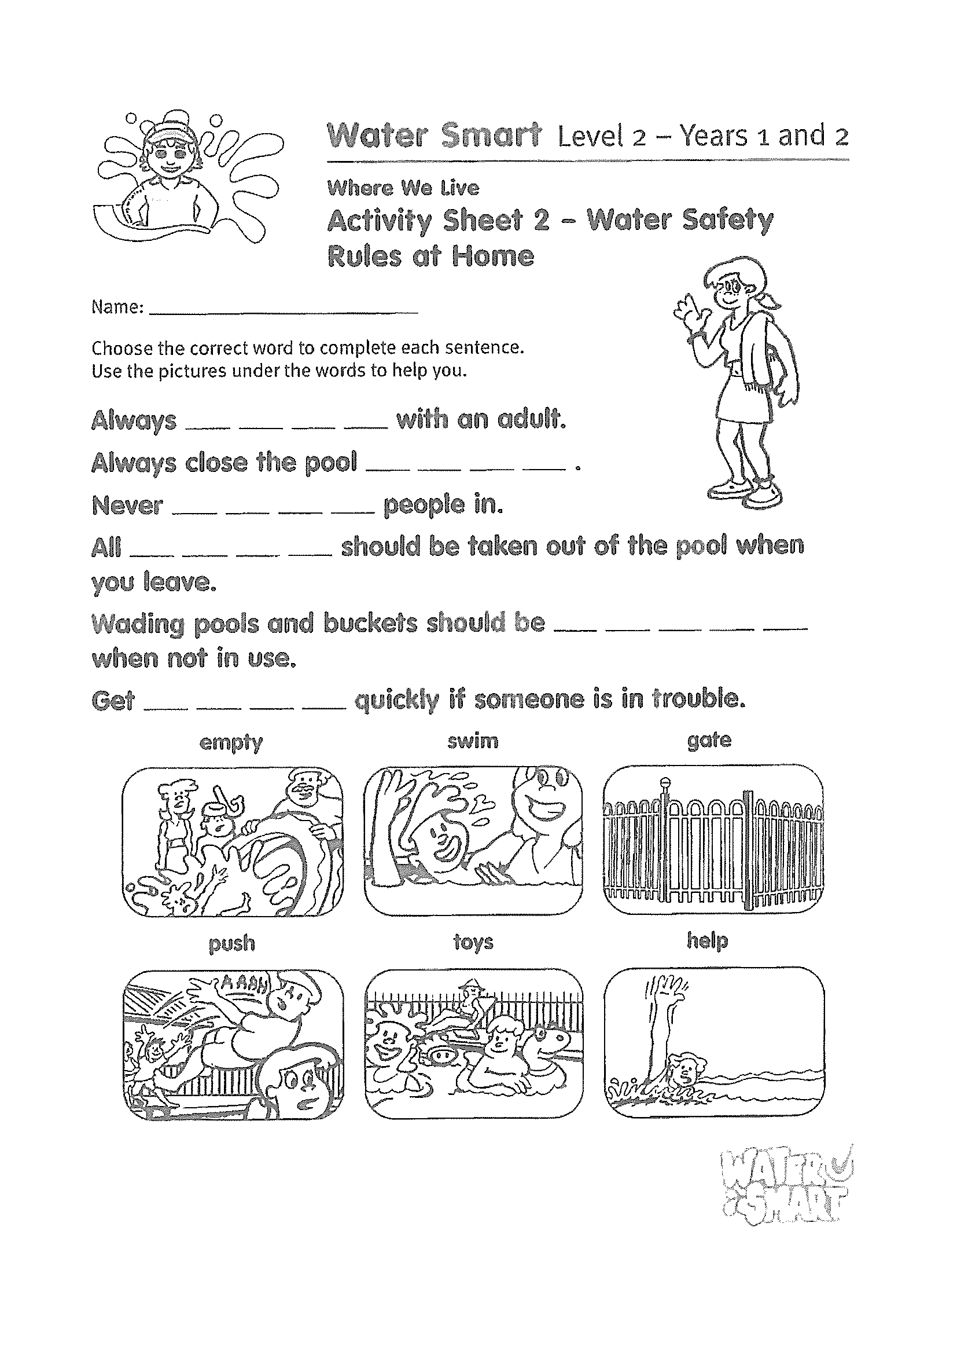
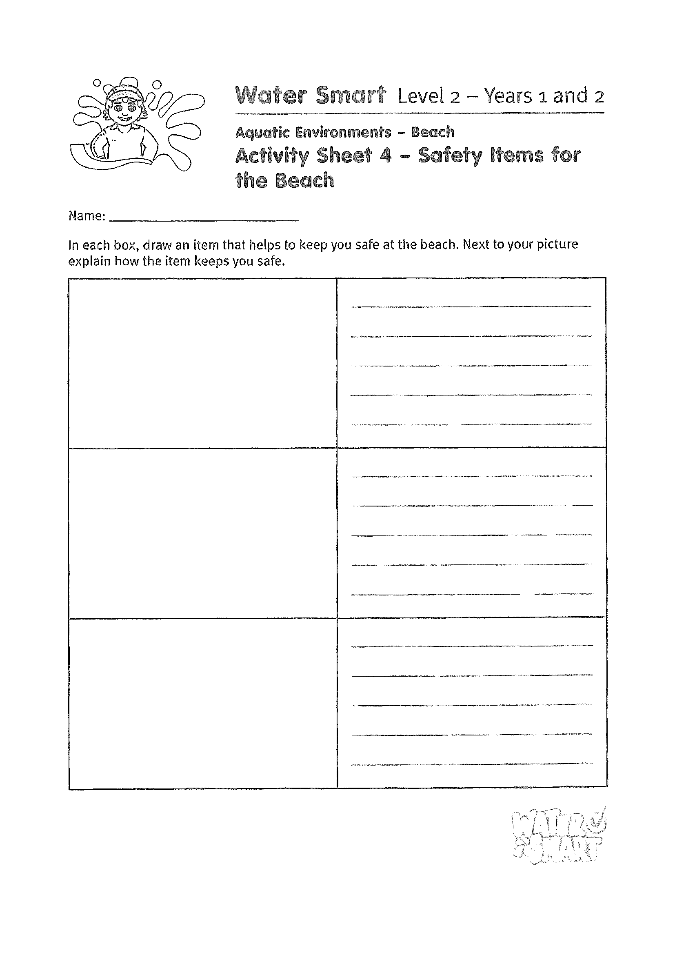

Slide 55
END OF DAY!
ENJOY your well-deserved break everyone!

Slide 56
Good morning
STAGE 1
FRIDAY 10th SEPTEMBER 2021 – WEEK 9
Please make sure you are sending one or two work samples to your classroom teacher via dojo.

Slide 57
WHATS ON TODAY?
WELL BEING FRIDAY!!
To focus on our well being and unplugging from technology, today is a tech free day. Choose activities from the Friday grid. Submit photos of what you have done to our school Facebook page NOT DOJO.

Slide 59
KLA - PDHPE
Fundamental Movement Skills
https://www.youtube.com/channel/UCFI8inXSYttI8PVkEcSuD7g

Slide 60
END OF Week!
ENJOY your well-deserved break everyone!

