Slide 1
STAGE 1
MISS UNAL
MS ROBINSON
MISS MORATA
MRS MAZLOUM/ MRS ENRIGHT
MRS FLEMING (ASSISTANT PRINCIPAL)
MISS HOLDSWORTH

Slide 2
Good morning
STAGE 1
MONDAY 30th AUGUST 2021 – WEEK 8
Please make sure you are sending one or two work samples to your classroom teacher via dojo.

Slide 3
WHATS ON TODAY?
Morning Task 1 - spelling Task 2 - reading Crunch n’ sip Task 3 - writing Task 4 - handwriting
Middle Task 1 - Maths Grid Task 2 - Worksheet
Final Geography

Slide 4
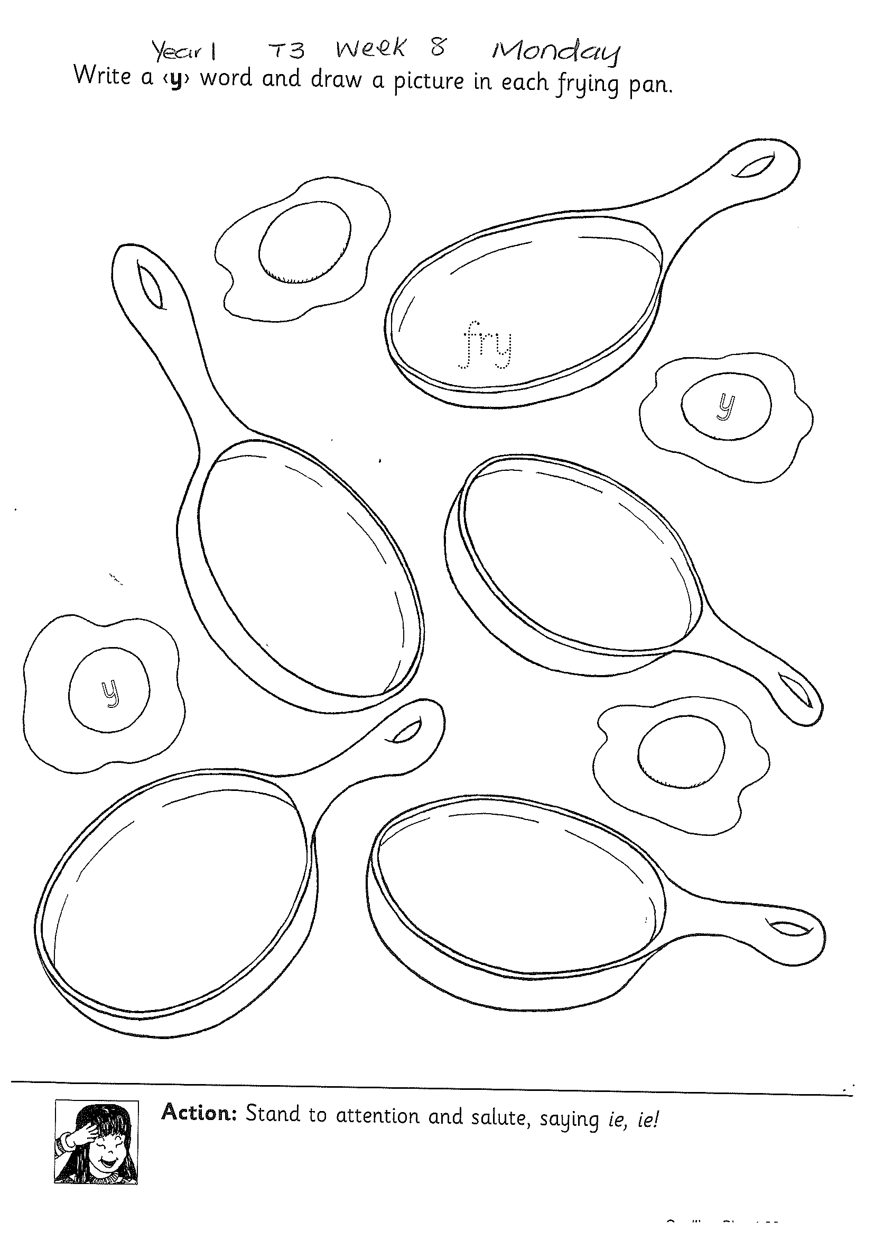
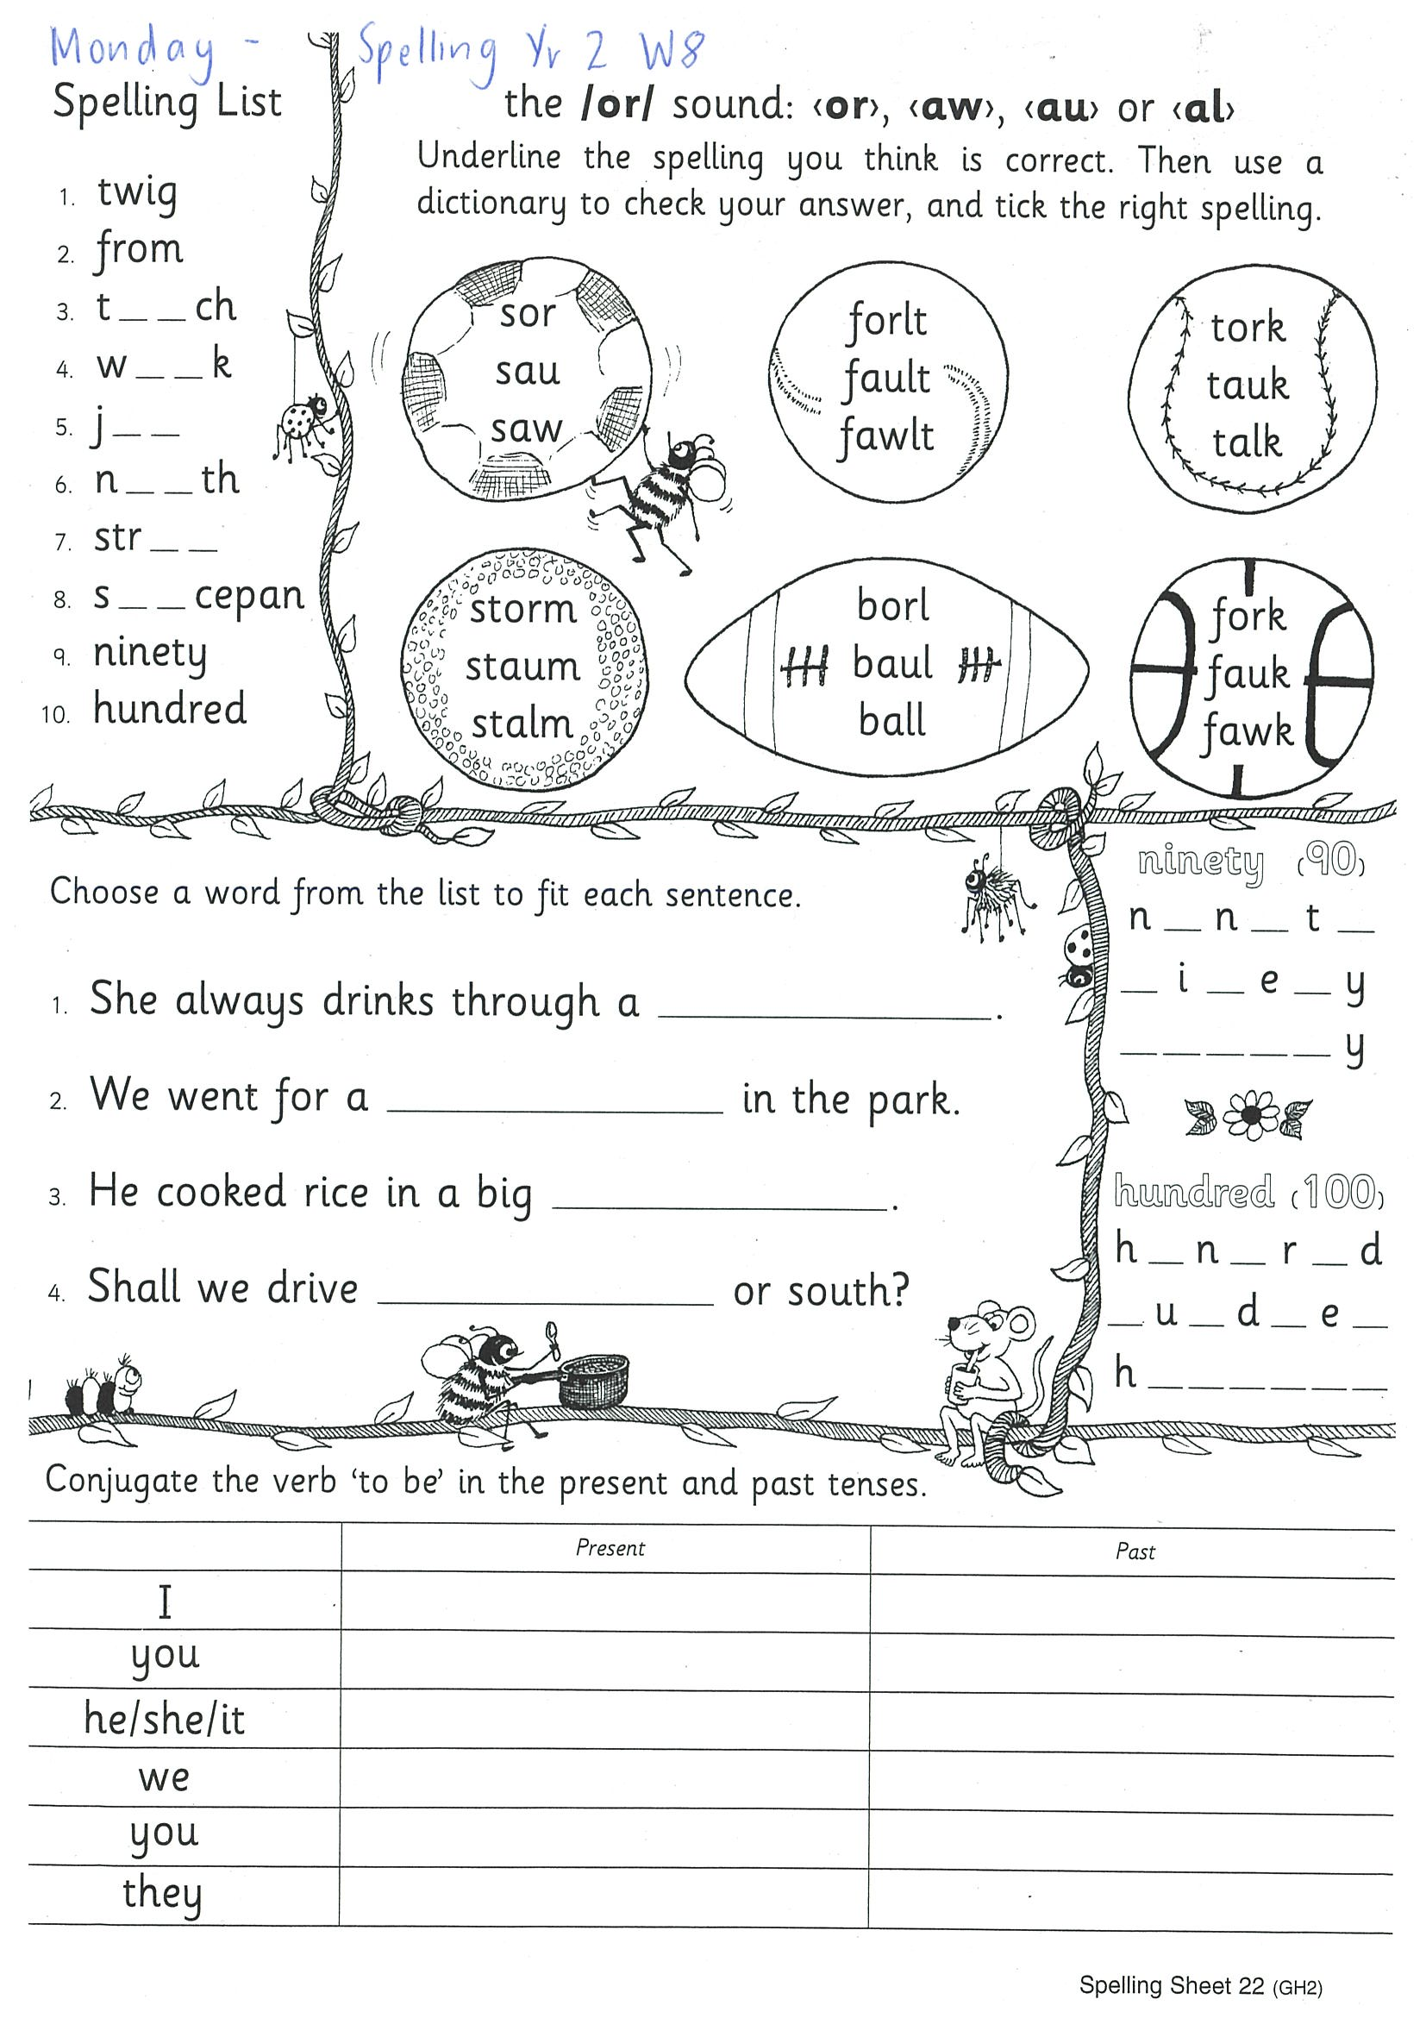
Task 1
Year 1
Year 2
Watch Mrs Warwick’s video’s for the sound of the week. Brainstorm a list of words using the sound focus of the week on a piece of paper. YEAR 1
https://www.youtube.com/watch?v=xEmtdNS12GM
https://www.youtube.com/watch?v=kX2nBTWLx2M
https://www.youtube.com/watch?v=XhfvNF6T3TM&feature=youtu.be YEAR 2
https://www.youtube.com/watch?v=W8cY6zaw_ac

Slide 5
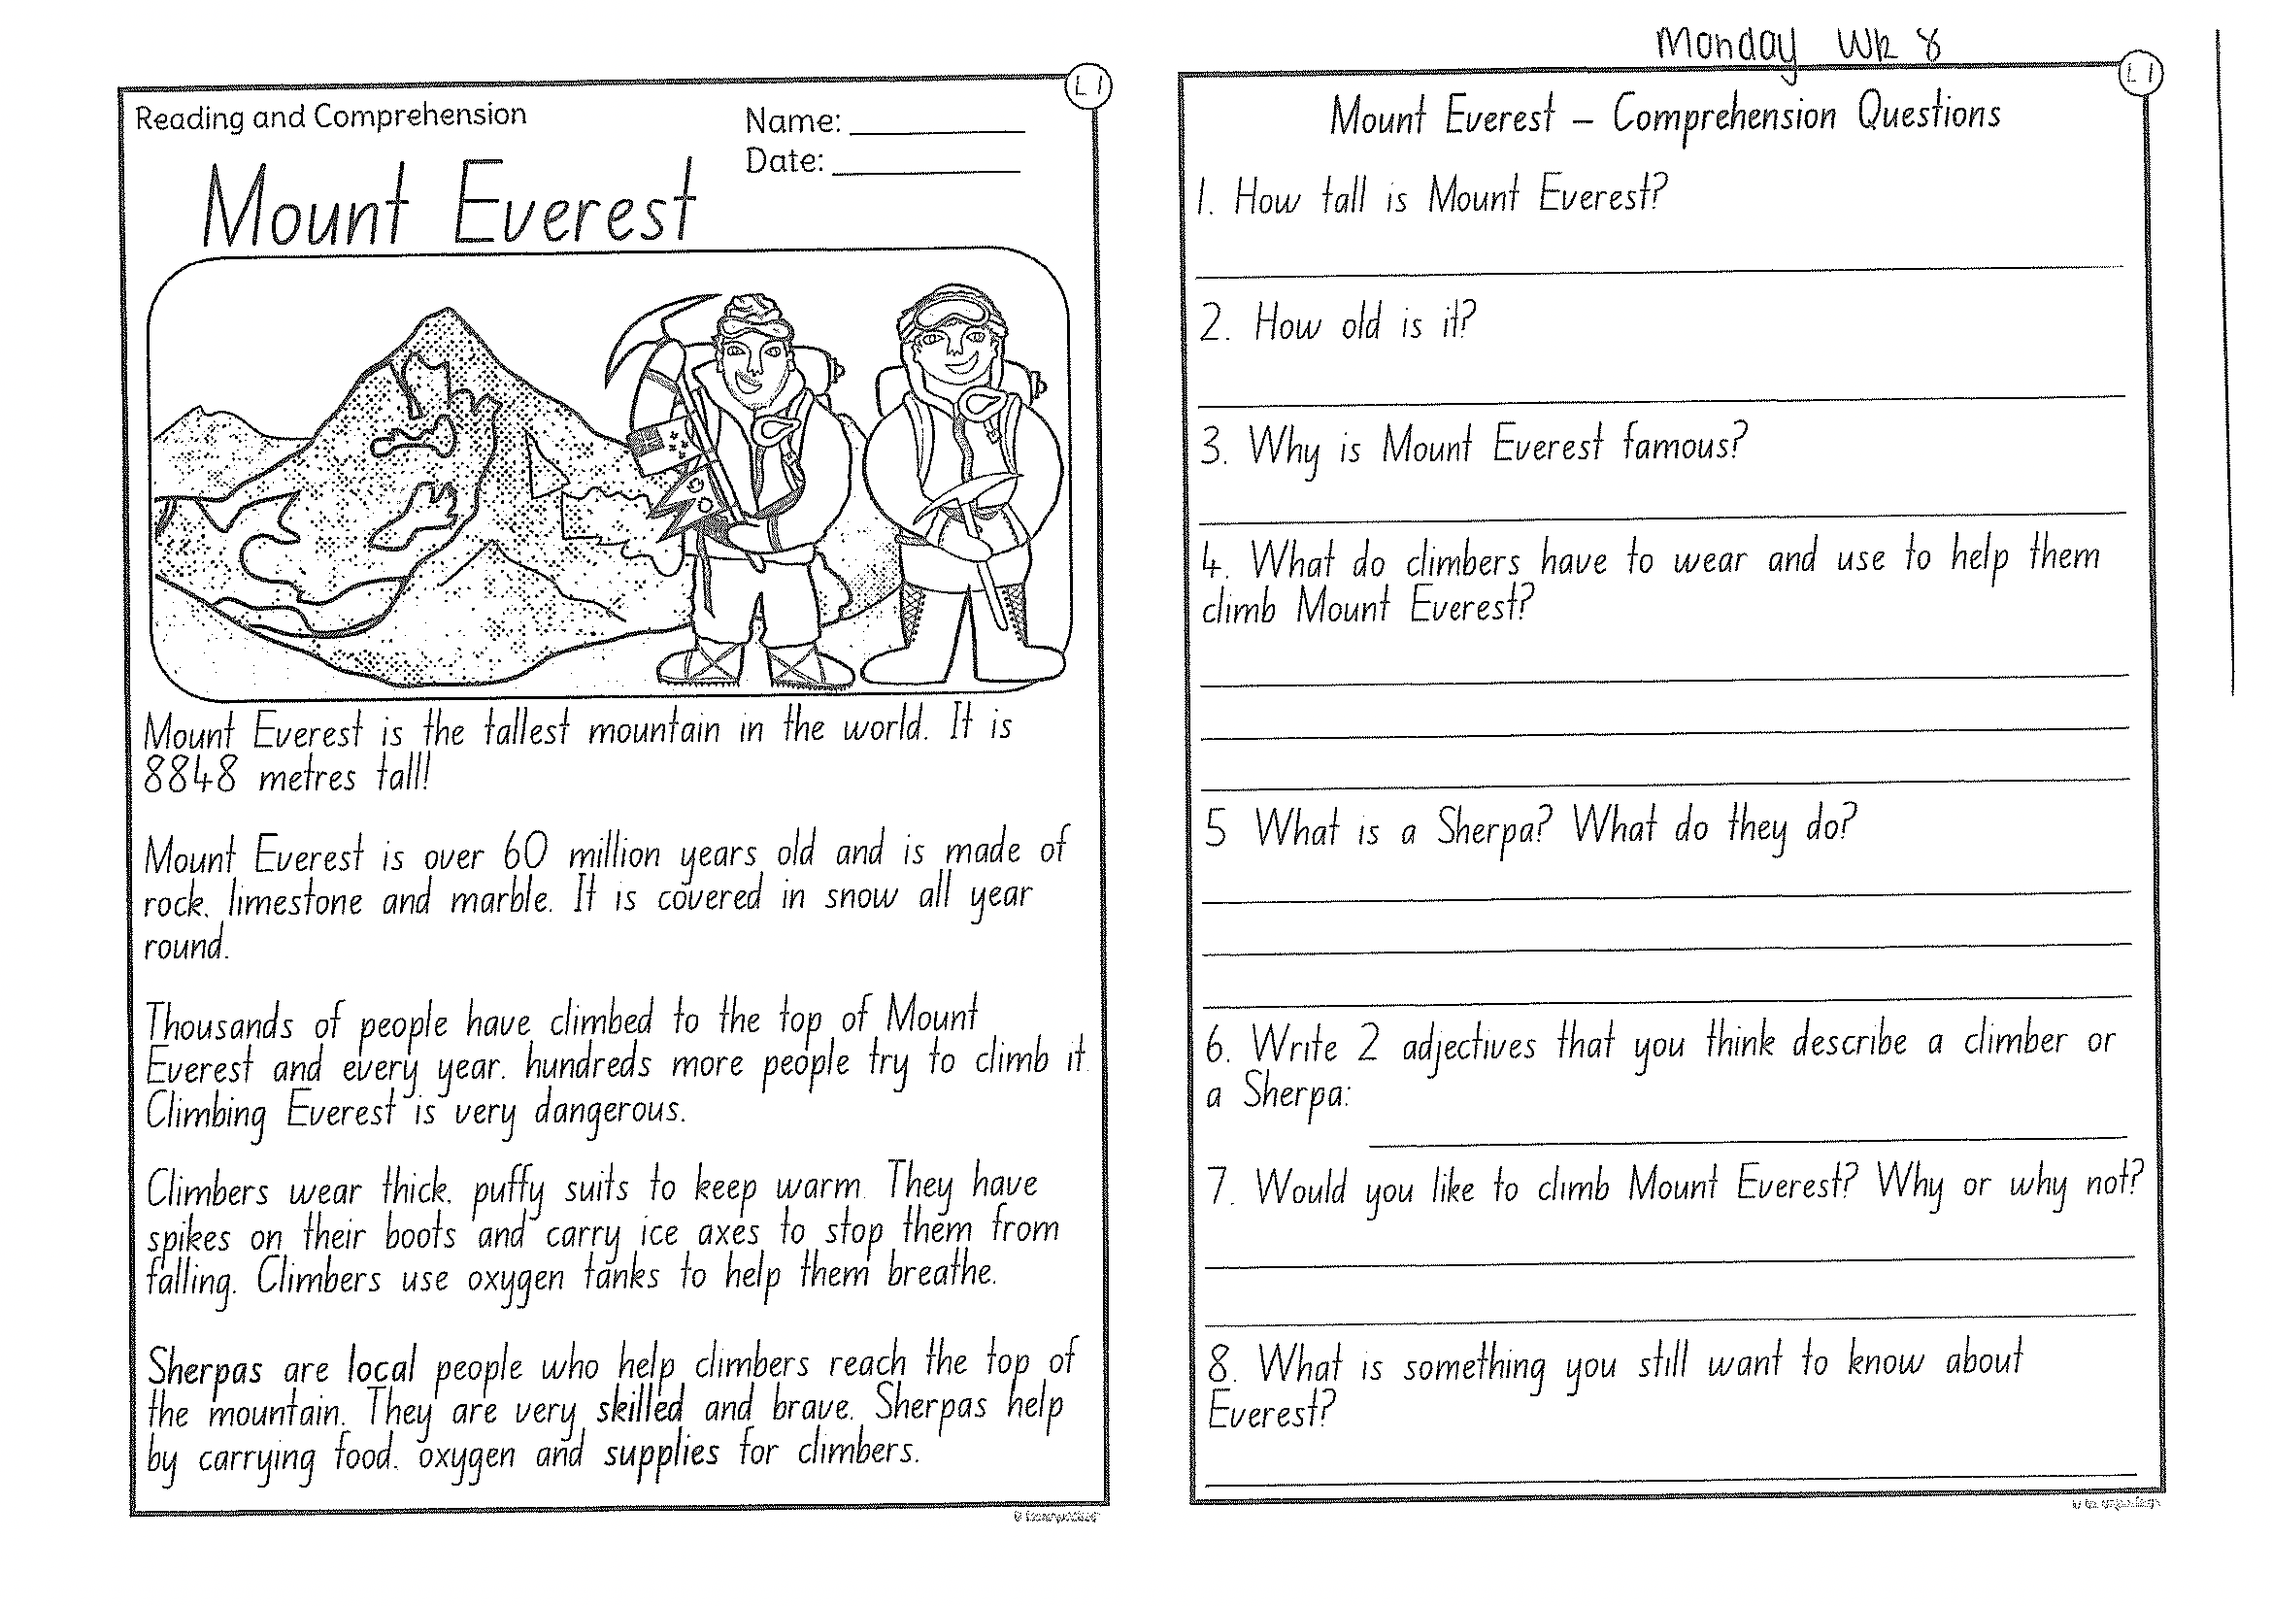
Task 2
Read or get an adult to read ‘Mount Everest’ and answer the questions.

Slide 6
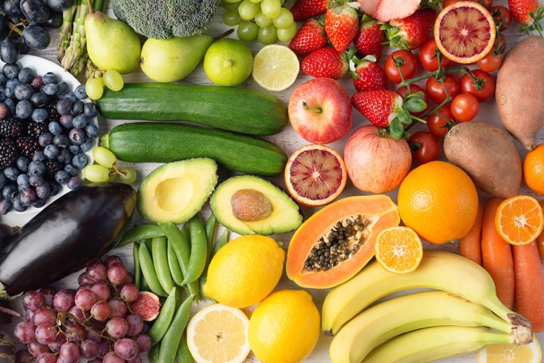
Crunch n’ sip

Slide 7
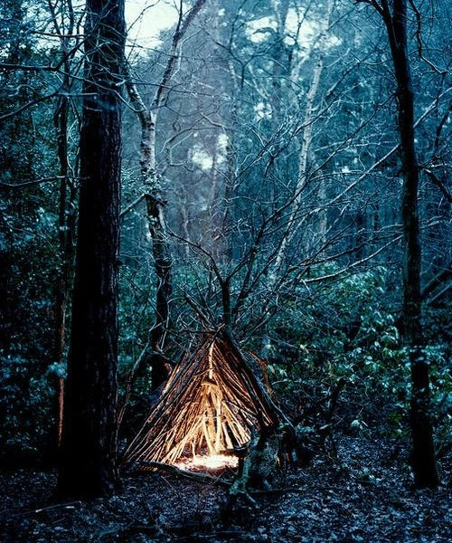
Task 3
Using the prompt, create an imaginative story of your own. Remember to tell us who is in the story, where they are, what they are doing and try to include a problem and solution!
What’s happening here?
Who is in your story?
What are they doing?
What is the problem? How is it fixed?

Slide 8
Task 4
Complete the letter “w” in your handwriting books.
https://www.youtube.com/watch?v=ehD07O599mI

Slide 9
Recess break (30 minutes)

Slide 10
Mathematics
Task 1
Complete an activity from the maths activity grid

Slide 11
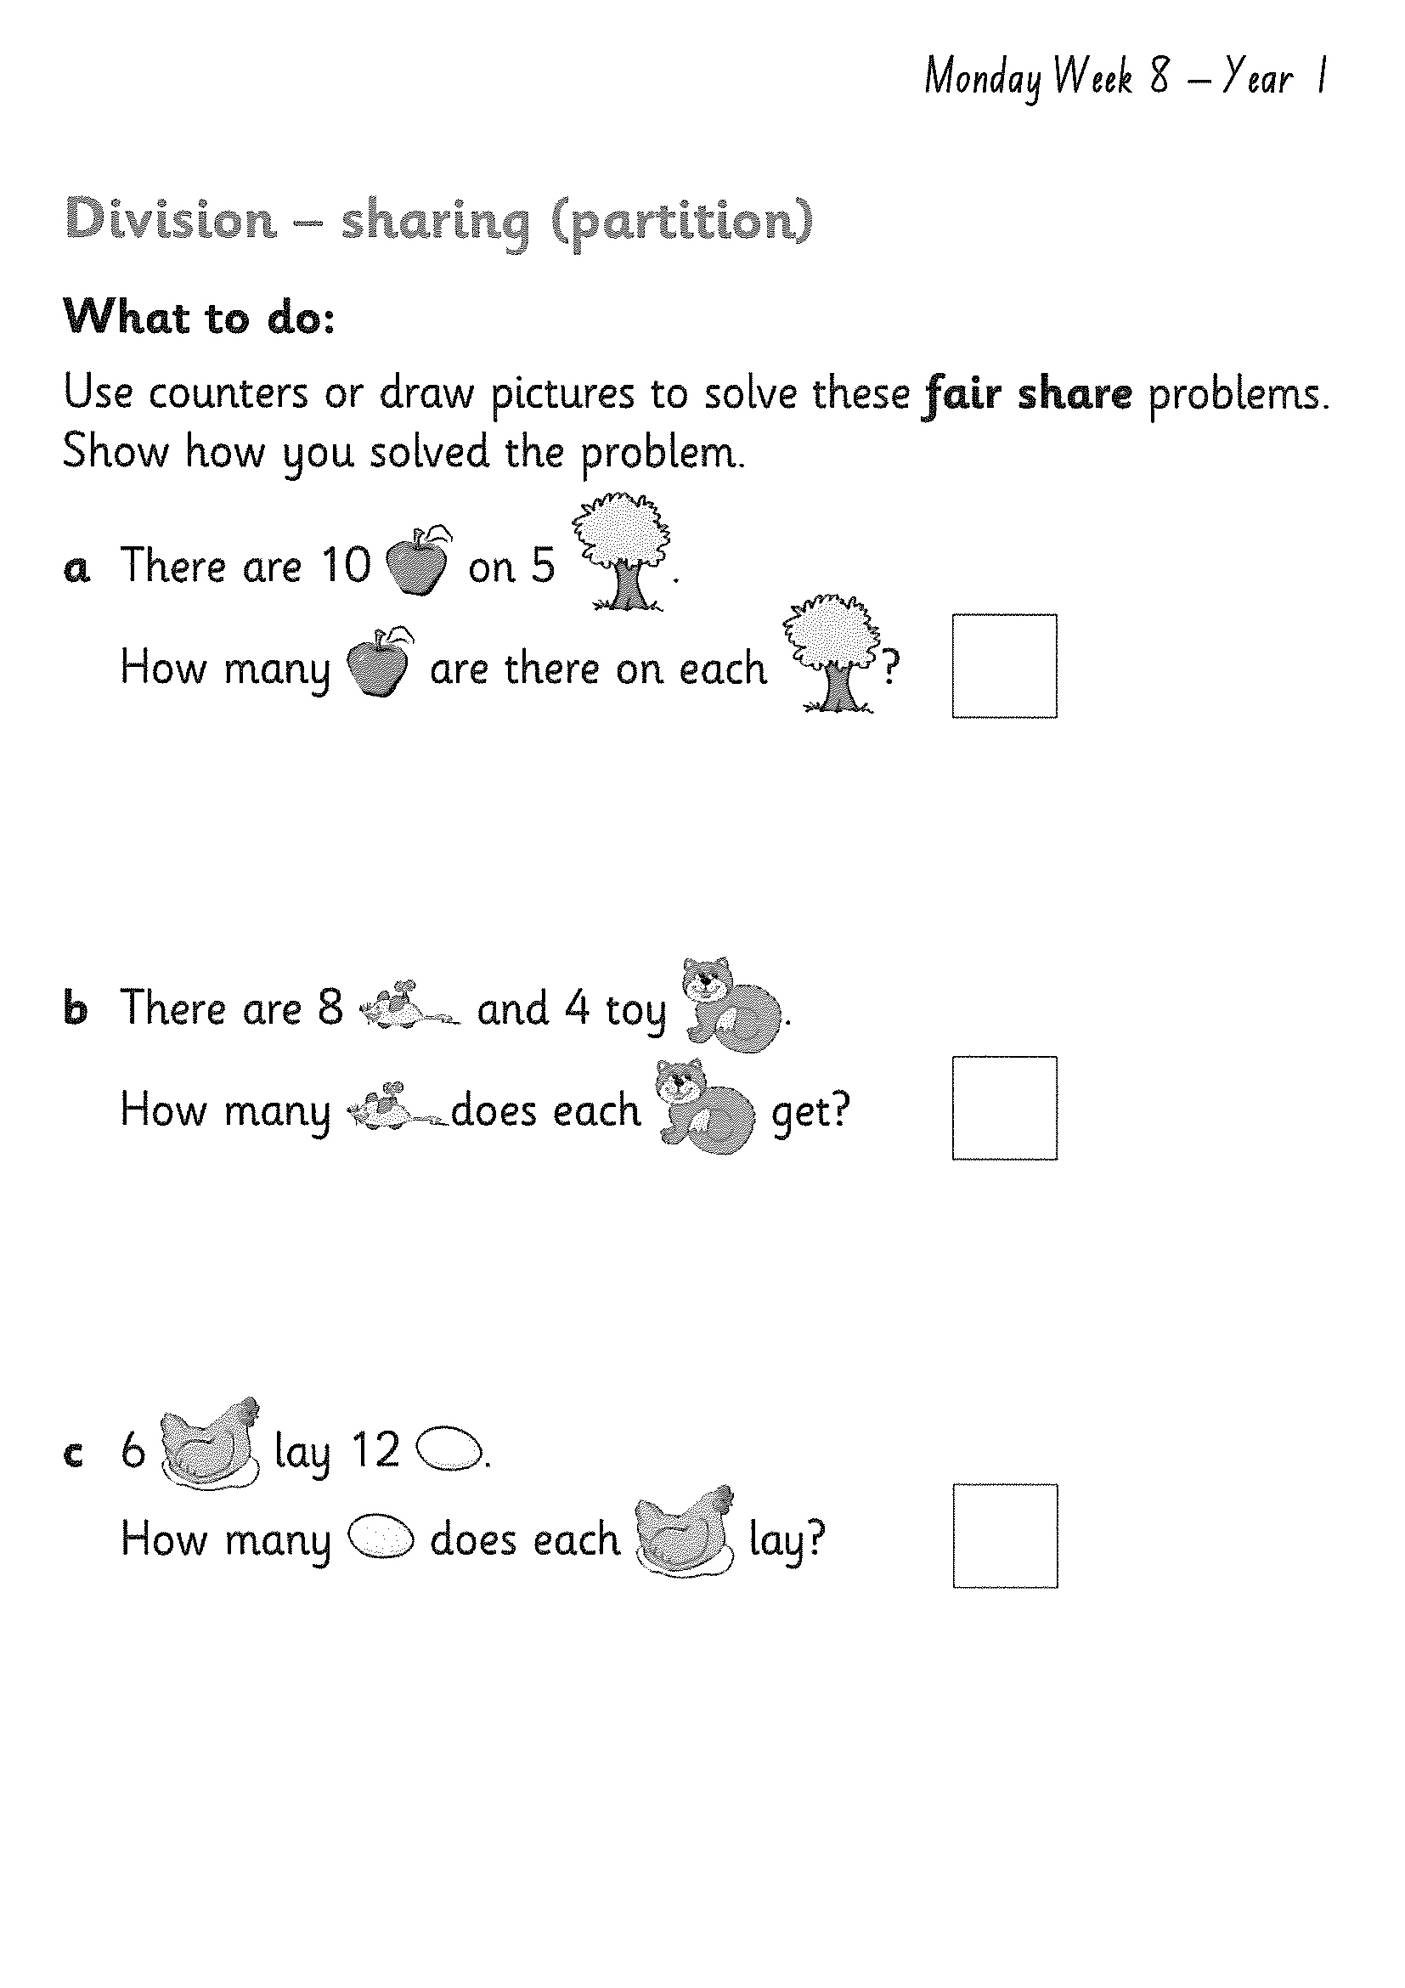
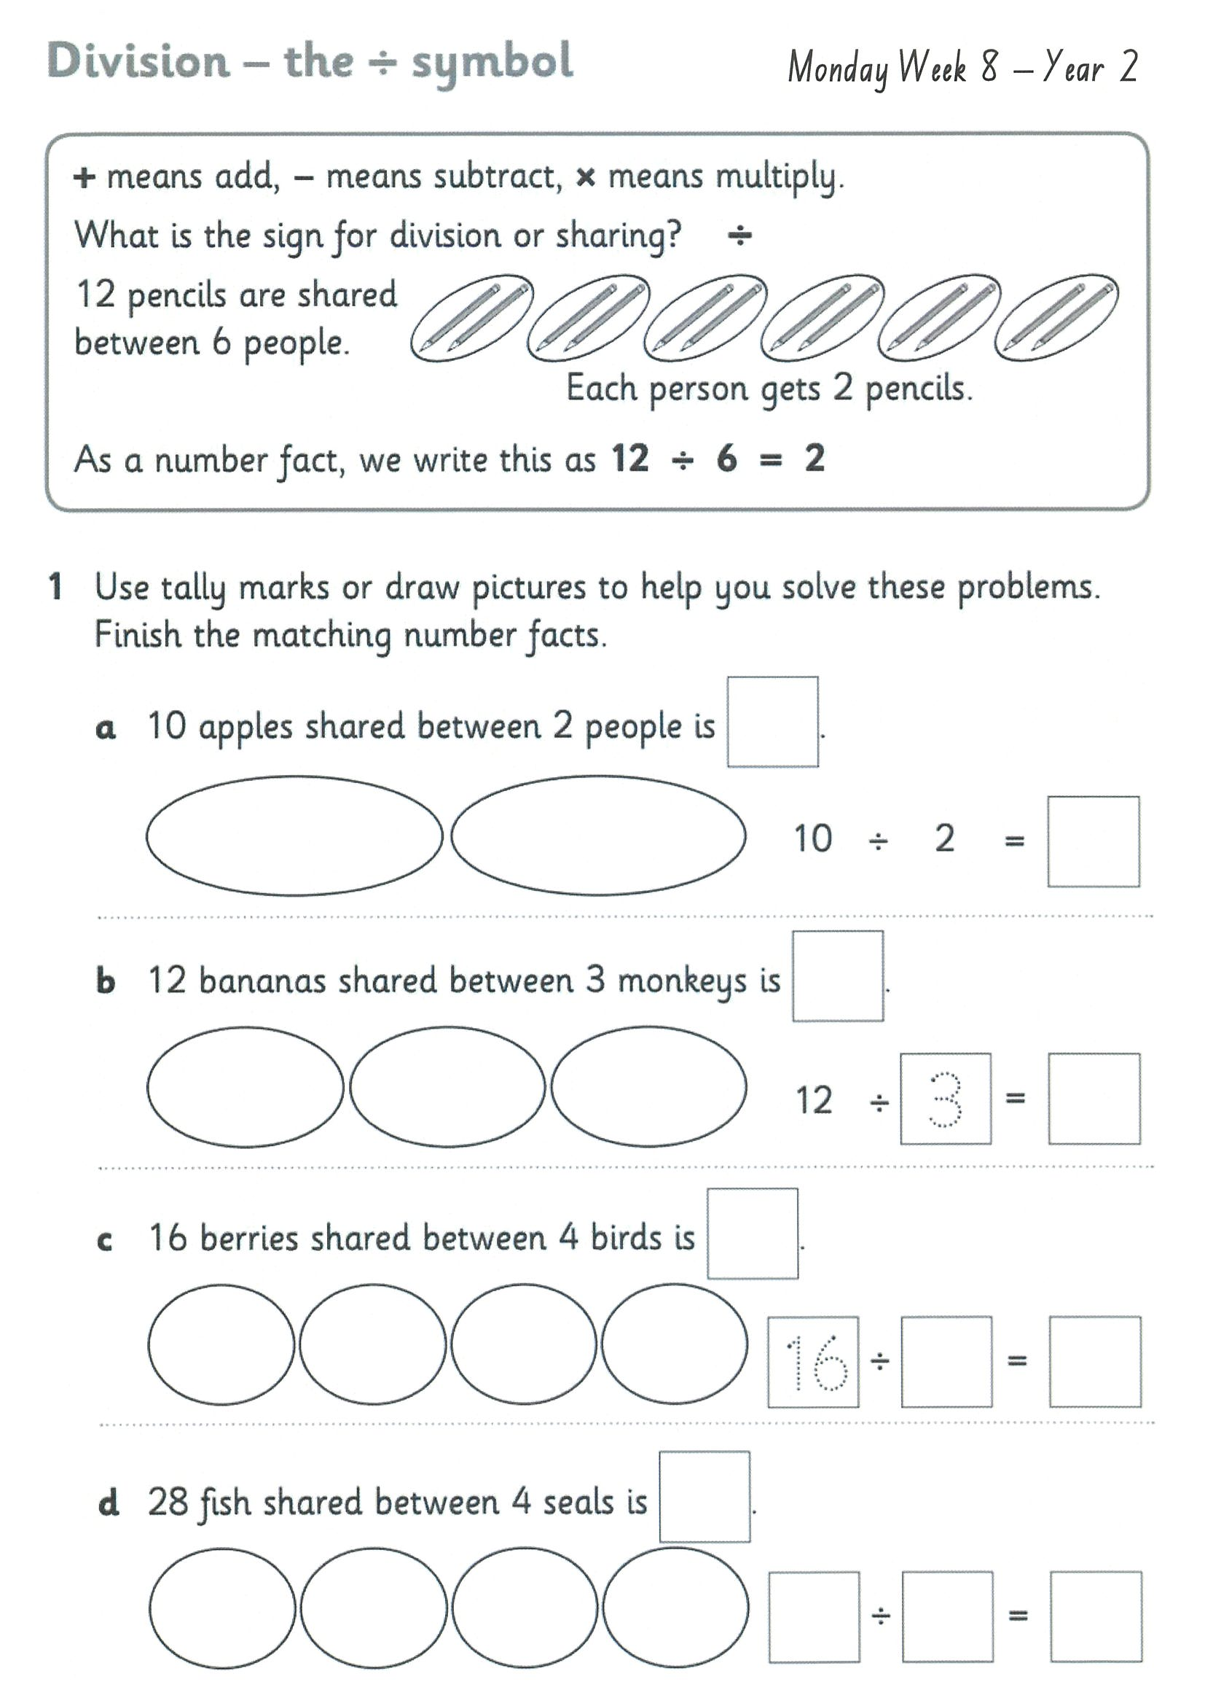
Task 2 Complete the worksheets and then do 3 activities on mathletics or studyladder.
D I v I s I o n

Slide 12
Lunch break (40 minutes)

Slide 13
KLA - geography
Todays lesson is on Managed Features. Lesson on pages 1 and 4 videos. Look at the pictures of children playing in the park.
Why do people go to parks? Talk about this with an adult or sibling.
Who looks after parks? Choose one of the videos to watch. Complete the worksheet and circle the pictures of people doing the right thing in the park.
http://inq.co/class/9wg
Code: 9484

Slide 14
END OF DAY!
ENJOY your well-deserved break everyone!

Slide 15
Good morning
STAGE 1
TUESDAY 31st AUGUST 2021 – WEEK 8
Please make sure you are sending one or two work samples to your classroom teacher via dojo.

Slide 16
WHATS ON TODAY?
Morning Task 1 – Spelling Task 2 – Reading Crunch n’ sip Task 3 - Writing Middle Task 1 – Maths Grid
Task 2 – Activity Worksheet
Final Library

Slide 17
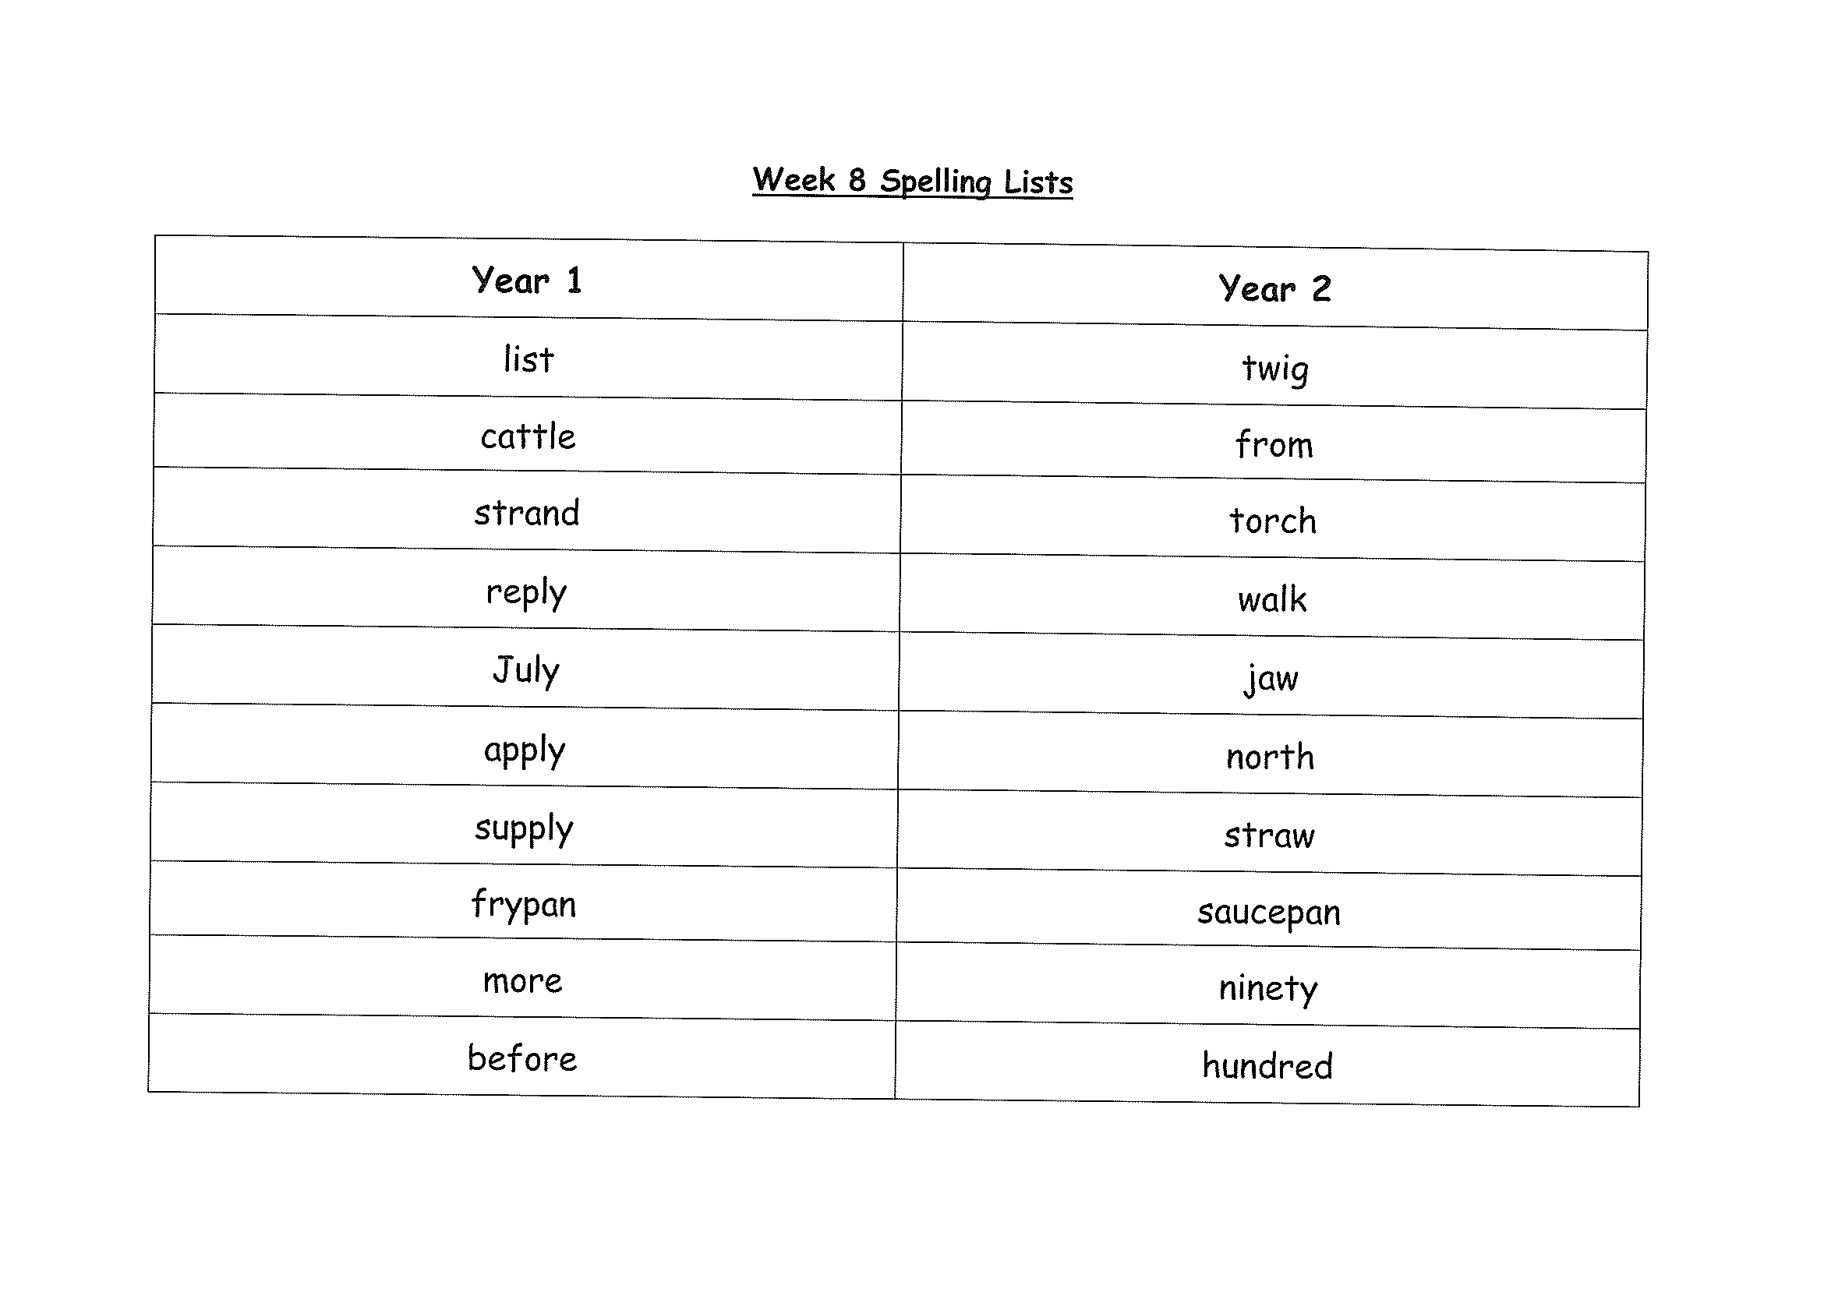
Task 1
Complete the Look, Cover, Write, Check worksheet (on a piece of paper). Write some sentences. Circle any nouns in your sentences.
Then complete your tricky word!

Slide 18
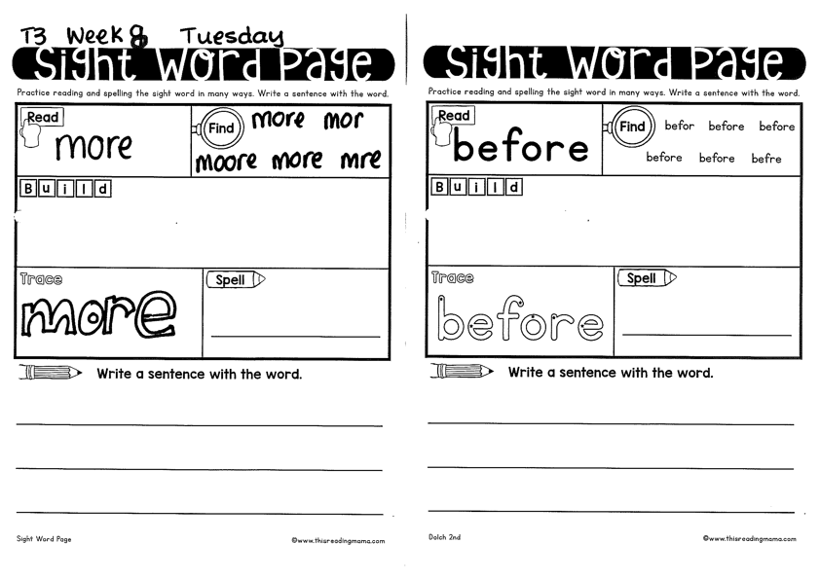
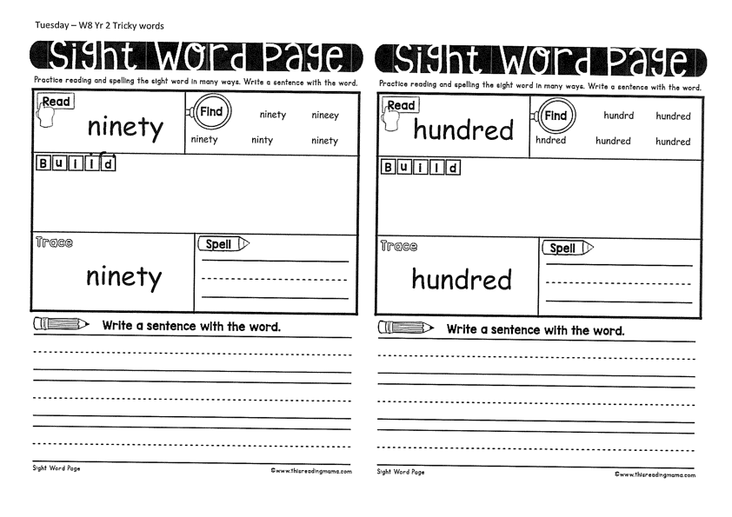
Year 1
Year 2

Slide 19
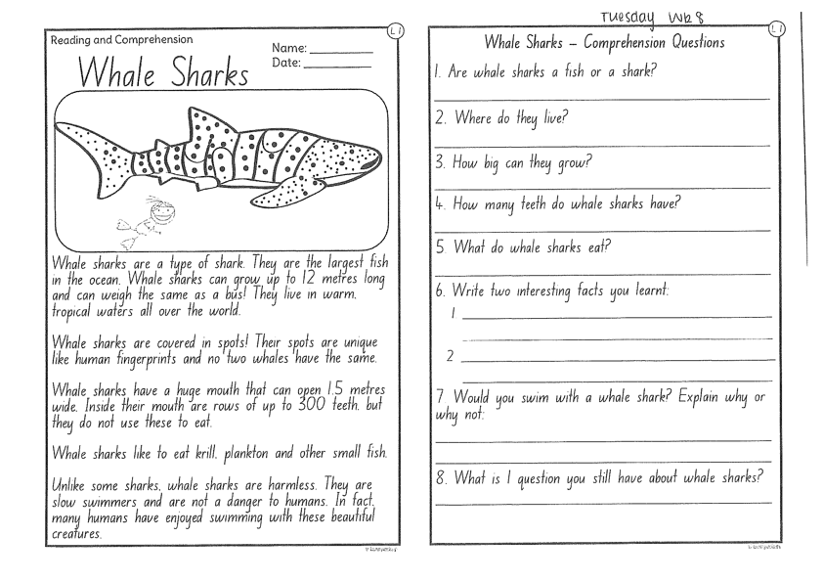
Task 2
Read or get an adult to read “Whale Sharks” and answer the questions.

Slide 20
Crunch n’ sip

Slide 21
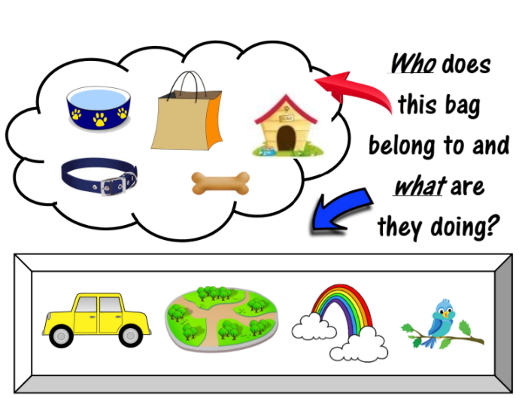
Task 3
Writing – who does this bag belong to?
Look at the questions in your learning pack guide.

Slide 22
Recess break (30 minutes)

Slide 23
Mathematics
M o n e y
Task 1
Complete an activity from the maths activity grid

Slide 24
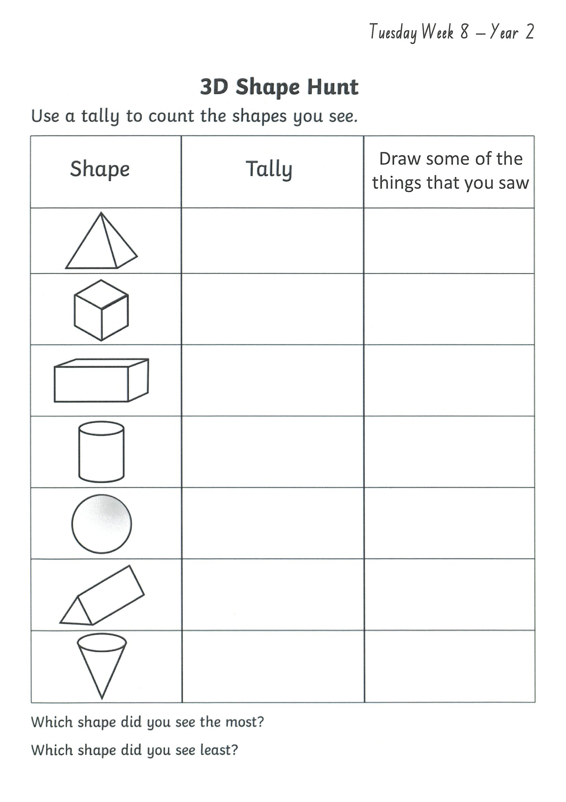
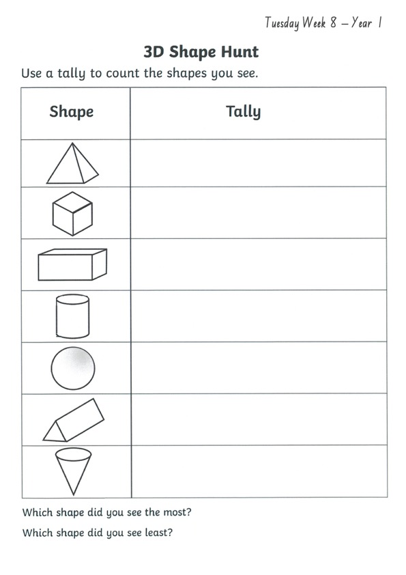
Task 2 Then complete 3 activities on studyladder or mathletic.
3d s h a p e s

Slide 25
Lunch break (40 minutes)

Slide 26
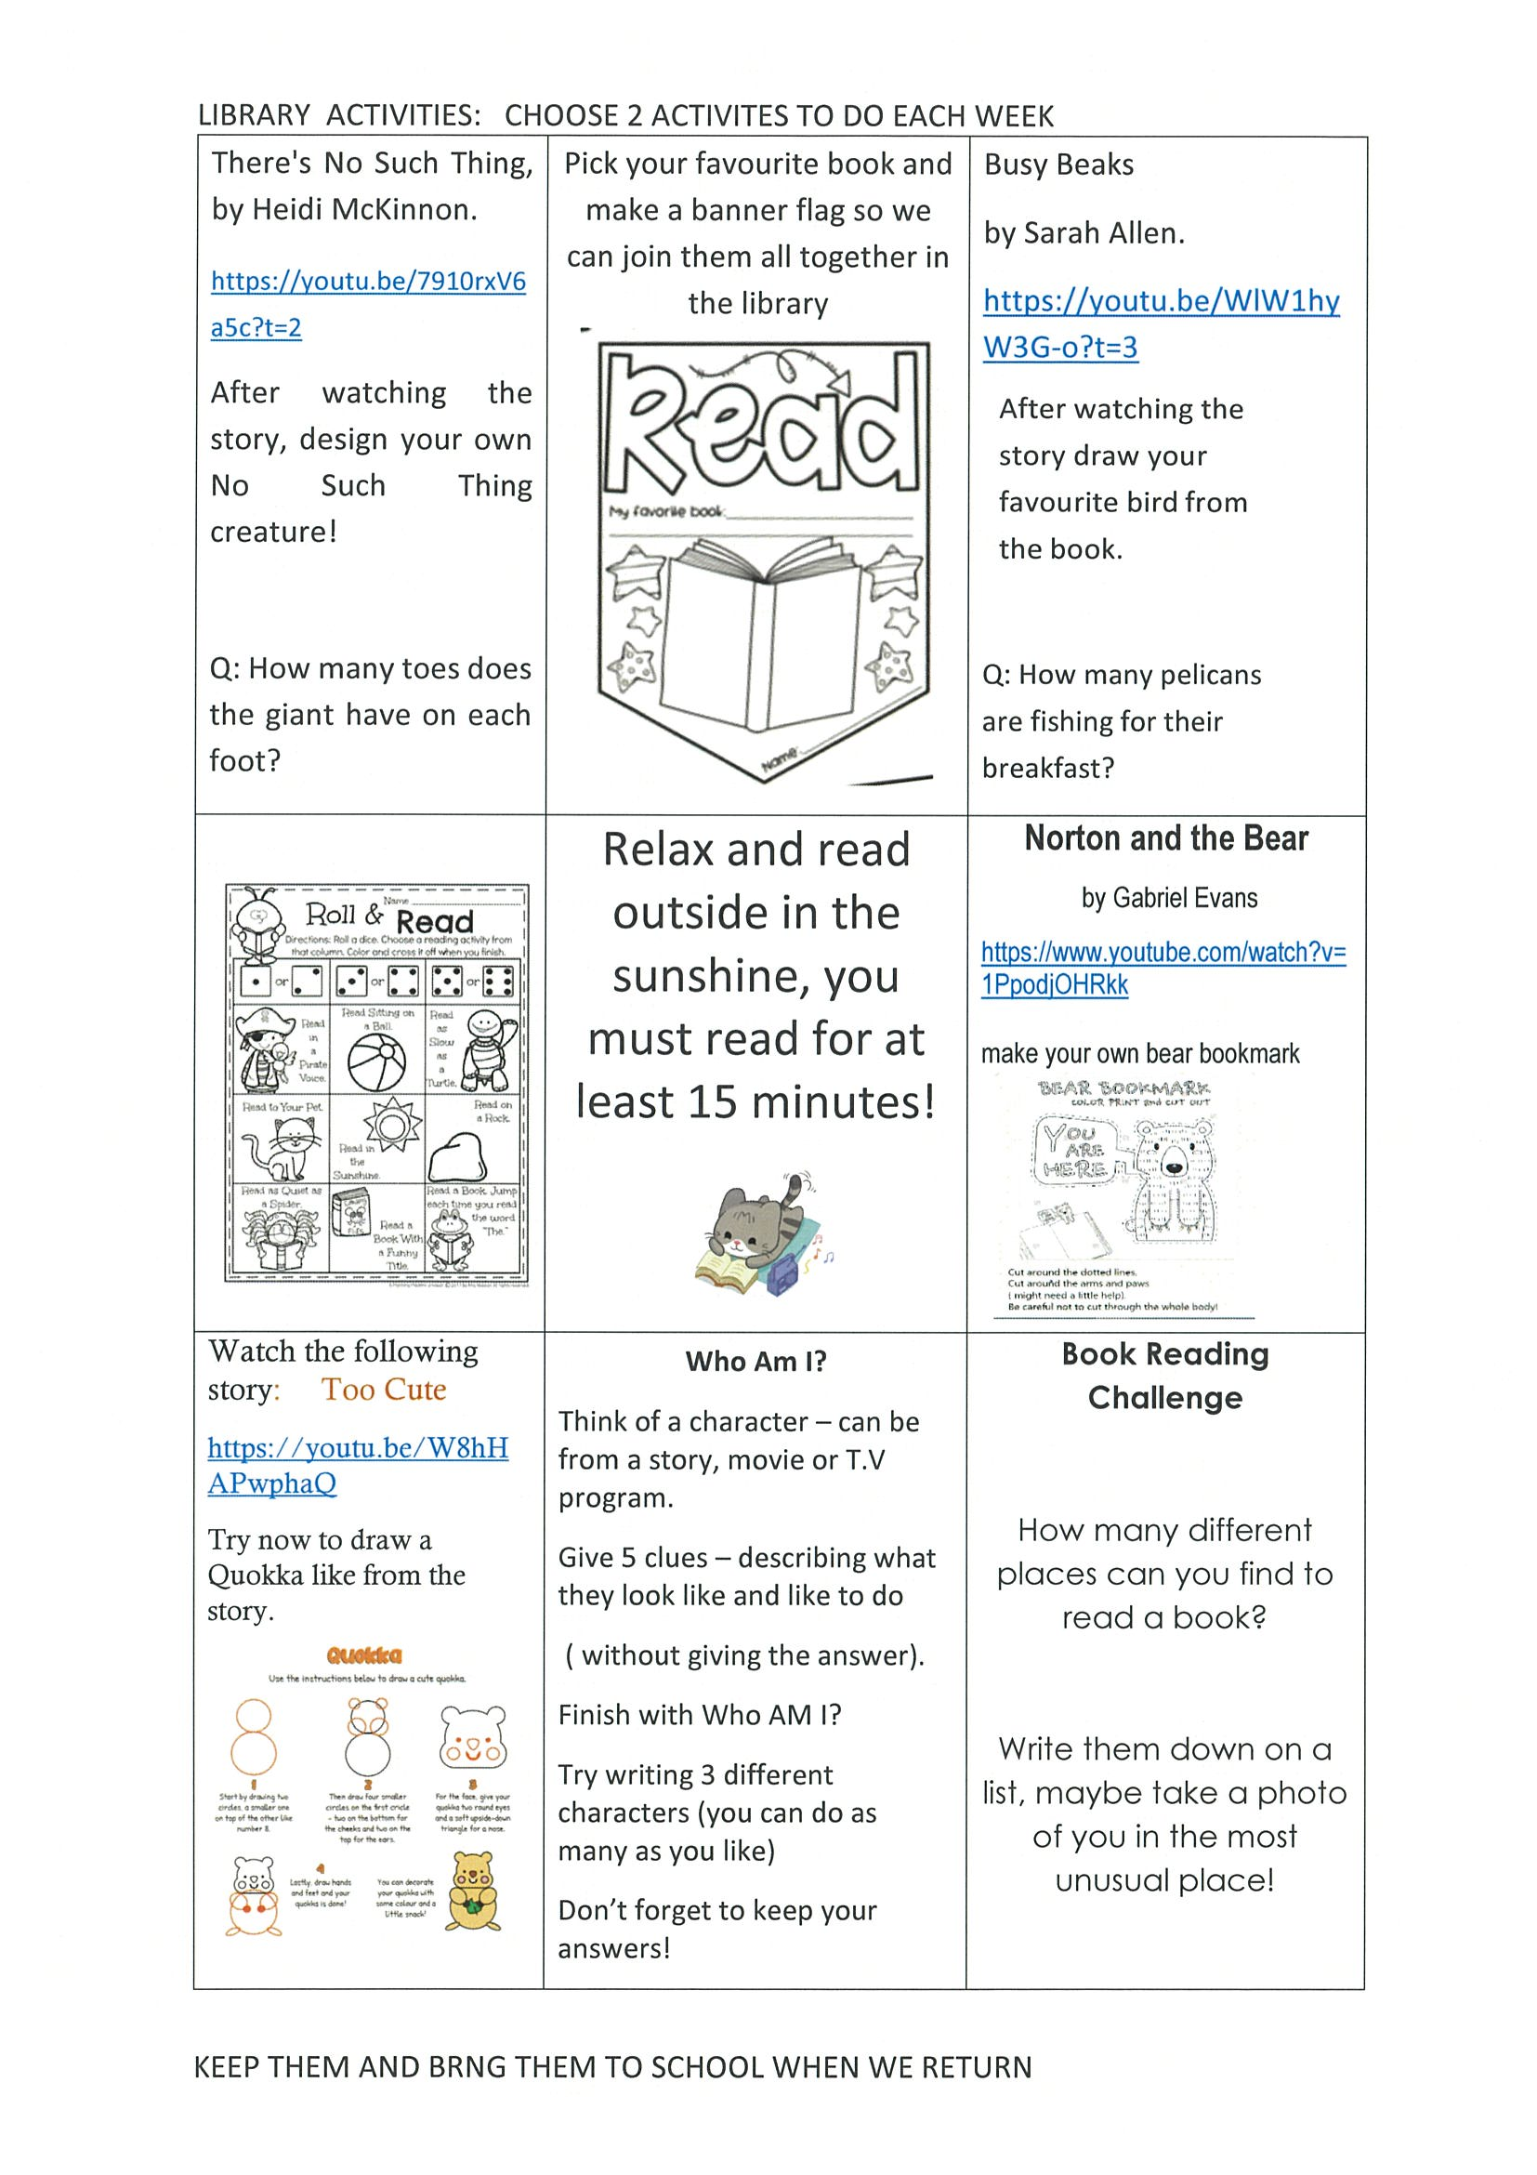
library
Silent reading
Choose one or two activities to complete each week from the NEW library activity grid.

Slide 27
END OF DAY!
ENJOY your well-deserved break everyone!

Slide 28
Good morning
STAGE 1
WEDNESDAY 1ST SEPTEMBER 2021 – WEEK 8
Please make sure you are sending one or two work samples to your classroom teacher via dojo.

Slide 29
WHATS ON TODAY?
Morning Task 1 – Spelling Task 2 – Reading Crunch n’ sip Task 3 - WUSHKA
Task 4 - Handwriting Middle Task 1 – Maths Grid Task 2 – Worksheet
Task 3 – Fitness
Final Science

Slide 30
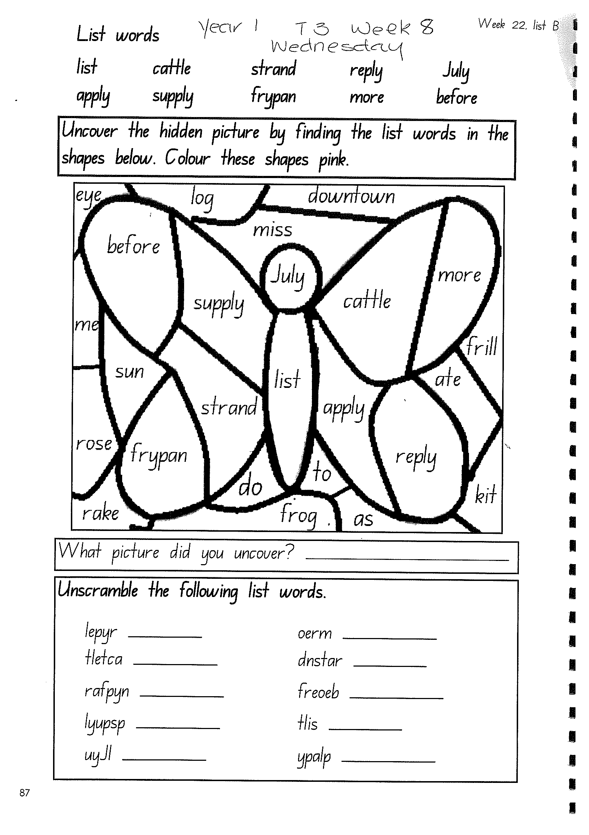
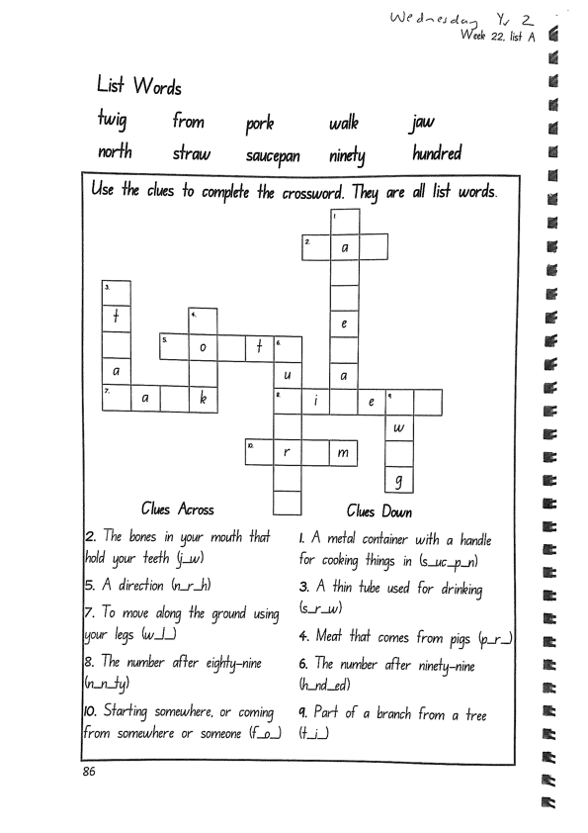
Task 1
Write down your spelling words and dot, dash, dive them on a piece of paper..
Video will be posted on dojo! Complete spelling tasks.

Slide 31
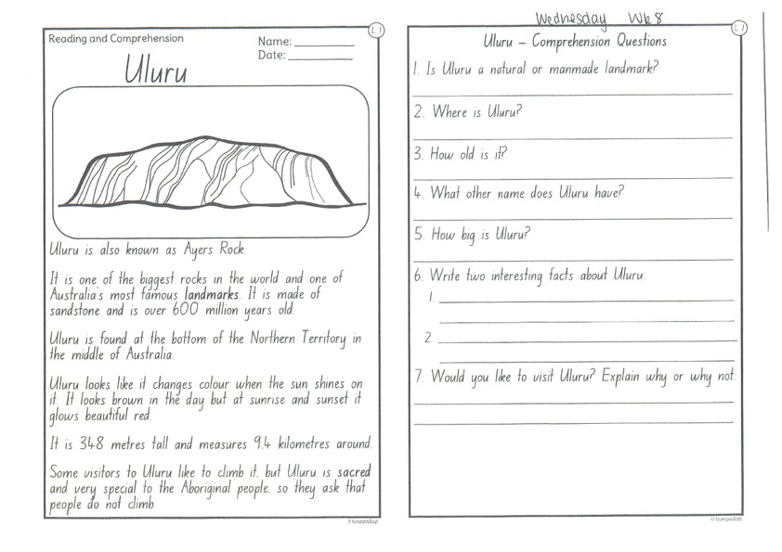
Task 2
Read or get an adult to read ”ULURU” and answer the questions.

Slide 32
Crunch n’ sip

Slide 33
Task 3
Wushka - Log into WUSHKA and do some reading.

Slide 34
Task 4
Complete the letter “K” in your handwriting books.
Https://www.youtube.com/watch?v=pOnWH3ntp70

Slide 35
Recess break (30 minutes)

Slide 36
Mathematics
Task 1
Complete an activity from the maths activity grid

Slide 37
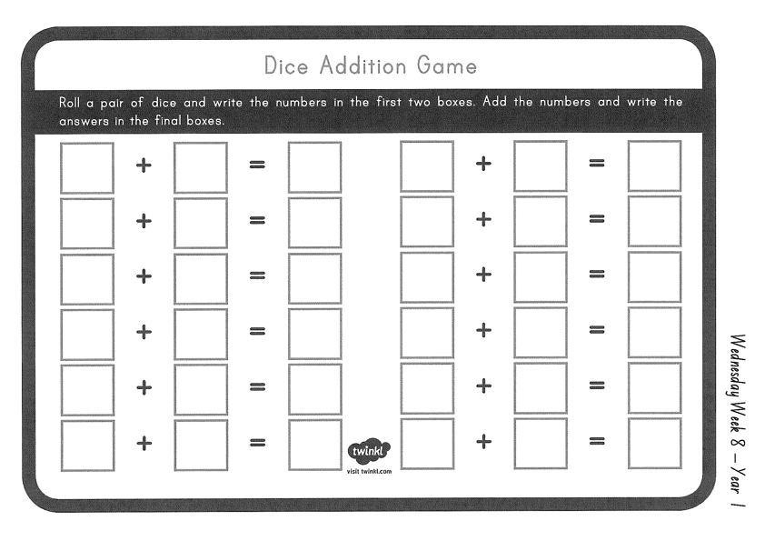
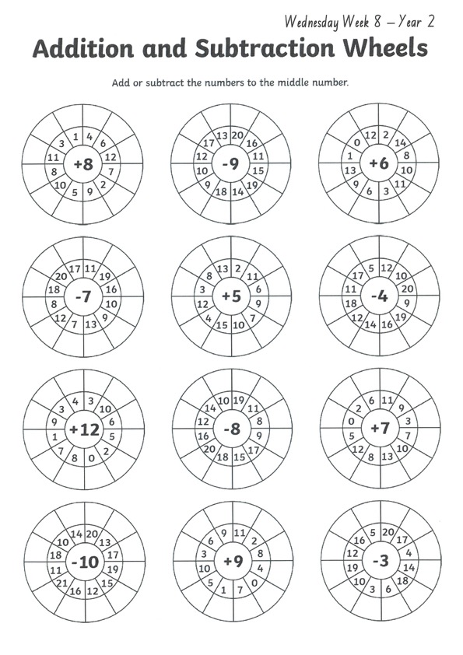
Task 2
A D D I T I O N
Year 1
Year 2

Slide 38
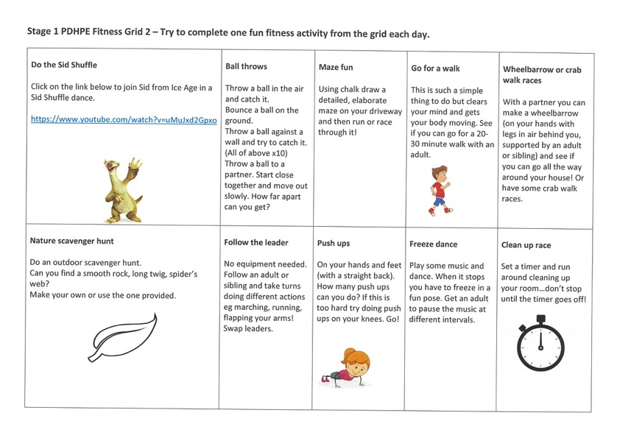
fitness
Choose an activity from the fitness grid to complete.
Not this one
(in your packs)

Slide 39
Lunch break (40 minutes)

Slide 40
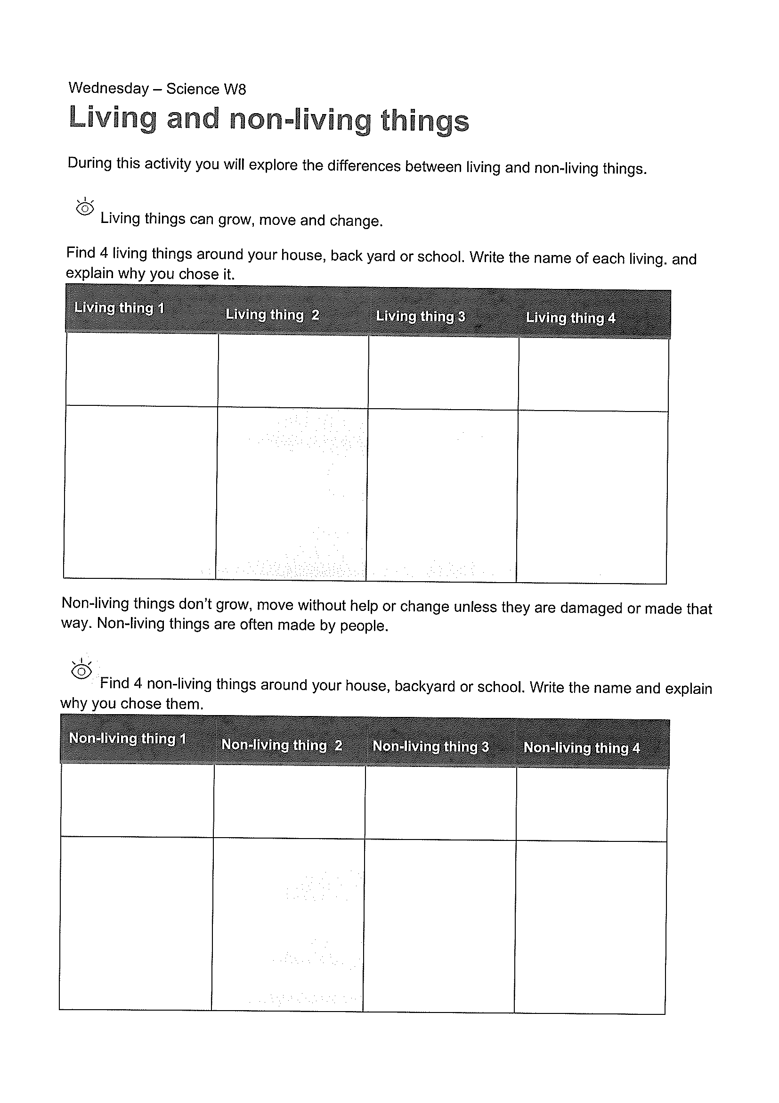
KLA - SCIENCE
Watch the video about living things:
Https://www.youtube.com/watch?v=Gy60BqCnTG4
What are living things? Be a detective in your house, backyard or at the local park and find 4 examples of living and non-living things in your house.
COMPLETE WORKSHEET

Slide 41
END OF DAY!
ENJOY your well-deserved break everyone!

Slide 42
Good morning
STAGE 1
THURSDAY 2ND SEPTEMBER 2021 – WEEK 8
Please make sure you are sending one or two work samples to your classroom teacher via dojo.

Slide 43
WHATS ON TODAY?
Morning Task 1 – GRAMMAR Task 2 – Reading Crunch n’ sip Task 3 - Writing Middle Task 1 – Maths Grid
Task 2 – Maths Worksheets
Final PDHPE

Slide 44
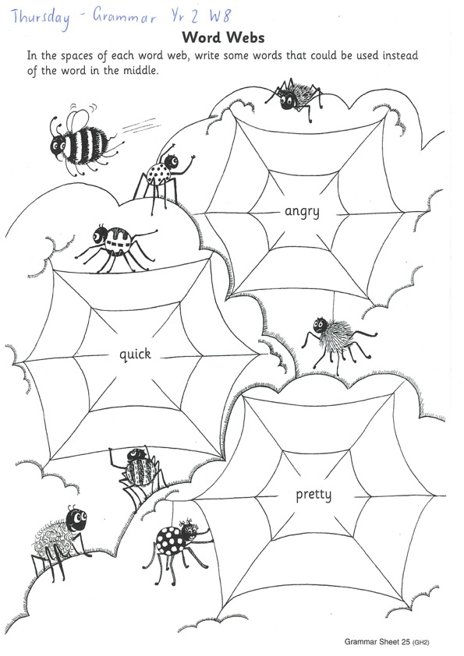
Task 1
The children write inside the outlines word ADJECTIVES in blue and read the adjectives in the snake. Then they read the sentences in the middle of the sheet. They choose one of the adjectives for each sentence and write it in the space. The adjectives can be used more than once.
Year 2 - Word Webs
We can make our writing more exciting by using more interesting words in our sentences. Look at the words in the web and write some other words that can be used instead of the word in the middle. E.g. sad= upset, miserable, lonely.

Slide 45
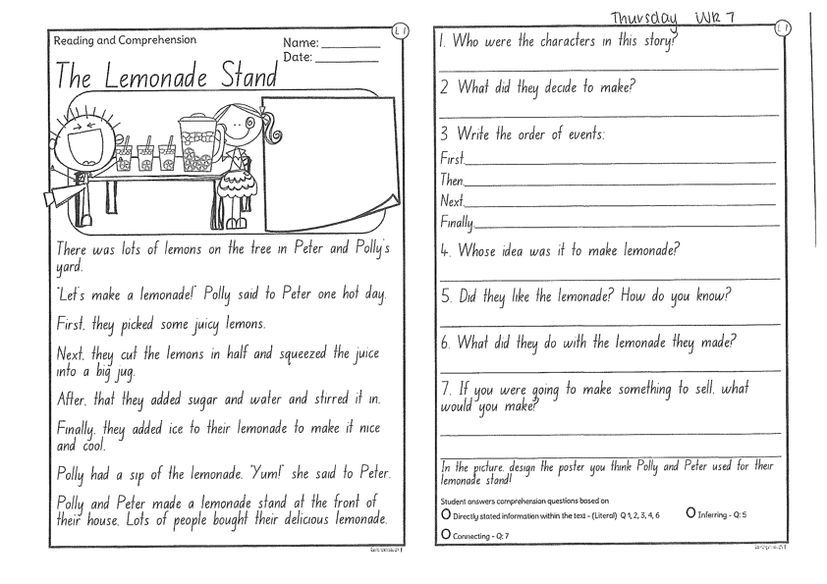
Task 2
Read or get an adult to read ”The Lemonade Stand” and answer the questions.

Slide 46
Crunch n’ sip

Slide 47
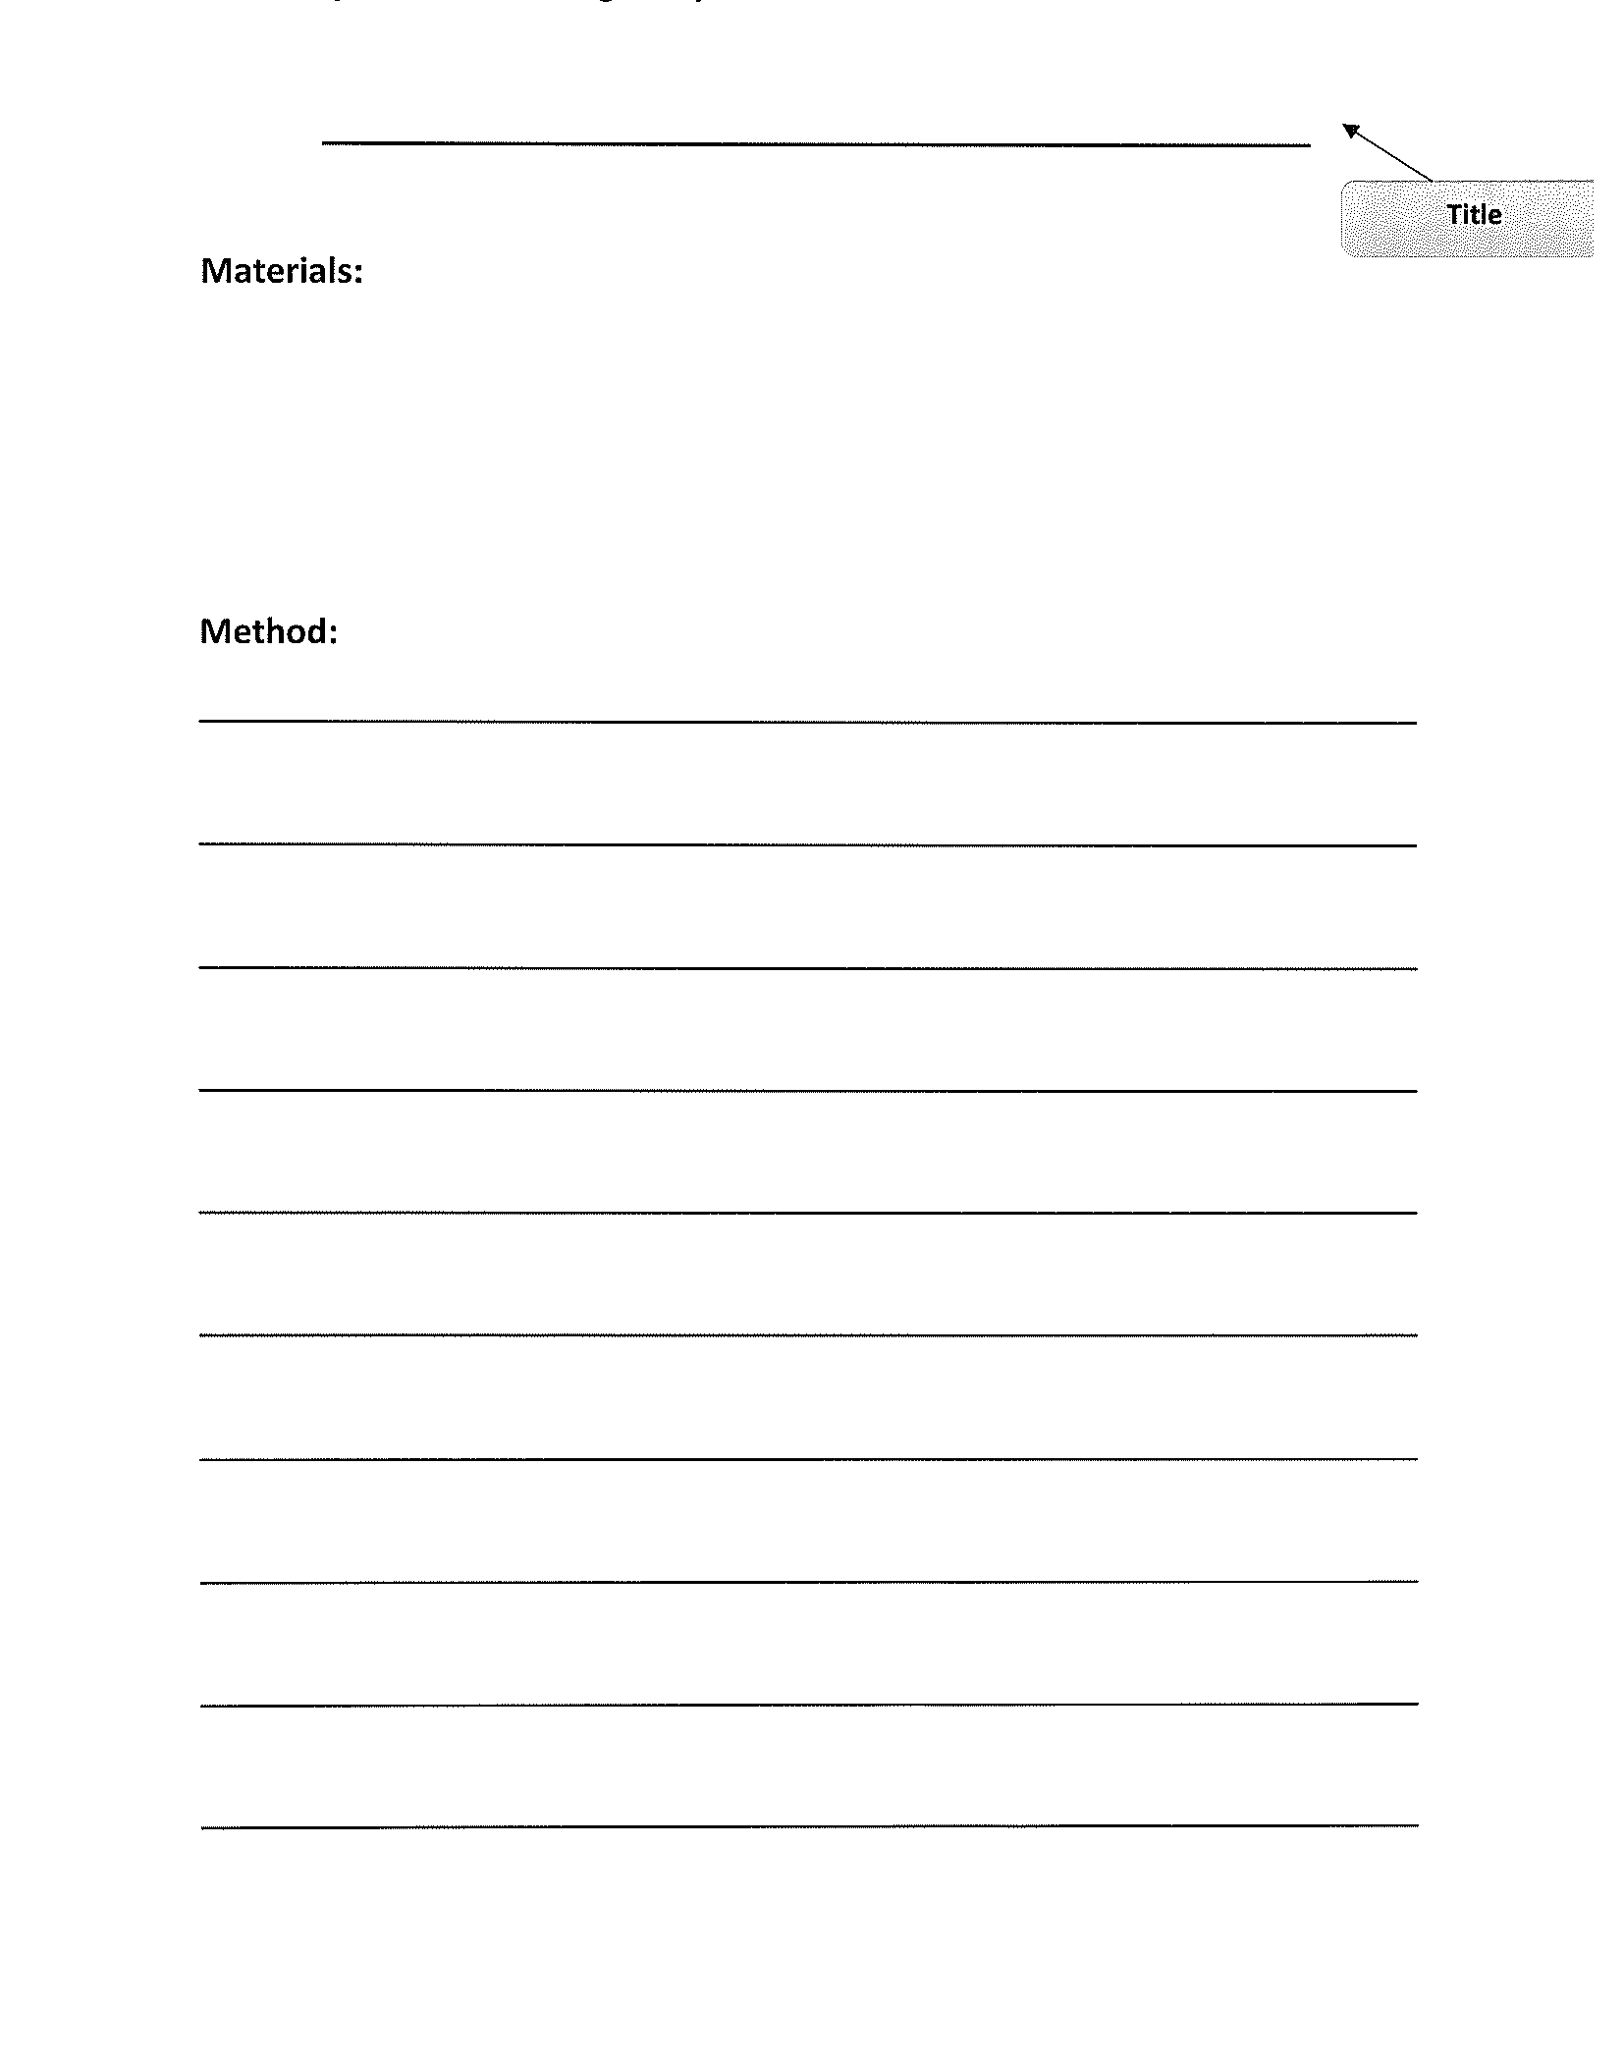
Task 3
Procedural writing
Call someone special to you. Maybe a grandparent, family member or friend you haven’t seen in a while. On a piece of paper, write a procedural text of ‘how to make a phone call’. Remember to add a title, list of items you need and a method (instructions). Don’t forget to start each step with a verb!

Slide 48
Recess break (30 minutes)

Slide 49
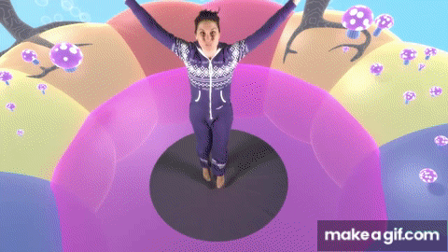
KLA – capa (dance)
SALSA Dance Lesson 1
Https://www.youtube.com/watch?v=FdQ87SOfb7Y&list=RDCMUCsJbboljkvAkxbnEu6w3nyg&index=4

Slide 50
Mathematics
Task 1
Complete an activity from the maths activity grid

Slide 51
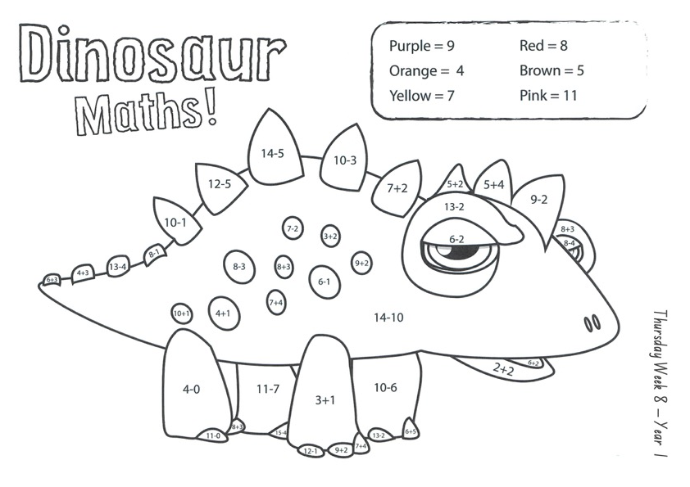
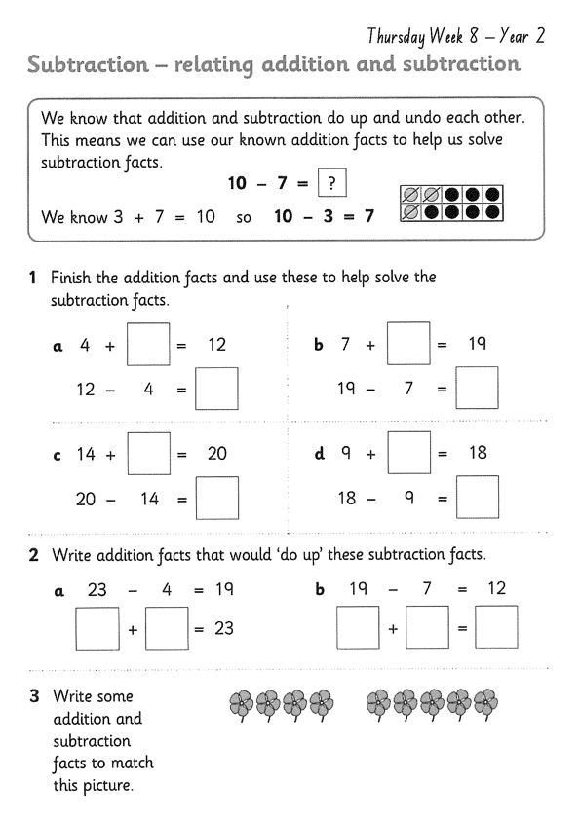
Task 2 Then complete 3 studyladder or mathletics activities
MIXED
Year 1
Year 2

Slide 52
Lunch break (40 minutes)

Slide 53
KLA - PDHPE
Water Safety
As the weather gets warmer the beach is a fun place to go with your family. When around water it is important to keep an eye out for dangers and make sure you keep yourself safe and listen to the adults looking after you. Watch the following video for beach safety tips and then complete the activities provided.
Https://www.youtube.com/watch?v=gxxWWiGPb0E

Slide 54
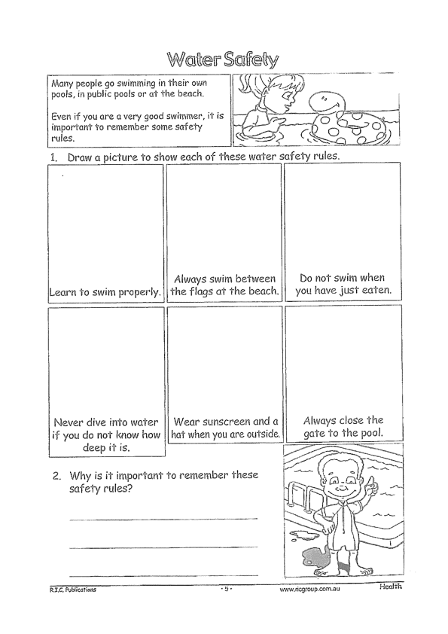
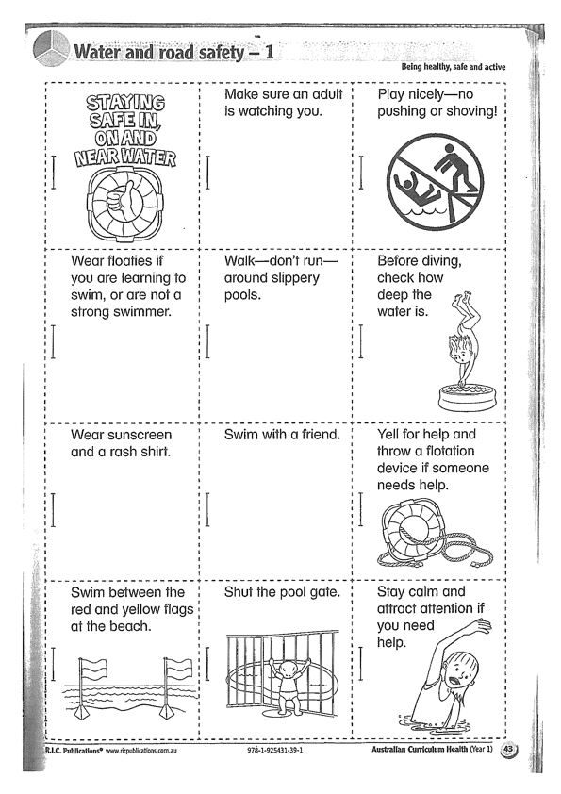

Slide 55
END OF DAY!
ENJOY your well-deserved break everyone!

Slide 56
Good morning
STAGE 1
FRIDAY 3RD SEPTEMBER 2021 – WEEK 8
Please make sure you are sending one or two work samples to your classroom teacher via dojo.

Slide 57
WHATS ON TODAY?
WELL BEING FRIDAY!!
To focus on our well being and unplugging from technology, today is a tech free day. Choose activities from the Friday grid. Submit photos of what you have done to our school Facebook page NOT DOJO.

Slide 59
KLA - PDHPE
Fundamental Movement Skills
https://www.youtube.com/channel/UCFI8inXSYttI8PVkEcSuD7g

Slide 60
END OF Week!
ENJOY your well-deserved break everyone!

