Slide 1
STAGE 1
MISS UNAL
MISS ENRIGHT
Ms Holdsworth
MS ROBINSON
MISS MORATA
Mrs Fleming
Miss Unal
MRS MAZLOUM/ MRS ENRIGHT
STAGE 1
CAN YOU FIND YOUR TEACHER’S NAME?
MRS FLEMING (ASSISTANT PRINCIPAL)
Miss Morata
Ms Robinson
MISS HOLDSWORTH
Mrs Mazloum

Slide 2
Good morning
STAGE 1
MONDAY 13th SEPTEMBER 2021 – WEEK 10
Please make sure you are sending one or two work samples to your classroom teacher via dojo.

Slide 3
WHATS ON TODAY?
Morning Task 1 - spelling Task 2 - reading Crunch n’ sip Task 3 - writing Task 4 - handwriting
Middle Task 1 - Maths Grid Task 2 - Worksheet
Final Geography

Slide 4
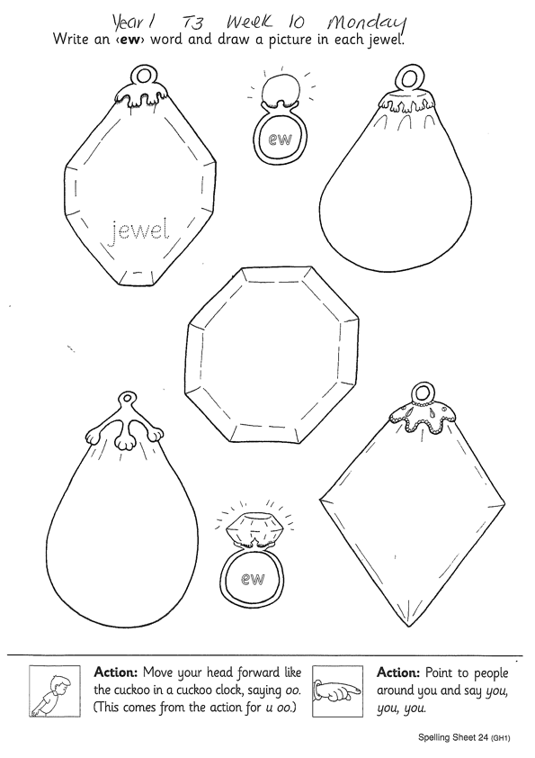
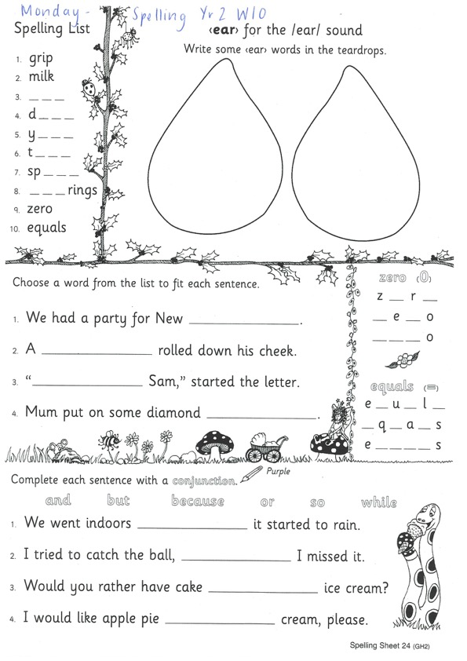
Task 1
Year 1
Year 2
Watch Mrs Warwick’s video’s for the sound of the week. Brainstorm a list of words using the sound focus of the week on a piece of paper.
Year 1
https://www.youtube.com/watch?v=dEEDmyhnG_Y
Year 2
https://www.youtube.com/watch?v=Sq2hLoQhI7Q

Slide 5
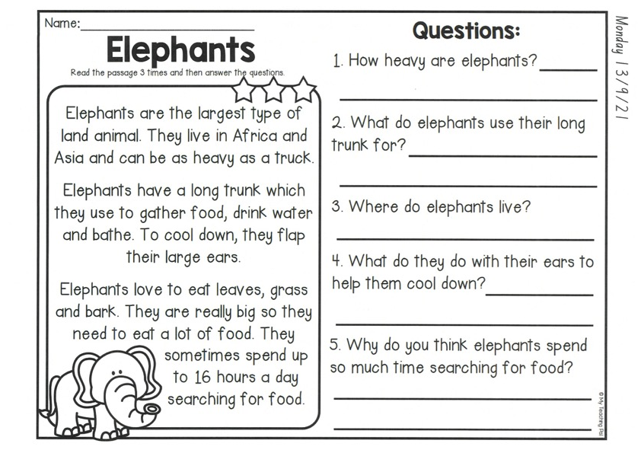
Task 2
Read or get an adult to read ‘Elephants’ and answer the questions.

Slide 6
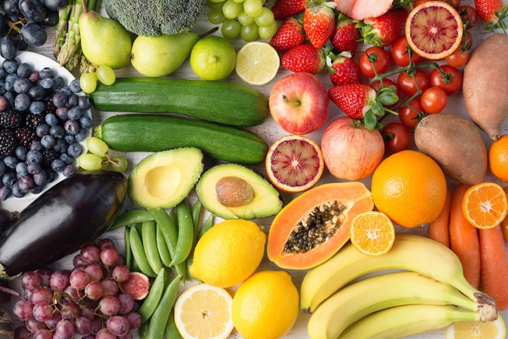
Crunch n’ sip

Slide 7
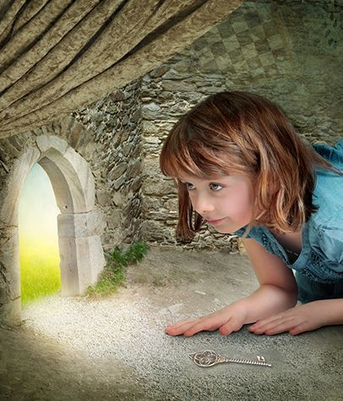
Task 3
Using the prompt, create an imaginative story of your own. Remember to tell us who is in the story, where they are, what they are doing and try to include a problem and solution!
What’s happening here?
Who is in your story?
What are they doing?
What is the problem? How is it fixed?

Slide 8
Task 4
Complete the letter “m” in your handwriting books.
https://www.youtube.com/watch?v=TyI_MBIBsPI

Slide 9
Recess break (30 minutes)

Slide 10
Mathematics
Task 1
Count how many different types of snacks you have in your house? Can you sort them into groups of healthy versus unhealthy (sometimes) foods.

Slide 11
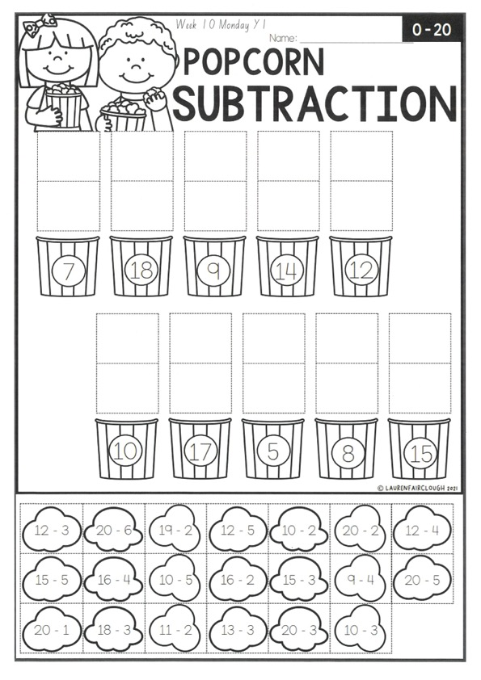
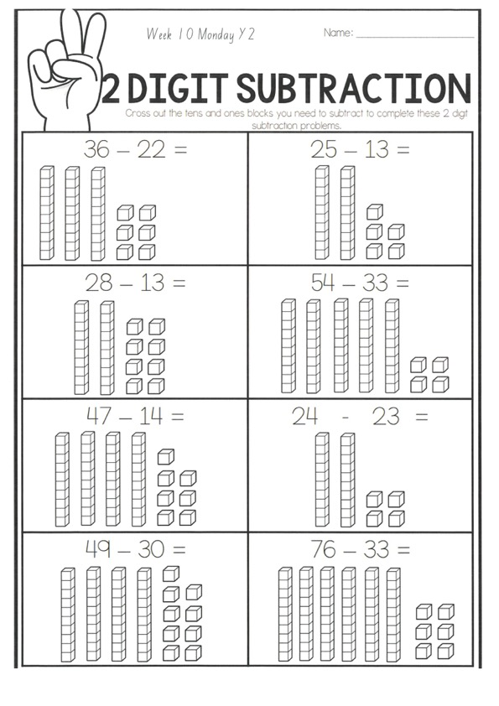
Task 2 Complete the worksheets and then do 3 activities on mathletics or studyladder.
S u b t r a c t I o n

Slide 12
Lunch break (40 minutes)

Slide 13
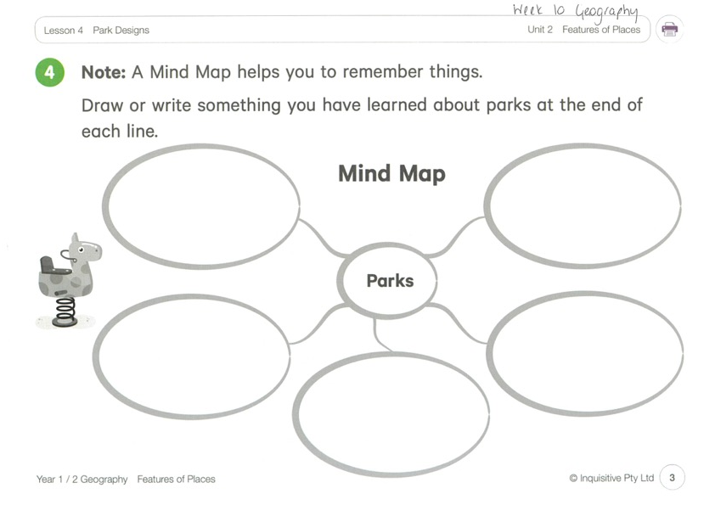
KLA - geography
Today’s lesson is on Park Designs. What features would the best parks have?
You can use the website links to look at some features of parks in other places, including special needs parks and natural parks. Use the mind map to help you plan and then draw a map of your park on the worksheet.
Click the link below to take you to todays lesson.
http://inq.co/class/9wg
Code: 9484

Slide 14
END OF DAY!
ENJOY your well-deserved break everyone!

Slide 15
Good morning
STAGE 1
TUESDAY 14TH SEPTEMBER 2021 – WEEK 10
Please make sure you are sending one or two work samples to your classroom teacher via dojo.

Slide 16
WHATS ON TODAY?
Morning Task 1 – Spelling Task 2 – Reading Crunch n’ sip Task 3 - Writing Middle Task 1 – Maths Grid
Task 2 – Activity Worksheet
Final Library

Slide 17
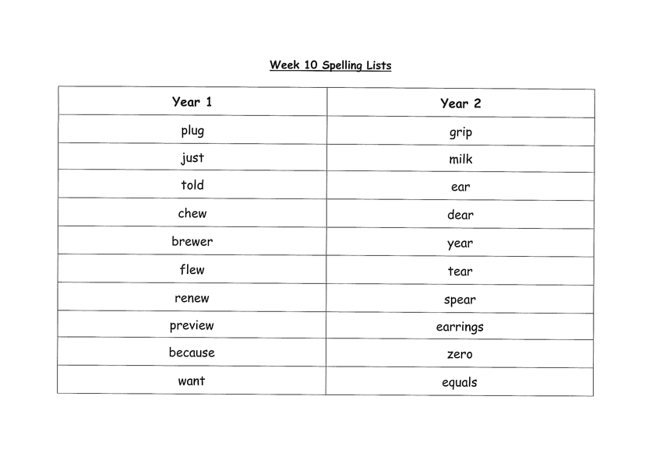
Task 1
Complete the Look, Cover, Write, Check worksheet (on a piece of paper). Write some sentences. Circle any nouns in your sentences.
Then complete your tricky word!

Slide 18
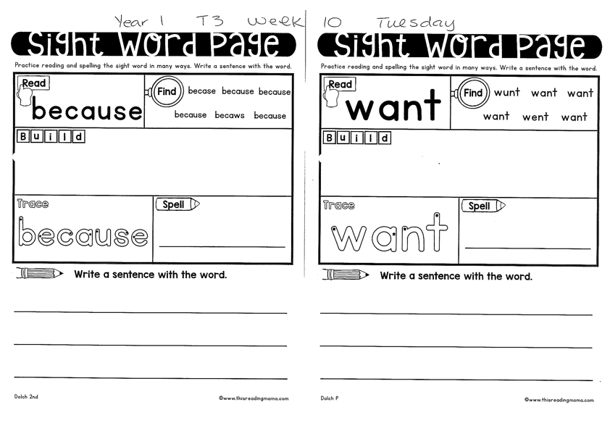
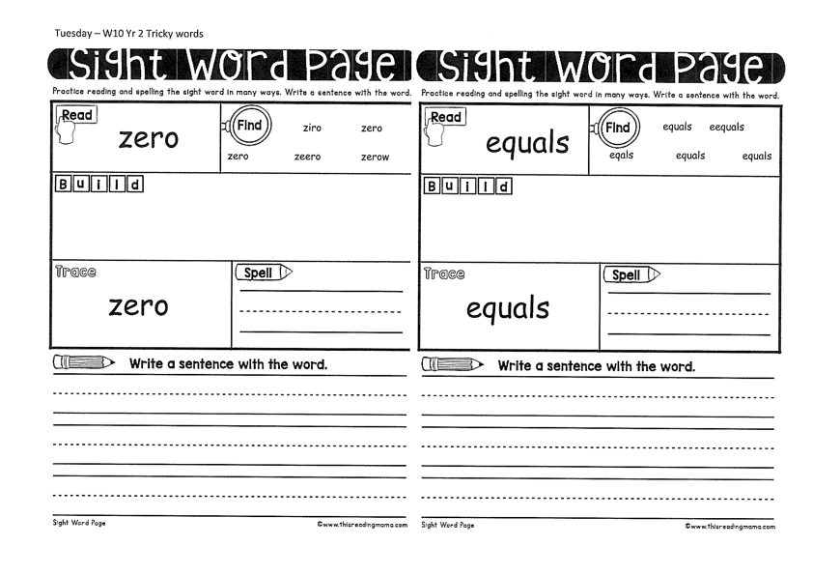
Year 1
Year 2

Slide 19
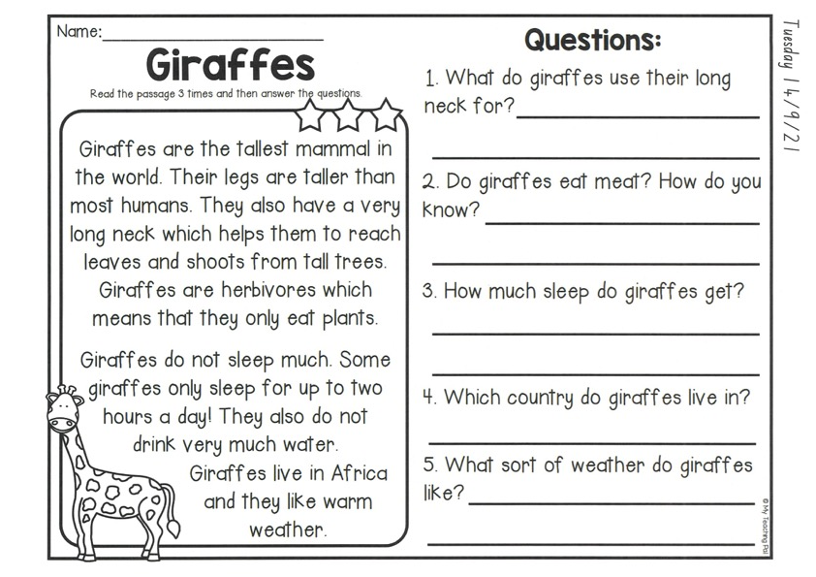
Task 2
Read or get an adult to read “Giraffes” and answer the questions.

Slide 20
Crunch n’ sip

Slide 21
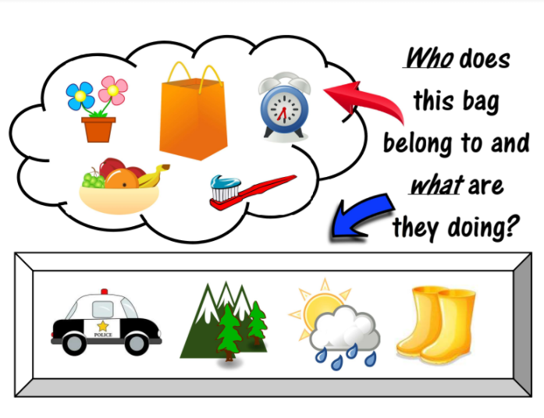
Task 3
Writing – who does this bag belong to?
Look at the questions in your learning pack guide.

Slide 22
Recess break (30 minutes)

Slide 23
Mathematics
M o n e y
Task 1
Write out your friends of 10 numbers. Do you think you could challenge yourself and do friends of 30?

Slide 24
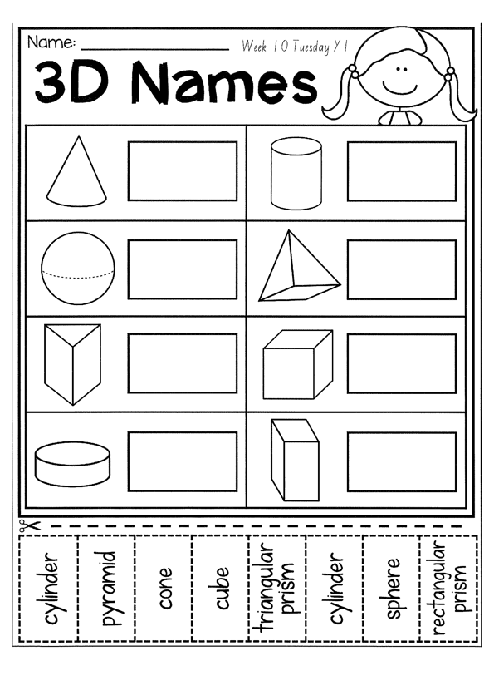
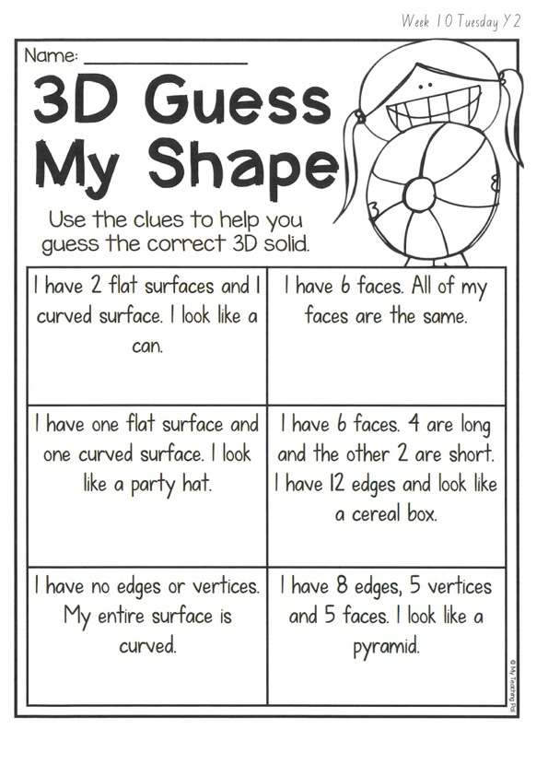
Task 2 Then complete 3 activities on studyladder or mathletic.
3d s h a p e s

Slide 25
Lunch break (40 minutes)

Slide 26
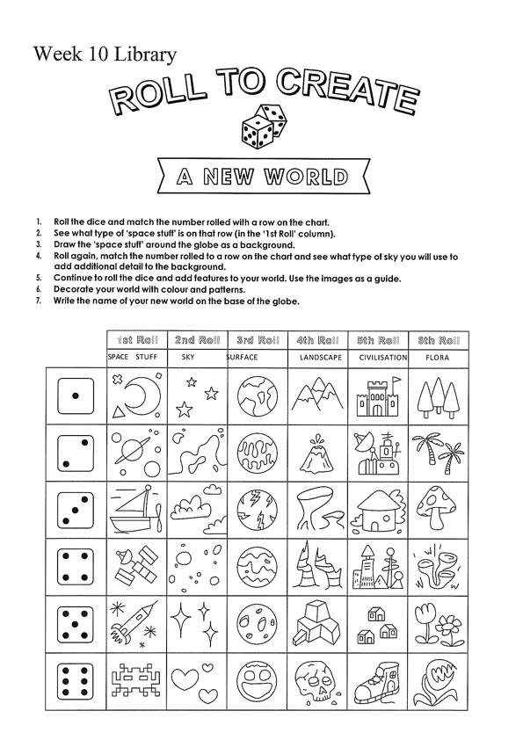
library
Silent reading
Choose one or two activities to complete each week from the NEW library activity grid.

Slide 27
END OF DAY!
ENJOY your well-deserved break everyone!

Slide 28
Good morning
STAGE 1
WEDNESDAY 15th SEPTEMBER 2021 – WEEK 10
Please make sure you are sending one or two work samples to your classroom teacher via dojo.

Slide 29
WHATS ON TODAY?
Morning Task 1 – Spelling Task 2 – Reading Crunch n’ sip Task 3 - WUSHKA
Task 4 - Handwriting Middle Task 1 – Maths Grid Task 2 – Worksheet
Task 3 – Fitness
Final Science

Slide 30
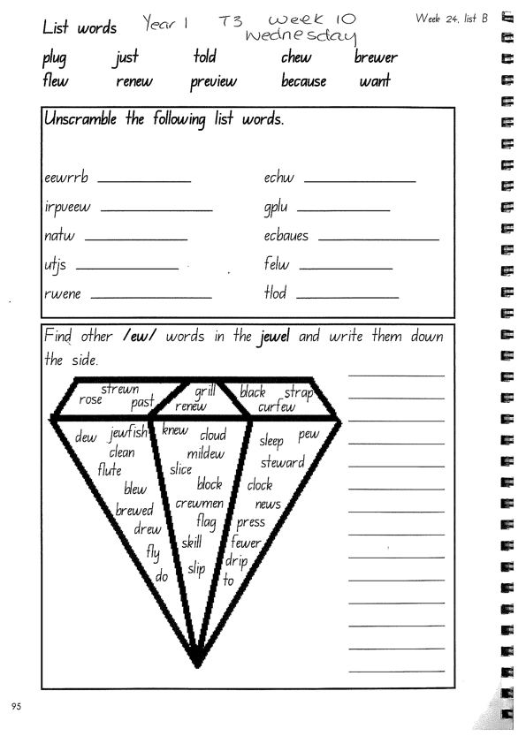
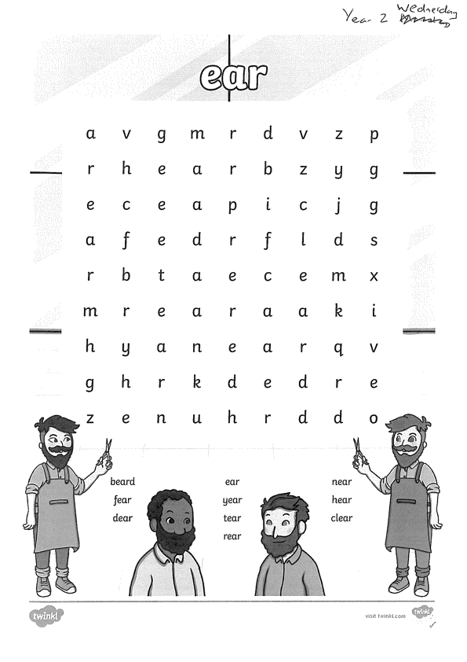
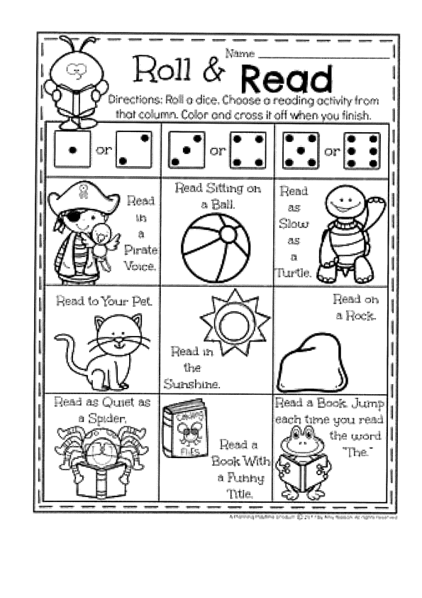
Task 1
Write down your spelling words and dot, dash, dive them on a piece of paper..
Video will be posted on dojo! Complete spelling tasks.

Slide 31
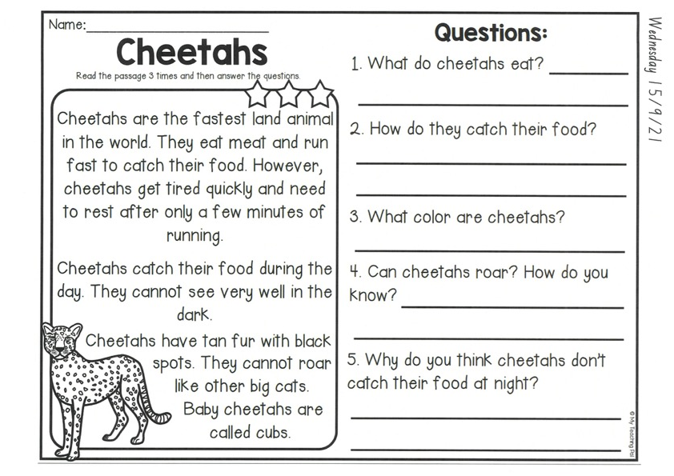
Task 2
Read or get an adult to read ”Cheetahs” and answer the questions.

Slide 32
Crunch n’ sip

Slide 33
Task 3
Wushka - Log into WUSHKA and do some reading.

Slide 34
Task 4
Complete the letter “p” in your handwriting books.
https://www.youtube.com/watch?v=8rWpHafUS4I

Slide 35
Recess break (30 minutes)

Slide 36
Mathematics
Task 1
Choose a boardgames like snakes and ladders or something similar where you need to use dice and count how many spots you need to move on a board and play with a family member.

Slide 37
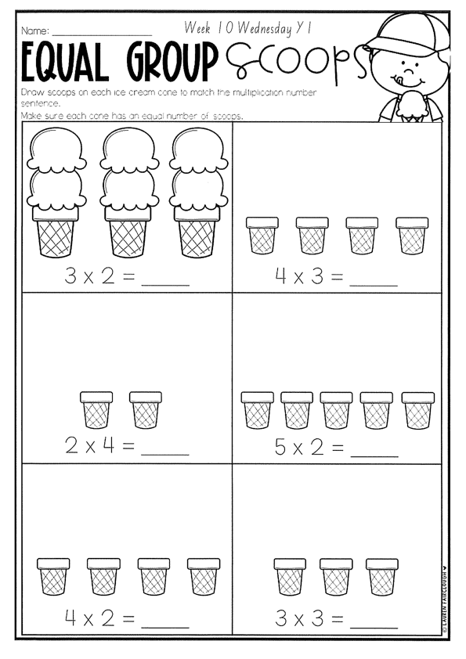
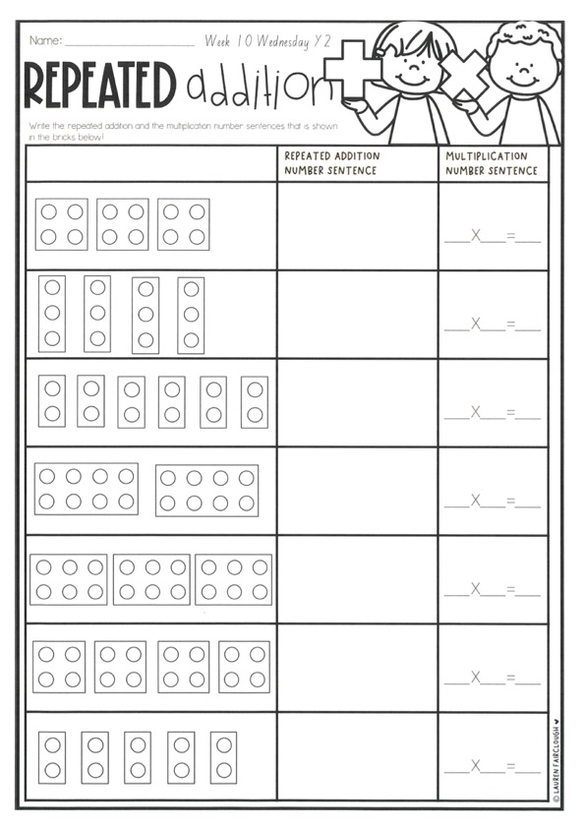
Task 2
A D D I T I O N
Year 1
Year 2

Slide 38
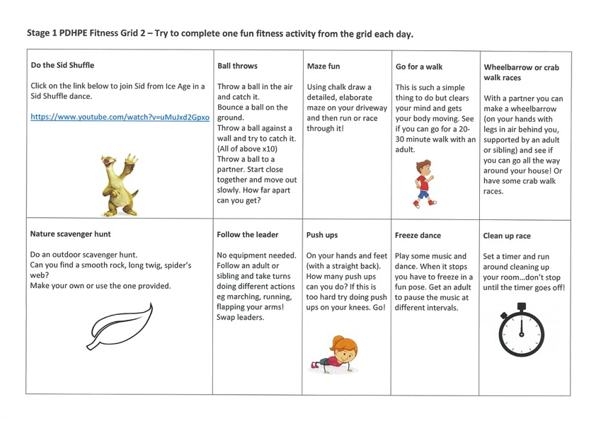
fitness
Choose an activity from the fitness grid to complete.
Not this one
(in your packs)

Slide 39
Lunch break (40 minutes)

Slide 40
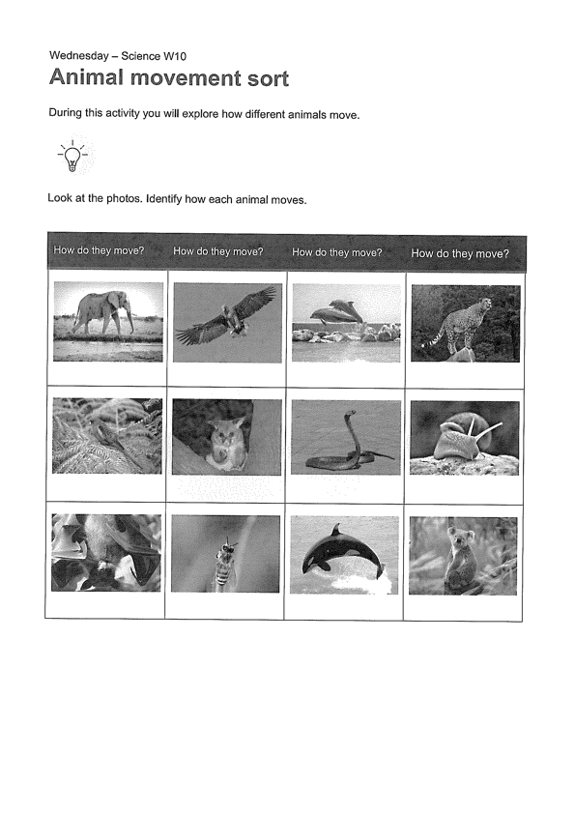
KLA - SCIENCE
Listen to the song about how animals move:
https://www.youtube.com/watch?v=CT86Dl442jA

Slide 41
END OF DAY!
ENJOY your well-deserved break everyone!

Slide 42
Good morning
STAGE 1
THURSDAY 16th SEPTEMBER 2021 – WEEK 10
Please make sure you are sending one or two work samples to your classroom teacher via dojo.

Slide 43
WHATS ON TODAY?
Morning Task 1 – GRAMMAR Task 2 – Reading Crunch n’ sip Task 3 - Writing Middle Task 1 – Maths Grid
Task 2 – Maths Worksheets
Final PDHPE

Slide 44
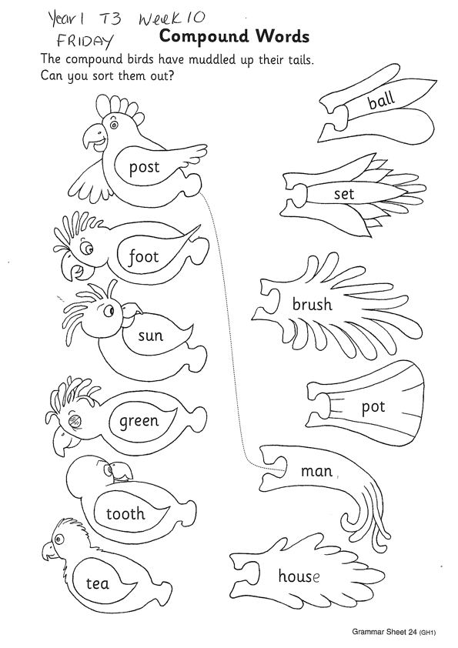
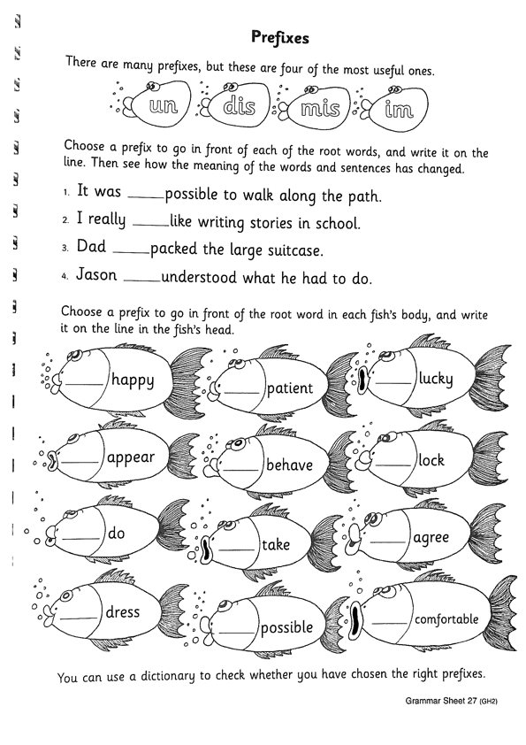
Task 1
Compound words
The children read the words in the birds’ wings and tails. Then they try adding the ‘tail words’ to the “wing words” to make compound words. They try each ‘tail word’ in turn until they find one that makes sense: ‘post’ and ‘ball’ makes ‘postball’, which is not a real word, whereas ‘post’ and ‘man’ makes ‘postman’.
Year 2
Prefixes are added to the beginning of words to change the meaning. There are many prefixes, but the most useful ones are ‘un’, ‘dis’, ‘mis’ and ‘im’. Add the prefixes to the words and see how it changes the meaning of each word.

Slide 45
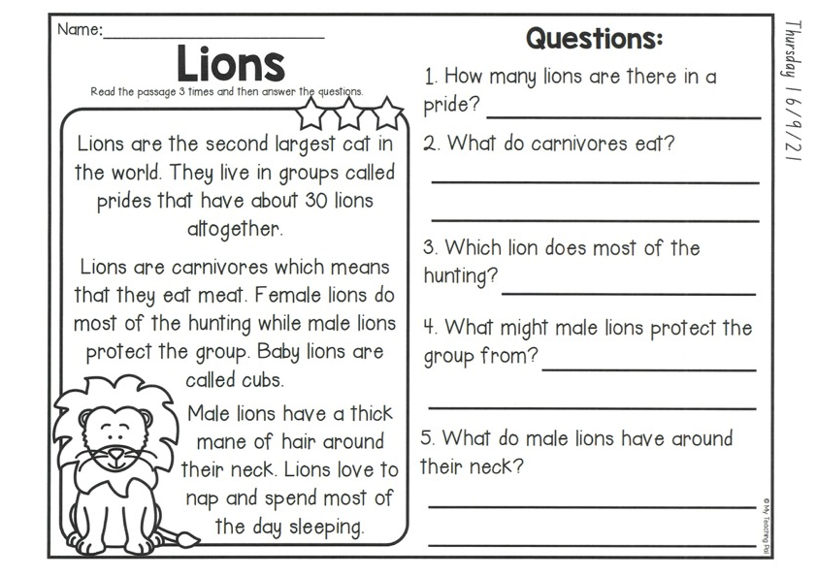
Comprehension
Read the story about ‘Lions’ and complete the questions.

Slide 46
Crunch n’ sip

Slide 47
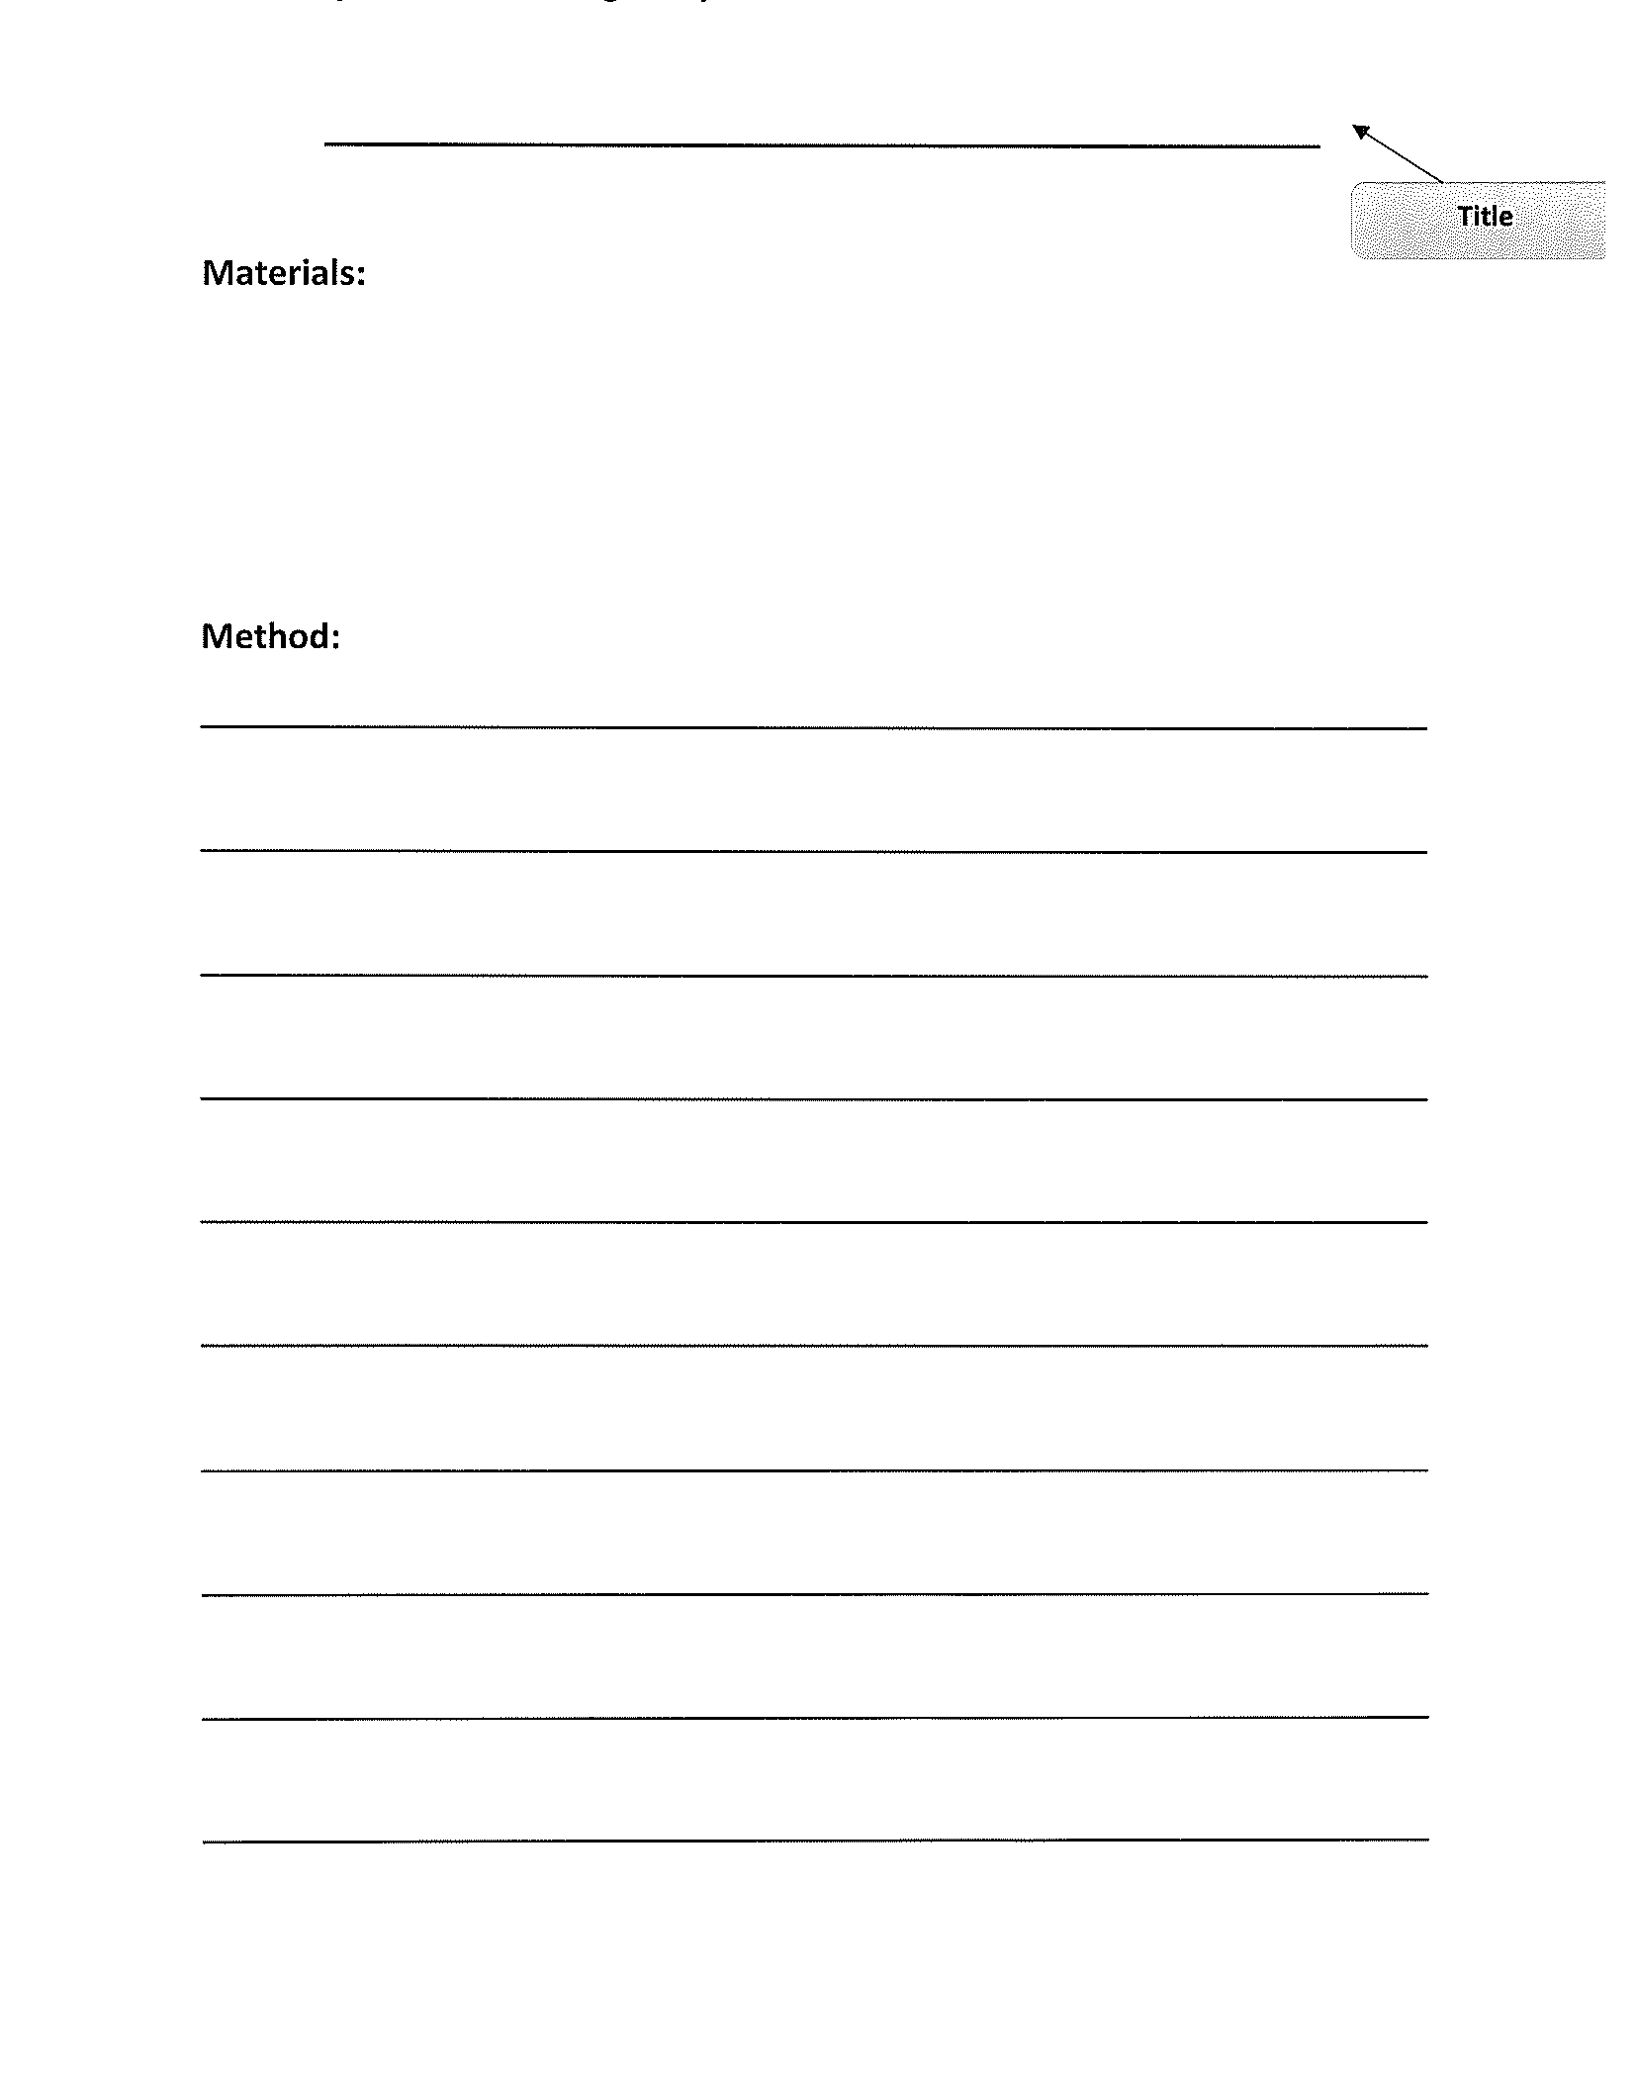
Task 3
Write a letter to someone who you miss. It may be family or friends. let them know how you have been going with home learning and tell them something you want to do in the school holidays! Remember to start with “Dear” and sign off with your name at the end. You might want to draw them a picture too!

Slide 48
Recess break (30 minutes)

Slide 49
KLA – capa (dance)
Line Dancing for Kids
Https://www.youtube.com/watch?v=5_srg-18Fz0
Line Dancing for Kids “Cha Cha Slide (2)
Https://www.youtube.com/watch?v=9JXHa5mM8b0
Line Dancing for kids “Nutbush” (3) - with instructions
Https://www.youtube.com/watch?v=XR-np8bkA3c

Slide 50
Mathematics
Task 1
Complete an activity from the maths activity grid

Slide 51
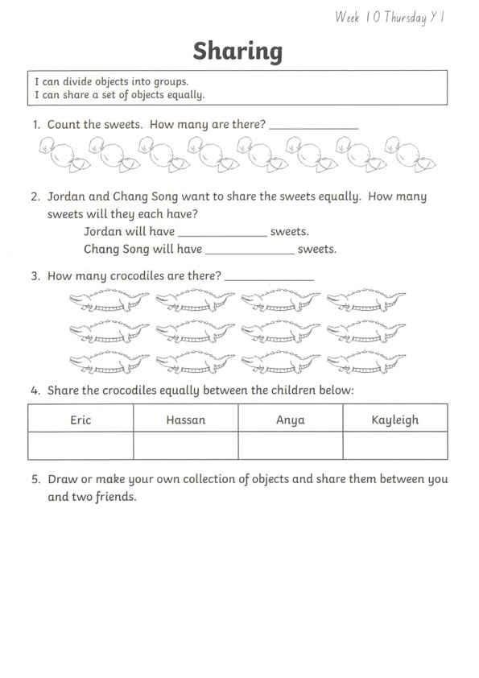
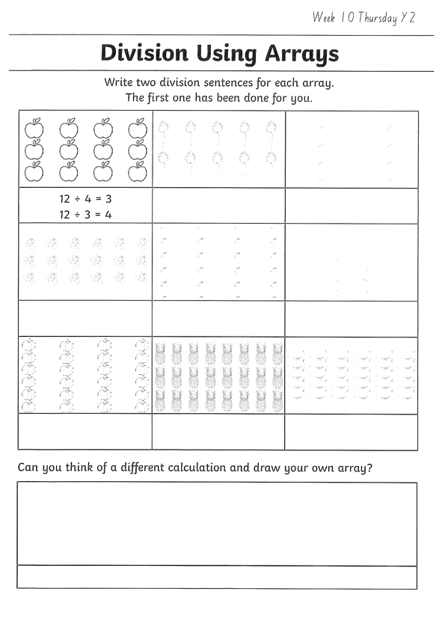
Task 2 Then complete 3 studyladder or mathletics activities
addition
Year 1
Year 2

Slide 52
Lunch break (40 minutes)

Slide 53
KLA - PDHPE
Water Safety at the beach
Playing at the beach can be fun, but it can also be dangerous if you don’t know the safety rules.
Visit:
https://www.youtube.com/watch?v=3_6mP_vLU5s&t=7s
To learn more about beach safety. Complete the worksheets on dangers at the beach.

Slide 54
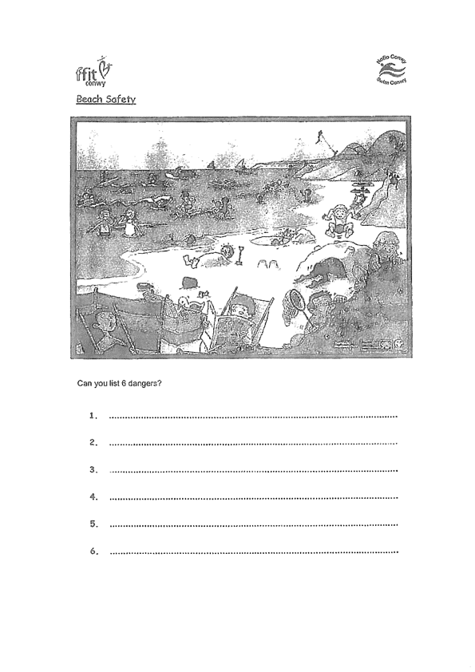
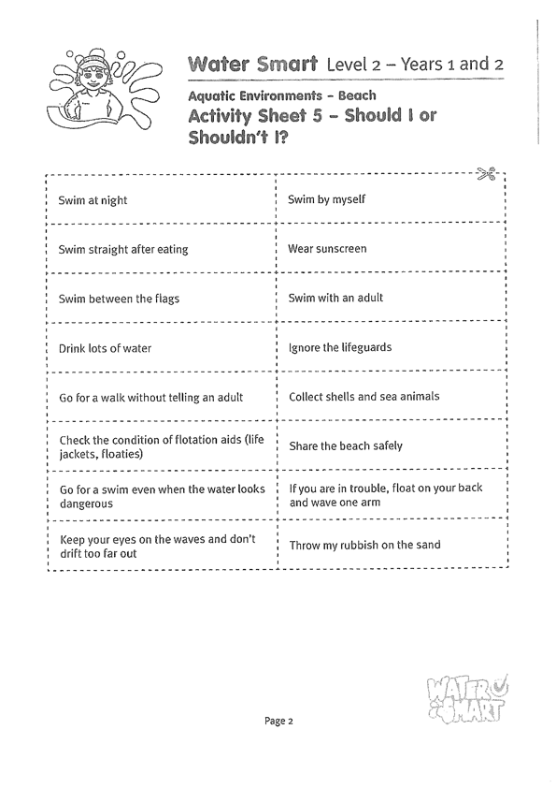

Slide 55
END OF DAY!
ENJOY your well-deserved break everyone!

Slide 56
Good morning
STAGE 1
FRIDAY 10th SEPTEMBER 2021 – WEEK 9
Please make sure you are sending one or two work samples to your classroom teacher via dojo.

Slide 57
WHATS ON TODAY?
WELL BEING FRIDAY!!
To focus on our well being and unplugging from technology, today is a tech free day. Choose activities from the Friday grid. Submit photos of what you have done to our school Facebook page NOT DOJO.

Slide 59
KLA - PDHPE
Fundamental Movement Skills
https://www.youtube.com/channel/UCFI8inXSYttI8PVkEcSuD7g

Slide 60
END OF Week!
ENJOY your well-deserved break everyone!

