Slide 1

STAGE 1
MRS FLEMING
MISS HOLDSWORTH
MISS MORATA
MS ROBINSON
MRS ENRIGHT
MRS MAZLOUM
MISS UNAL

Slide 2
Good morning
STAGE 1
MONDAY 16th AUGUST 2021 – WEEK 6
Please make sure you are sending one or two work samples to your classroom teacher via dojo.

Slide 3
WHATS ON TODAY?
Morning
Task 1 - spelling
Task 2 - reading
Crunch n’ sip
Task 3 - writing
Task 4 - handwriting
Middle
Task 1 - Maths Grid
Task 2 - Worksheet
Final
Geography

Slide 4
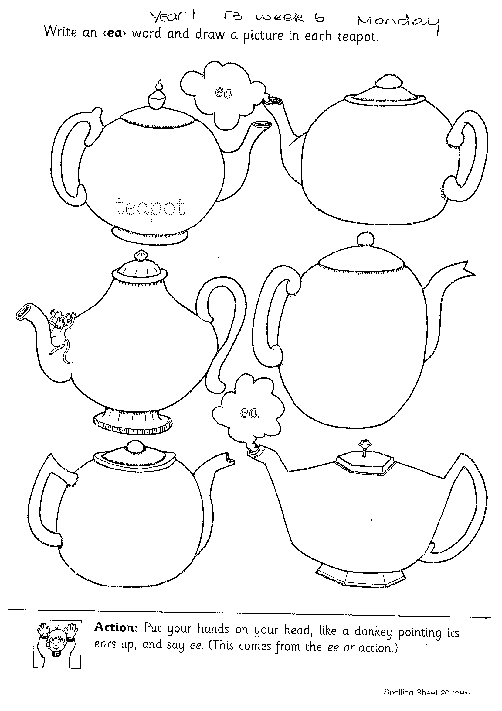
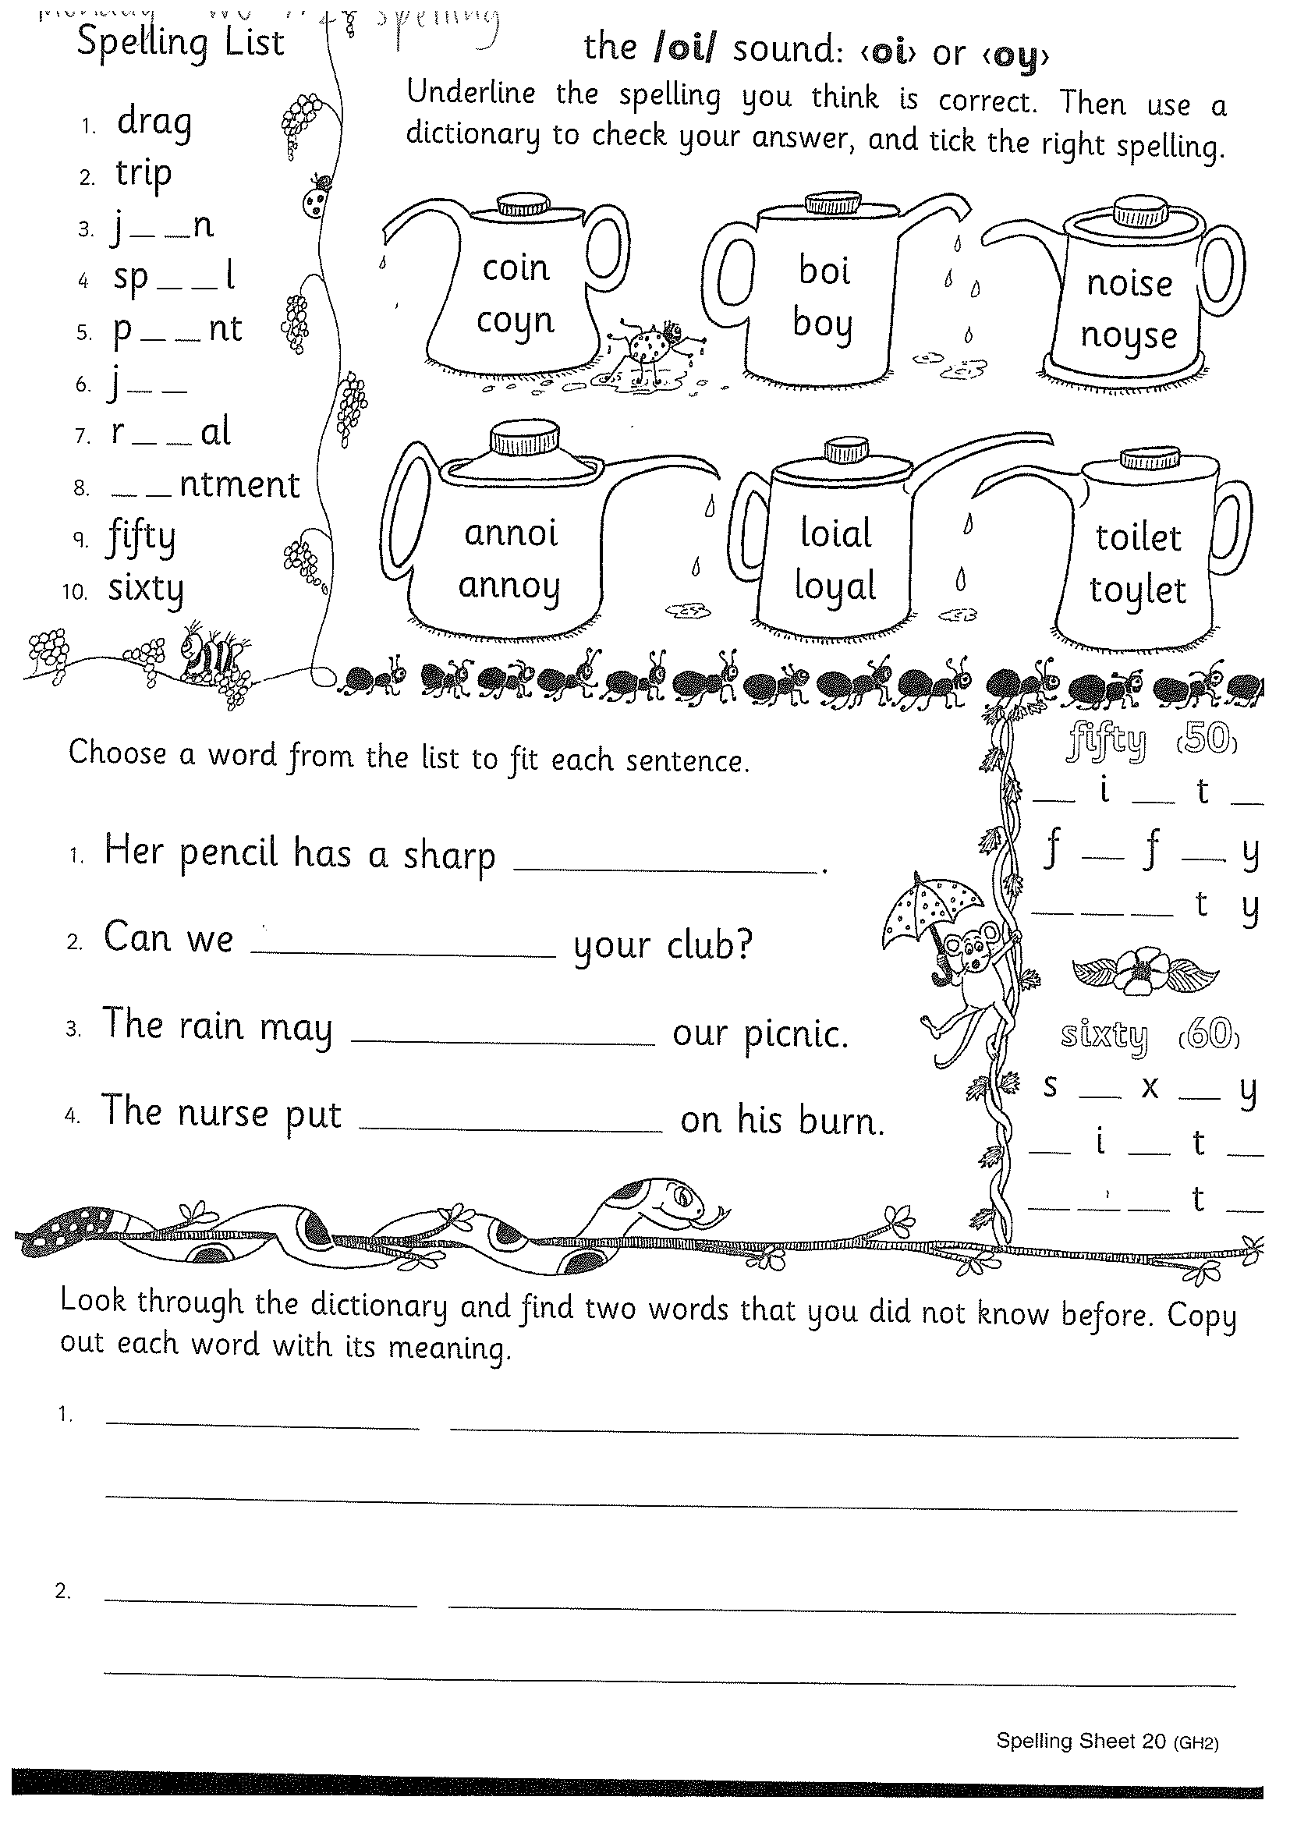
Task 1
Year 1
Year 2
Watch Mrs Warwick’s video’s for the sound of the week. Brainstorm a list of words using the sound focus of the week on a piece of paper.
YEAR 1
https://www.youtube.com/watch?v=Sq2hLoQhI7Q
YEAR 2
https://www.youtube.com/watch?v=eoQkRLn_sWw

Slide 5
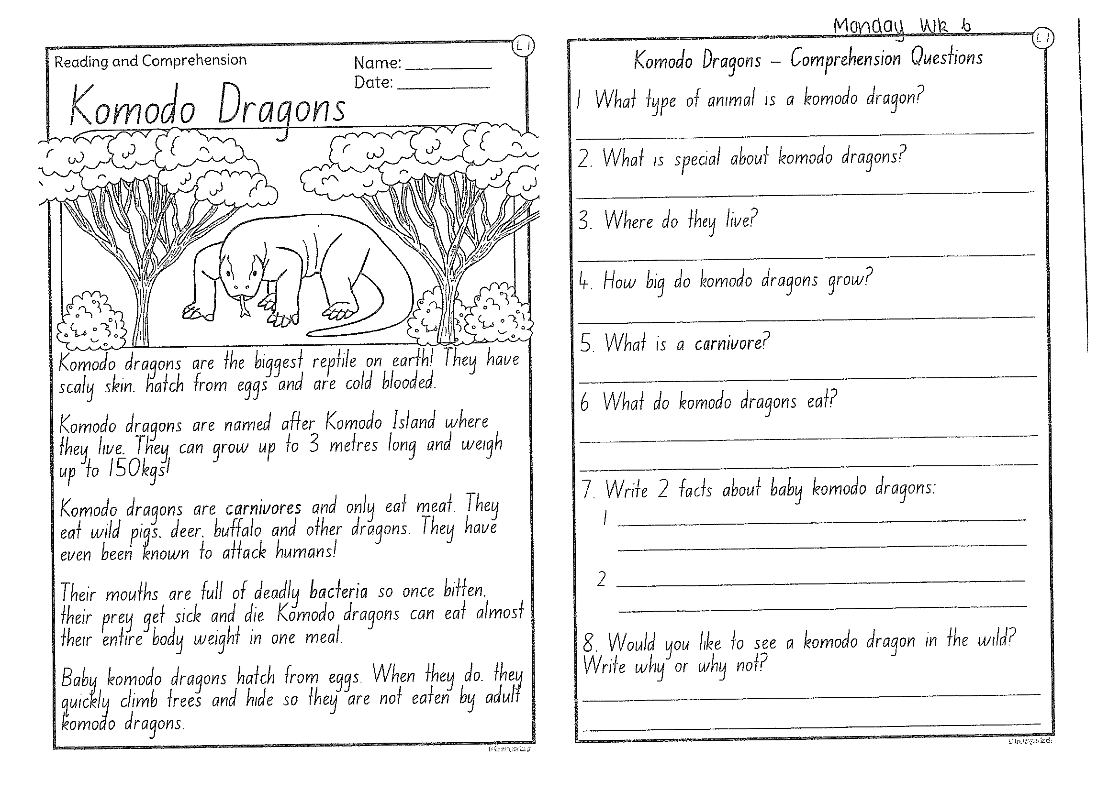
Task 2
Read or get an adult to read ‘Komodo Dragons’ and answer the questions.

Slide 6
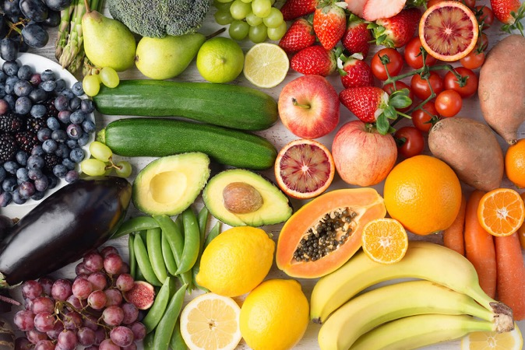
Crunch n’ sip

Slide 7
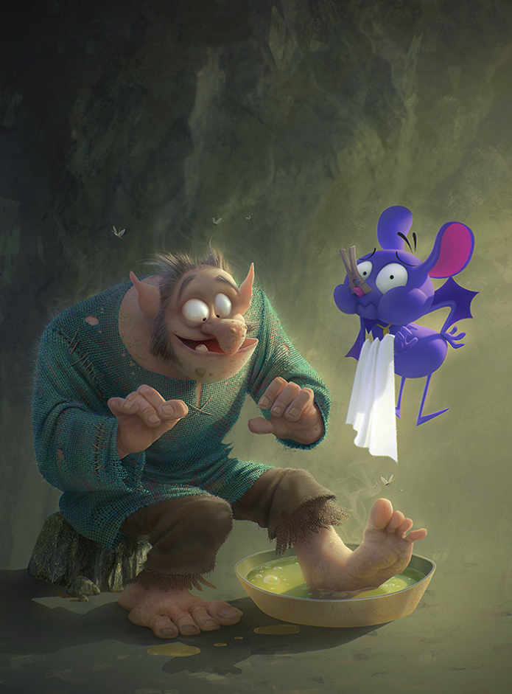
Task 3
Using the prompt, create an imaginative story of your own. Remember to tell us who is in the story, where they are, what they are doing and try to include a problem and solution!
What’s happening here?
Give the creatures names.
Why does the purple creature have a peg on its nose?
Is the large character A troll? Something else?
Why does he have his foot in a bowl?

Slide 8



Task 4
Complete the letter “e” in your handwriting books.
Https:/www.youtube.com/watch?v=d6TlmRx-xPA

Slide 9

Recess break (30 minutes)

Slide 10
Mathematics
Task 1
Complete an activity from the maths activity grid

Slide 11
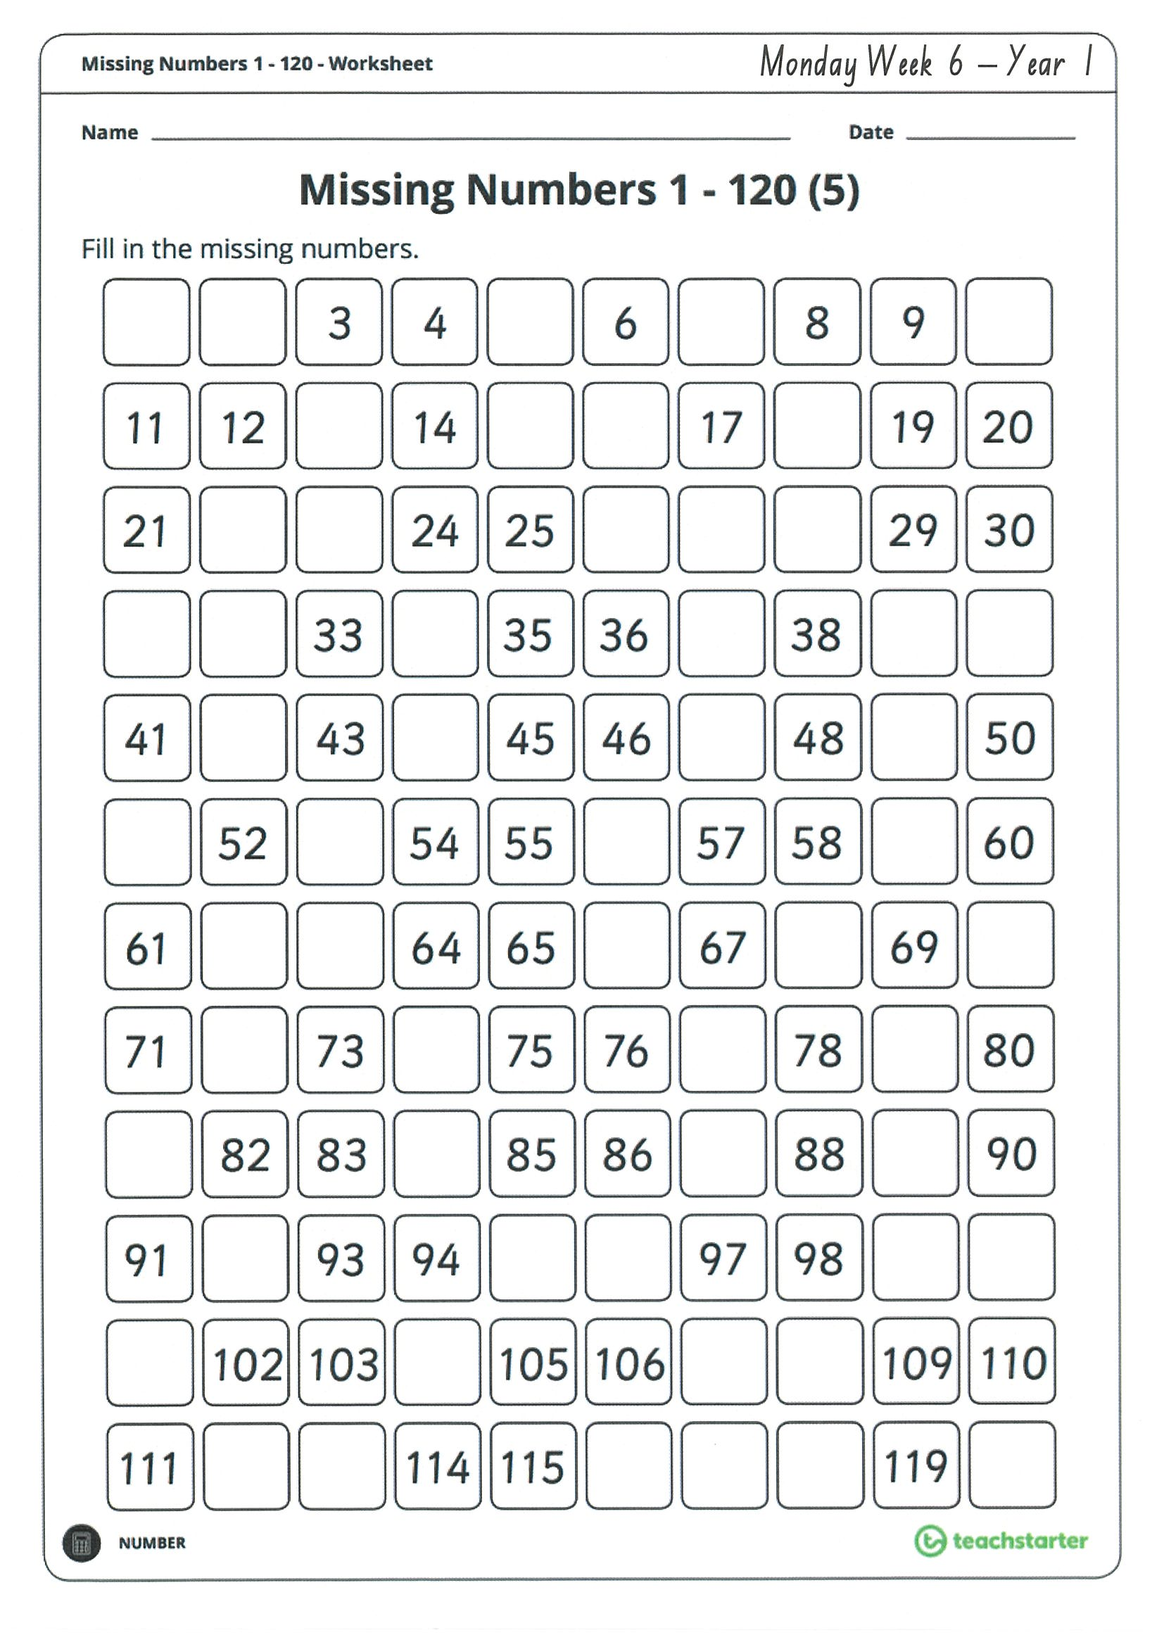
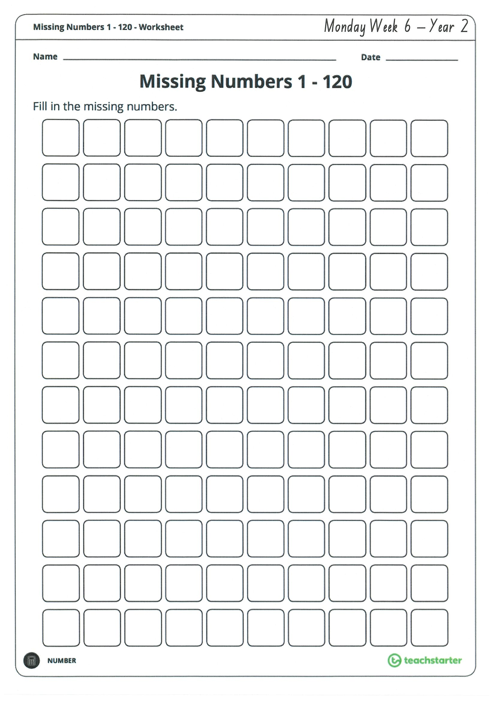
Task 2
Complete the worksheets and then do 3 activities on mathletics or studyladder.
A d d I t I o n

Slide 12
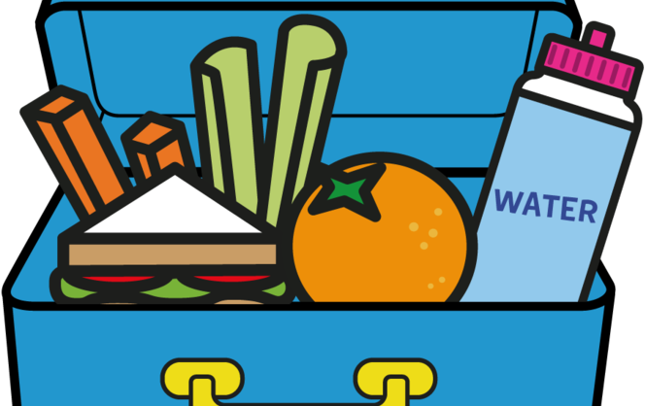

Lunch break (40 minutes)

Slide 13
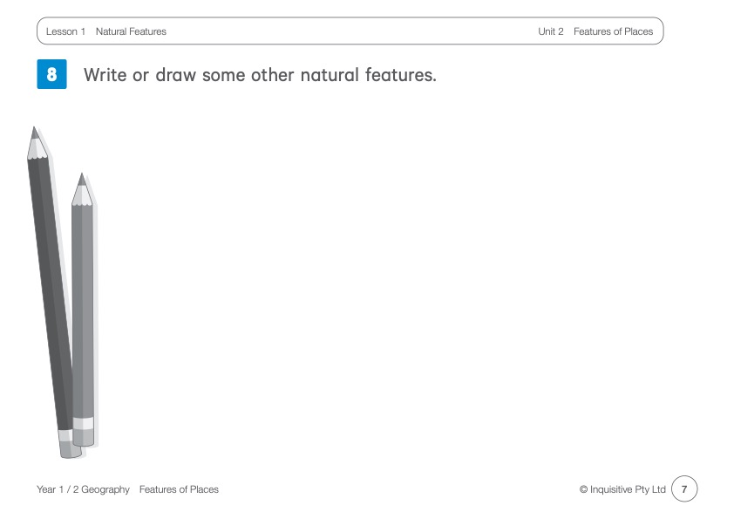
KLA - geography
Today’s lesson is on ‘Natural Features’. Natural Features are things like mountains, rocks, creeks and waterholes.
Click on the link below for todays lesson. Watch the dreamtime story about Tiddalick the frog. Think about and verbally answer the questions. Try to move like the frog or eel.
http://inq.co/class/9wg
Code: 9484

Slide 14
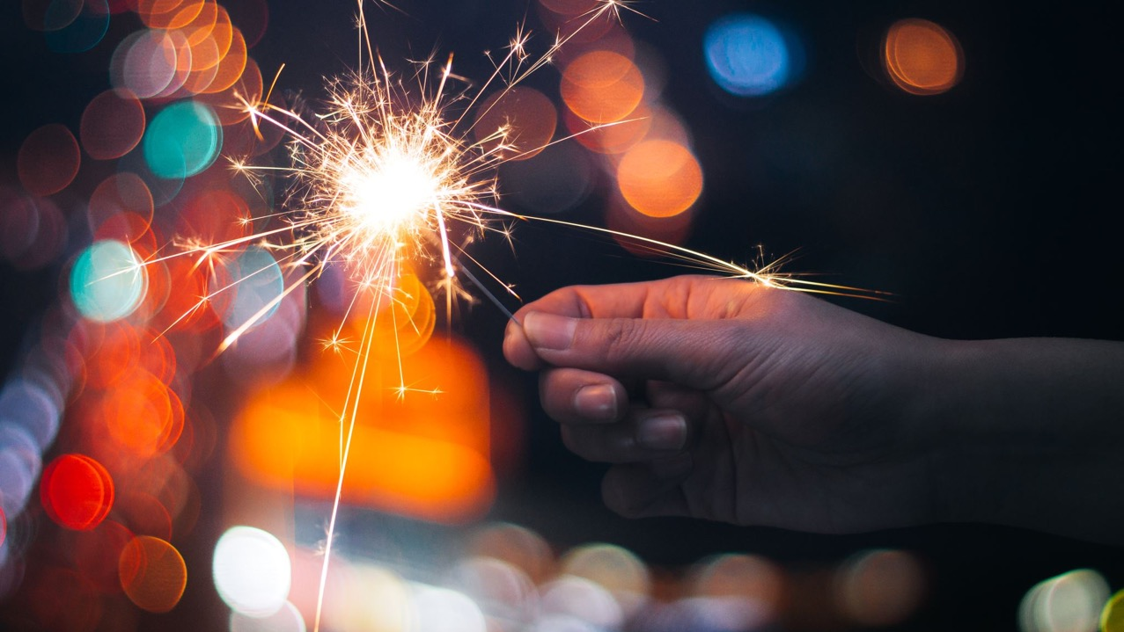
END OF DAY!
ENJOY your well-deserved break everyone!

Slide 15
Good morning
STAGE 1
TUESDAY 17th AUGUST 2021 – WEEK 6
Please make sure you are sending one or two work samples to your classroom teacher via dojo.

Slide 16
WHATS ON TODAY?
Morning
Task 1 – Spelling
Task 2 – Reading
Crunch n’ sip
Task 3 - Writing
Middle
Task 1 – Maths Grid
Task 2 – Activity Worksheet
Final
Library

Slide 17
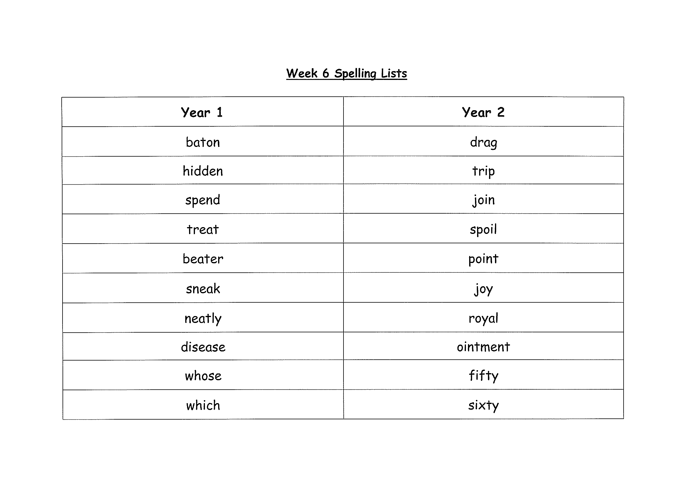
Task 1
Complete the Look, Cover, Write, Check worksheet (on a piece of paper). Write some sentences. Circle any nouns in your sentences.
Then complete your tricky word!

Slide 18
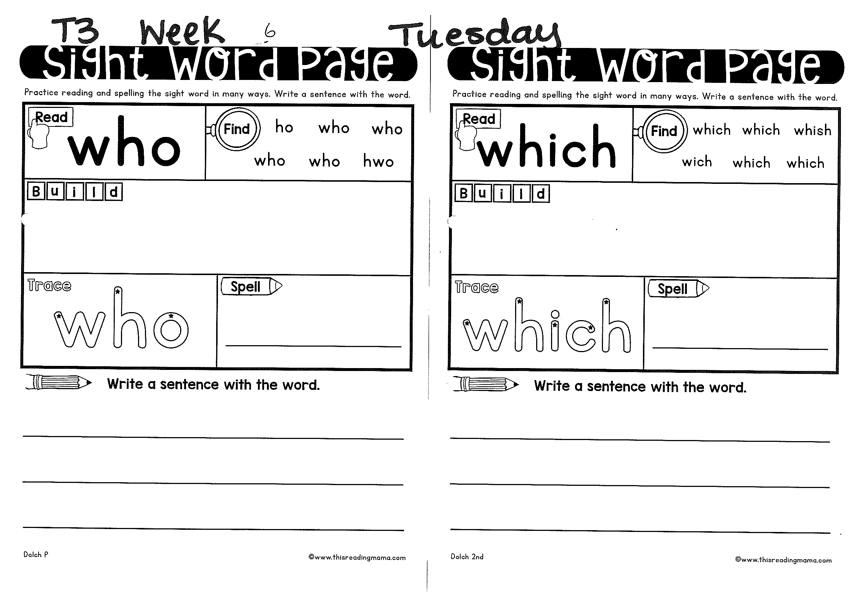
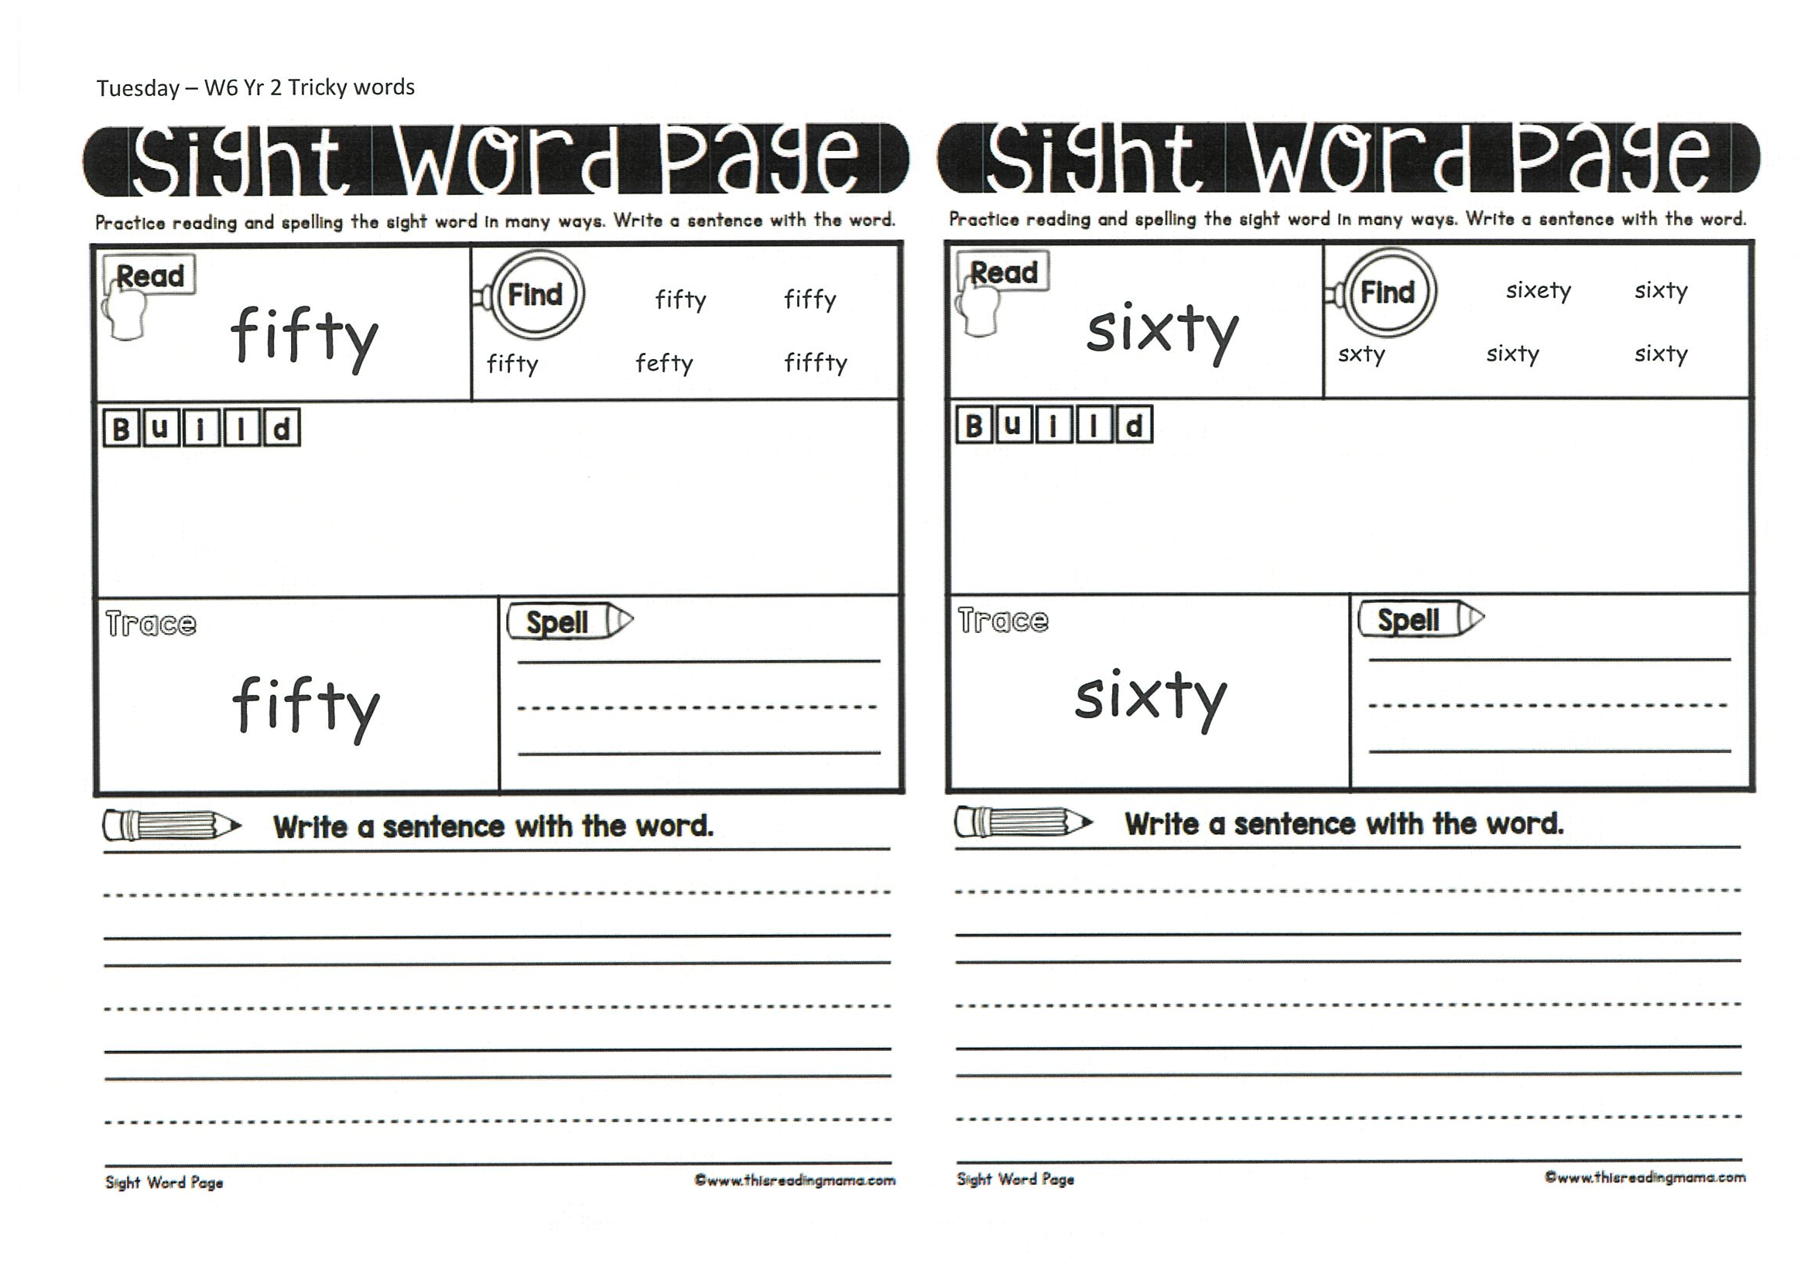

Slide 19
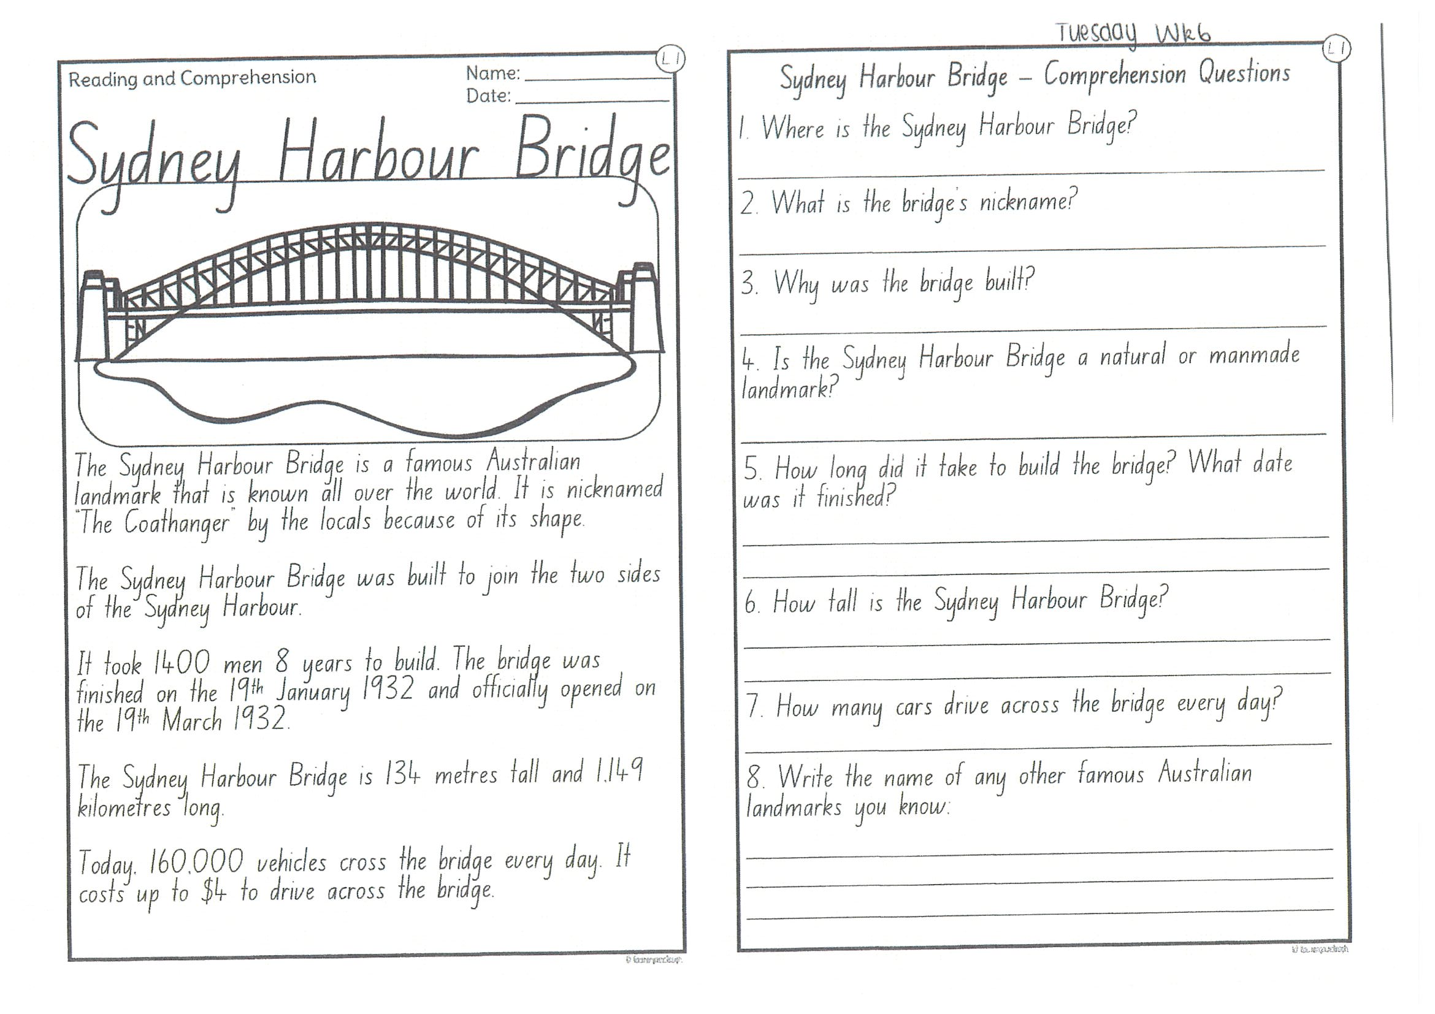
Task 2
Read or get an adult to read ”Sydney Harbour Bridge” and answer the questions.

Slide 20
Crunch n’ sip

Slide 21
Task 3
Writing – who does this bag belong to?
Look at the questions in your learning pack guide.

Slide 22
Recess break (30 minutes)

Slide 23
Mathematics
M o n e y
Task 1
Complete an activity from the maths activity grid

Slide 24
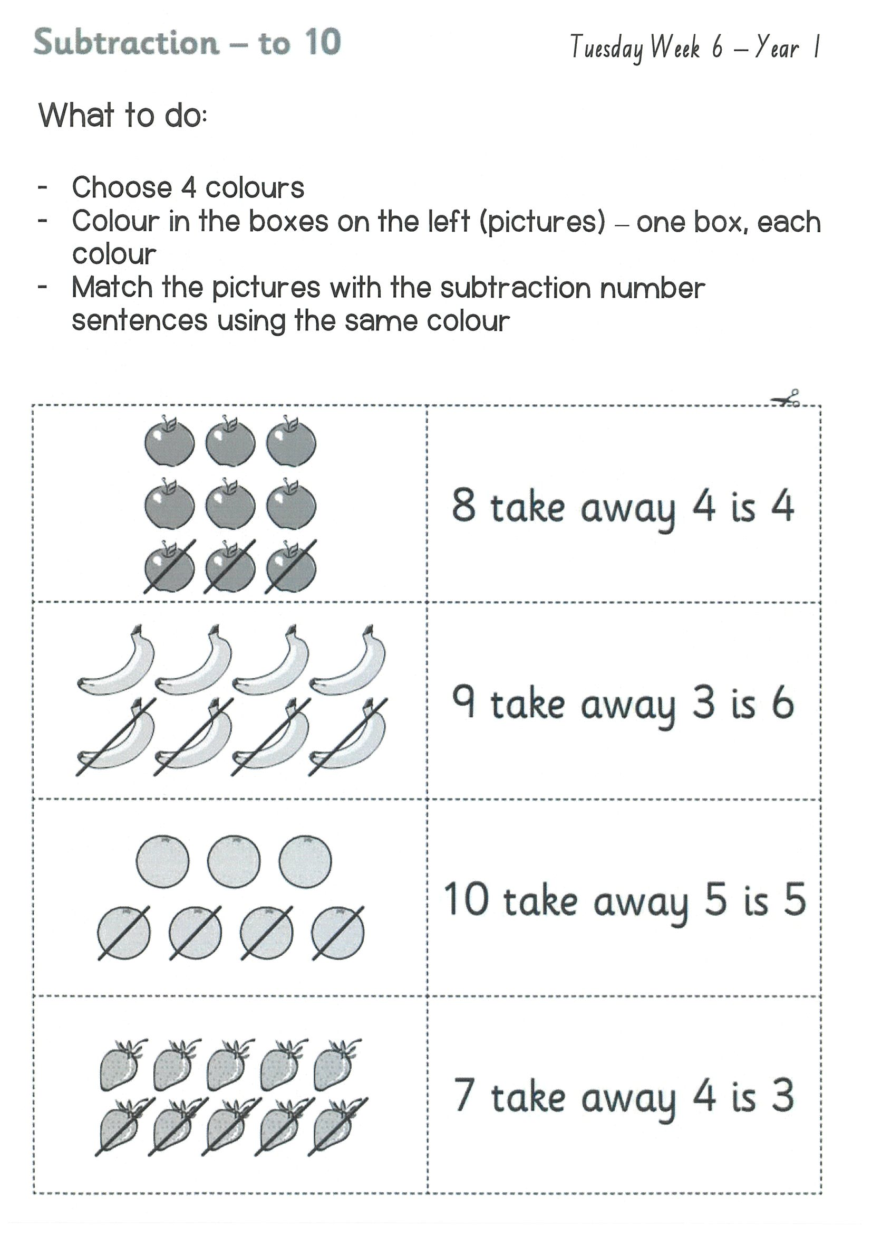
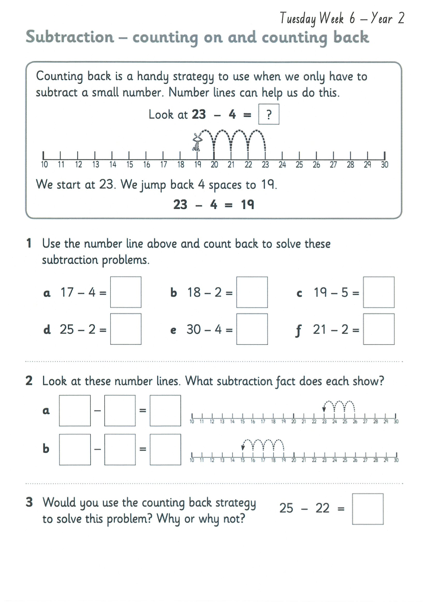
Task 2
Then complete 3 activities on studyladder or mathletic.
S u b t r a c t I o n

Slide 25
Lunch break (40 minutes)

Slide 26
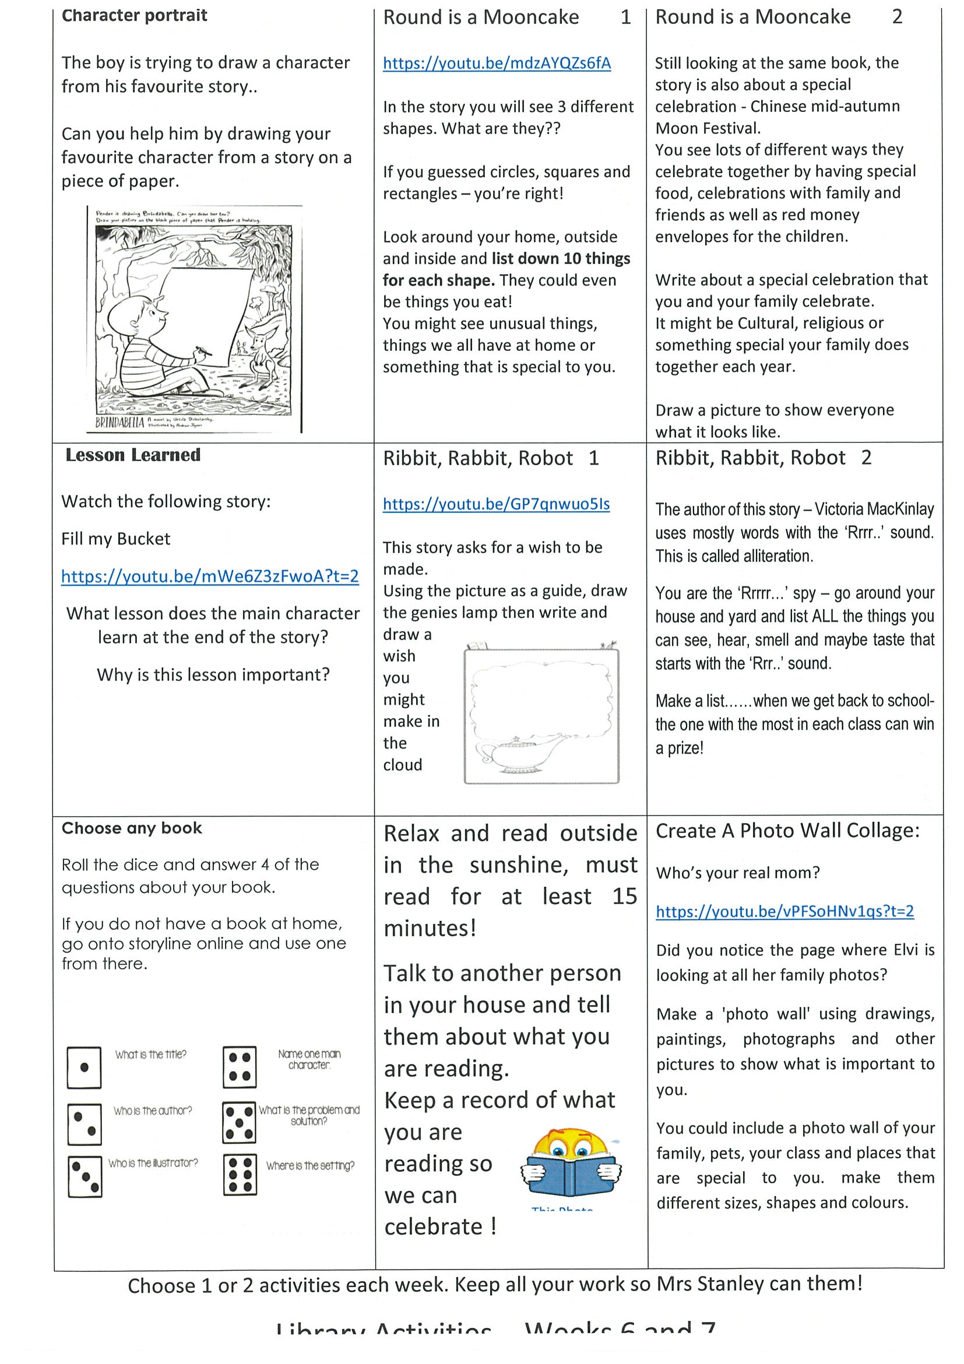
library
Silent reading
Choose one or two activities to complete each week from the NEW library activity grid.

Slide 27
END OF DAY!
ENJOY your well-deserved break everyone!

Slide 28
Good morning
STAGE 1
WEDNESDAY 18TH AUGUST 2021 – WEEK 6
Please make sure you are sending one or two work samples to your classroom teacher via dojo.

Slide 29
WHATS ON TODAY?
Morning
Task 1 – Spelling
Task 2 – Reading
Crunch n’ sip
Task 3 - Writing
Task 4 - Handwriting
Middle
Task 1 – Maths Grid
Task 2 – Worksheet
Task 3 – Fitness
Final
Science

Slide 30
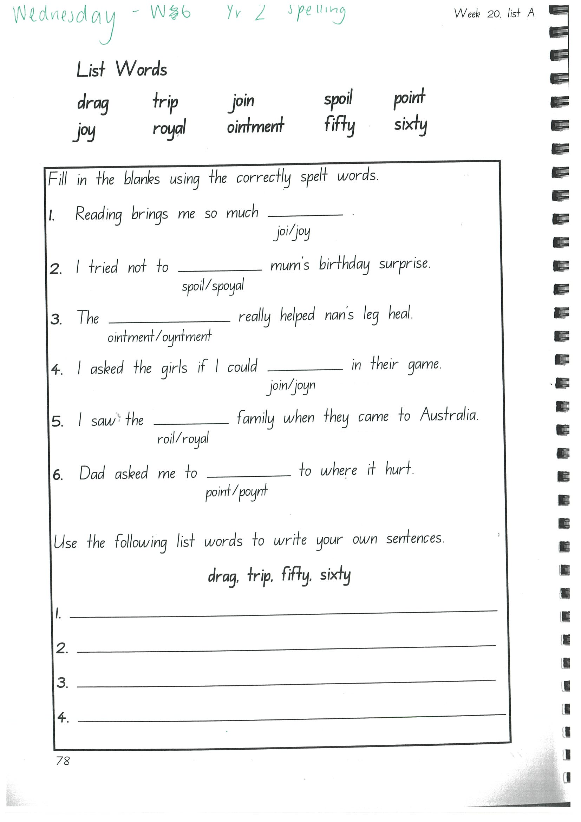
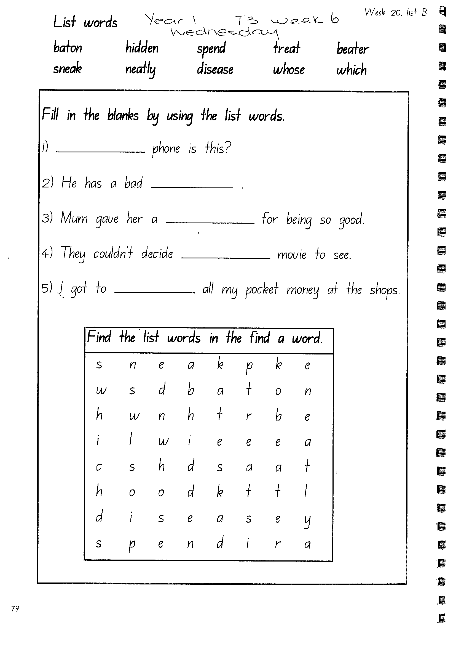
Task 1
Write down your spelling words and dot, dash, dive them on a piece of paper..
Video will be posted on dojo!
Complete spelling tasks.

Slide 31
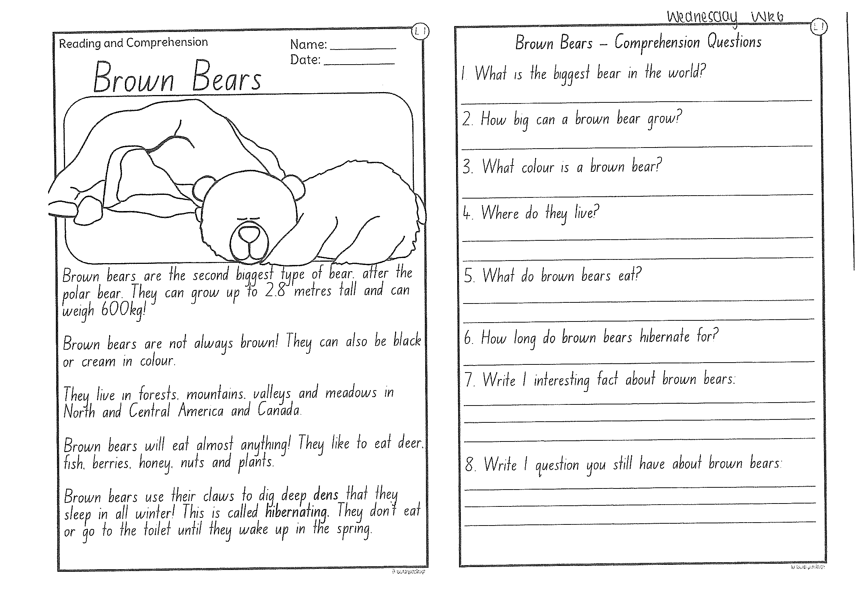
Task 2
Read or get an adult to read ”Brown Bears” and answer the questions.

Slide 32
Crunch n’ sip

Slide 33

Task 3
Writing – watch the video below:
http://www.youtube.com/watch?v=LxQasStPy9U
On a piece of paper write a procedural text of ’how to make fairy bread’. Be creative. Remember to add a title, list of materials and a method (instructions). Don’t forget to start each step with a verb!

Slide 34
Task 4
Complete the letter “f” in your handwriting books.
https://www.youtube.com/watch?v=Dbe4IKgQYh4

Slide 35
Recess break (30 minutes)

Slide 36
Mathematics
Task 1
Complete an activity from the maths activity grid

Slide 37
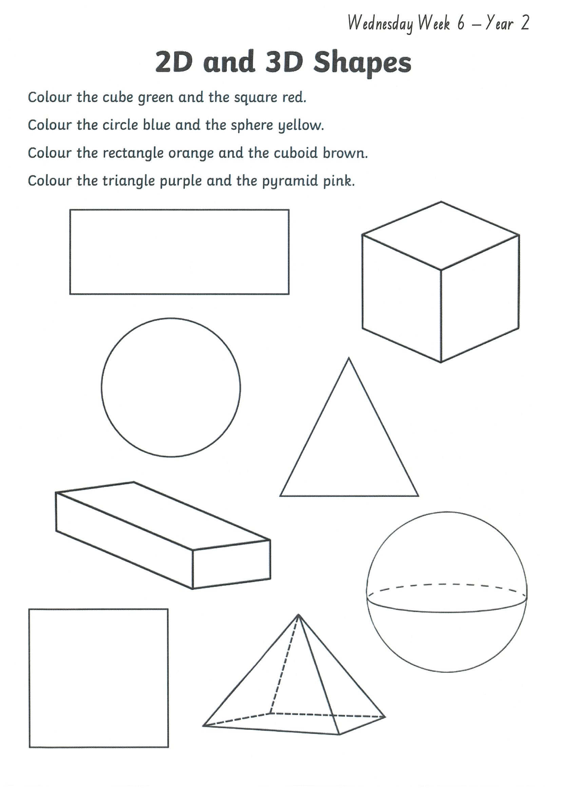
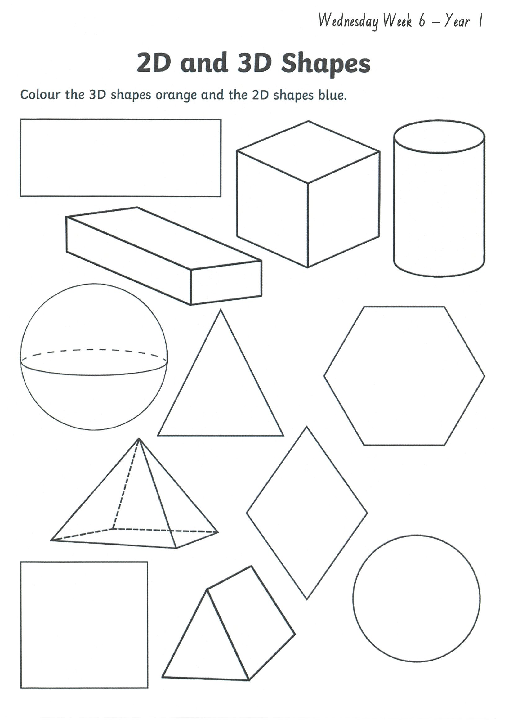
Task 2
Year 1
Year 2
2d and 3d shapes

Slide 38
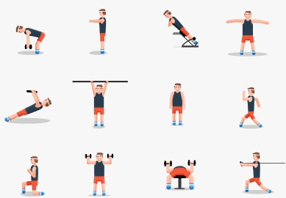
fitness
Choose an activity from the fitness grid to complete.
Not this one
(in your packs)

Slide 39
Lunch break (40 minutes)

Slide 40
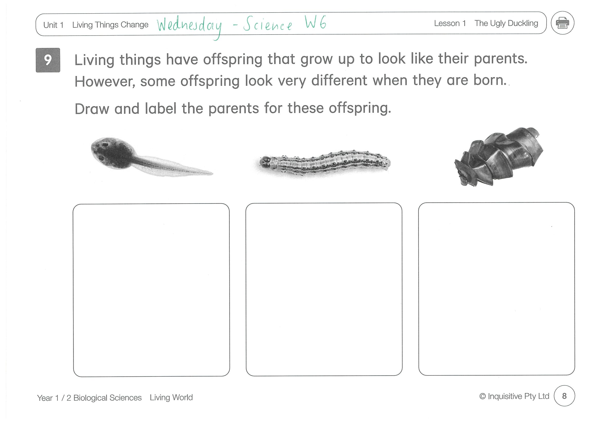
KLA - SCIENCE
Some living things have offspring that look very different to their parents. Look at the images on the worksheet. What do the parents of tadpoles, caterpillars and shark eggs look like? Draw and label their parents.

Slide 41
END OF DAY!
ENJOY your well-deserved break everyone!

Slide 42
Good morning
STAGE 1
THURSDAY 19TH AUGUST 2021 – WEEK 6
Please make sure you are sending one or two work samples to your classroom teacher via dojo.

Slide 43
WHATS ON TODAY?
Morning
Task 1 – Spelling
Task 2 – Reading
Crunch n’ sip
Task 3 - Writing
Middle
Task 1 – Maths Grid
Task 2 – Maths Worksheets
Final
PDHPE

Slide 44
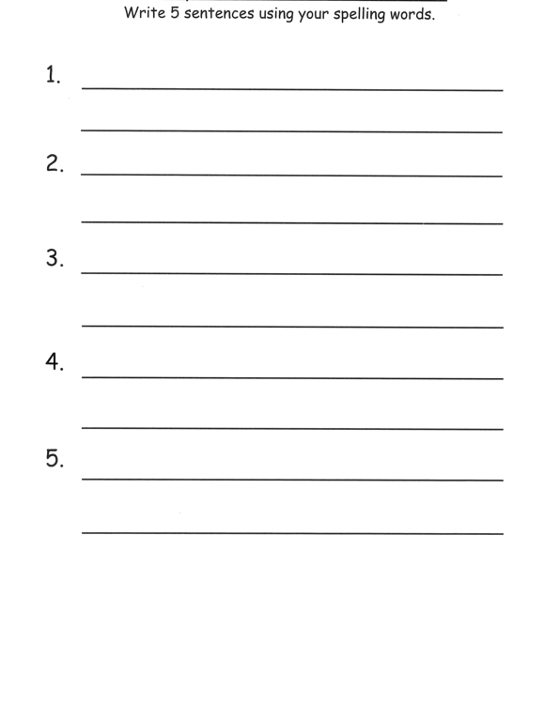
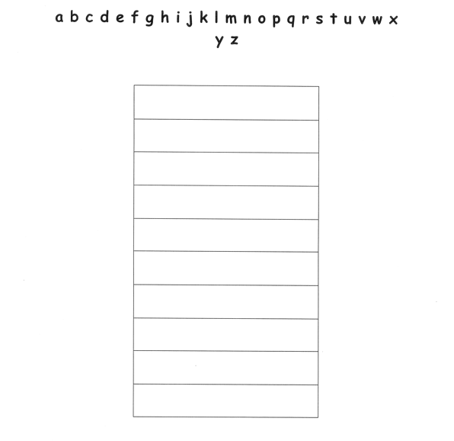
Task 1
Practice your spelling words in alphabetical order on a piece of paper.
Write 5 sentences using your spelling words on a piece of paper. Circle any verbs (action words) in your sentence.

Slide 45
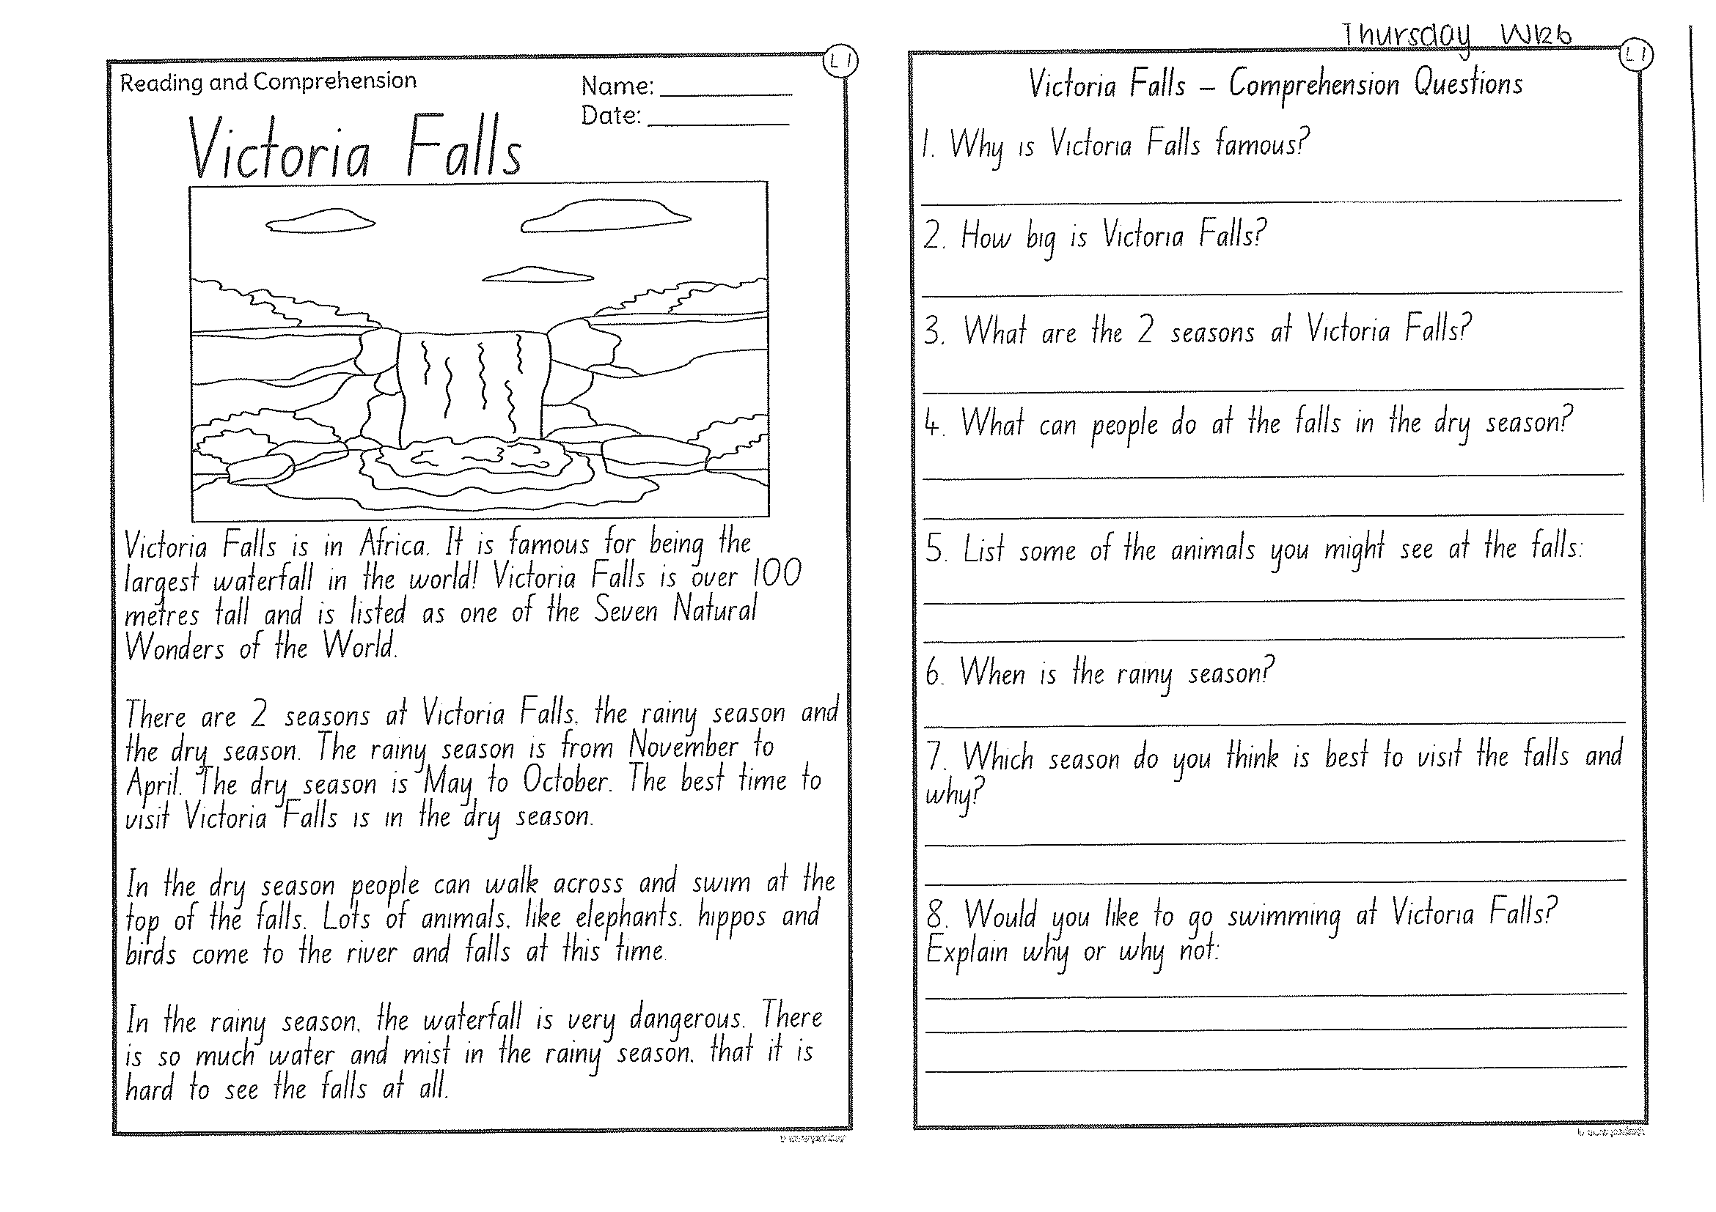
Task 2
Read or get an adult to read ”Victoria Falls” and answer the questions.

Slide 46
Crunch n’ sip

Slide 47
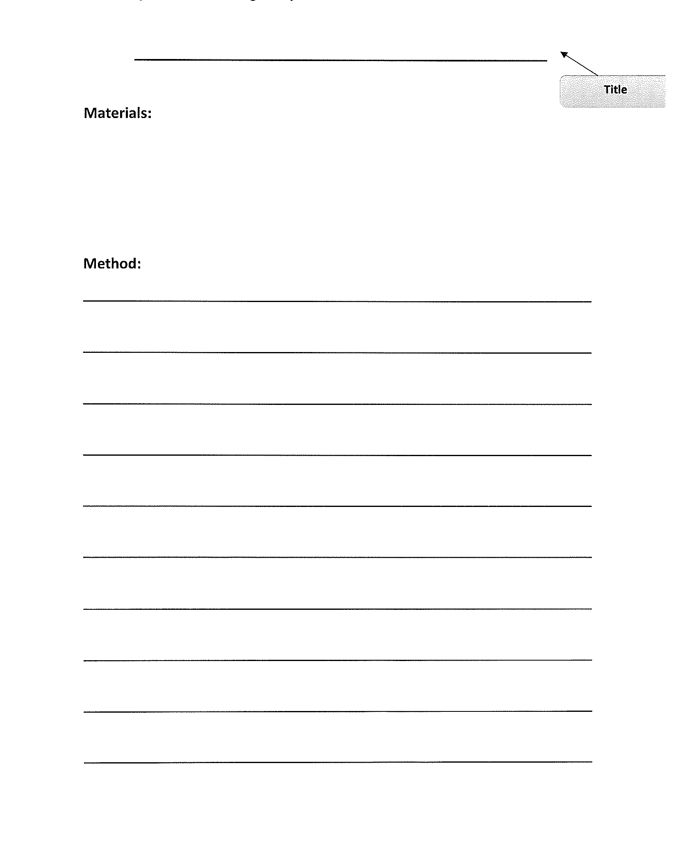
Task 3
Procedural writing
Watch the video of Mrs Mazloum making a smoothie on your dojo.
Be creative! Write your own procedural text on ‘How to make a smoothie’. Remember to add a title, a list of materials and a method (instructions). Don’t forget to start each step with a VERB!

Slide 48
Recess break (30 minutes)

Slide 49
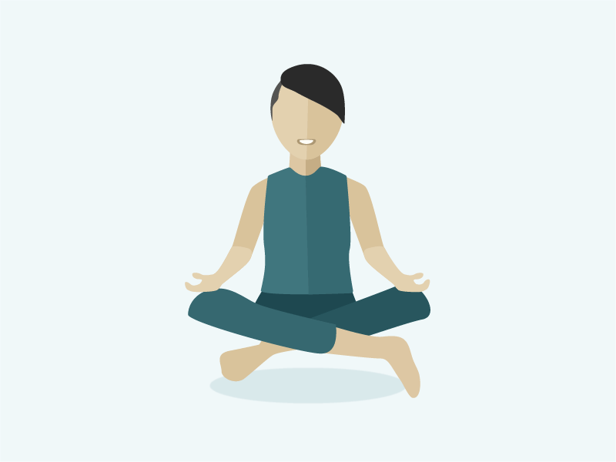
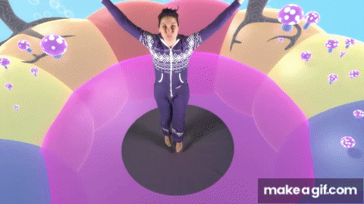
KLA – capa (dance)
AFRICAN DANCE LESSON 1
http://www.youtube.com/watch?v=VvXSbuEwd1M&lkist=RDCMUCsJbboljkvAkxbnEu6w3nyg&index=2

Slide 50
Mathematics
Task 1
Complete an activity from the maths activity grid

Slide 51
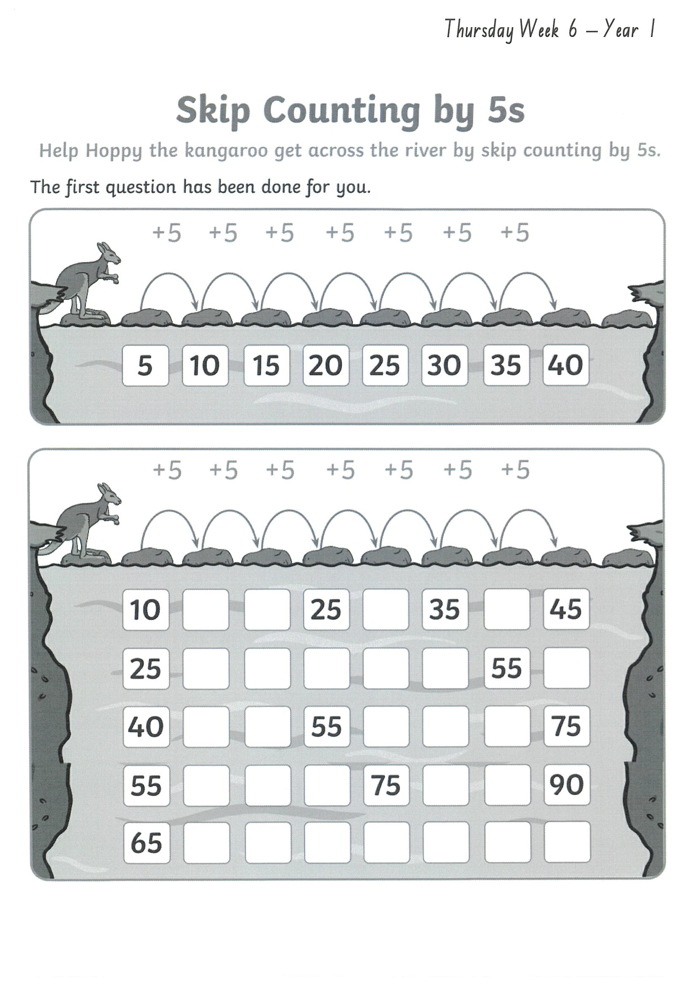
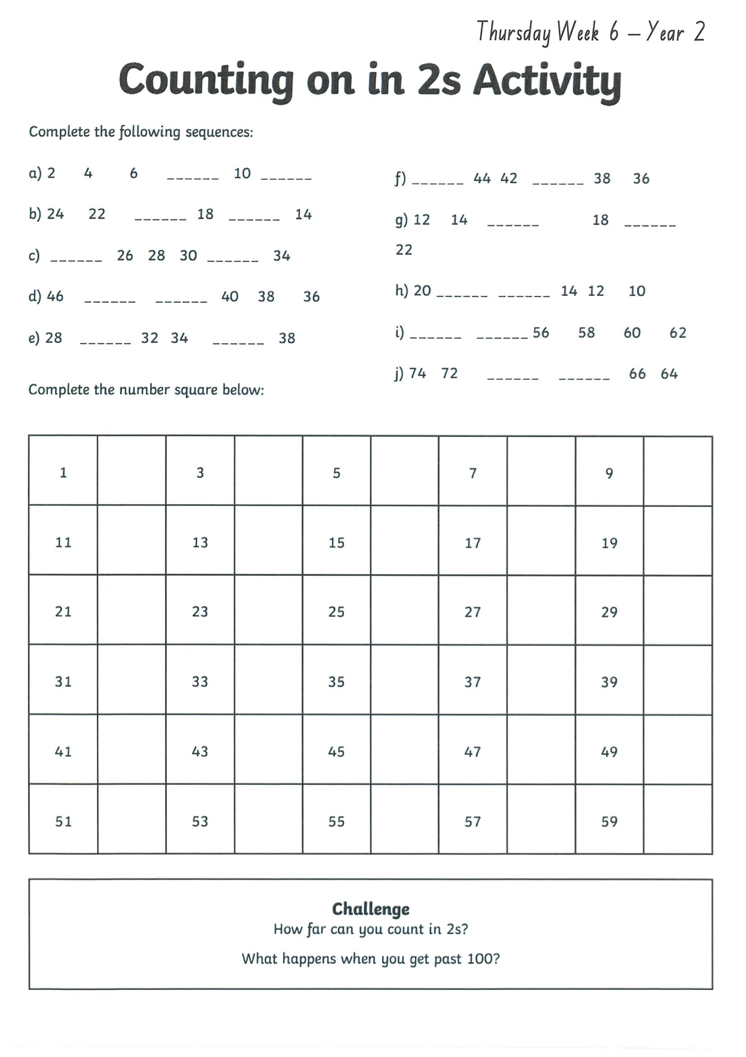
Task 2
Then complete 3 studyladder or mathletics activities
multiplication
Year 1
Year 2

Slide 52
Lunch break (40 minutes)

Slide 53
KLA - PDHPE
BICYCLE SAFETY
Whenever you ride a bicycle, there are rules that must be followed. All cyclists must know the rules of the road, which signals to use and what the different road signs mean. Bicycles need to be in good working order and all cyclists need to wear a helmet. If riding at night, bikes should have a front and rear light. Complete the worksheets.

Slide 54
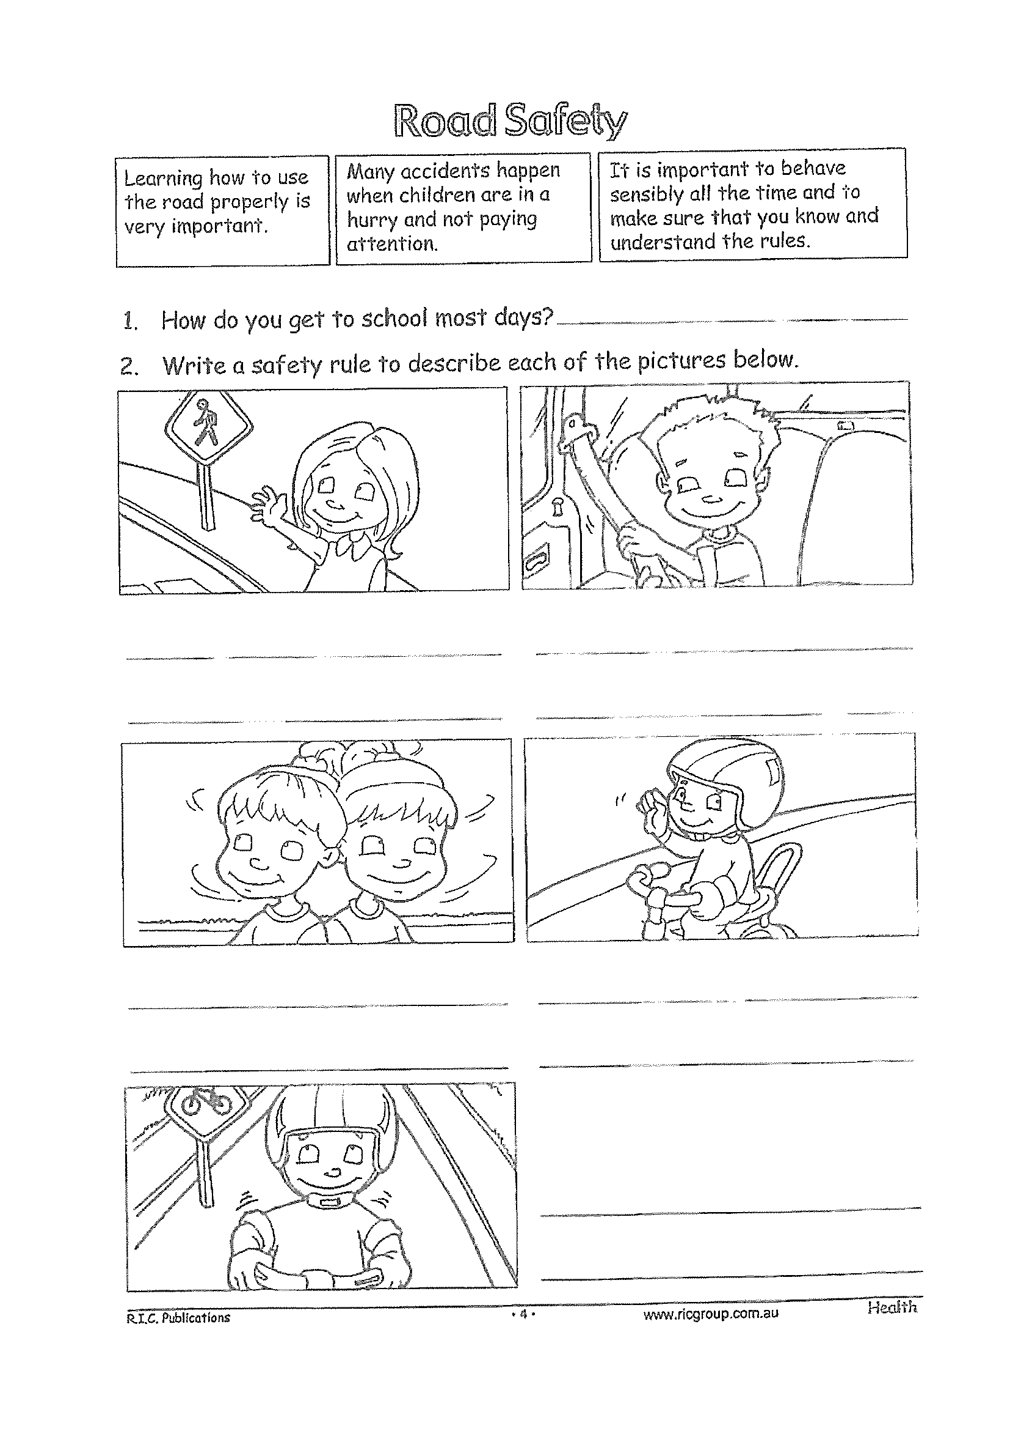
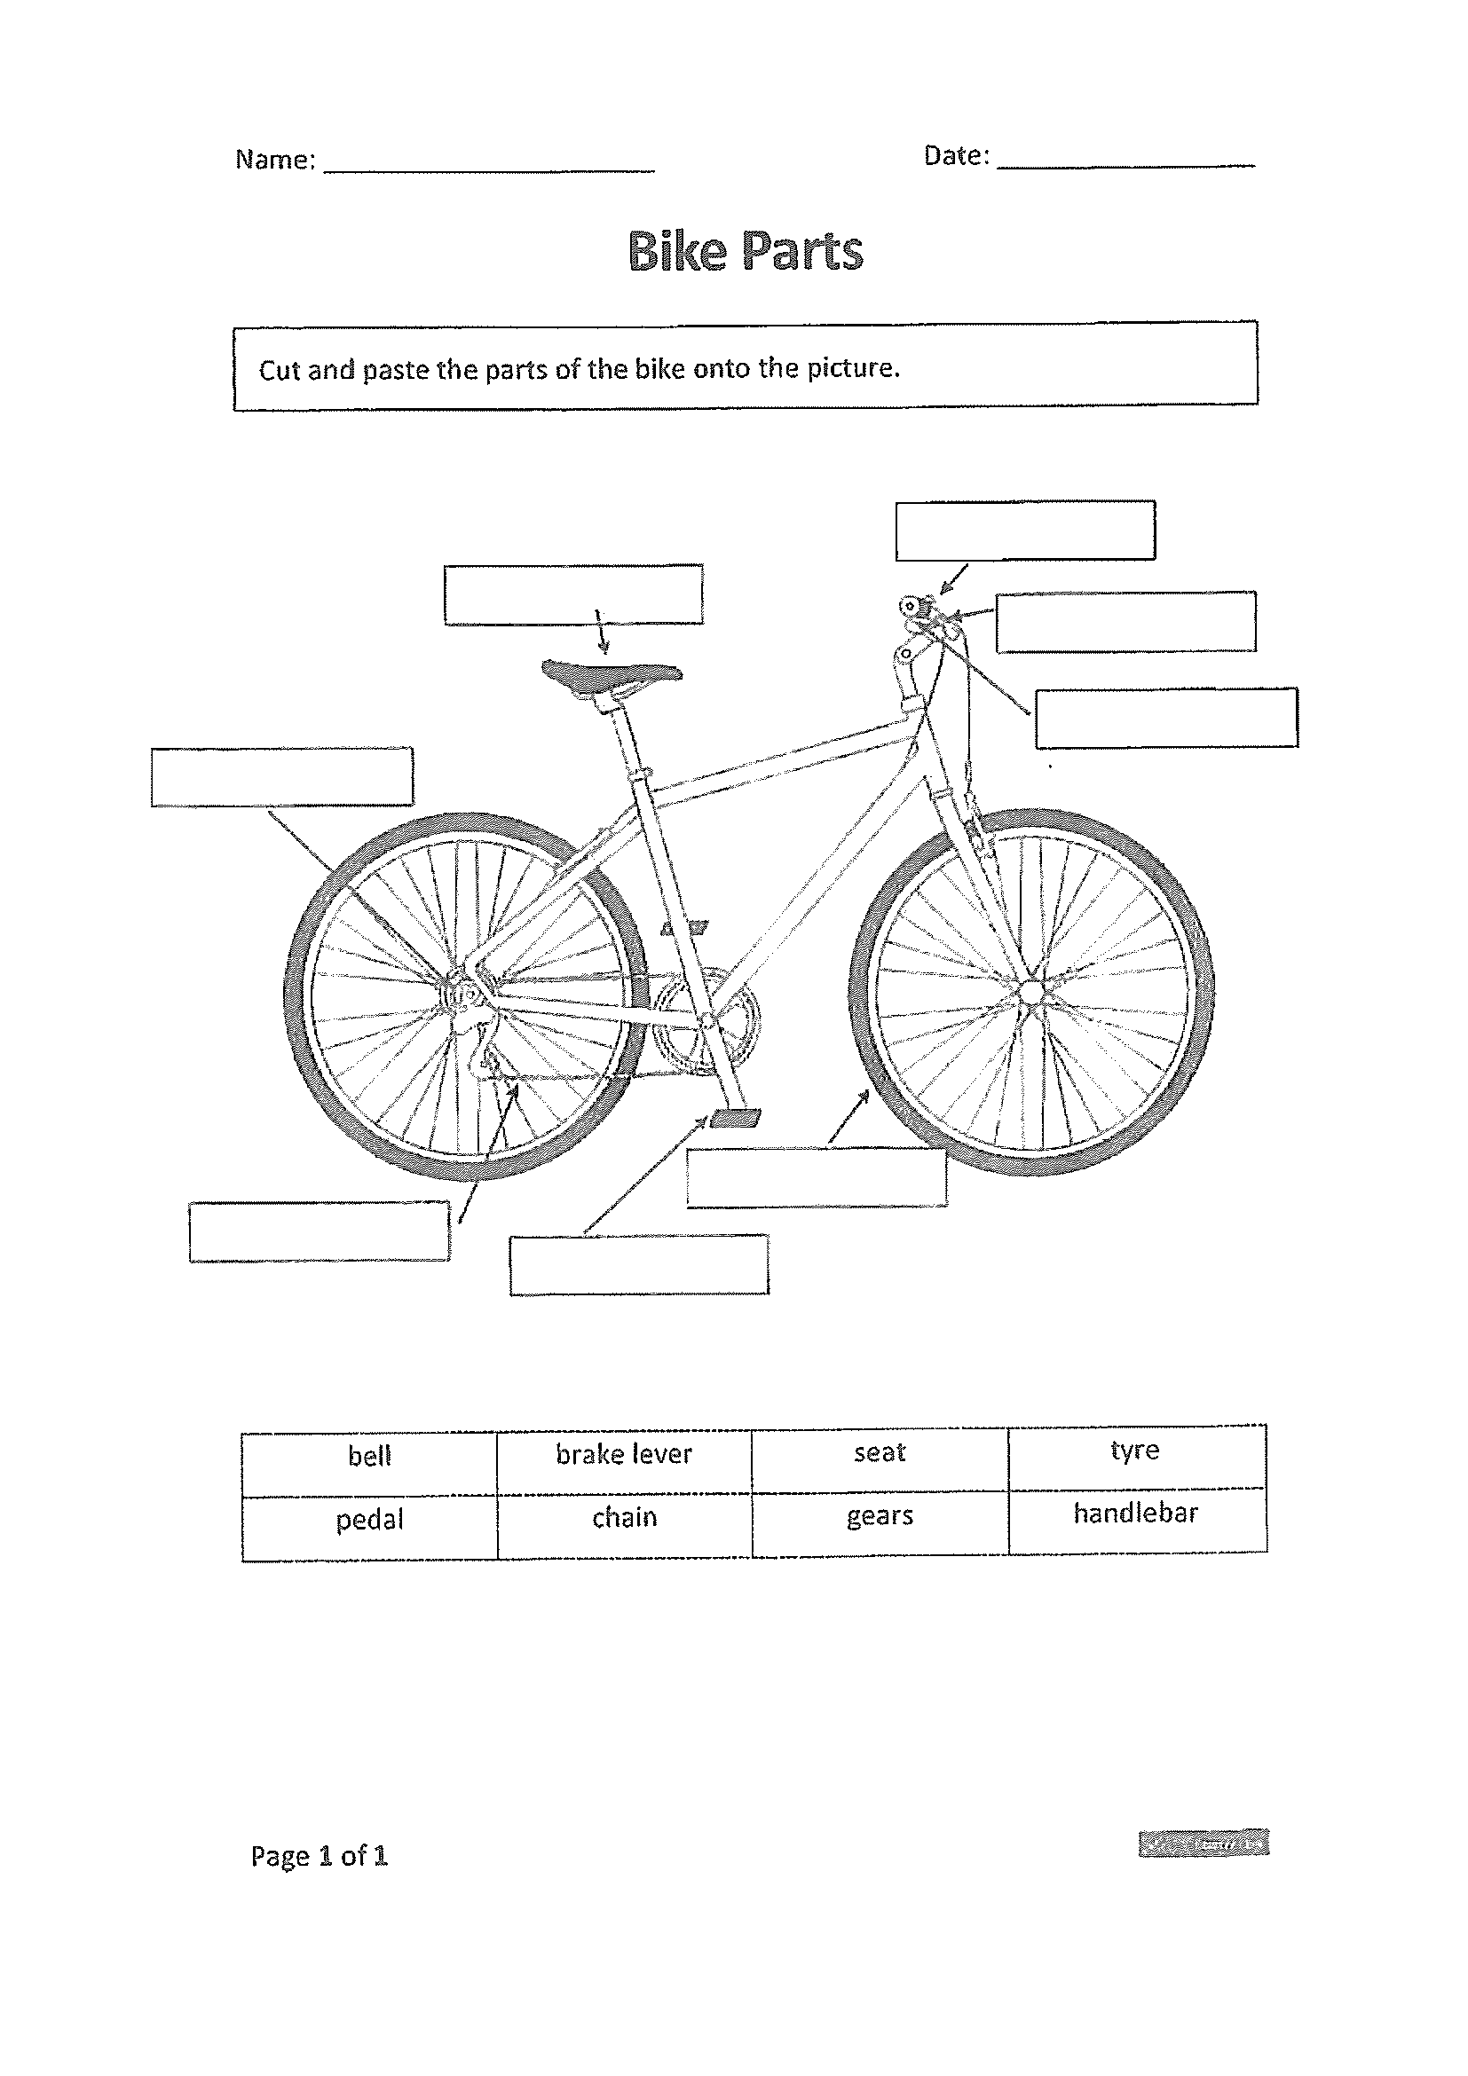
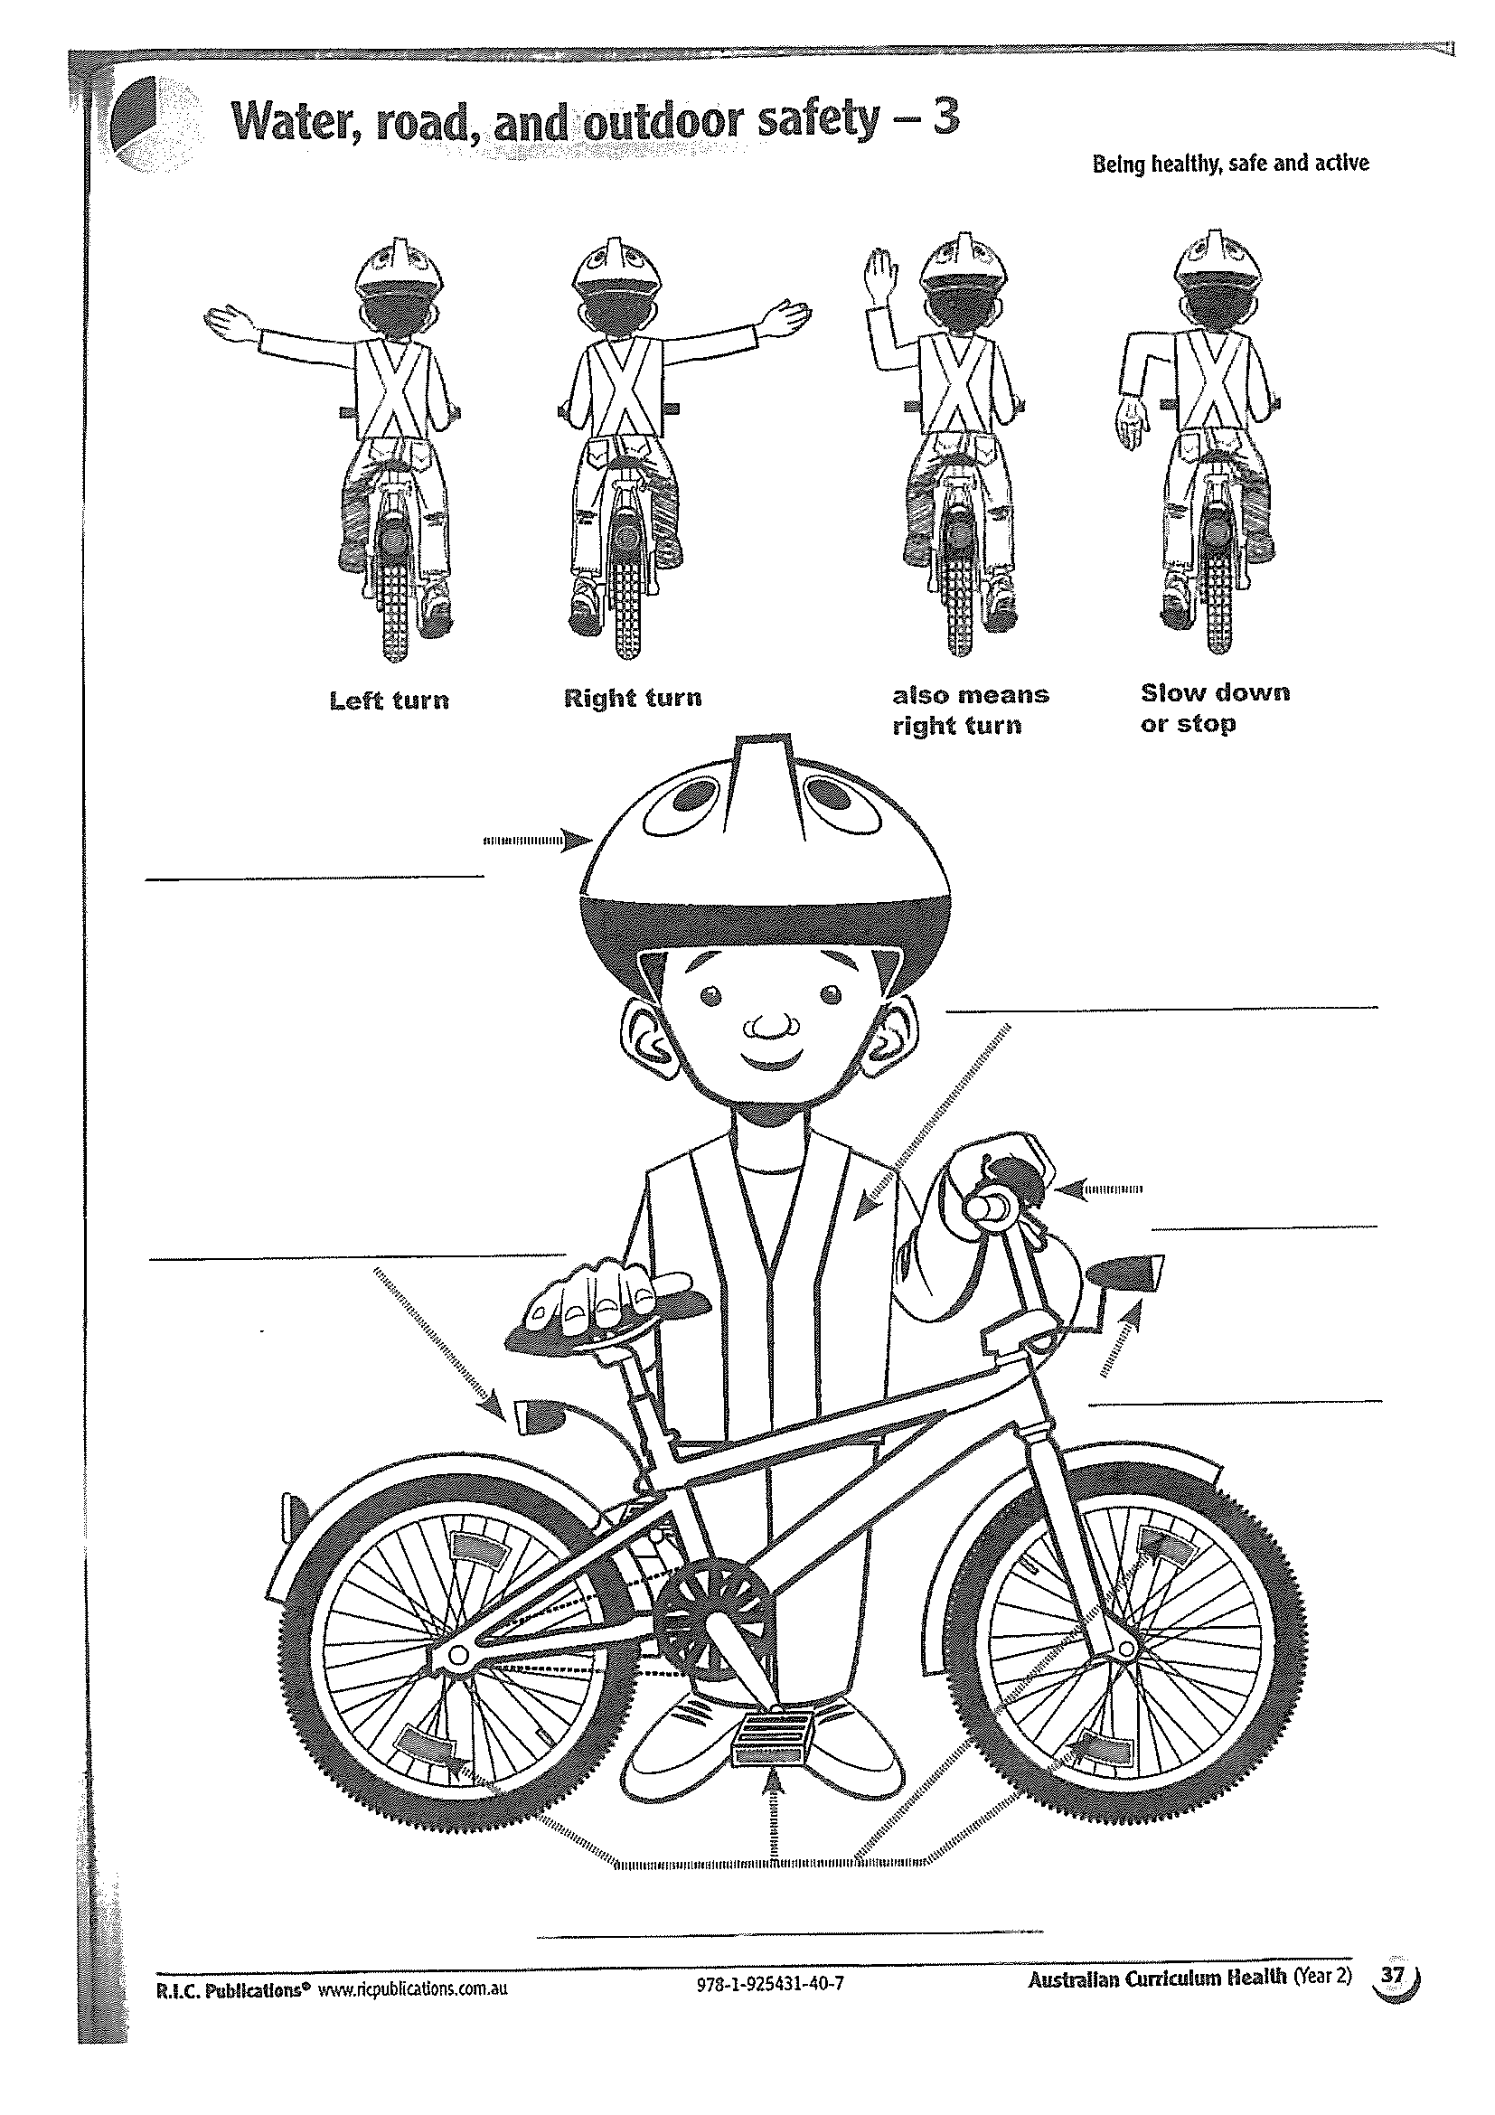

Slide 55
END OF DAY!
ENJOY your well-deserved break everyone!

Slide 56
Good morning
STAGE 1
FRIDAY 20TH AUGUST 2021 – WEEK 6
Please make sure you are sending one or two work samples to your classroom teacher via dojo.

Slide 57



WHATS ON TODAY?
WELL BEING FRIDAY!!
To focus on our well being and unplugging from technology, today is a tech free day. Choose activities from the Friday grid. Submit photos of what you have done to our school Facebook page NOT DOJO.

Slide 58
END OF Week!
ENJOY your well-deserved break everyone!

