Slide 1

STAGE 1
MRS FLEMING
MISS HOLDSWORTH
MISS MORATA
MS ROBINSON
MRS ENRIGHT
MRS MAZLOUM
MISS UNAL

Slide 2
Good morning
STAGE 1
MONDAY 9th AUGUST 2021 – WEEK 5
Please make sure you are sending one or two work samples to your classroom teacher via dojo.

Slide 3
WHATS ON TODAY?
Morning
Task 1 - spelling
Task 2 - reading
Crunch n’ sip
Task 3 - writing
Task 4 - handwriting
Middle
Task 1 - Maths Grid
Task 2 - Fractions Worksheet
Final
Geography

Slide 4
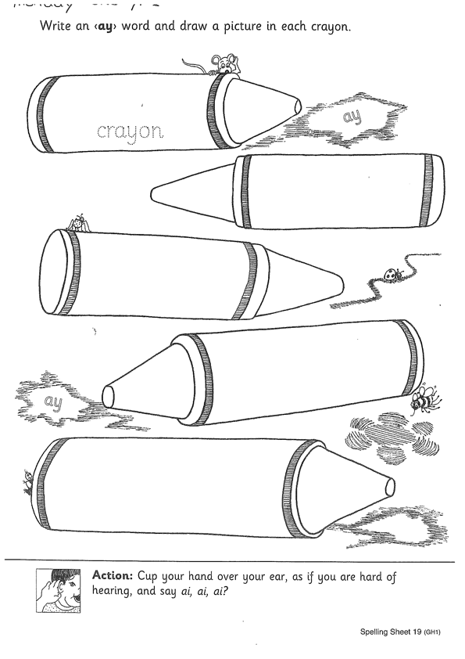
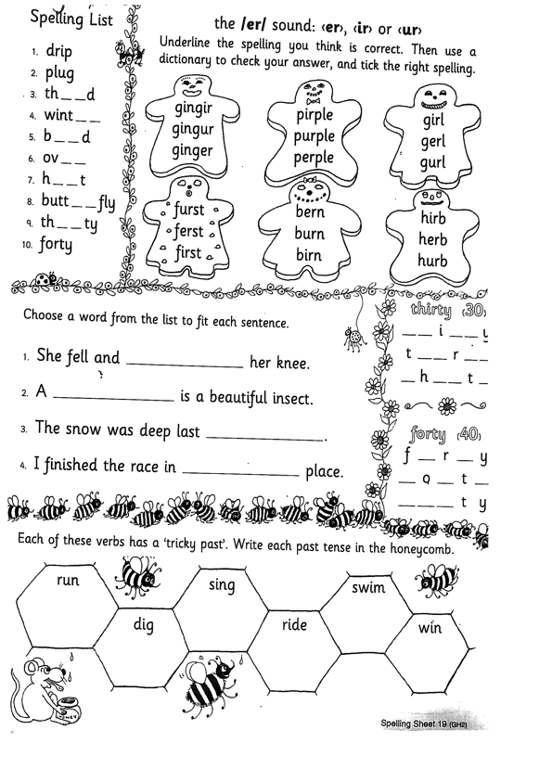
Task 1
Year 1
Year 2
Watch Mrs Warwick’s video’s for the sound of the week. Brainstorm a list of words using the sound focus of the week on a piece of paper.
YEAR 1
https://vimeo.com/577548425
YEAR 2
https://vimeo.com/583128464

Slide 5
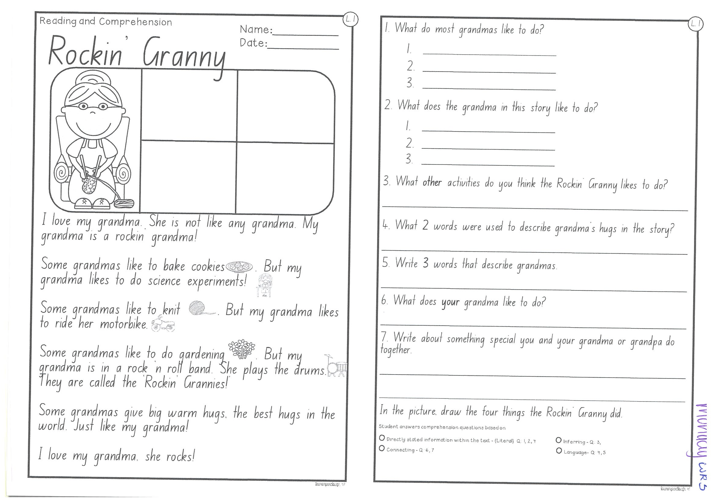
Task 2
Read or get an adult to read ‘Rockin’ Granny’ and answer the questions.

Slide 6
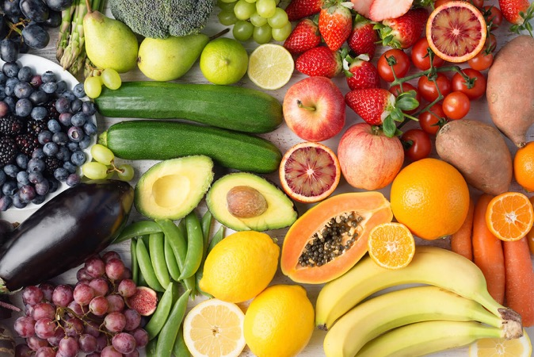
Crunch n’ sip

Slide 7
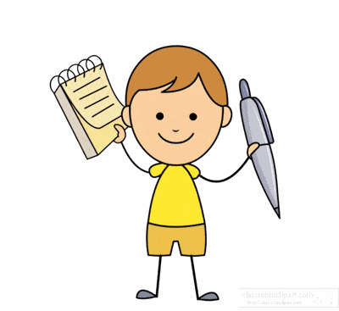
Task 3
Write a letter to your teacher. Let them know all about your home learning and what you like and don’t like. Tell us some of the fun you have been having at home. Remember to start your letter with “Dear Mrs ….. ” and sign off at the end with your name!

Slide 8



Task 4
Complete the letter “T” in your handwriting books.

Slide 9

Recess break (30 minutes)

Slide 10
Mathematics
Task 1
Complete an activity from the maths activity grid

Slide 11
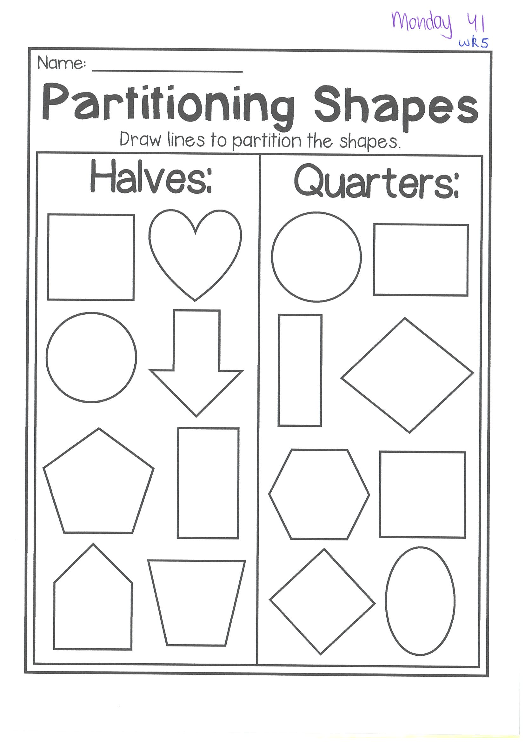
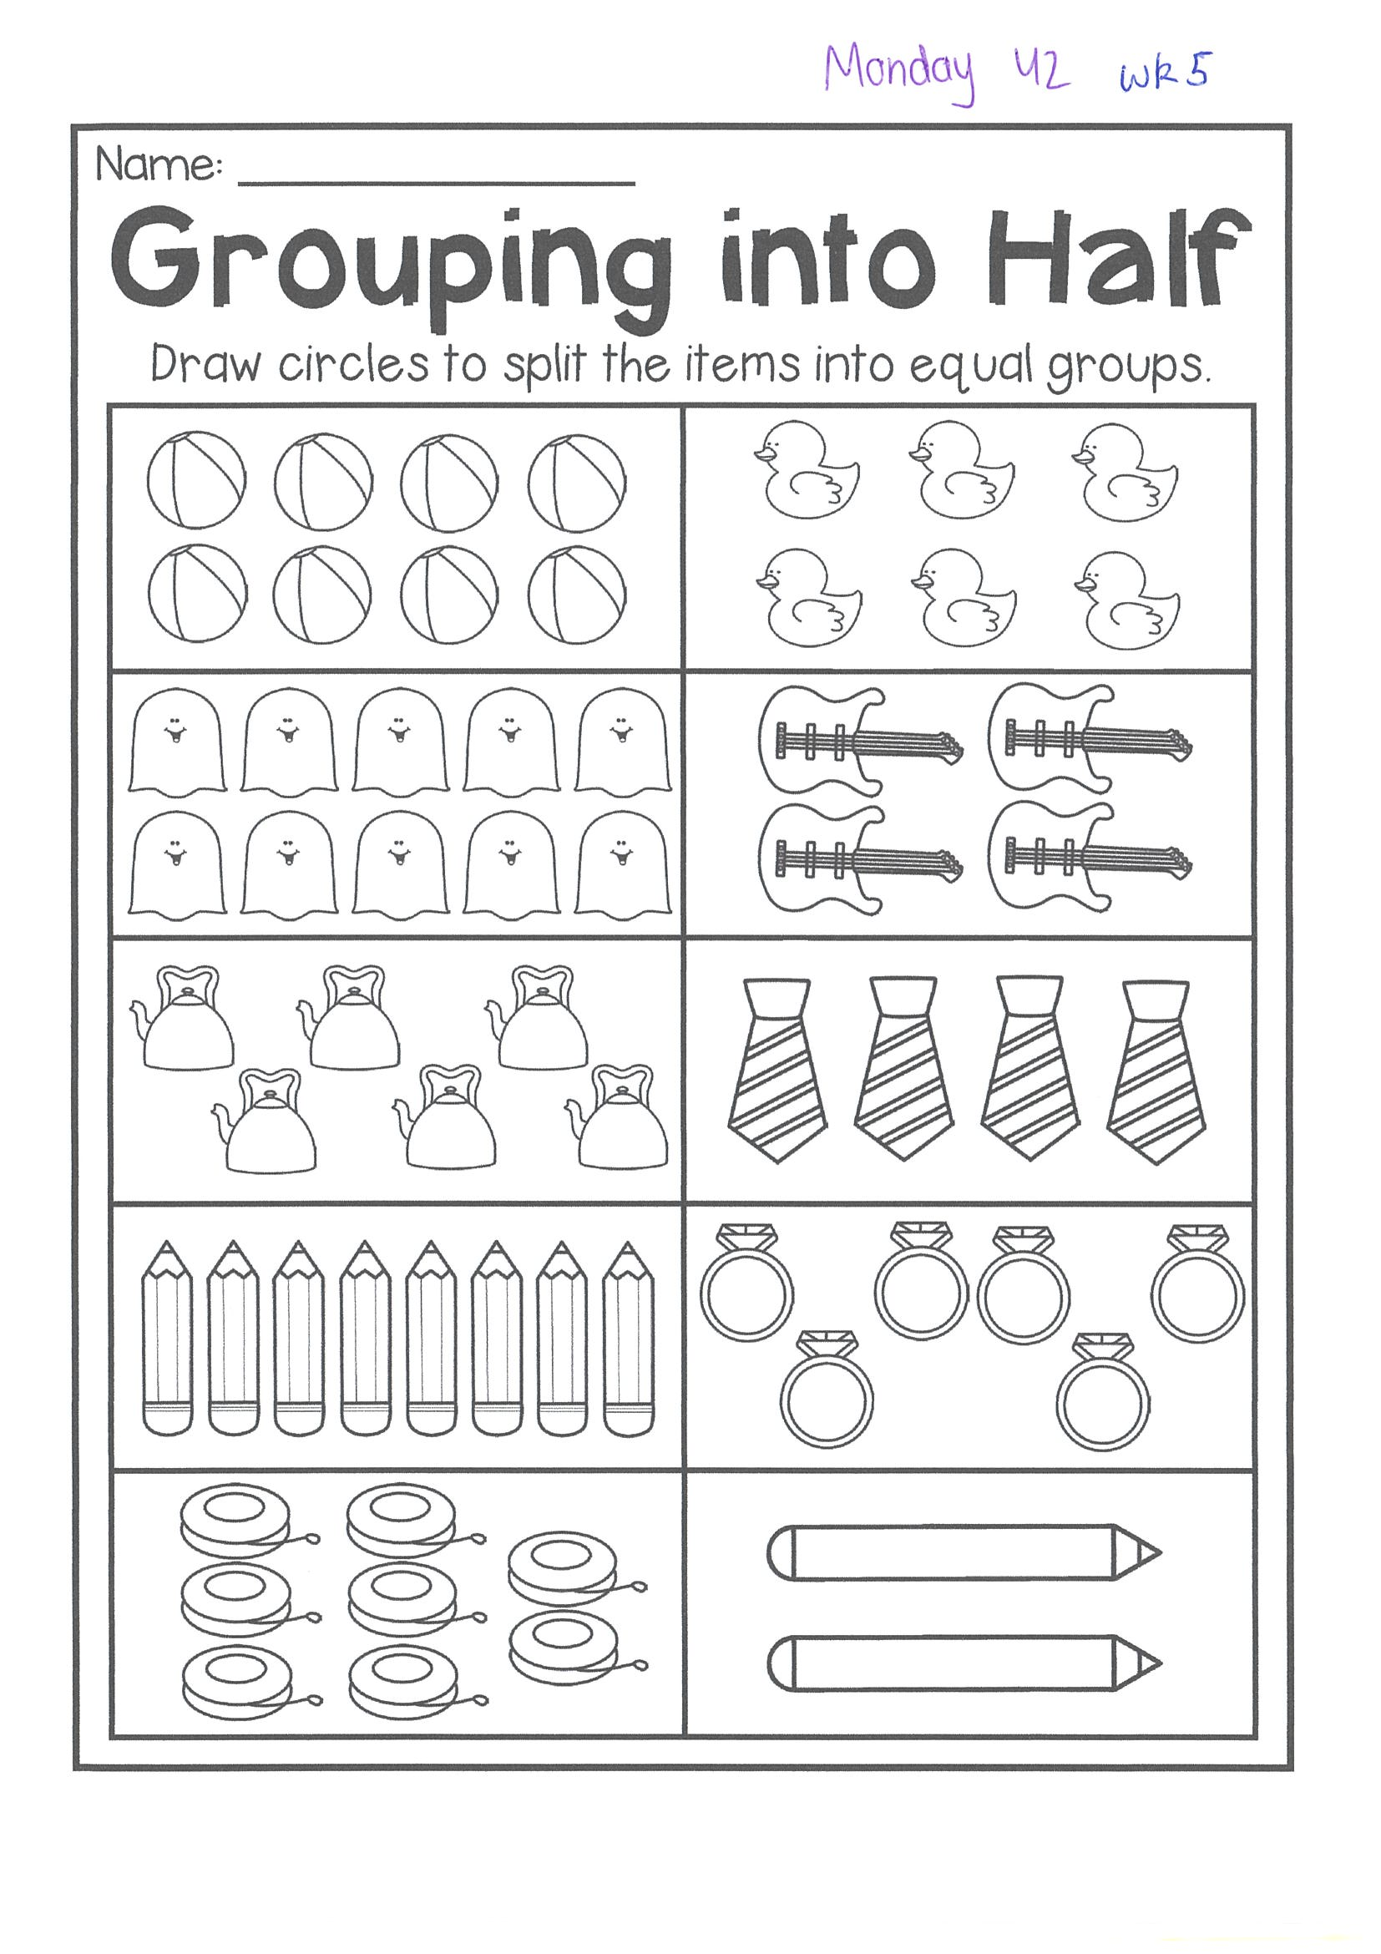
Task 2
Complete the worksheets and then do 3 activities on mathletics or studyladder.
F r a c t I o n s

Slide 12


Lunch break (40 minutes)

Slide 13
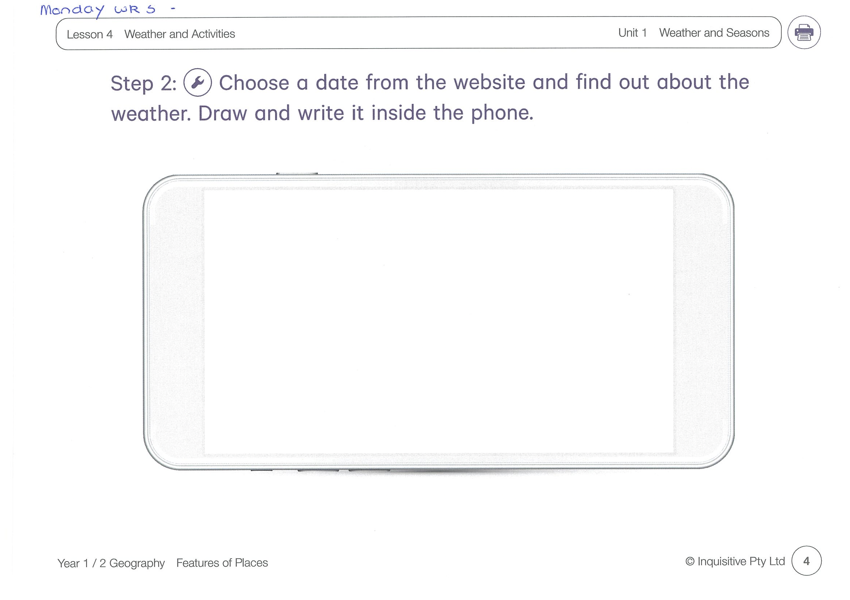
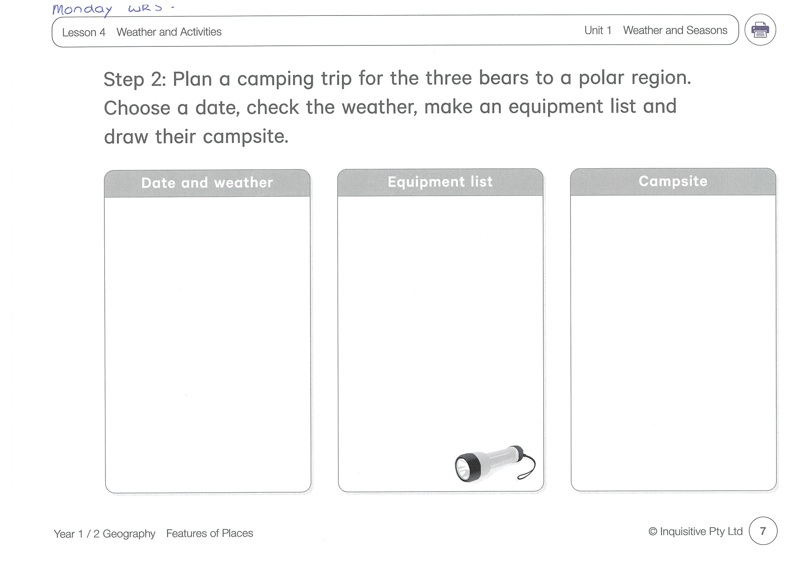
KLA - geography
Today we are learning about ‘Weather and Activities’. Look at the pictures and help the bears plan their camping trip. Complete the ‘Step 2’ worksheet. Remember to pack equipment that is suitable for the weather.
http://inq.co/class/9wg
Code: 9484

Slide 14

END OF DAY!
ENJOY your well-deserved break everyone!

Slide 15
Good morning
STAGE 1
TUESDAY 10th AUGUST 2021 – WEEK 5
Please make sure you are sending one or two work samples to your classroom teacher via dojo.

Slide 16
WHATS ON TODAY?
Morning
Task 1 – Spelling
Task 2 – Reading
Crunch n’ sip
Task 3 - Writing
Middle
Task 1 – Maths Grid
Task 2 – Activity Worksheet
Final
Library

Slide 17
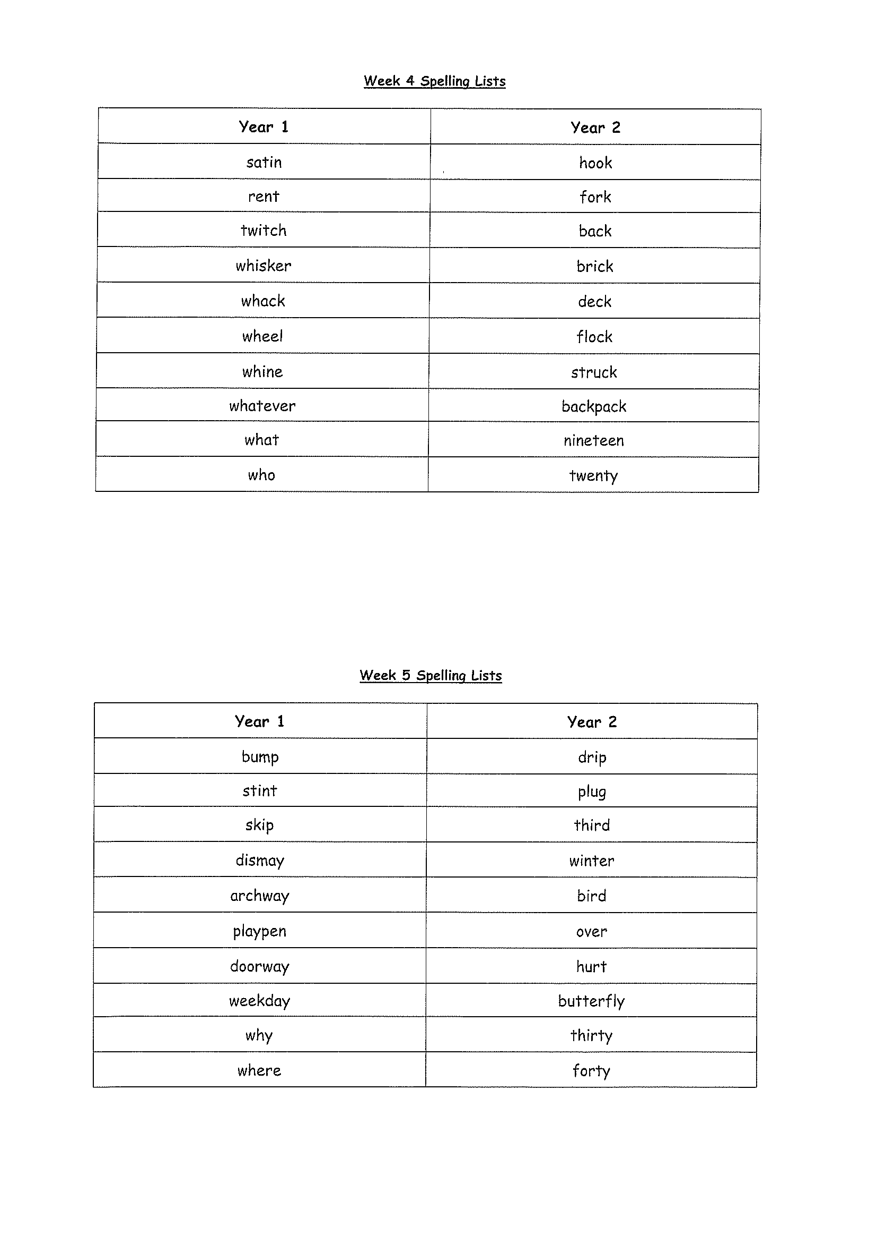
Task 1
Complete the Look, Cover, Write, Check worksheet (on a piece of paper). Write some sentences. Circle any nouns in your sentences.
Then complete your tricky word!
Year 1 – why and where
Year 2 – thirty and forty

Slide 18
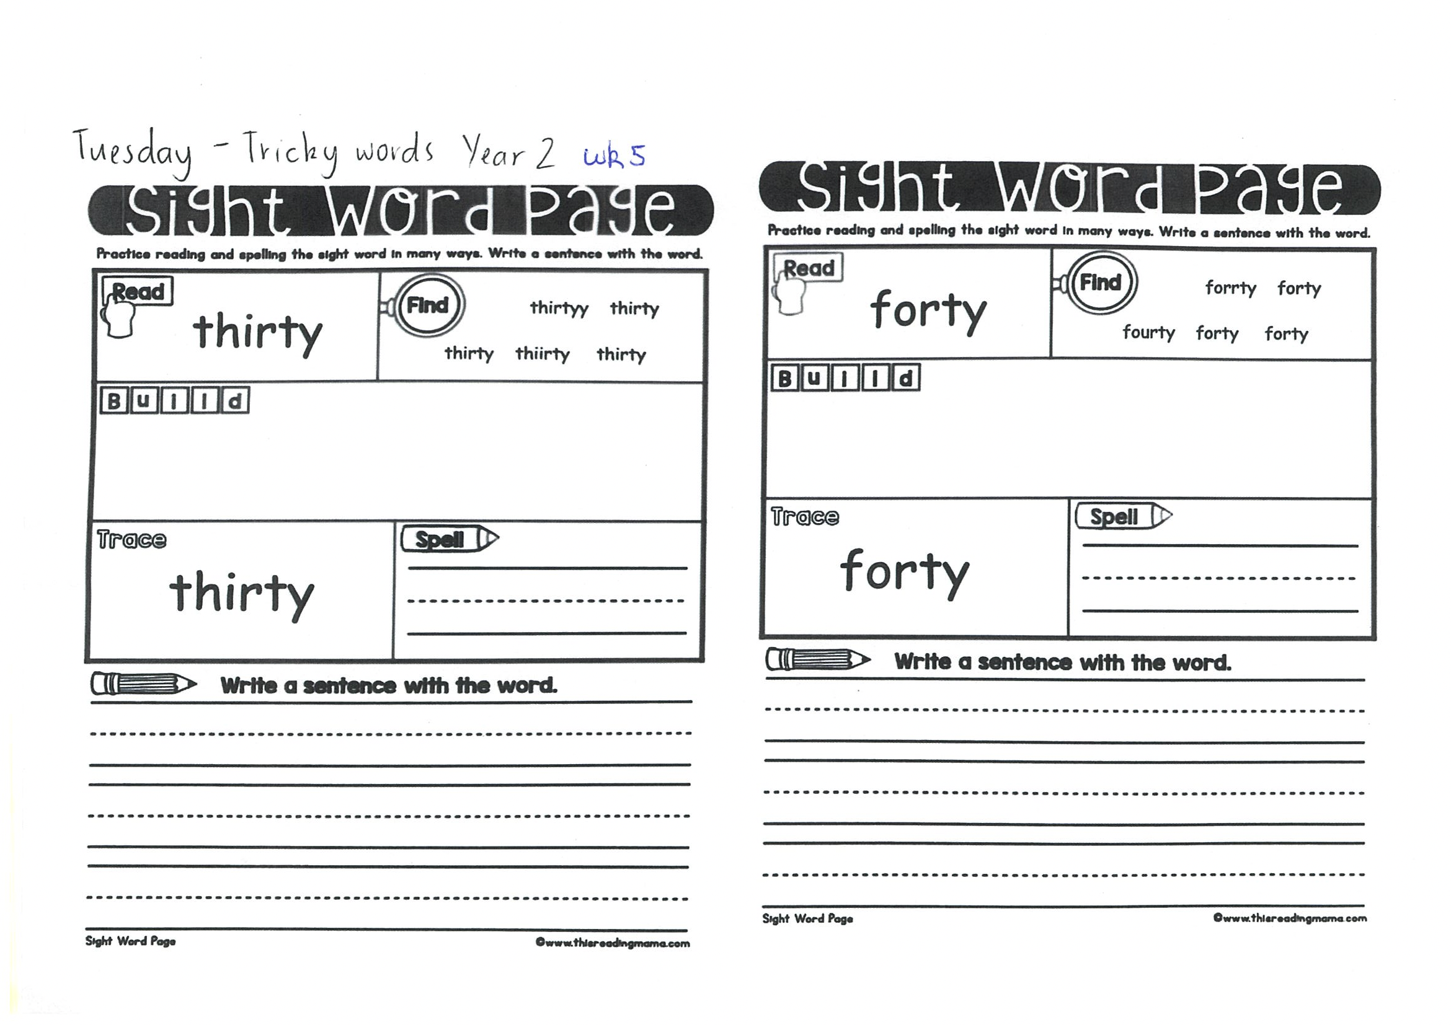
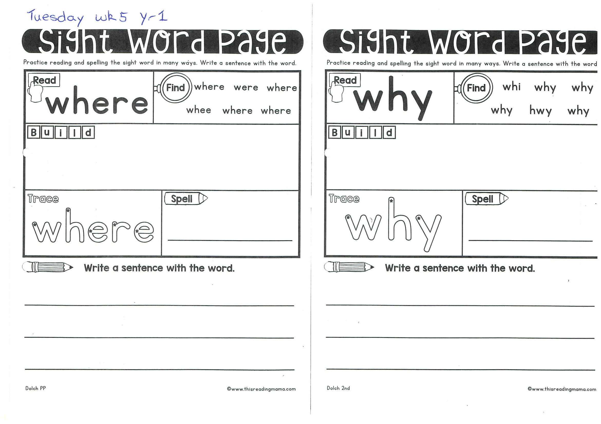

Slide 19
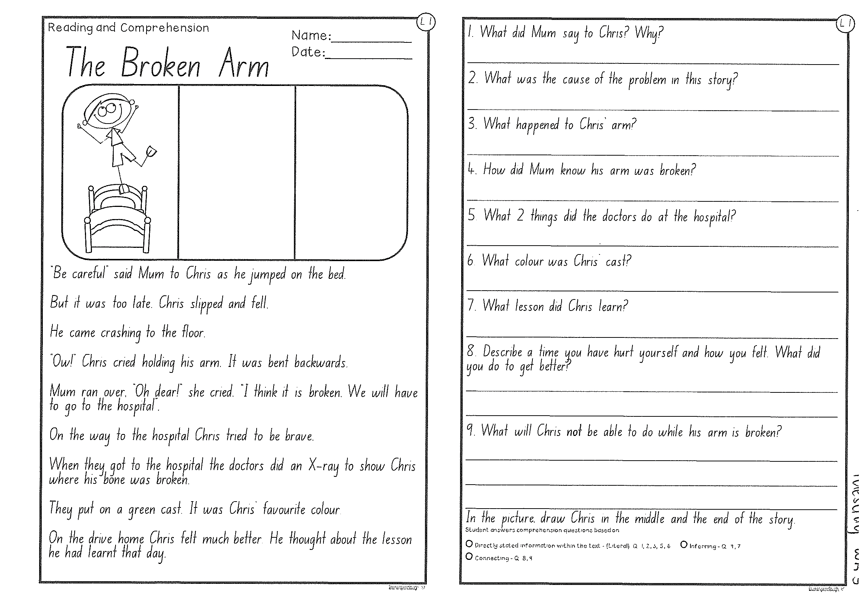
Task 2
Read or get an adult to read ”The broken arm” and answer the questions.

Slide 20
Crunch n’ sip

Slide 21
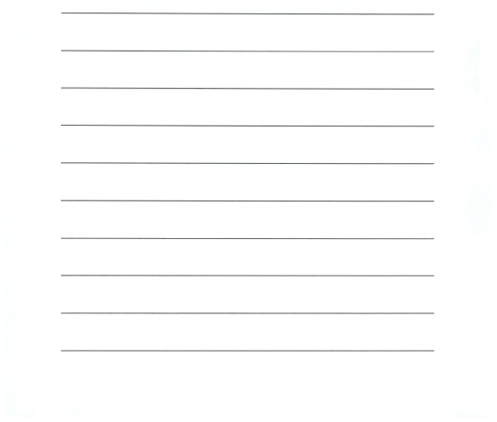
Task 3
Writing – who does this bag belong to?
Look at the questions in your learning pack guide.

Slide 22
Recess break (30 minutes)

Slide 23
Mathematics
M o n e y
Task 1
Complete an activity from the maths activity grid

Slide 24
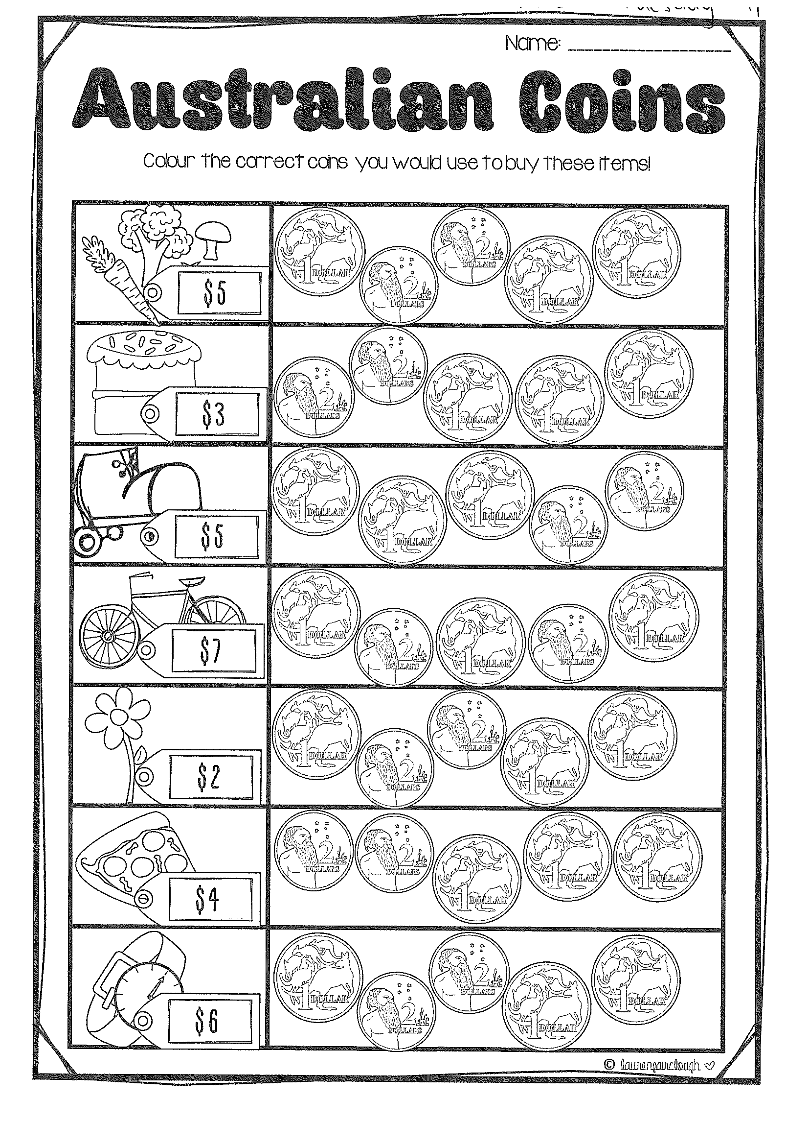
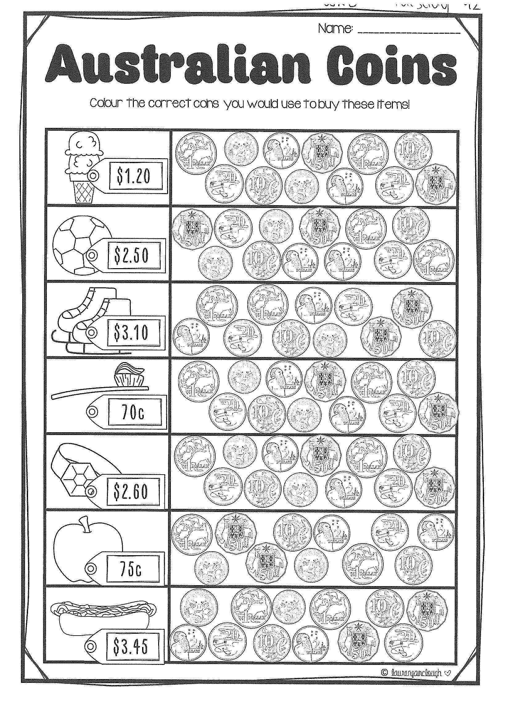
Task 2 watch the video of Ms Holdsworth to help guide you through this task. (video on dojo)
Then complete 3 activities on studyladder or mathletic.
M o n e y

Slide 25
Lunch break (40 minutes)

Slide 26
library
Silent reading
Choose one or two activities to complete each week from the NEW library activity grid.

Slide 27
END OF DAY!
ENJOY your well-deserved break everyone!

Slide 28
Good morning
STAGE 1
WEDNESDAY 11TH AUGUST 2021 – WEEK 5
Please make sure you are sending one or two work samples to your classroom teacher via dojo.

Slide 29
WHATS ON TODAY?
Morning
Task 1 – Spelling
Task 2 – Reading
Crunch n’ sip
Task 3 - Writing
Task 4 - Handwriting
Middle
Task 1 – Maths Grid
Task 2 – Worksheet
Task 3 – Fitness
Final
Science

Slide 30
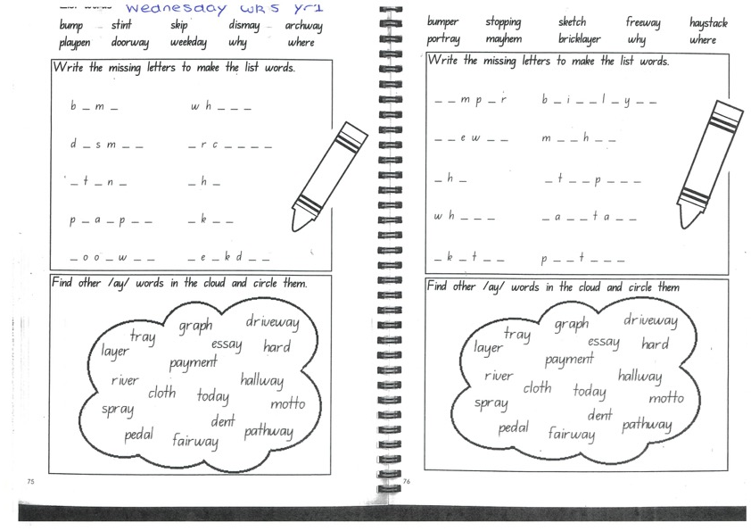
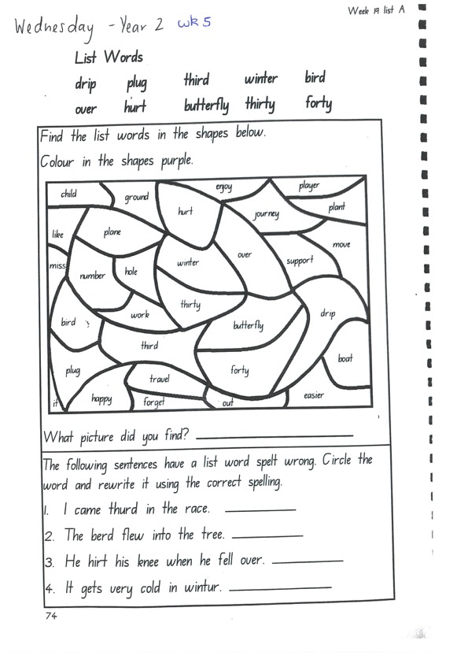
Task 1
Write down your spelling words and dot, dash, dive them on a piece of paper..
Video will be posted on dojo!
Complete spelling tasks.

Slide 31
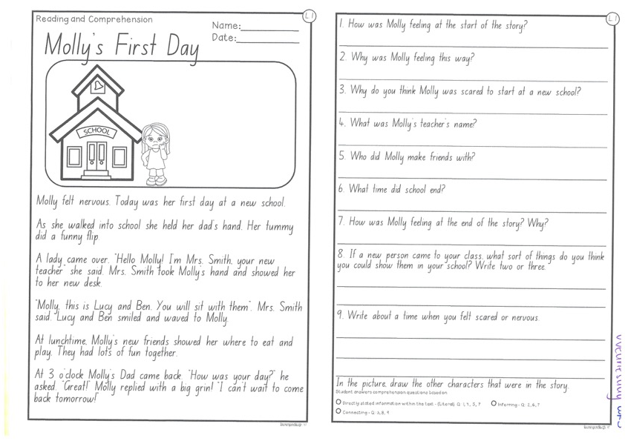
Task 2
Read or get an adult to read ”Molly’s First Day” and answer the questions.

Slide 32
Crunch n’ sip

Slide 33
Task 3
Writing – Pick one activity around your house to help out with today. E.g. cooking dinner, making the bed.
On a piece of paper, write a procedural text telling us how you did it. Remember your title, list of materials and step by step instructions. Start each step with a verb!

Slide 34

Task 4
Complete the letter “v” in your handwriting books.
https://www.youtube.com/watch?v=R0yasNOE6Lk

Slide 35
Recess break (30 minutes)

Slide 36
Mathematics
Task 1
Complete an activity from the maths activity grid

Slide 37
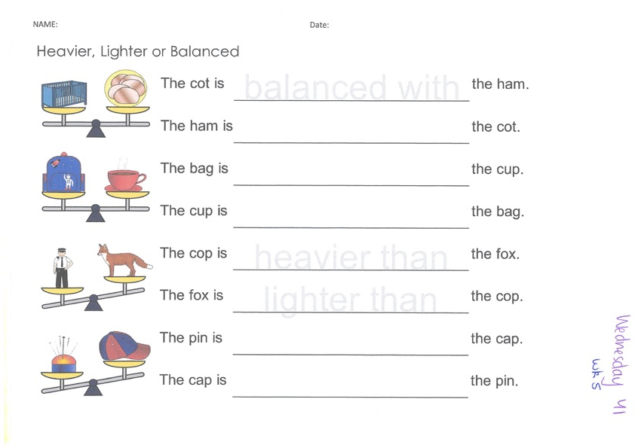
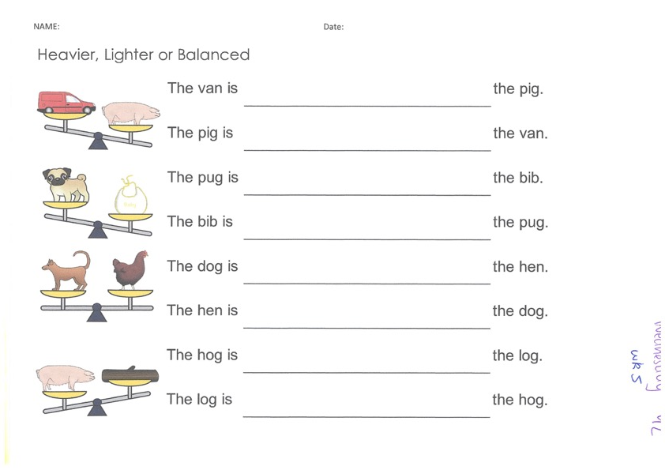
Task 2
Year 1
M a s s
Year 2

Slide 38
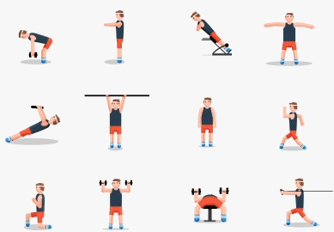
fitness
Choose an activity from the fitness grid to complete.
Not this one
(in your packs)

Slide 39
Lunch break (40 minutes)

Slide 40
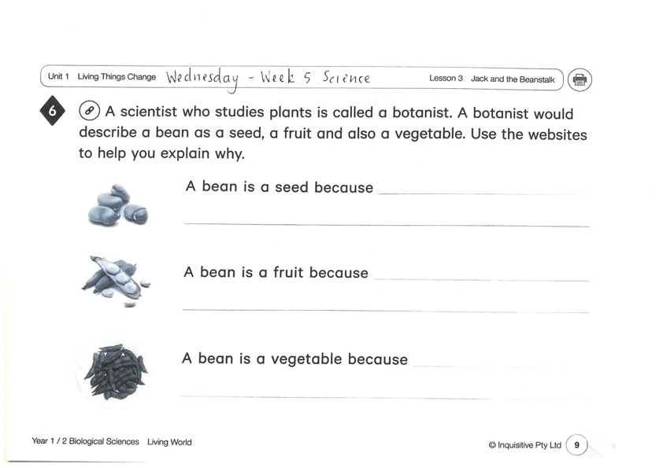
KLA - SCIENCE
Listen to the story of ‘Jack and the Beanstalk’. Using the ‘Britannica kids’ link, finish the sentences about beans.
Optional experiment:
Page 2 link:
https://www.inquisitive.com/class/9wk/login
code:5742

Slide 41
END OF DAY!
ENJOY your well-deserved break everyone!

Slide 42
Good morning
STAGE 1
THURSDAY 12TH AUGUST 2021 – WEEK 5
Please make sure you are sending one or two work samples to your classroom teacher via dojo.

Slide 43
WHATS ON TODAY?
Morning
Task 1 – Spelling
Task 2 – Reading
Crunch n’ sip
Task 3 - Writing
Middle
Task 1 – Maths Grid
Task 2 – Maths Worksheets
Final
PDHPE

Slide 44
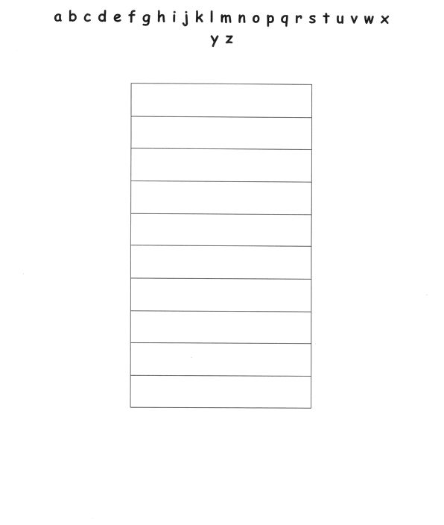
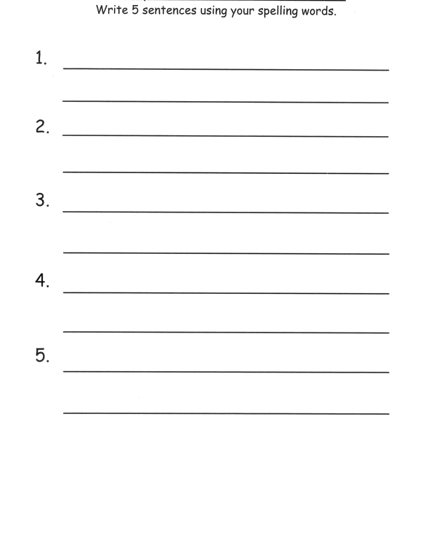
Task 1
Practice your spelling words in alphabetical order on a piece of paper.
Write 5 sentences using your spelling words on a piece of paper. Circle any verbs (action words) in your sentence.

Slide 45
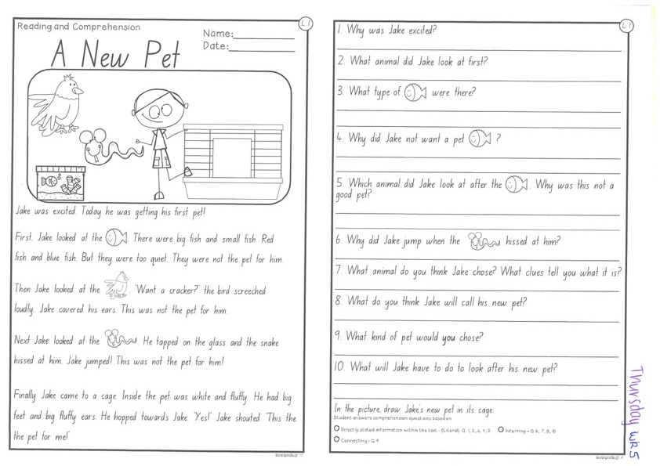
Task 2
Read or get an adult to read ”A New Pet” and answer the questions.

Slide 46
Crunch n’ sip

Slide 47
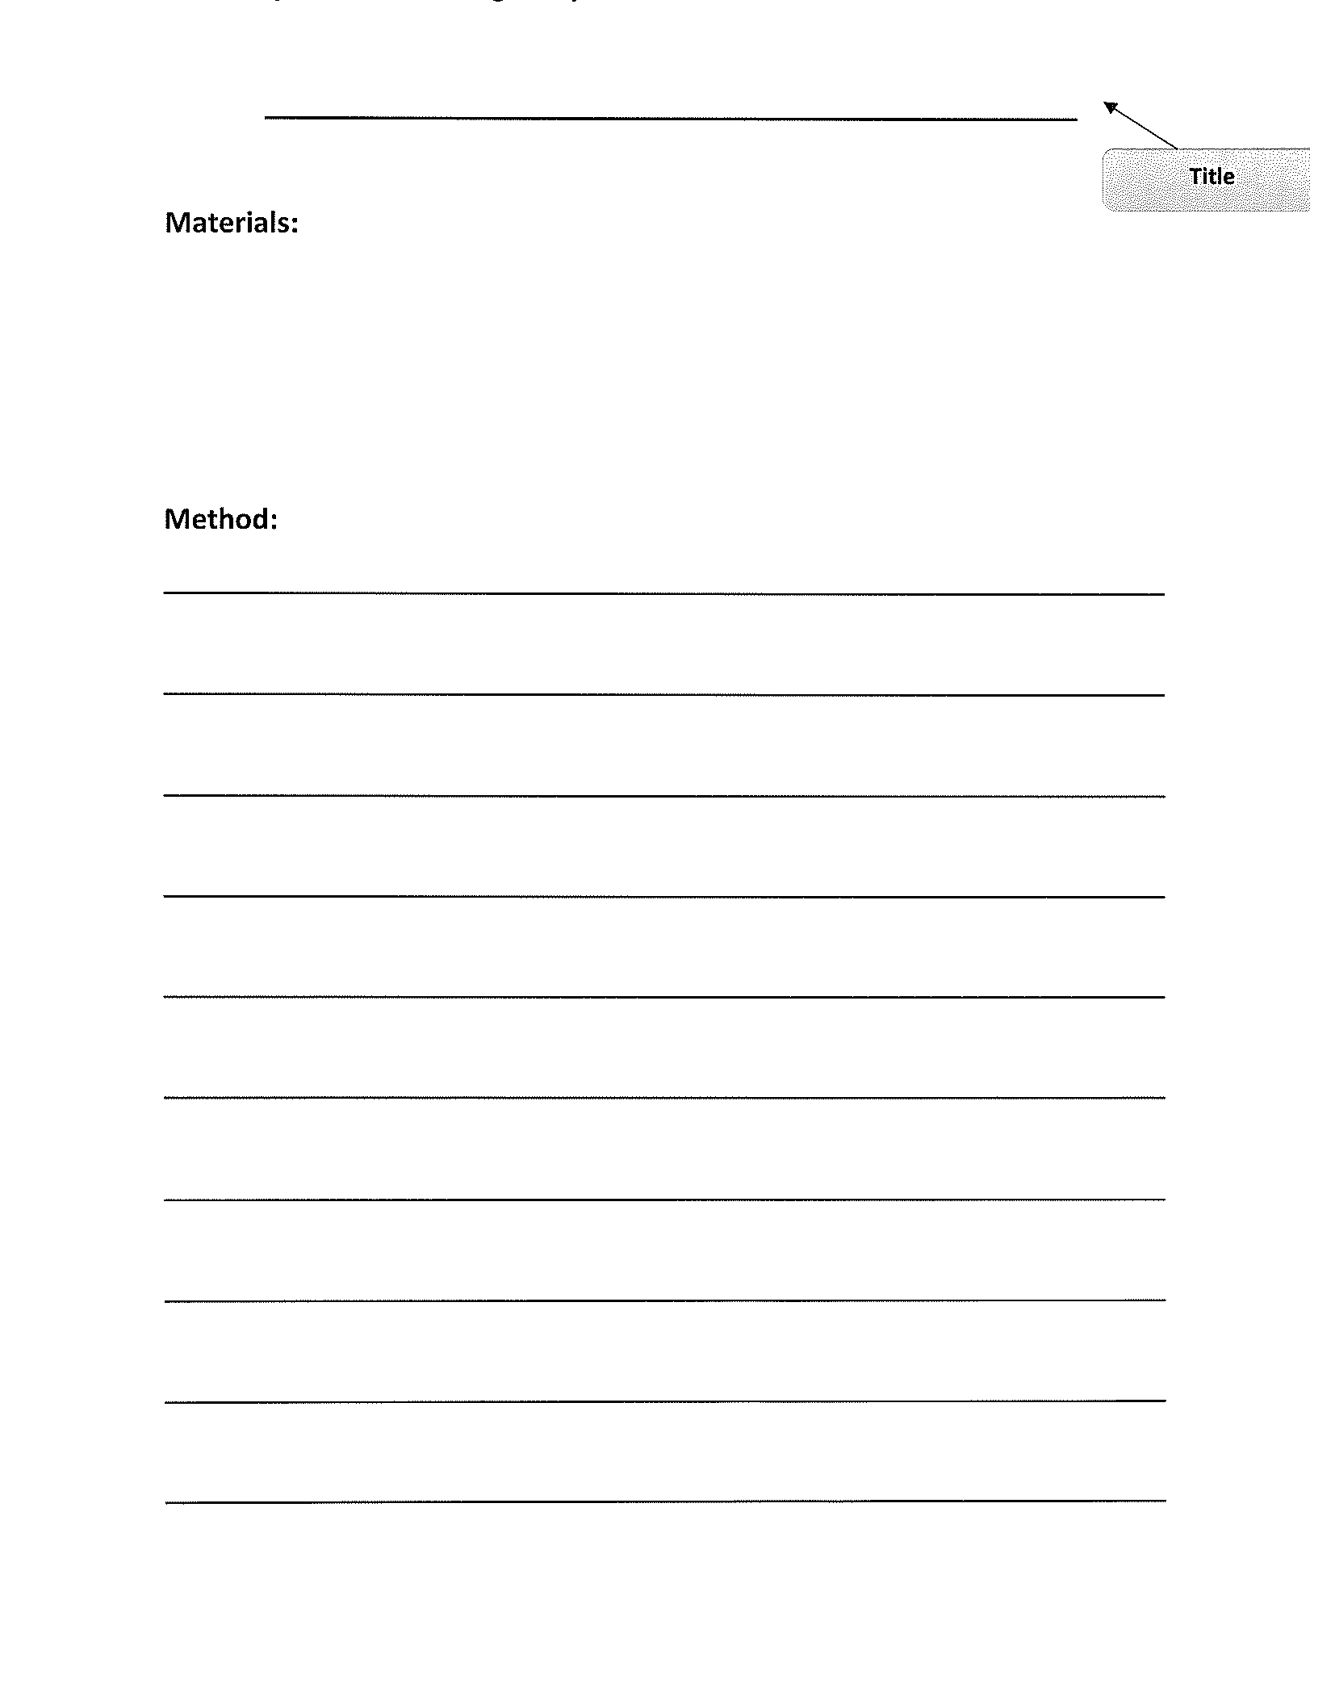
Task 3
Procedural writing
https://www.youtube.com/watch?v=ZFb6gP7mZZo
Write a procedural text about ‘how to make wombat stew’. Be creative! You can use ingredients to make your own wombat stew gooey, chewy and crunchy. Remember to add a title, a list of materials and a method (instructions). Don’t forget to start each step with a VERB!

Slide 48
Recess break (30 minutes)

Slide 49
Mathematics
Task 1
Complete an activity from the maths activity grid

Slide 50
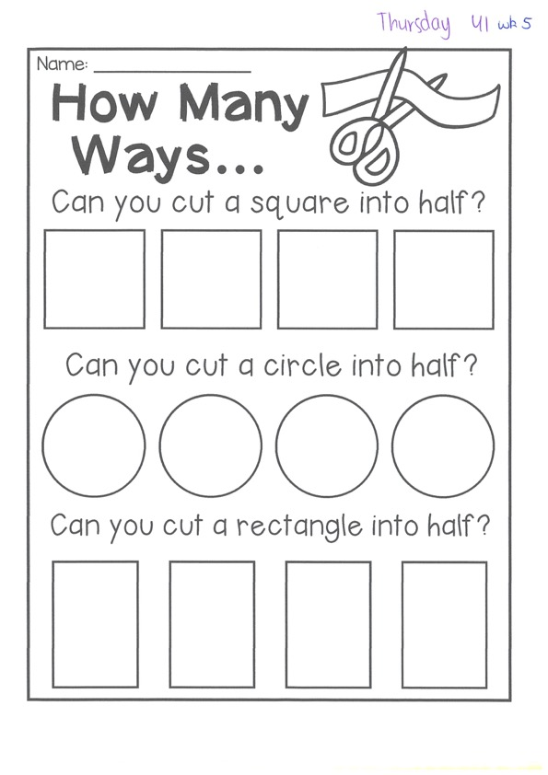

Task 2
Then complete 3 studyladder or mathletics activities
F r a c t I o n s
Year 1
Year 2

Slide 51
Lunch break (40 minutes)

Slide 52
KLA - PDHPE
HOME SAFETY
Around your home, school and community there are many places that can be dangerous if rules aren’t followed. It is important to be able to recognise these and have an understanding of how to avoid dangerous situations. Rules can help us play and work safely in a range of environments. To keep us safe rules need to be followed, can you think of what may happen if rules aren’t followed in the following environments. Complete the worksheets.

Slide 53
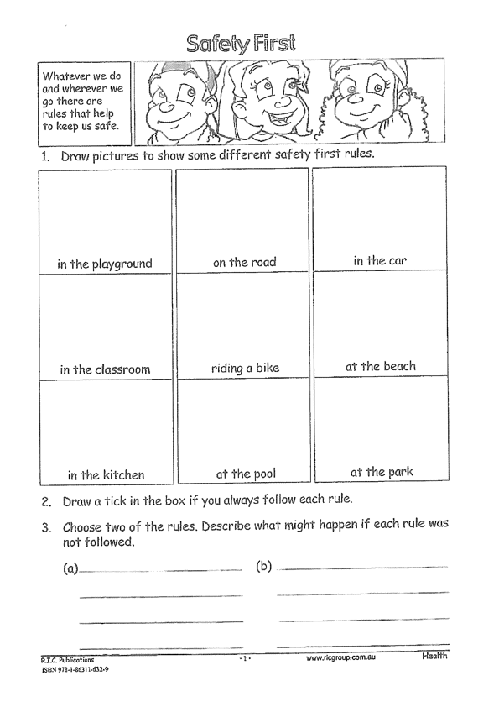
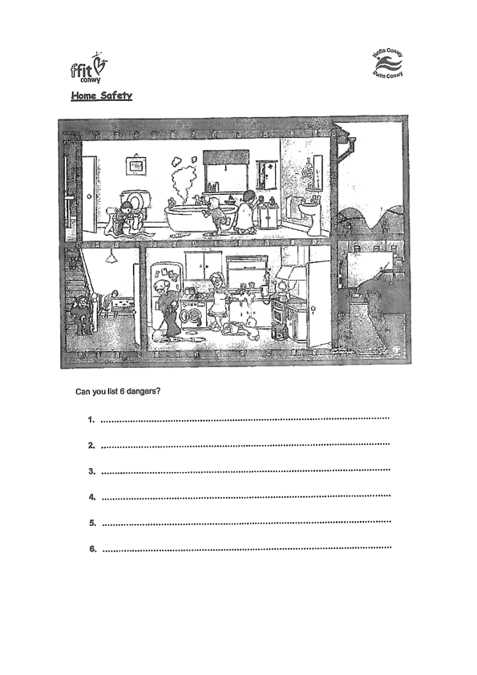

Slide 54
END OF DAY!
ENJOY your well-deserved break everyone!

Slide 55
Good morning
STAGE 1
FRIDAY 13TH AUGUST 2021 – WEEK 5
Please make sure you are sending one or two work samples to your classroom teacher via dojo.

Slide 56
WHATS ON TODAY?
Morning
Task 1 – Grammar
Task 2 – Reading
Crunch n’ sip
Task 3 - Writing
Middle
Task 1 – Maths Grid
Task 2 – Maths Money Worksheet
Task 3 - Fitness
Final
CAPA – Dance
FREE PLAY

Slide 57
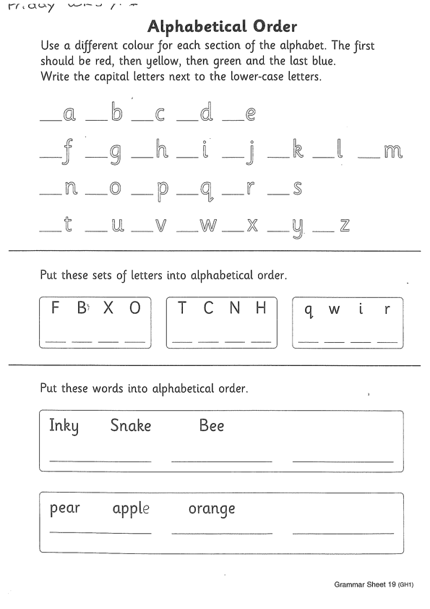
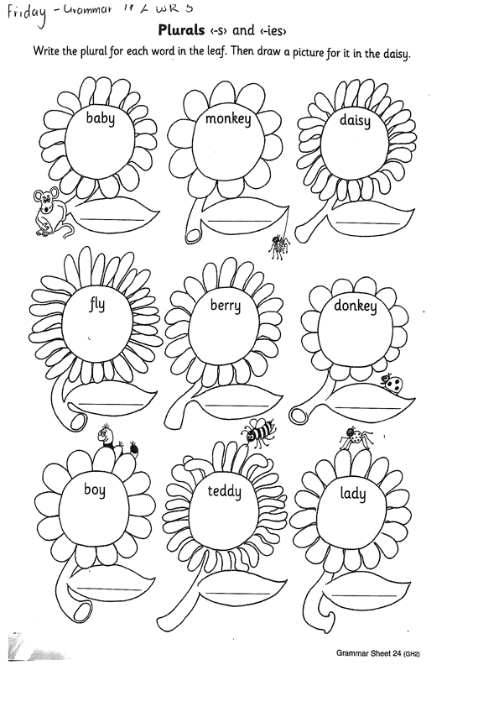
Task 1
Complete the grammar worksheets.
Year 1 – alphabetical order
Year 2 – plurals
Follow instructions in your pack.

Slide 58
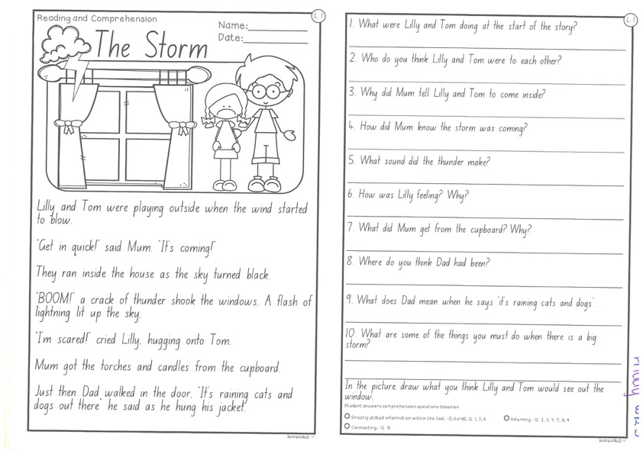
Task 2
Read or get an adult to read ”The Storm” and answer the questions.

Slide 59
Crunch n’ sip

Slide 60
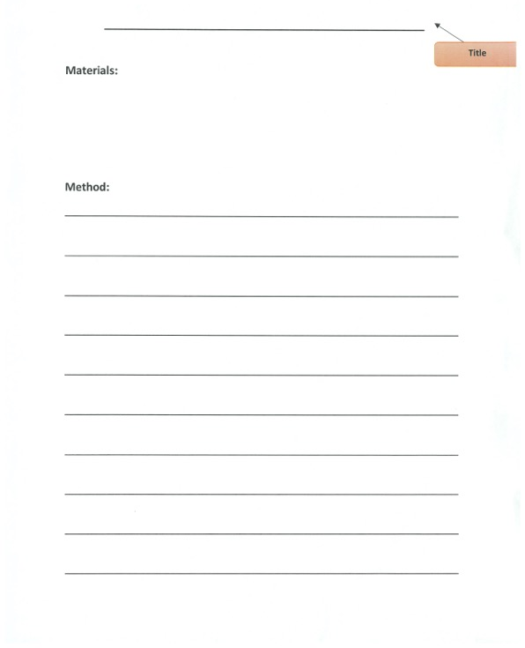
Task 3
Writing – procedural writing
Watch the video of Mrs Mazloum doing the washing on your dojo.
On a piece of paper write your own procedural text on ‘How to do the washing’. Remember to include a title, list of materials and step by step instructions (method). Don’t forget to start with a verb!

Slide 61
Recess break (30 minutes)

Slide 62
Mathematics
Task 1
Complete an activity from the maths activity grid

Slide 63
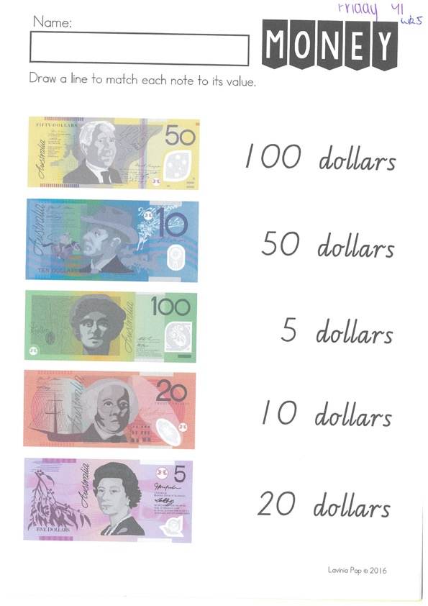
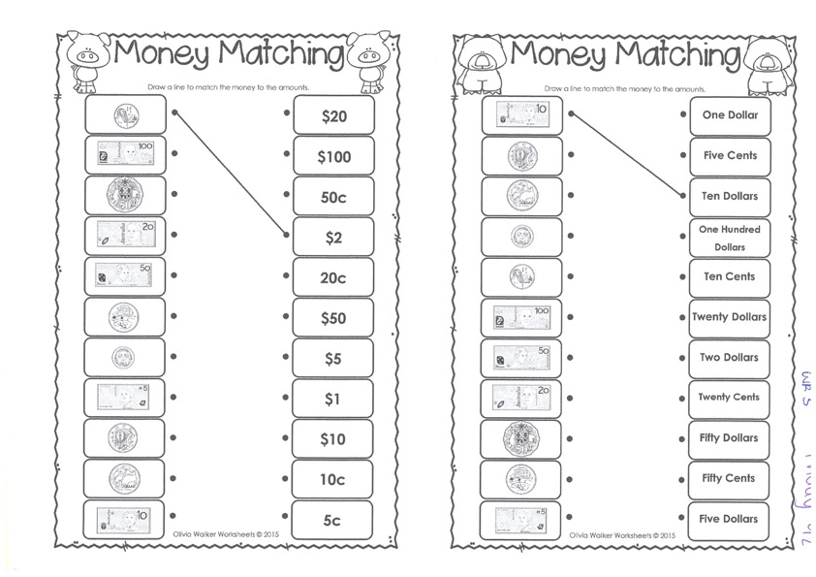
Task 2
Then complete 3 activities on studyladder or mathletics
M o n e y
Year 1
Year 2

Slide 64
Task 3. fitness
Choose an activity from the fitness grid to complete.
Not this one
(in your packs)

Slide 65
Lunch break (40 minutes)

Slide 66

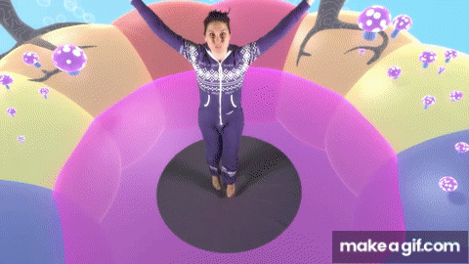
KLA – capa (dance)
DANCE DISCO YOGA
Hawaiian Roller Coaster Ride
https://www.youtube.com/watch?v=nBh7yWbNOfY
Hawaiian Dance – learn about clothing and dance
https://www.youtube.com/watch?v=lQOvJsE1Ddg

Slide 67
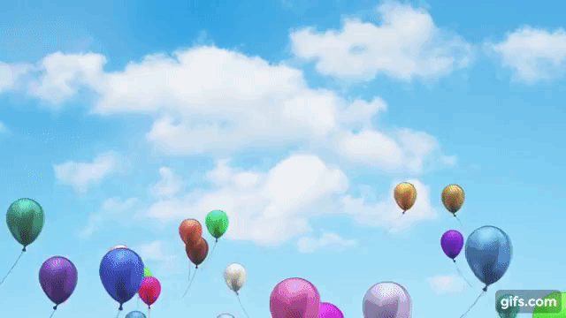
FREE PLAY
Build or construct an object or building using blocks

Slide 68
END OF Week!
ENJOY your well-deserved break everyone!

