Slide 1

STAGE 1
MRS FLEMING
MISS HOLDSWORTH
MISS MORATA
MS ROBINSON
MRS ENRIGHT
MRS MAZLOUM
MISS UNAL
PRESENTATION BY MISS UNAL

Slide 2
Good morning
STAGE 1
MONDAY 2ND AUGUST 2021 – WEEK 4
Please make sure you are sending one or two work samples to your classroom teacher via dojo.

Slide 3
WHATS ON TODAY?
Morning
Task 1 - spelling
Task 2 - reading
Crunch n’ sip
Task 3 - writing
Task 4 - handwriting
Middle
Task 1 - Maths Grid
Task 2 - Fractions Worksheet
Final
Geography

Slide 4
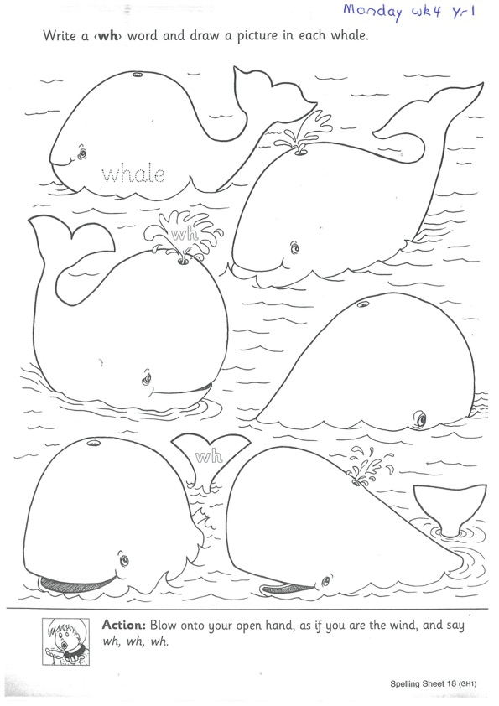
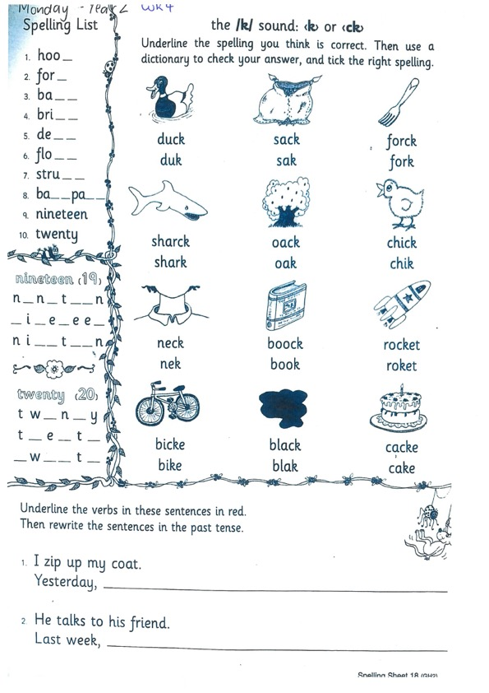
Task 1
Year 1
Year 2
Watch Mrs Warwick’s video’s for the sound of the week.
YEAR 1
https://vimeo.com/580928643
YEAR 2
https://vimeo.com/580928543

Slide 5
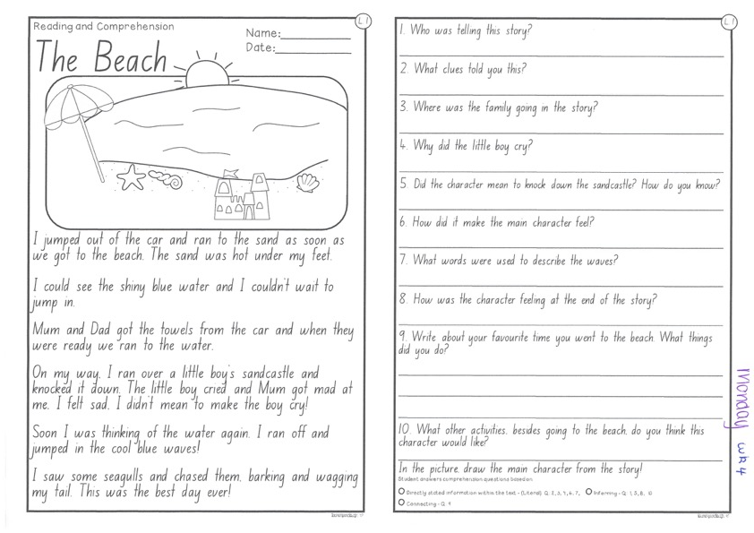
Task 2
Read or get an adult to read ‘The Beach’ and answer the questions.

Slide 6
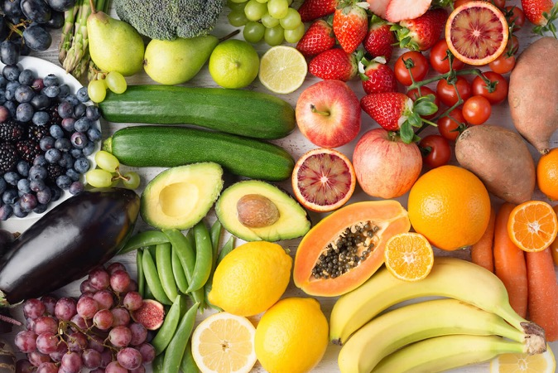
Crunch n’ sip

Slide 7


Task 3
Design a new event for the Olympic Games. Be creative! On a piece of paper, write a description of what the event is, what equipment is needed and the instructions and rules to complete. You can draw a picture too!

Slide 8



Task 4
Complete the letter “s” in your handwriting books.

Slide 9

Recess break (30 minutes)

Slide 10
Mathematics
Task 1
Complete an activity from the maths activity grid

Slide 11
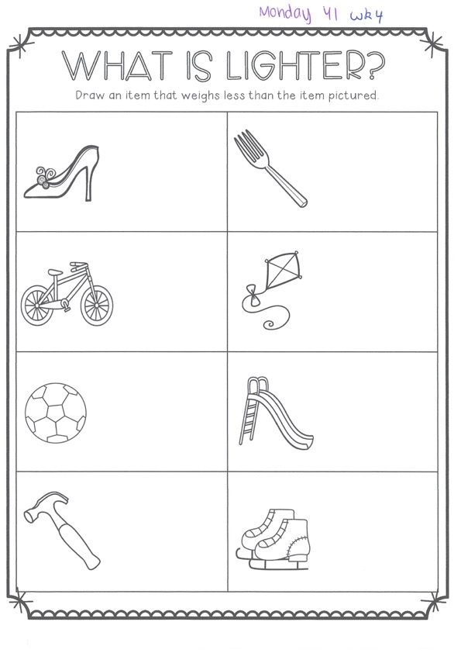
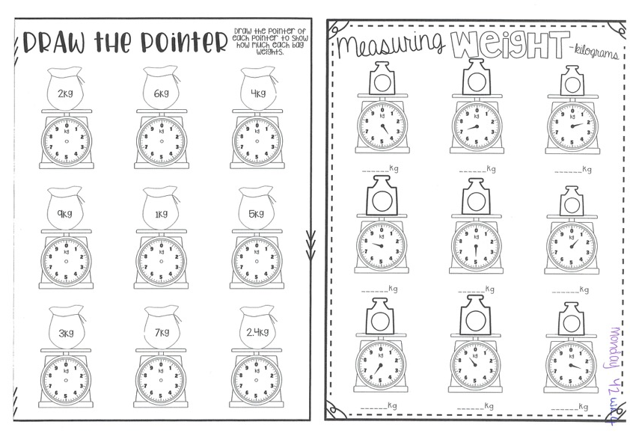
Task 2
Completethe worksheets and then do 3 activities on mathletics or studyladder.
M A S S

Slide 12


Lunch break (40 minutes)

Slide 13
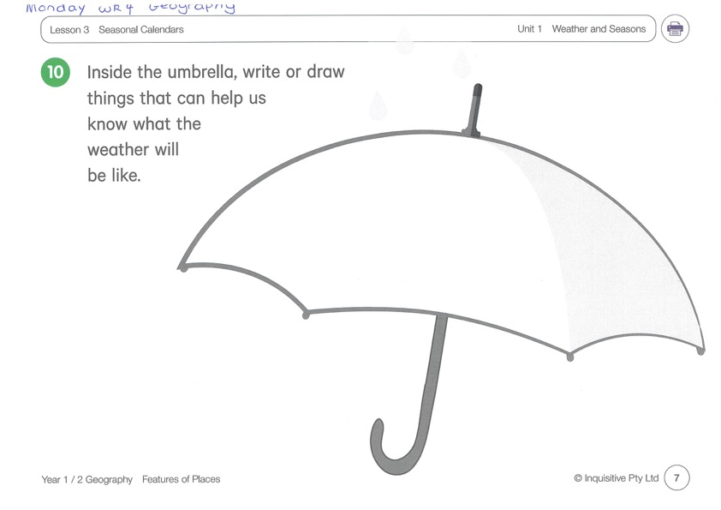
KLA - geography
Watch and sing along to the video ‘hot and cold’ and listen to the story ‘Big rain coming’ to complete the umbrella
http://inq.co/class/9wg
Code: 9484

Slide 14

END OF DAY!
ENJOY your well-deserved break everyone!

Slide 15
Good morning
STAGE 1
TUESDAY 3RD AUGUST 2021 – WEEK 4
Please make sure you are sending one or two work samples to your classroom teacher via dojo.

Slide 16
WHATS ON TODAY?
Morning
Task 1 – Spelling
Task 2 – Reading
Crunch n’ sip
Task 3 - Writing
Middle
Task 1 – Maths Grid
Task 2 – Activity Worksheet
Final
Library

Slide 17
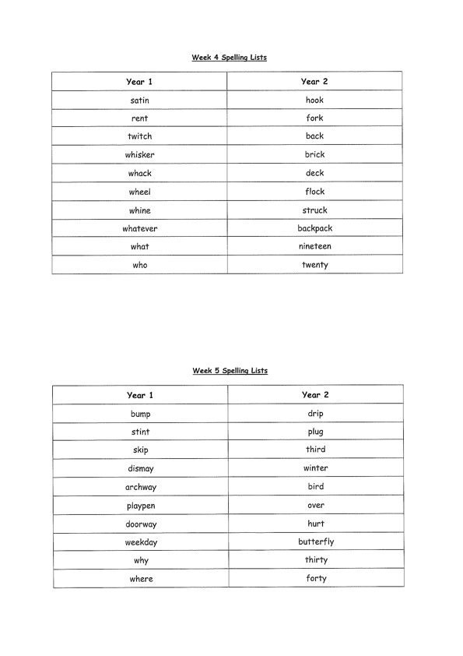
Task 1
Complete the Look, Cover, Write, Check worksheet (in your booklet).
Then complete your tricky word!

Slide 18
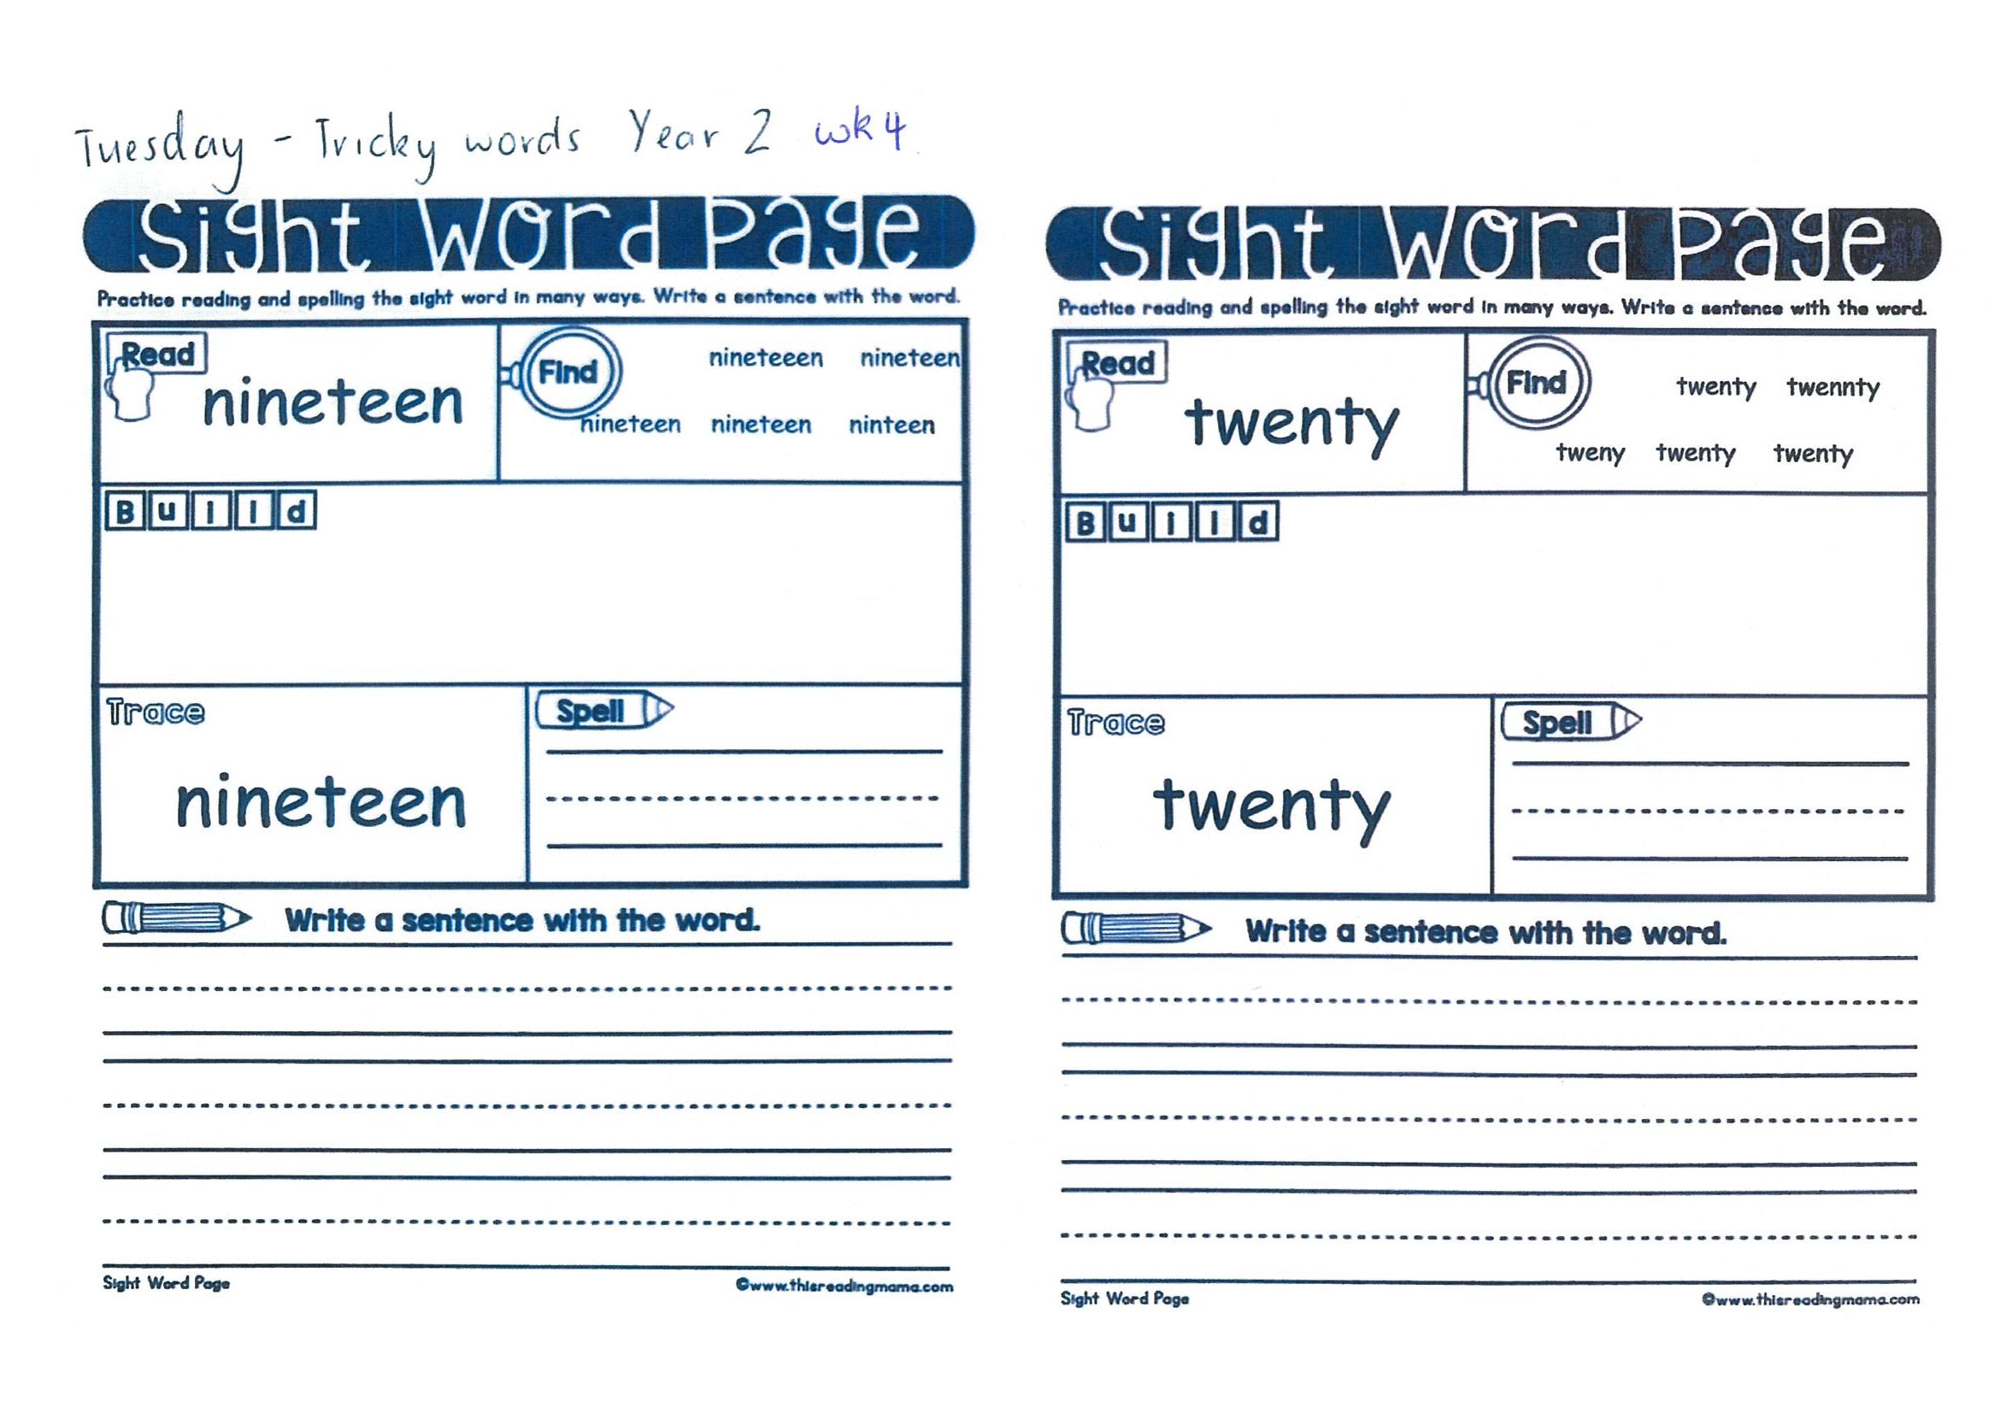
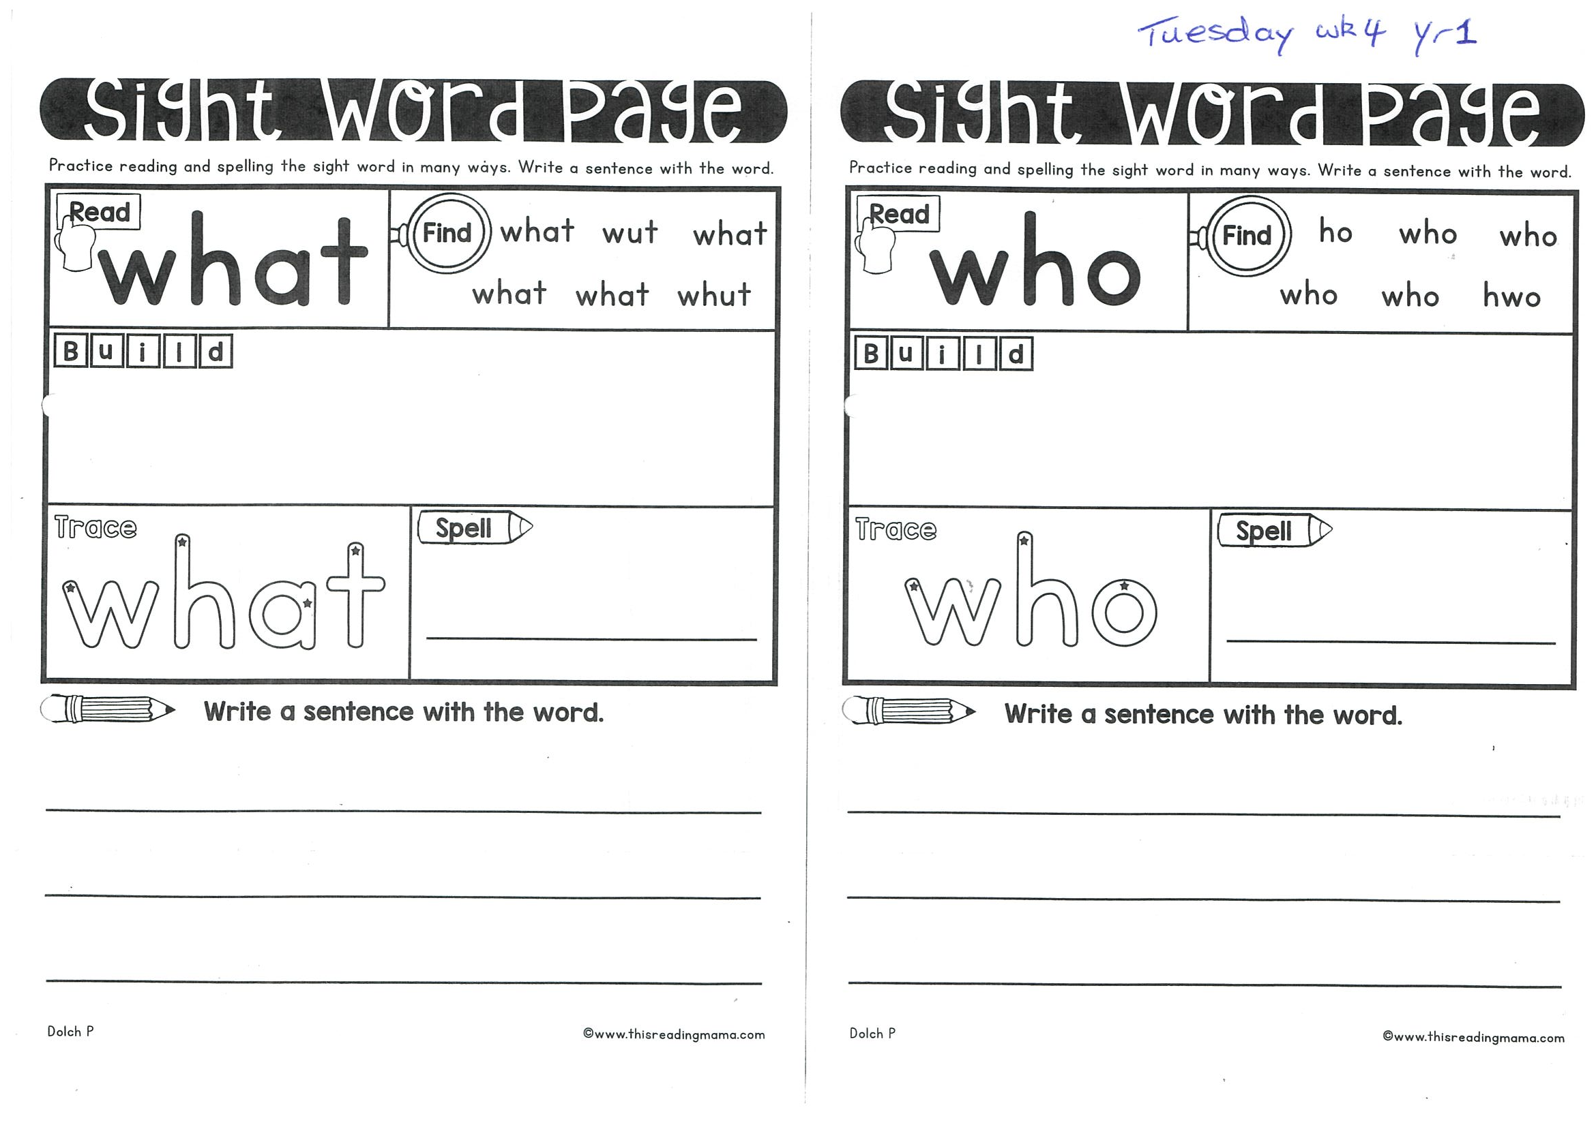

Slide 19
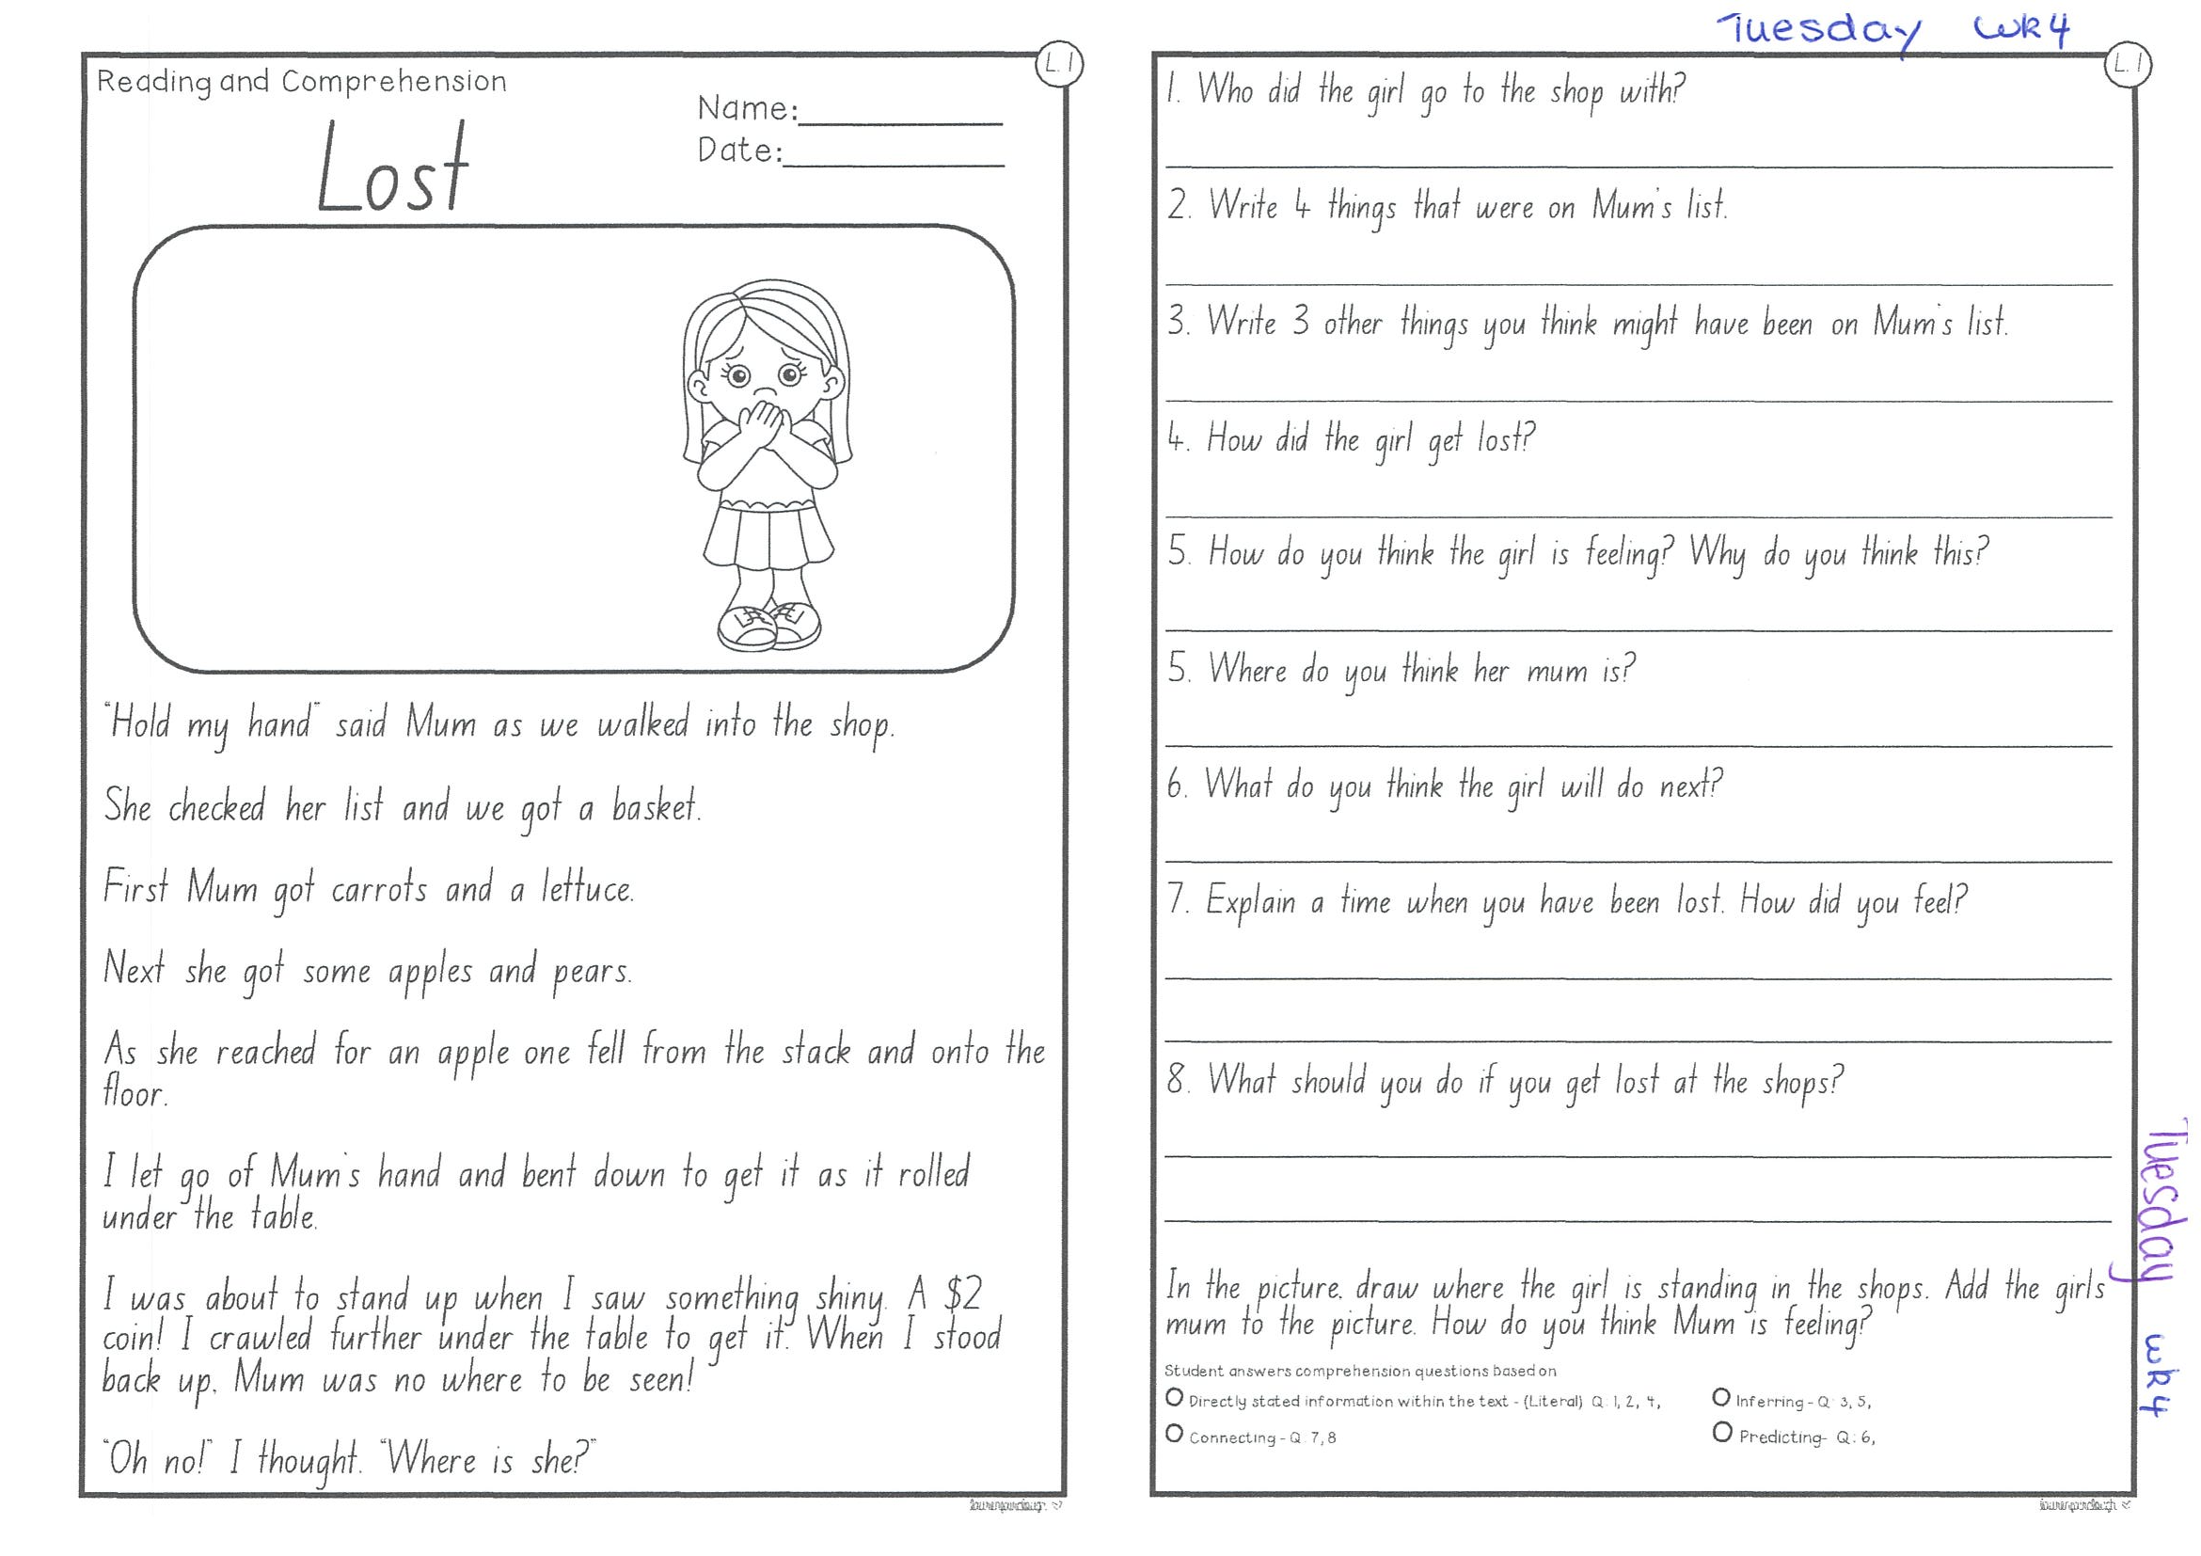
Task 2
Read or get an adult to read ”Lost” and answer the questions.

Slide 20
Crunch n’ sip

Slide 21
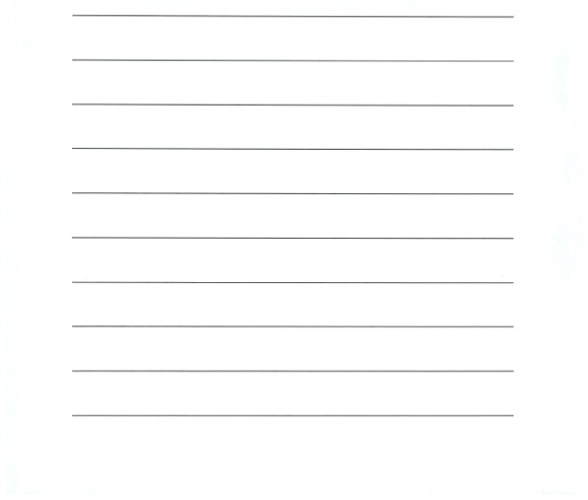
Task 3
Writing – who does this bag belong to?
Look at the questions in your learning pack guide.

Slide 22
Recess break (30 minutes)

Slide 23
Mathematics
M o n e y
Task 1
Complete an activity from the maths activity grid

Slide 24
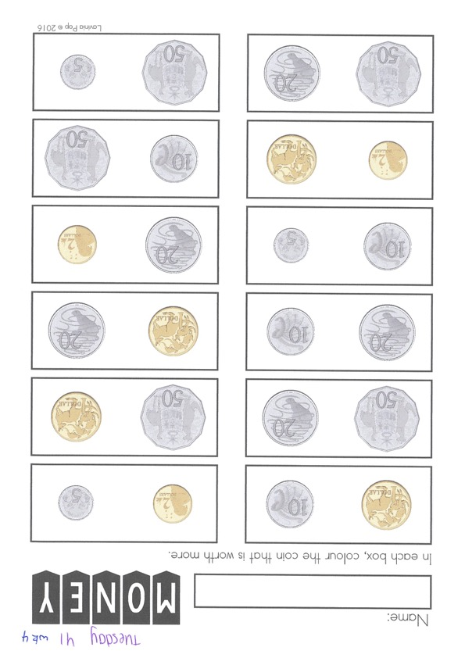
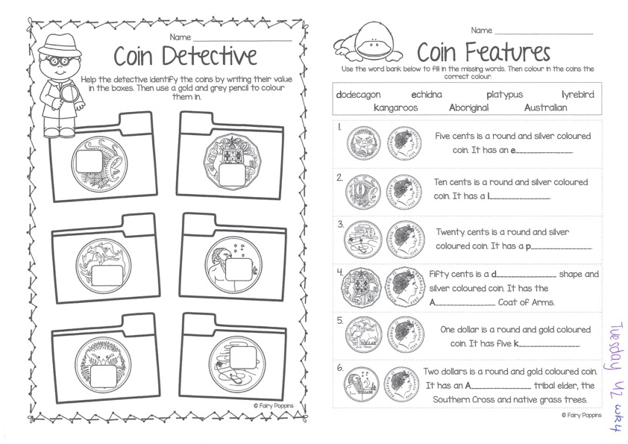
Task 2 watch the video of Ms Holdsworth to help guide you through this task. (video on dojo)
Then complete 3 activities on studyladder or mathletic.
M o n e y

Slide 25
Lunch break (40 minutes)

Slide 26
library
Silent reading
Choose one or two activities to complete each week from the red library activity grid.

Slide 27
END OF DAY!
ENJOY your well-deserved break everyone!

Slide 28
Good morning
STAGE 1
WEDNESDAY 4TH AUGUST 2021 – WEEK 4
Please make sure you are sending one or two work samples to your classroom teacher via dojo.

Slide 29
WHATS ON TODAY?
Morning
Task 1 – Spelling
Task 2 – Reading
Crunch n’ sip
Task 3 - Writing
Task 4 - Handwriting
Middle
Task 1 – Maths Grid
Task 2 – Fractions Worksheet
Task 3 – Fitness
Final
Science

Slide 30
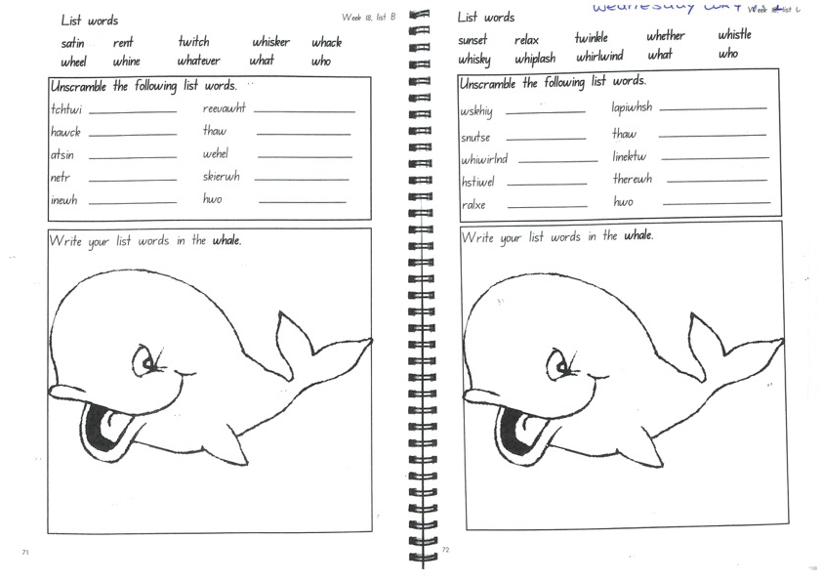
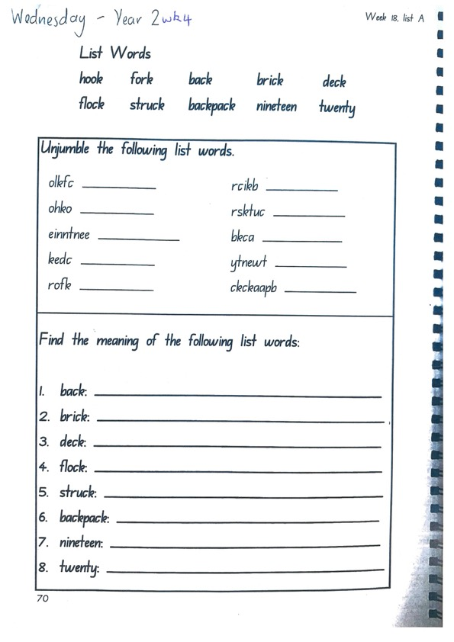
Task 1
Write down your spelling words and dot, dash, dive them on a piece of paper..
Video will be posted on dojo with surprise teacher for help!
Complete spelling tasks.

Slide 31
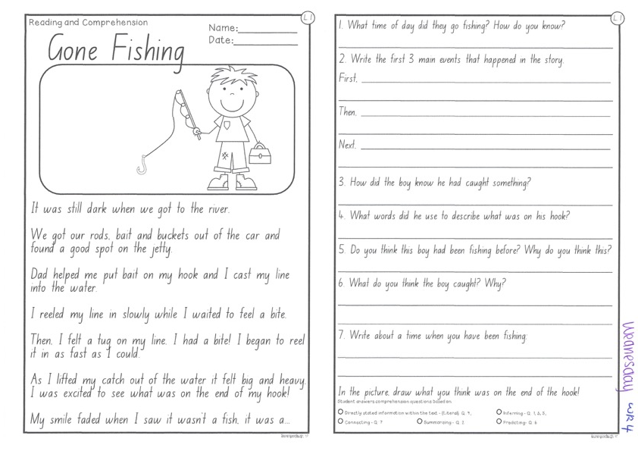
Task 2
Read or get an adult to read ”Going Fishing” and answer the questions.

Slide 32
Crunch n’ sip

Slide 33













Task 3
Writing – have a think about what your favourite sport is at the Olympics. E.g. running, swimming. Skateboarding. On a piece of paper, write a procedural text of ‘how to win gold in my favourite sport’. Be creative! Tell us what YOU would do to win a gold medal.

Slide 34

Task 4
Complete the letter “” in your handwriting books.
https://www.youtube.com/watch?v=7YuVE2Eydlw

Slide 35
Recess break (30 minutes)

Slide 36
Mathematics
Task 1
Complete an activity from the maths activity grid

Slide 37
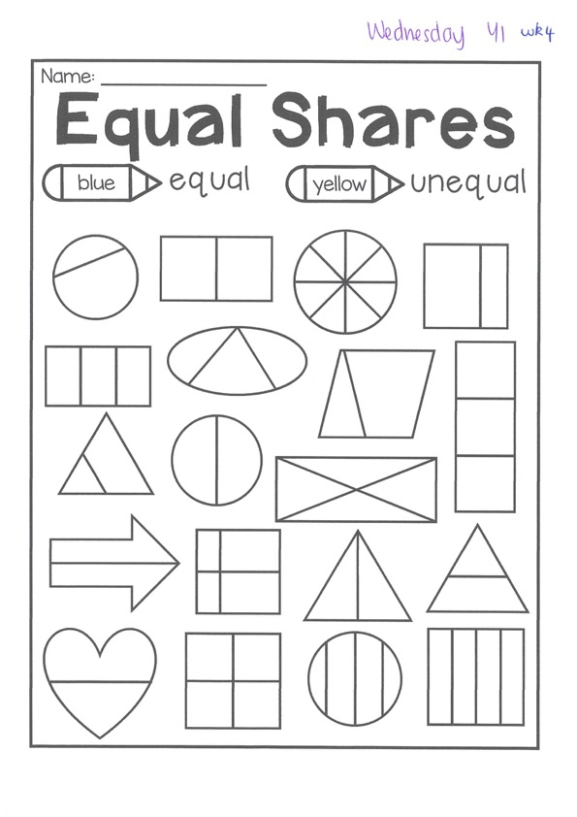
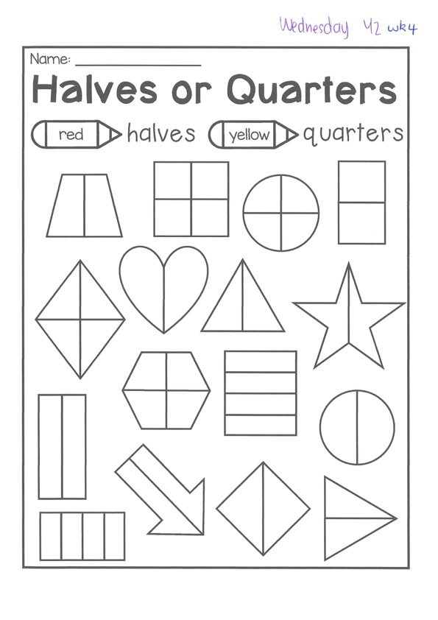
Task 2
f r a c t I o n s
Year 1
Year 2

Slide 38
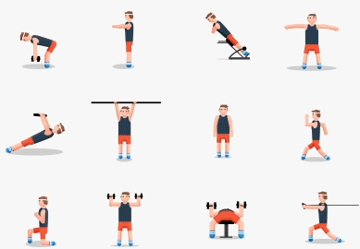
fitness
Choose an activity from the fitness grid to complete.
Not this one
(in your packs)

Slide 39
Lunch break (40 minutes)

Slide 40
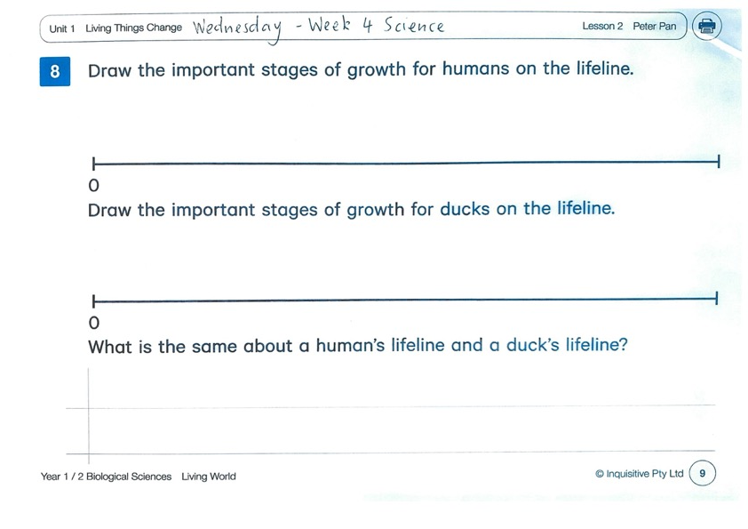
KLA - SCIENCE
Watch the video of Vince again. What parts of your body change as you grow up? Think about things that cannot be seen.
Using your worksheet, draw the important stages of growth for humans and ducks.
https://www.inquisitive.com/class/9wk/login
code:5742

Slide 41
END OF DAY!
ENJOY your well-deserved break everyone!

Slide 42
Good morning
STAGE 1
THURSDAY 5TH AUGUST 2021 – WEEK 4
Please make sure you are sending one or two work samples to your classroom teacher via dojo.

Slide 43
WHATS ON TODAY?
Morning
Task 1 – Spelling
Task 2 – Reading
Crunch n’ sip
Task 3 - Writing
Middle
Task 1 – Maths Grid
Task 2 – Maths Worksheets
Final
PDHPE

Slide 44
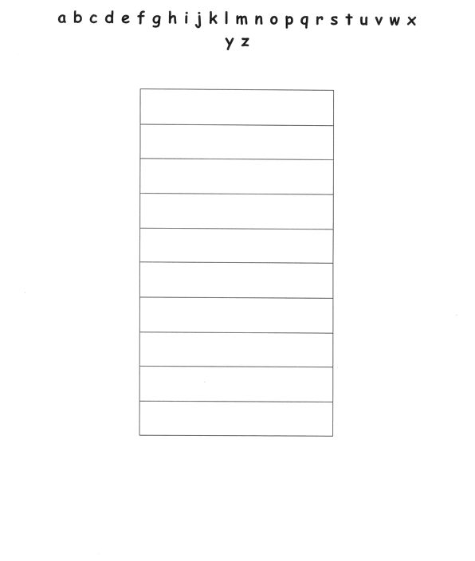
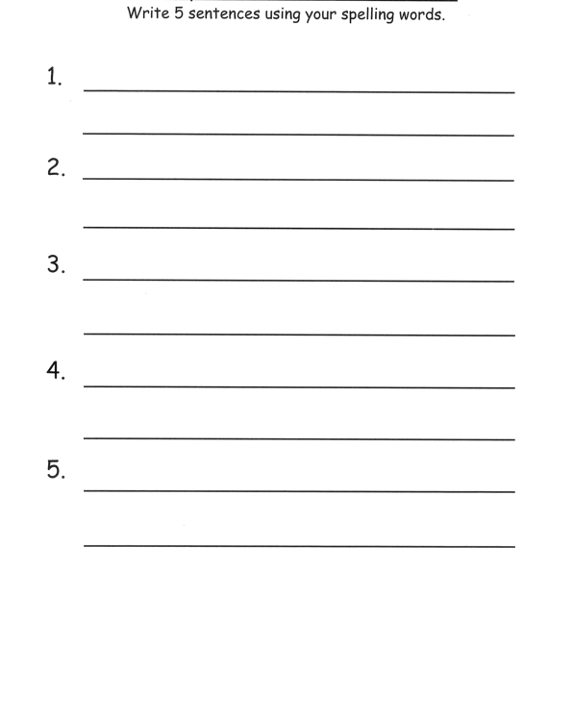
Task 1
Practice your spelling words in alphabetical order on a piece of paper.
Write 5 sentences using your spelling words on a piece of paper. Circle any verbs (action words) in your sentence.

Slide 45
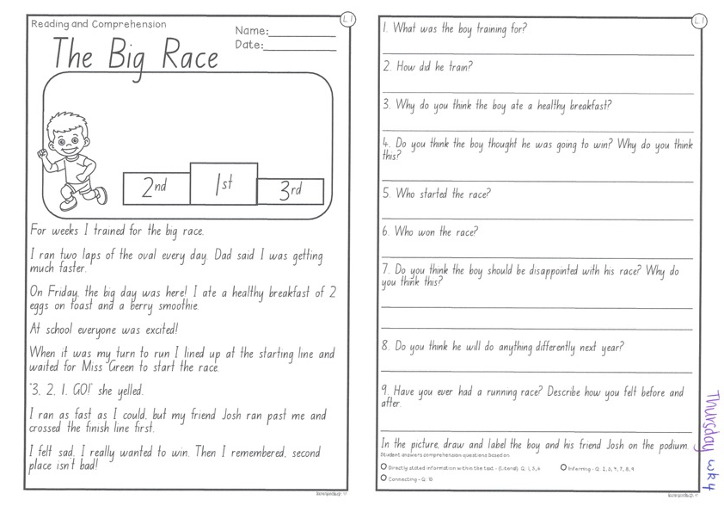
Task 2
Read or get an adult to read ”The Big Race” and answer the questions.

Slide 46
Crunch n’ sip

Slide 47
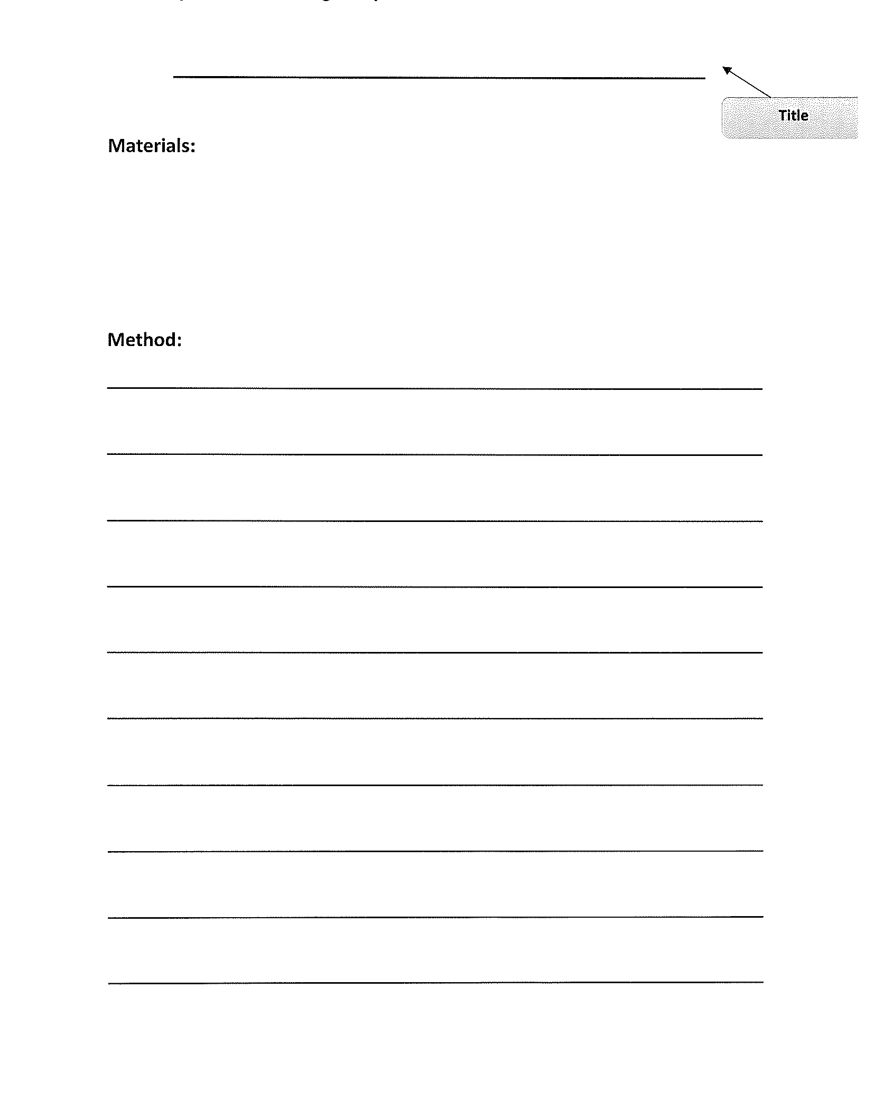
Task 3
Procedural writing
https://www.youtube.com/watch?v=-obFVuDSYjY
Write a procedural text about ‘how to catch the tooth fairy’. Be creative! Remember to add a title, a list of materials and a method (instructions). Don’t forget to start each step with a VERB!

Slide 48
Recess break (30 minutes)

Slide 49
Mathematics
Task 1
Complete an activity from the maths activity grid

Slide 50
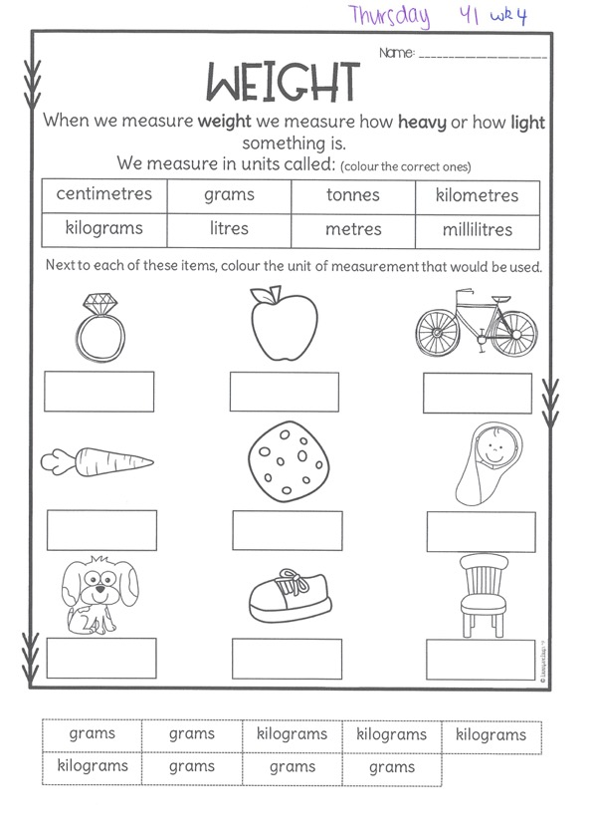
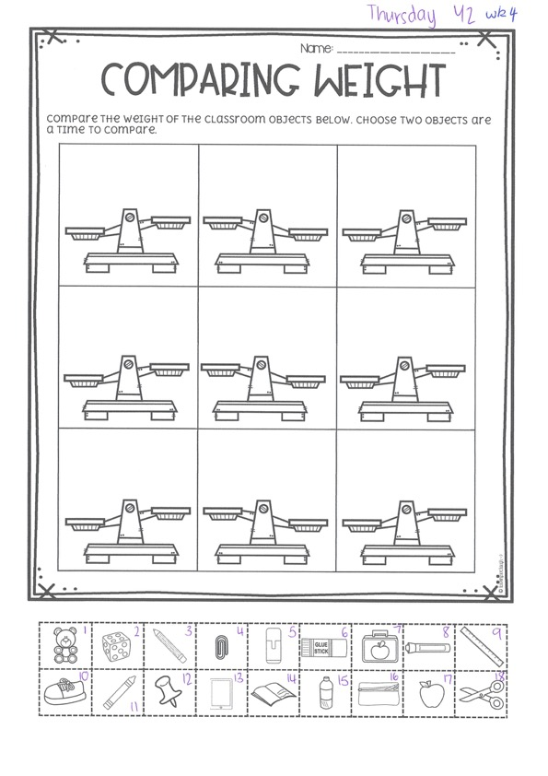
Task 2
Then complete 3 studyladder or mathletics activities
M a s s
Year 1
Year 2

Slide 51
Lunch break (40 minutes)

Slide 52
KLA - PDHPE
DANGER IN EMERGENCIES
Around your home, school or community there are many items that can be dangerous if misused. Its important to be able to recognise these and have an understanding of how to avoid dangerous situations. The police, ambulance and fire brigade are the 3 major organisations that provide emergency services to our community. These can be accessed by phoning 000. there are often separate numbers that be used when siutations are not life threatening. Can you work out the difference? If you had to make a call to your house would you know your full name, address and phone number?

Slide 53
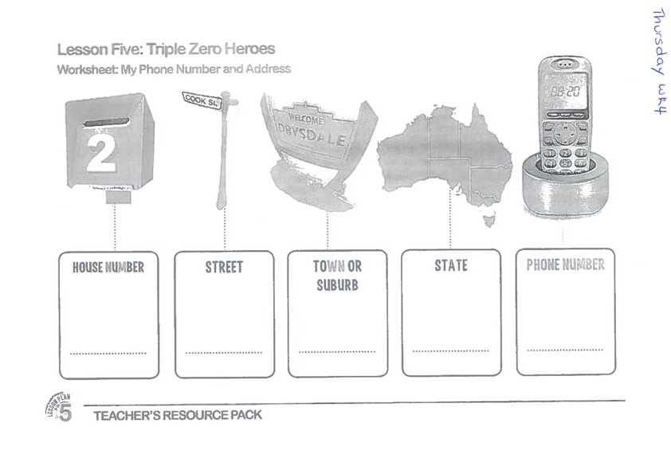
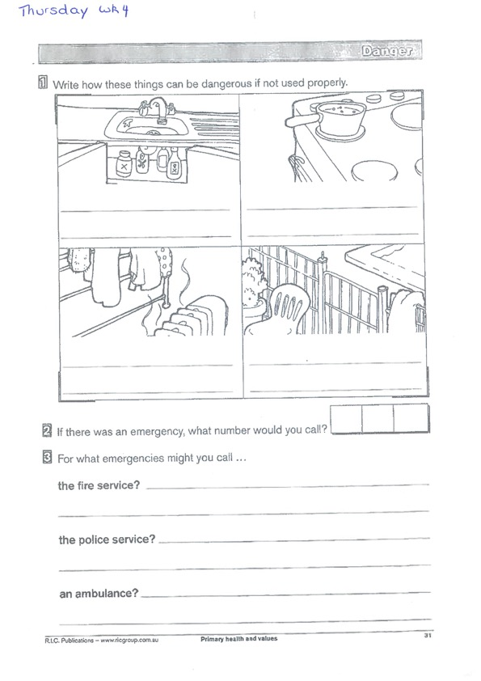

Slide 54
END OF DAY!
ENJOY your well-deserved break everyone!

Slide 55
Good morning
STAGE 1
FRIDAY 6TH AUGUST 2021 – WEEK 4
Please make sure you are sending one or two work samples to your classroom teacher via dojo.

Slide 56
WHATS ON TODAY?
Morning
Task 1 – Grammar
Task 2 – Reading
Crunch n’ sip
Task 3 - Writing
Middle
Task 1 – Maths Grid
Task 2 – Maths Money Worksheet
Task 3 - Fitness
Final
CAPA – Dance
FREE PLAY

Slide 57
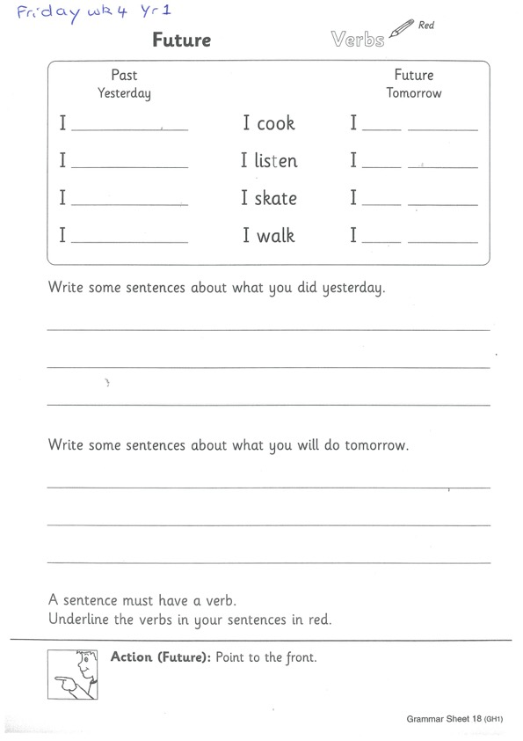
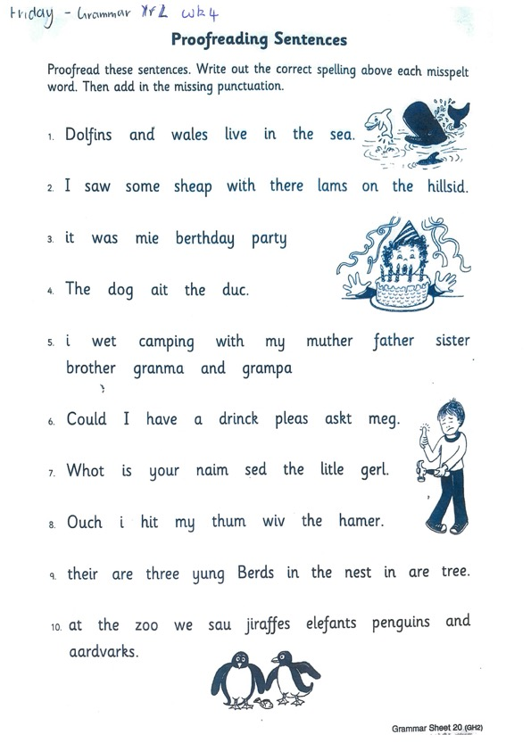
Task 1
Complete the grammar worksheets.
Year 1 – future
Year 2 –proofreading
Follow instructions in your pack.

Slide 58
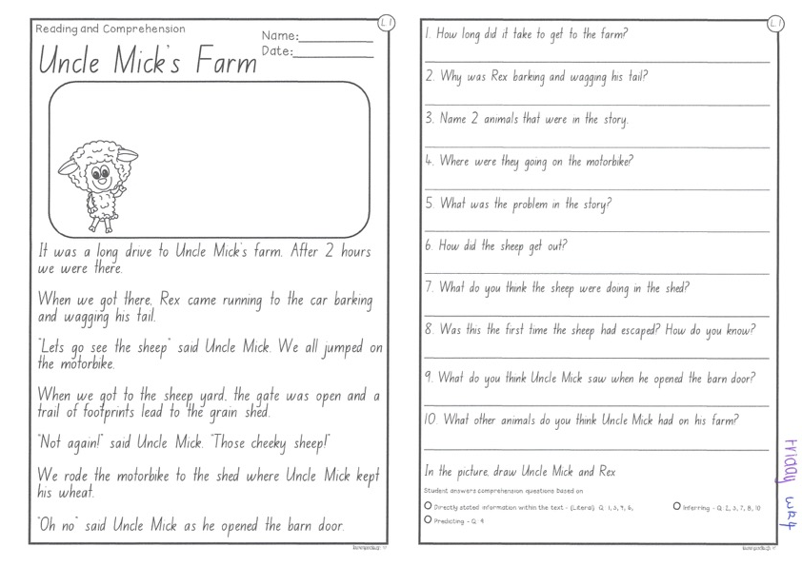
Task 2
Read or get an adult to read ”Uncle Mick’s Farm” and answer the questions.

Slide 59
Crunch n’ sip

Slide 60
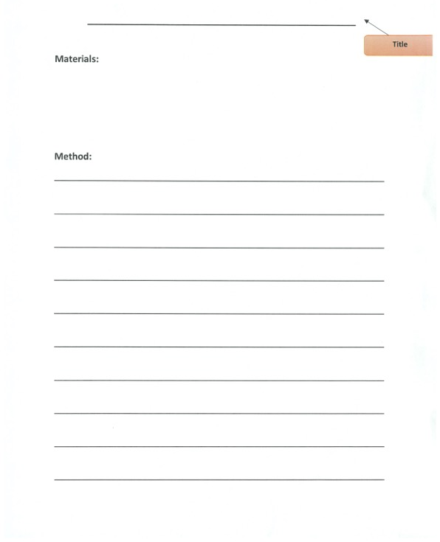
Task 3
Writing – procedural writing
Watch the video of Mrs Mazloum making her sandwich on your dojo.
On a piece of paper write your own procedural text on ‘How to make a sandwich’. Remember to include a title, list of materials and step by step instructions (method). Don’t forget to start with a verb!

Slide 61
Recess break (30 minutes)

Slide 62
Mathematics
Task 1
Complete an activity from the maths activity grid

Slide 63
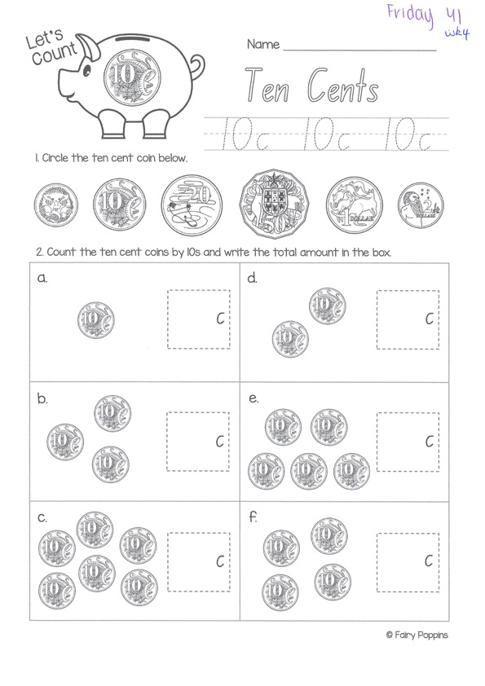
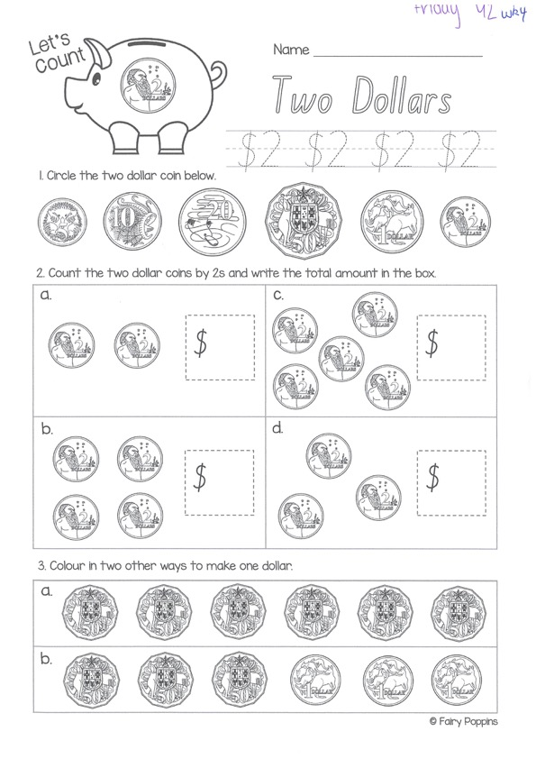
Task 2
Then complete 3 activities on studyladder or mathletics
M o n e y
Year 1
Year 2

Slide 64
Task 3. fitness
Choose an activity from the fitness grid to complete.
Not this one
(in your packs)

Slide 65
Lunch break (40 minutes)

Slide 66

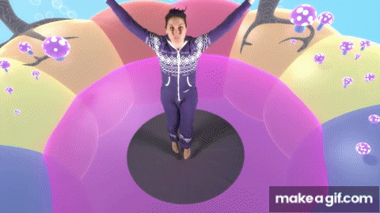
KLA – capa (dance)
DANCE DISCO YOGA
Who let the dogs out
https://www.youtube.com/watch?v=qAFzBJ3H3oc
Dancing under the sea
https://www.youtube.com/watch?v=SH-7A3NVQbY

Slide 67
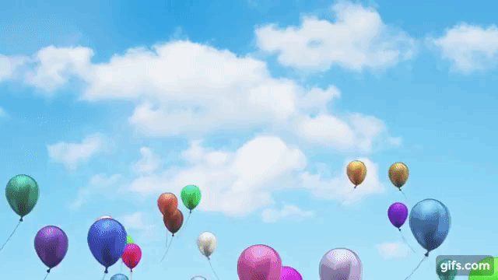
FREE PLAY
Build or construct an object or building using blocks

Slide 68
END OF Week!
ENJOY your well-deserved break everyone!

