Slide 1
term 3 week 3
Mrs Fleming
M I S S M O R A T A
M I S S H O L D S W O R T H
M S R O B I N S O N
M R S M A Z L O U M
M I S S U N A L
M R S E N R I G H T

Slide 2
Good morning
STAGE 1
MONDAY 26TH JULY 2021 – WEEK 3
Please make sure you are sending one or two work samples to your classroom teacher via dojo.

Slide 3
WHATS ON TODAY?
Morning Task 1 - Spelling Task 2 - Handwriting Crunch n’ sip Task 3 - Writing Task 4 - Reading
Middle Task 1 - Maths Grid Task 2 - Fractions Worksheet
Final Geography

Slide 4
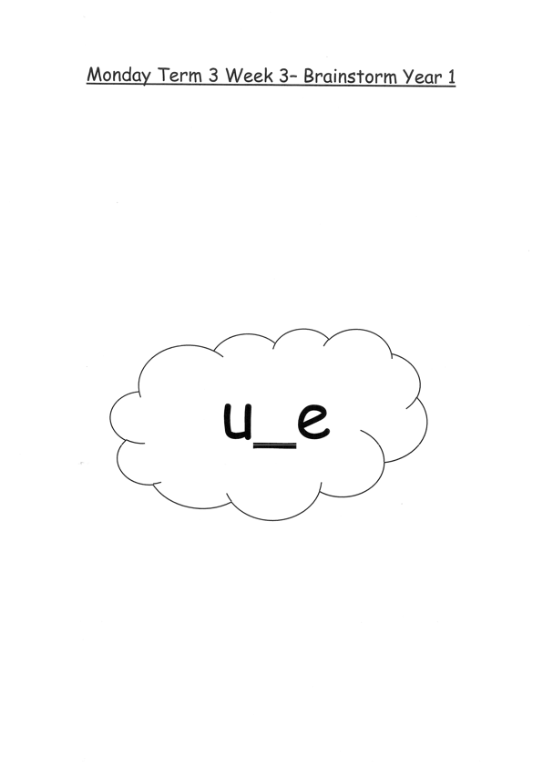
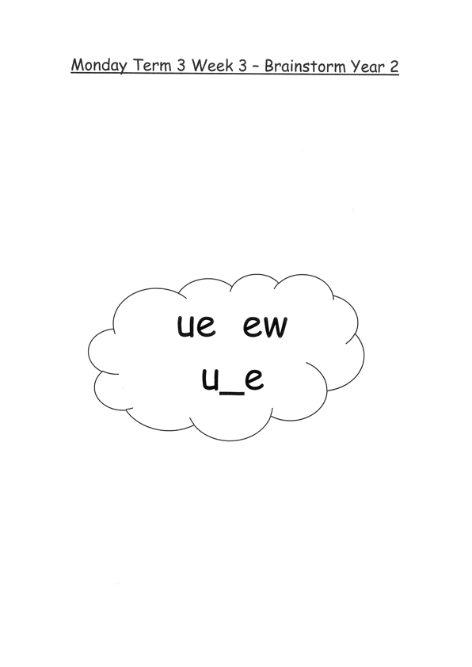
Task 1
Year 1
Year 2
Brainstorm a list of words relating to this week’s sound focus on paper.
Complete Jolly Phonics worksheet (in your booklet)

Slide 5
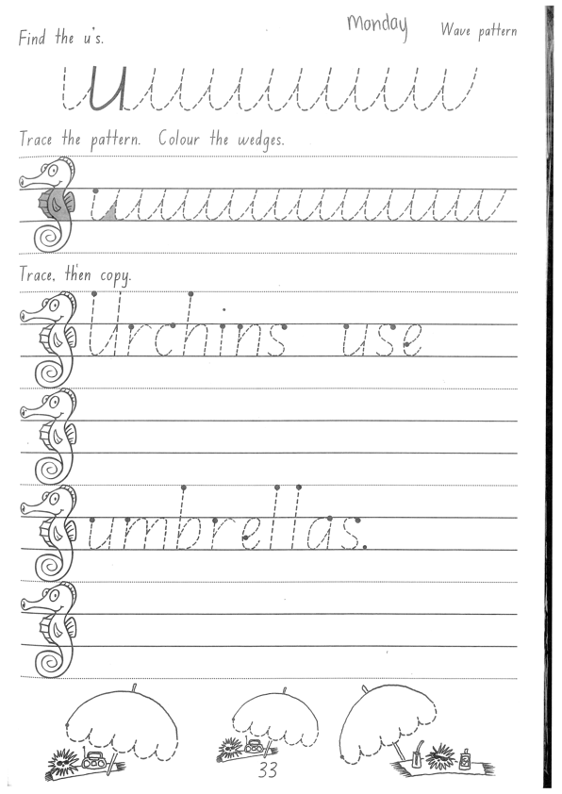
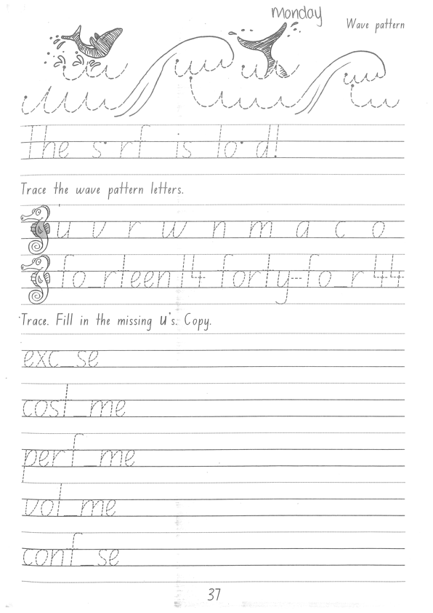
Task 2
Complete the letter “u” in your handwriting books.

Slide 6
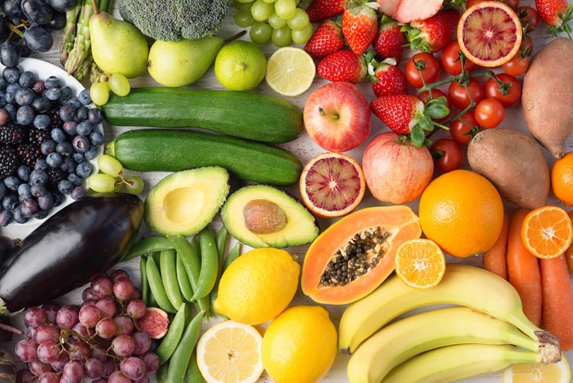
Crunch n’ sip

Slide 7
Task 3
Imagine that you are at the beach and find a special shell. Have some time to think about the shell you find and what it does. Does it have special powers? Is it a house for a special sea creature? Use your imagination to think of something fun! Remember to include who, what, when, where. Draw a picture to match.

Slide 8
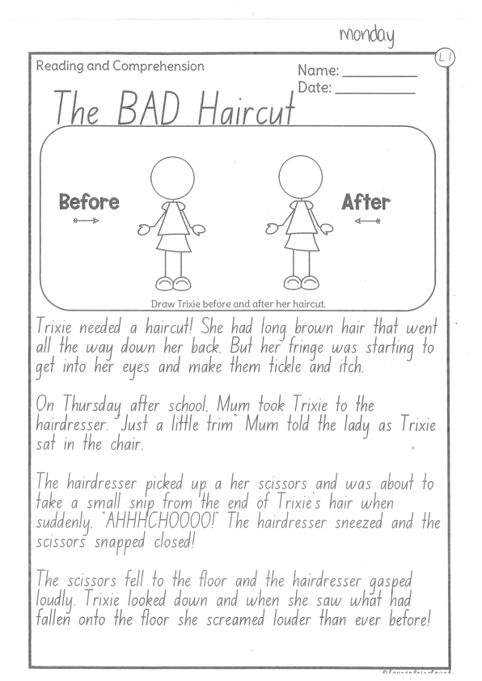
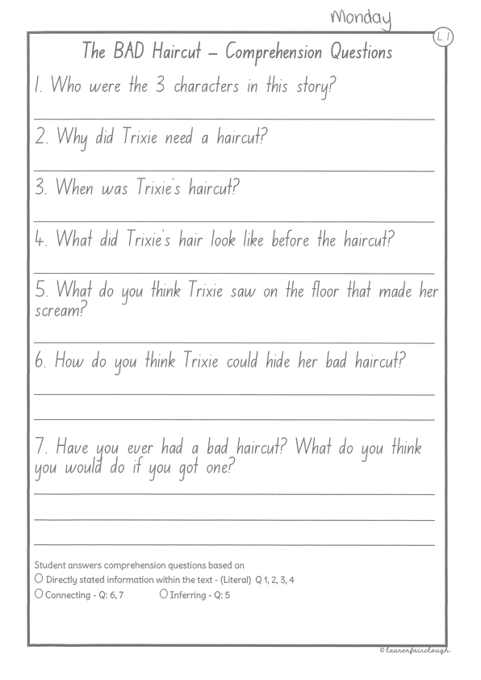
Task 4
Read or get an adult to read ‘The BAD Haircut’ and answer the questions.

Slide 9
Recess break (30 minutes)

Slide 10
Mathematics
Task 1
Complete an activity from the maths activity grid

Slide 11
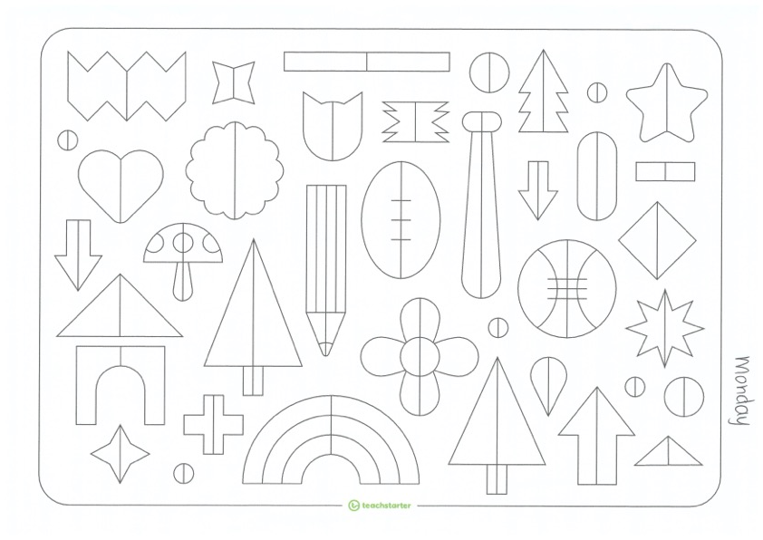
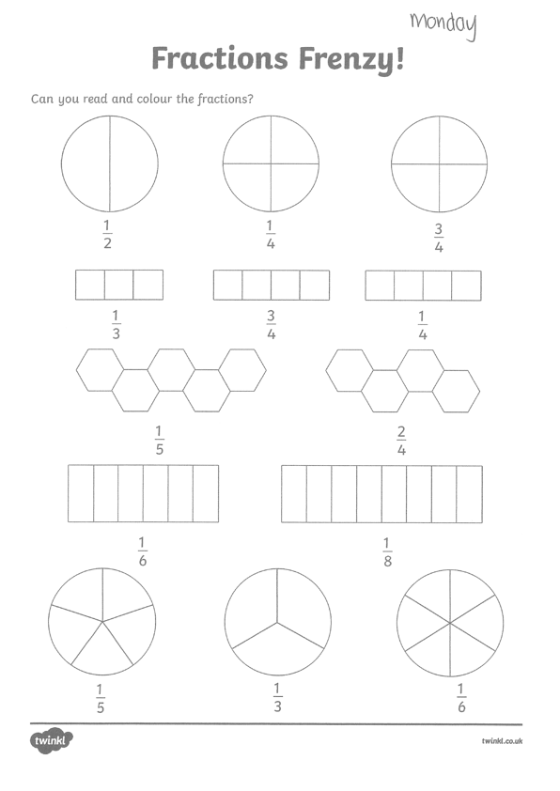
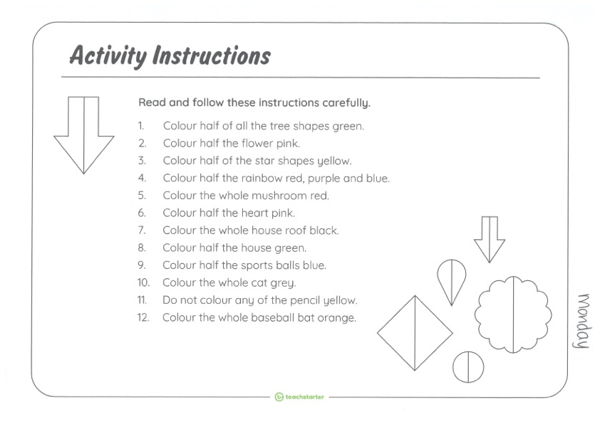
Task 2
F R A C T I O N S

Slide 12
Lunch break (40 minutes)

Slide 13
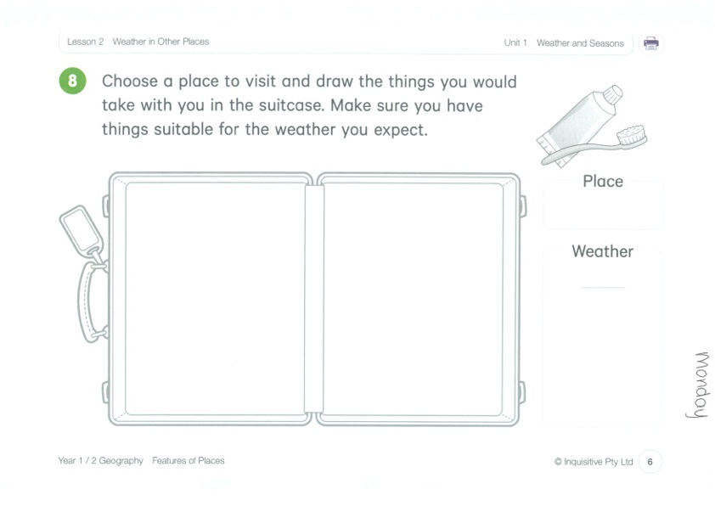
KLA - geography
Copy the link below:
http://inq.co/class/9wg Code: 9484
We are learning about weather in other places.

Slide 14
END OF DAY!
ENJOY your well-deserved break everyone!

Slide 15
Good morning
STAGE 1
TUESDAY 27TH JULY 2021 – WEEK 3
Please make sure you are sending one or two work samples to your classroom teacher via dojo.

Slide 16
WHATS ON TODAY?
Morning Task 1 – Spelling Task 2 – Reading Crunch n’ sip Task 3 - Writing Middle Task 1 – Maths Grid
Task 2 – Activity Worksheet
Final Library

Slide 17
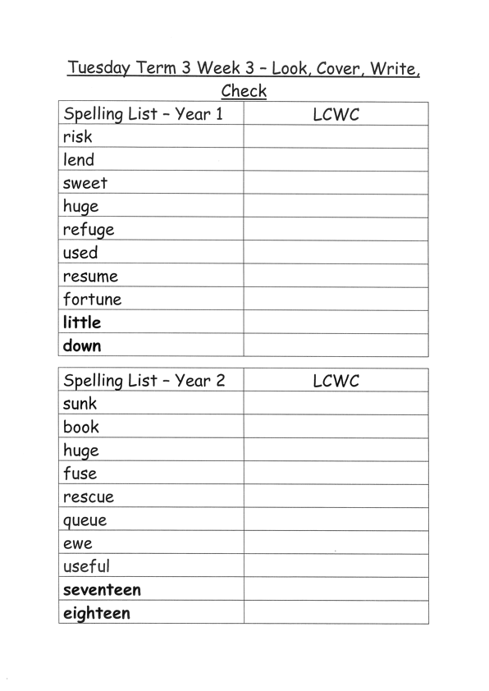
Task 1
Complete the Look, Cover, Write, Check worksheet (in your booklet).
Then complete your tricky word!

Slide 18
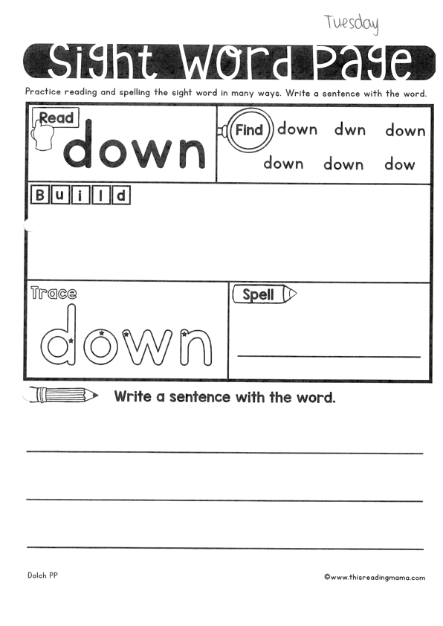
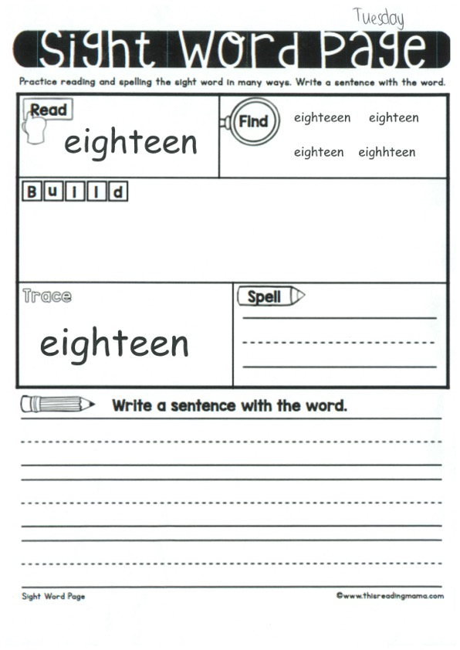

Slide 19
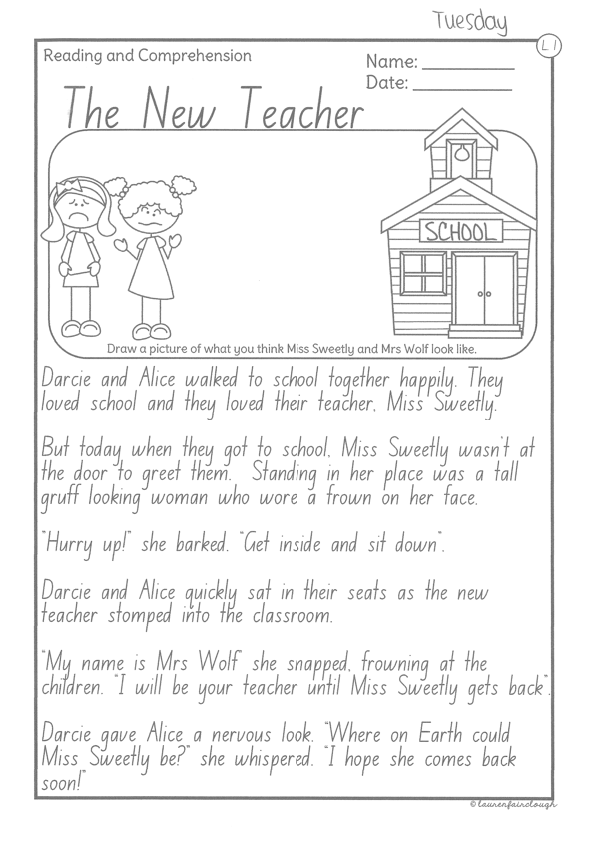
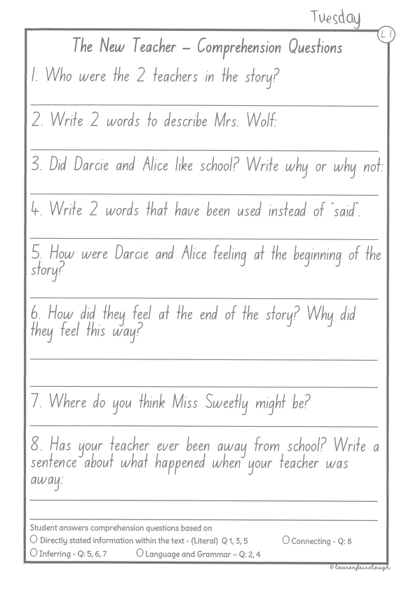
Task 2
Read or get an adult to read ”The New Teacher” and answer the questions.

Slide 20
Crunch n’ sip

Slide 21
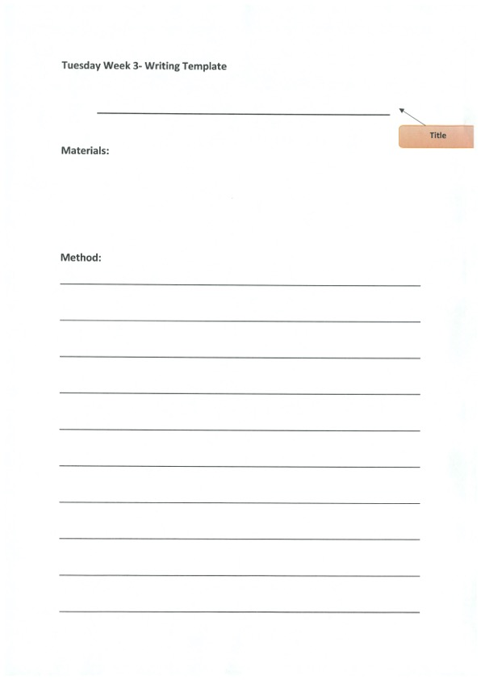
Task 3
Writing your own procedural text on ‘How to play hide and seek’. Remember to include a title, a list of materials and step by step instructions (method). Don’t forget to start each step with a verb!

Slide 22
Recess break (30 minutes)

Slide 23
Mathematics
M o n e y
Task 1
Complete an activity from the maths activity grid

Slide 24
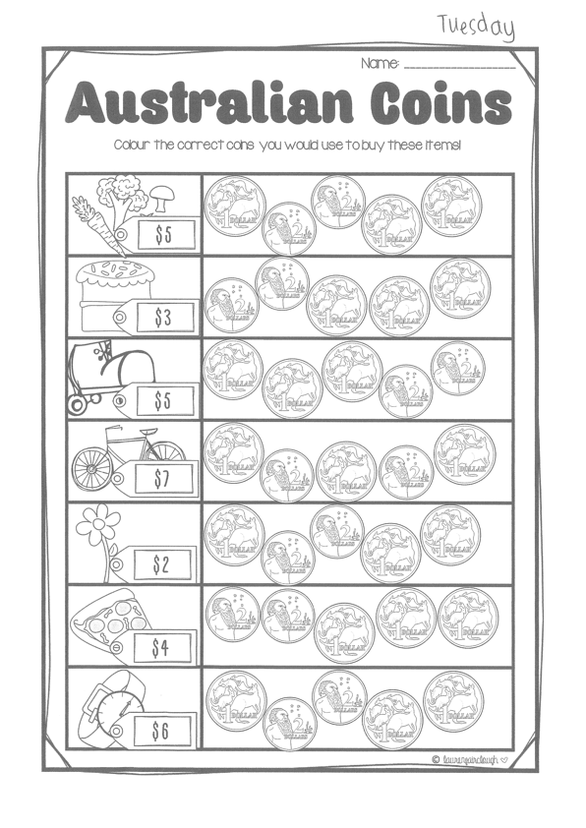
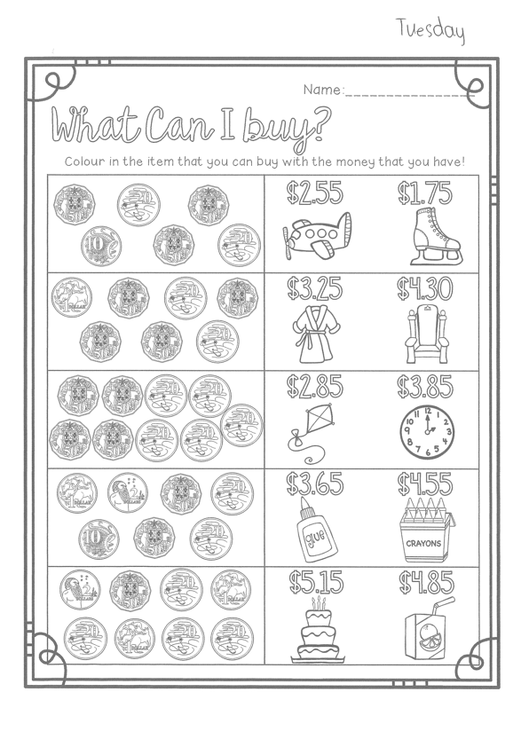
Task 2
M o n e y

Slide 25
Lunch break (40 minutes)

Slide 26
library
Silent reading
Choose one or two activities to complete each week from the red library activity grid.

Slide 27
END OF DAY!
ENJOY your well-deserved break everyone!

Slide 28
Good morning
STAGE 1
WEDNESDAY 28th JULY 2021 – WEEK 3
Please make sure you are sending one or two work samples to your classroom teacher via dojo.

Slide 29
WHATS ON TODAY?
Morning Task 1 – Spelling Task 2 – Reading Crunch n’ sip Task 3 - Writing Middle Task 1 – Maths Grid Task 2 – Mass Worksheet
Task 3 – Fitness
Final Science

Slide 30
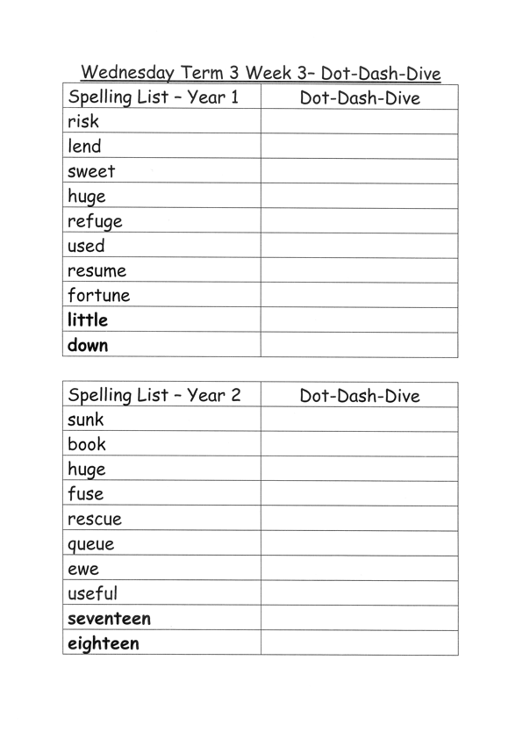
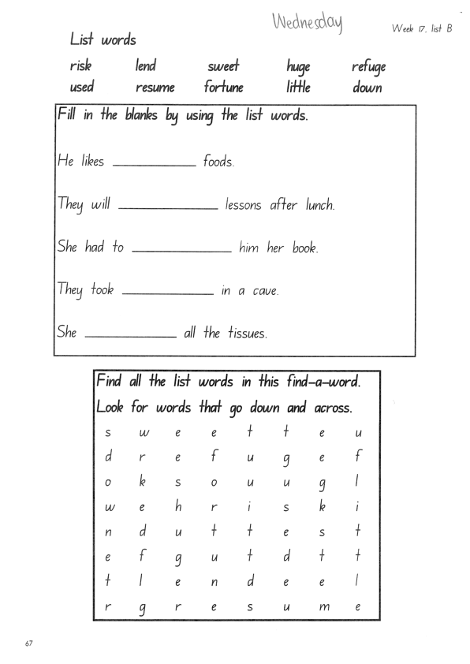
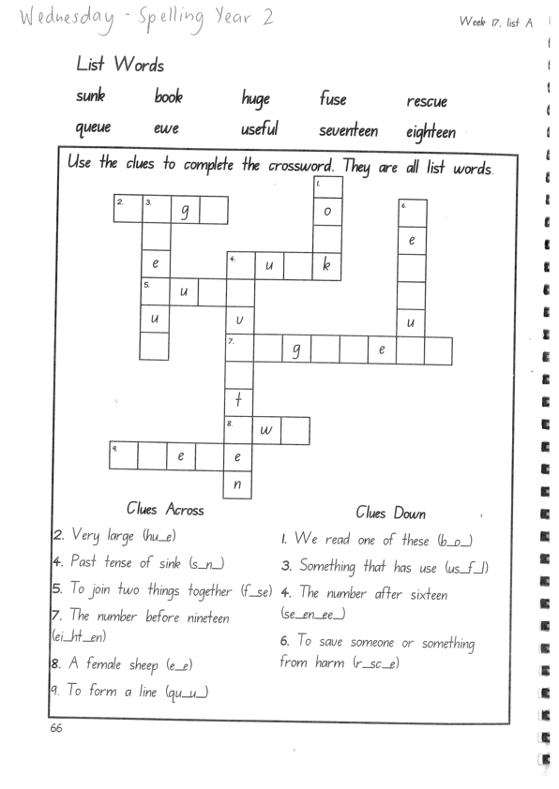
Task 1
Complete dot, dash, dive worksheets.
Video links:
https://www.youtube.com/watch?v=82ojiAZt1X8

Slide 31
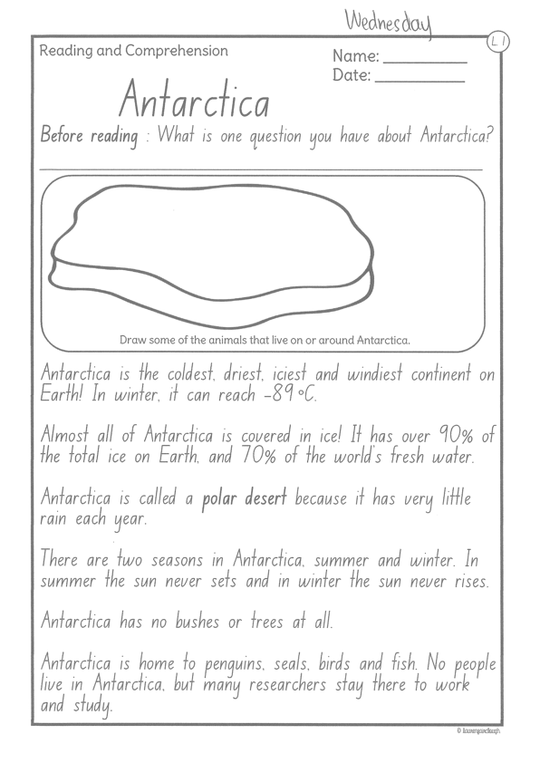
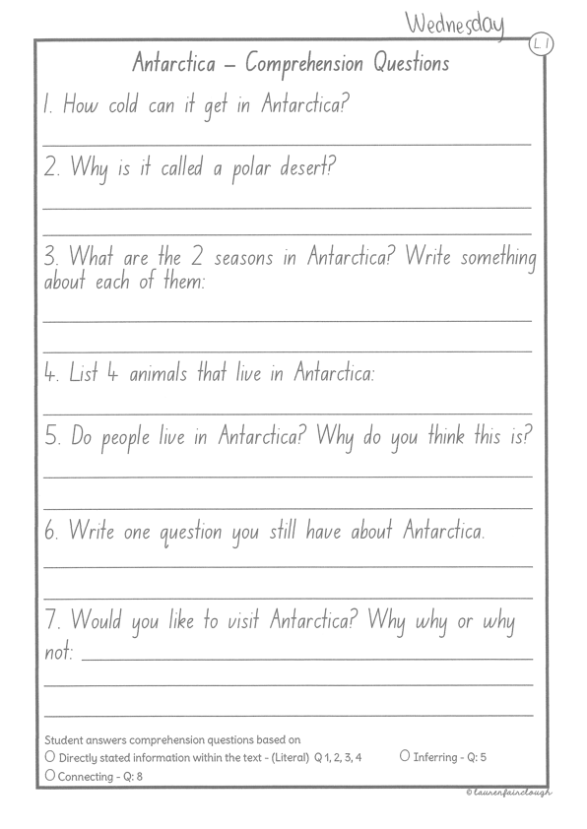
Task 2
Read or get an adult to read ”Antarctica” and answer the questions.

Slide 32
Crunch n’ sip

Slide 33
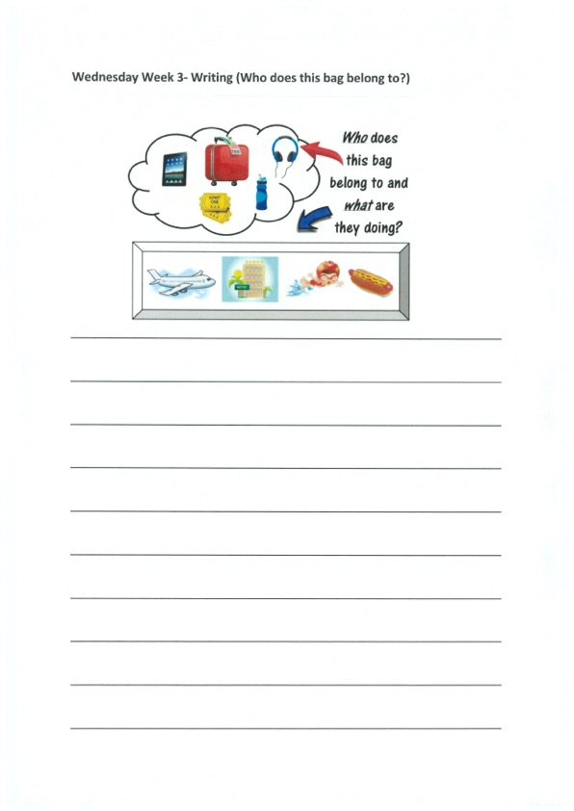
Task 3
Writing – who does this bag belong to?
Look at the questions in your learning pack guide.

Slide 34
Recess break (30 minutes)

Slide 35
Mathematics
Task 1
Complete an activity from the maths activity grid

Slide 36
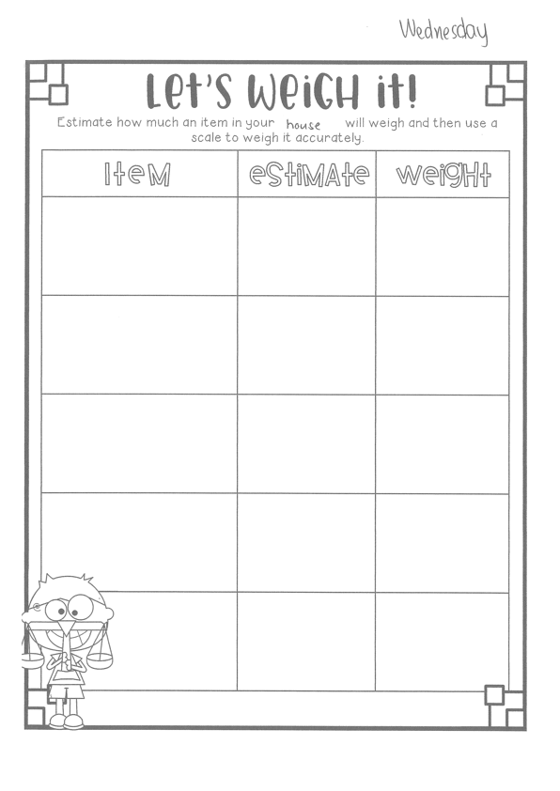
Task 2
M a s s
Year 2
Year 1

Slide 37
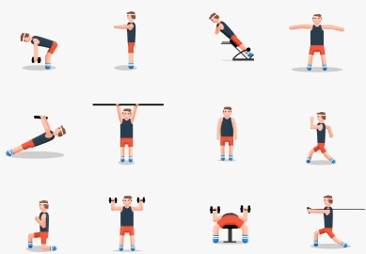
fitness
Choose an activity from the fitness grid to complete.
Not this one
(in your packs)

Slide 38
Lunch break (40 minutes)

Slide 39
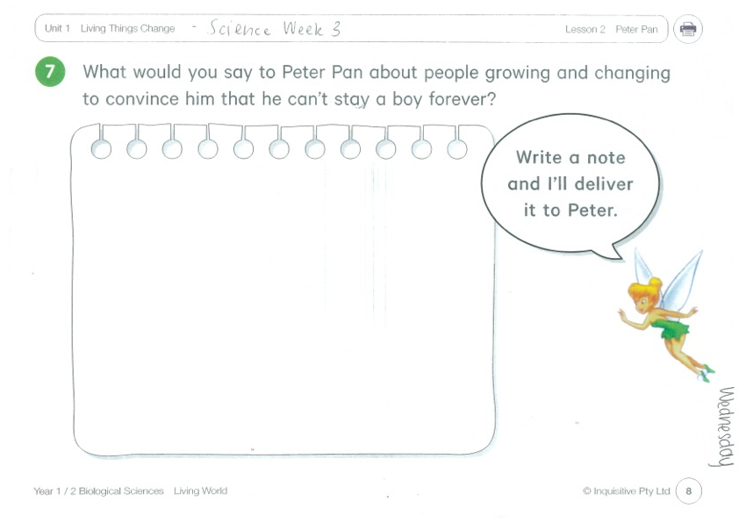
KLA - SCIENCE
Inquisitive link – http://inq.co/class/9wk
Access Code: 5742
Watch the video on ‘Peter Pan’ and complete the worksheet.

Slide 40
END OF DAY!
ENJOY your well-deserved break everyone!

Slide 41
Good morning
STAGE 1
THURSDAY 28th JULY 2021 – WEEK 3
Please make sure you are sending one or two work samples to your classroom teacher via dojo.

Slide 42
WHATS ON TODAY?
Morning Task 1 – Spelling Task 2 – Reading Crunch n’ sip Task 3 - Writing Middle Task 1 – Maths Grid
Task 2 – Maths Worksheets
Final PDHPE

Slide 43
Task 1
Complete the worksheet. Write your spelling words in alphabetical order. Then write 5 sentences using your spelling words. Circle any verbs in your sentences.

Slide 44
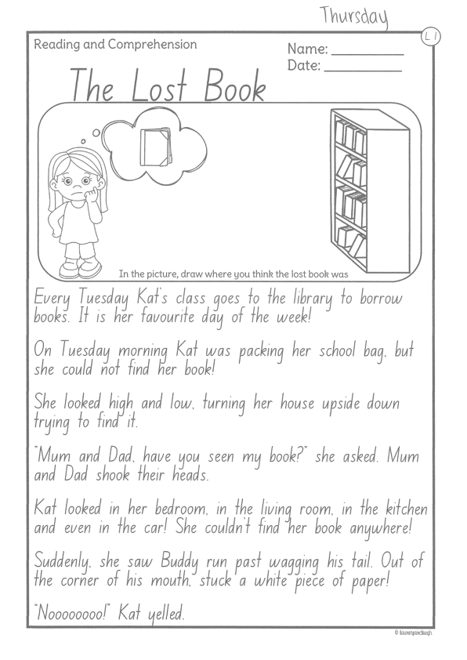
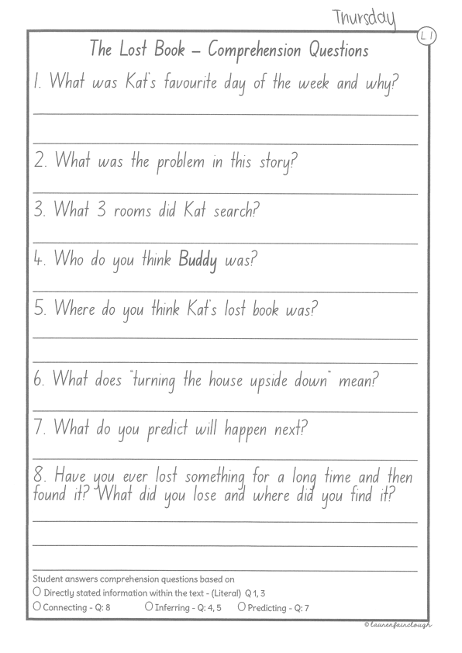
Task 2
Read or get an adult to read ”The Lost Book” and answer the questions.

Slide 45
Crunch n’ sip

Slide 46
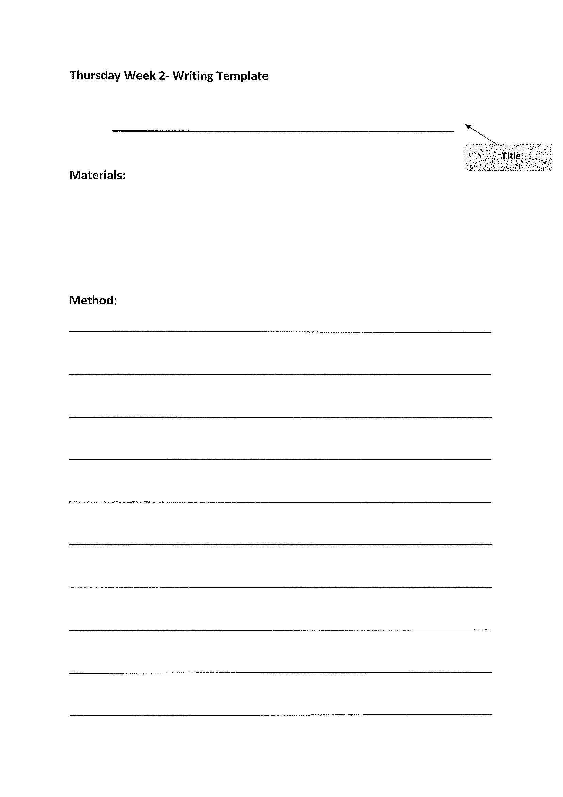
Task 3
Writing – procedural writing
Watch the video
https://www.youtube.com/watch?v=pdnxmJYXiWY
Read through the questions in the learning pack to complete the task.

Slide 47
Recess break (30 minutes)

Slide 48
Mathematics
Task 1
Complete an activity from the maths activity grid

Slide 49
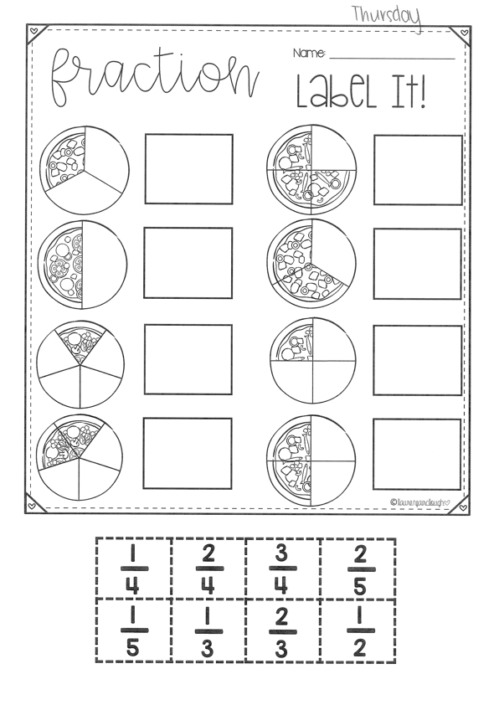
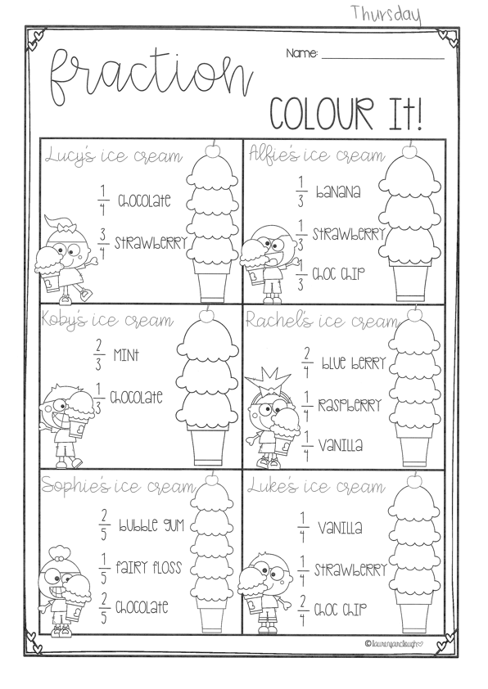
Task 2
f r a c t I o n s
Year 1
Year 2

Slide 50
Lunch break (40 minutes)

Slide 51
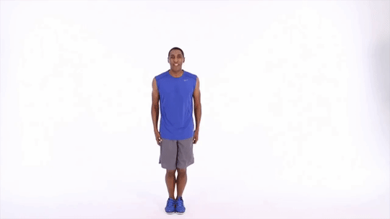
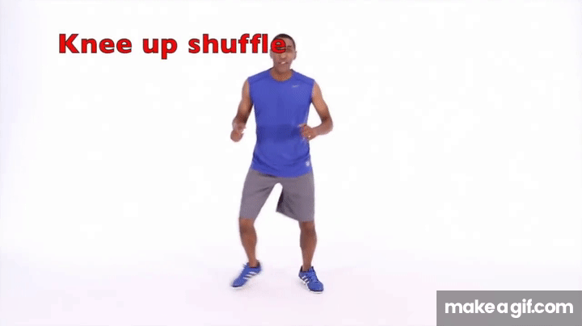
KLA - PDHPE
Visit the Hammondville PS YouTube page to see what goals Mr Withers has set for you this week.
Watch the Fundamental Movement Skills video – Overarm Throw.
https://www.youtube.com/channel/UCFI8inXSYttI8PVkEcSuD7g

Slide 52
END OF DAY!
ENJOY your well-deserved break everyone!

Slide 53
Good morning
STAGE 1
FRIDAY 30th JULY 2021 – WEEK 3
Please make sure you are sending one or two work samples to your classroom teacher via dojo.

Slide 54
WHATS ON TODAY?
Morning Task 1 – Grammar Task 2 – Reading Crunch n’ sip Task 3 - Writing Middle Task 1 – Maths Grid
Task 2 – Maths Money Worksheet
Task 3 - Fitness
Final CAPA – Dance FREE PLAY

Slide 55
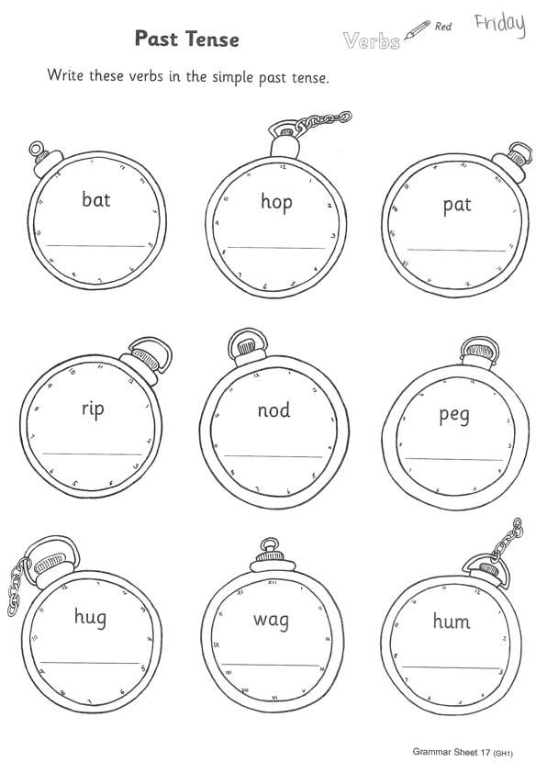
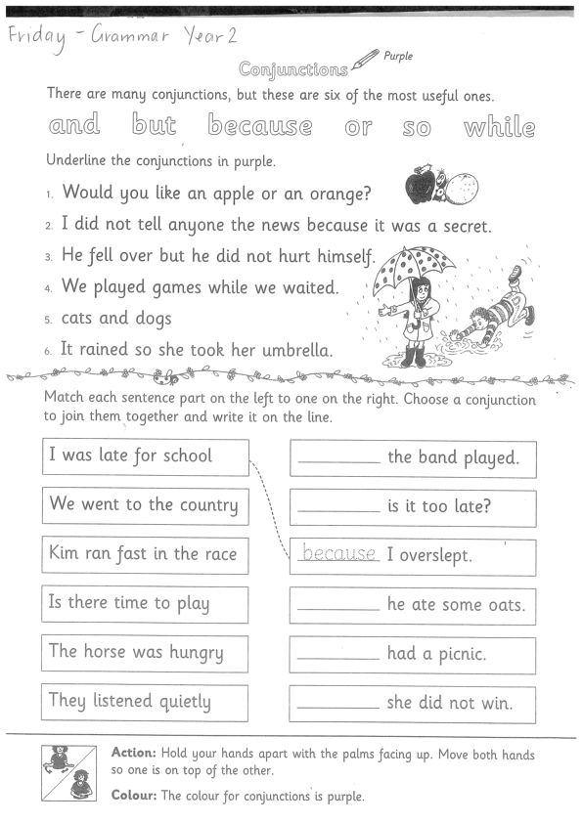
Task 1
Complete the grammar worksheets.
Year 1 – verb past Tense: doubling rule
Year 2 – Conjunctions
Follow instructions in your pack.

Slide 56
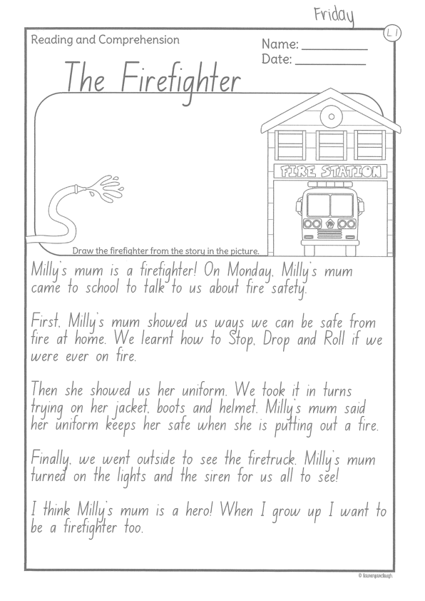
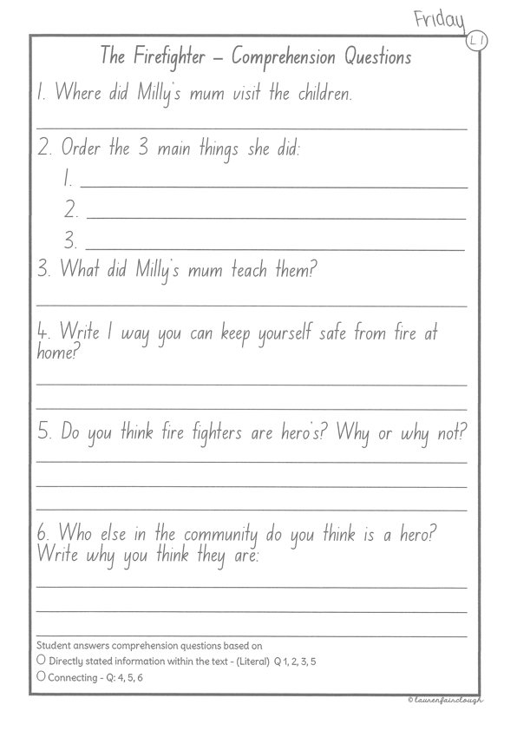
Task 2
Read or get an adult to read ”The Firefighter” and answer the questions.

Slide 57
Crunch n’ sip

Slide 58
Task 3
Writing – procedural writing
Watch the song below:
https://www.youtube.com/watch?v=CeDlXJAaPyI
Read through the instructions in the learning pack to complete the task.

Slide 59
Recess break (30 minutes)

Slide 60
Mathematics
Task 1
Complete an activity from the maths activity grid

Slide 61
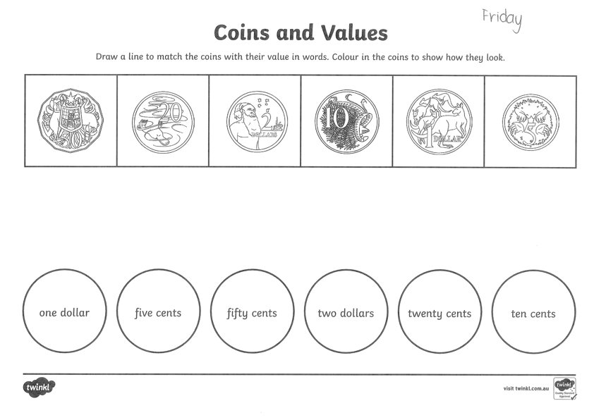
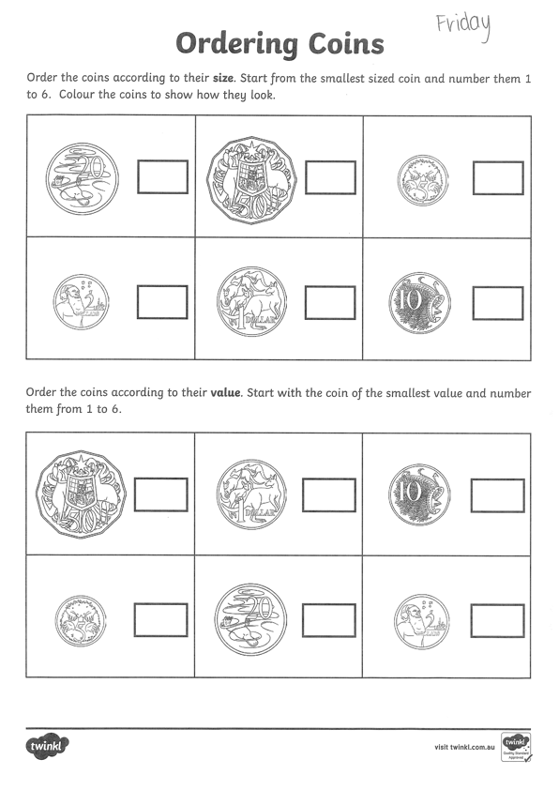
Task 2
M o n e y
Year 1
Year 2

Slide 62
Task 3. fitness
Choose an activity from the fitness grid to complete.
Not this one
(in your packs)

Slide 63
Lunch break (40 minutes)

Slide 64
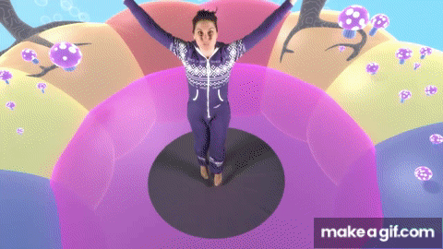
KLA – capa (dance)
DANCE DISCO YOGA
Gummy Bear – https://www.youtube.com/watch?v=6Q7-tzCCh3w
Move like an animal –
https://www.youtube.com/watch?v=EQ8p8SOJBlY

Slide 65
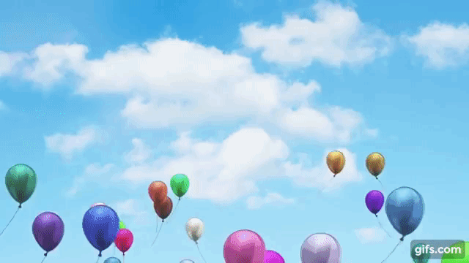
FREE PLAY
Build or construct an object or building using blocks

Slide 66
END OF Week!
ENJOY your well-deserved break everyone!

