Slide 1
term 3 week 1
Mrs Fleming
M I S S M O R A T A
M I S S H O L D S W O R T H
M S R O B I N S O N
M R S M A Z L O U M
M I S S U N A L
M R S E N R I G H T

Slide 2
Good morning
STAGE 1
FRIDAY 16TH JULY 2021 – WEEK 2
Please make sure you are sending one or two work samples to your classroom teacher via dojo.

Slide 3
WHATS ON TODAY?
Morning Task 1 – Play fly swat with your sight words. Task 2 – Reading (non-fiction) Crunch n’ sip Writing
Middle Maths – Pattern hunt, Fractions PDHPE - Ball kicking
Final CAPA Free Play

Slide 4
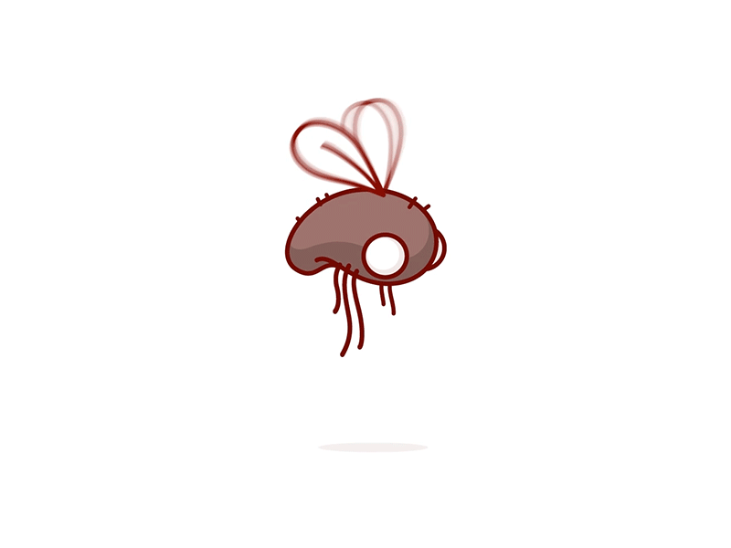
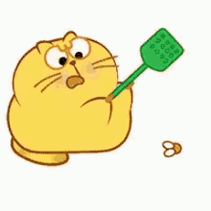
Task 1
Play fly swat with your sight words. An adult says a word, you find the word and splat it with your hand. Time how long it takes to write out five spelling words. Try again. See if you can beat your first time.

Slide 5
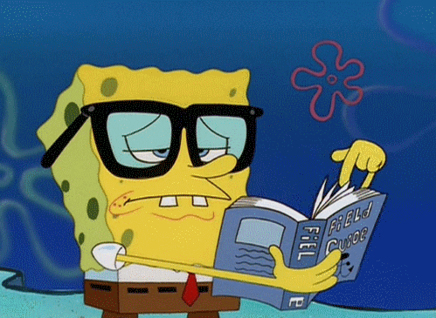
Task 2
Choose a non-fictional book to read aloud with a parent/carer. Read it aloud together. How does the title describe the content of the book? Was the title a good one for this book? Why or why not?

Slide 6
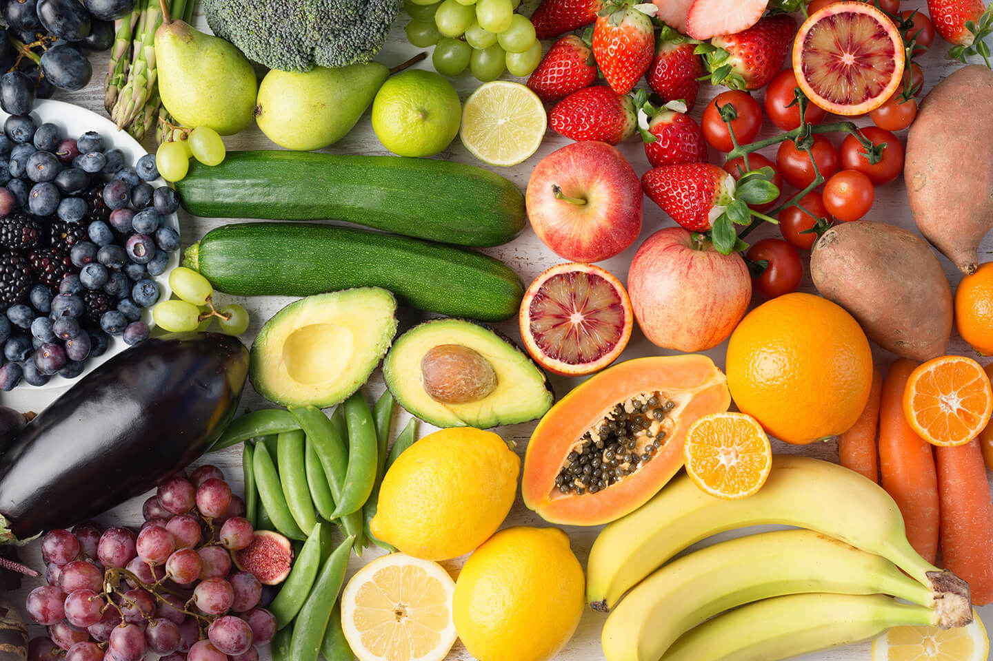
Crunch n’ sip

Slide 7
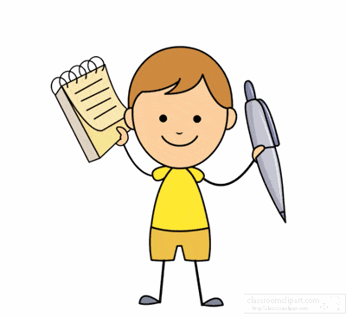
Task 4
Write a list of food you would like to eat for dinner. Think of the main dish and dessert. Write a description of a person or animal in your home using adjectives (describing words).

Slide 8
Recess break (30 minutes)

Slide 9
Mathematics
Task 1
Pattern Hunt: What patterns can you find in and around your home/classroom? Ask someone to help you describe your favourite pattern.
Use a pencil, pen, a block or paddle pop sticks to measure five of your favourite toys. Measure how tall your toys are/ Order them from shortest to tallest.

Slide 10
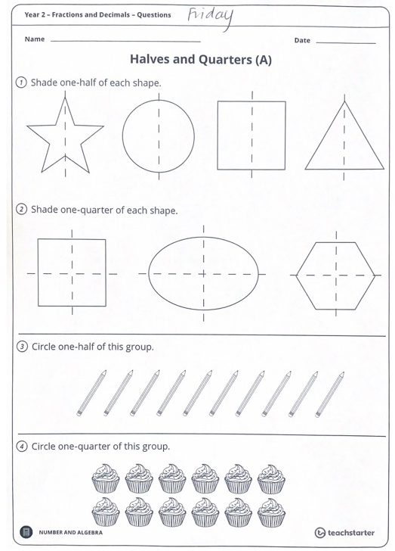
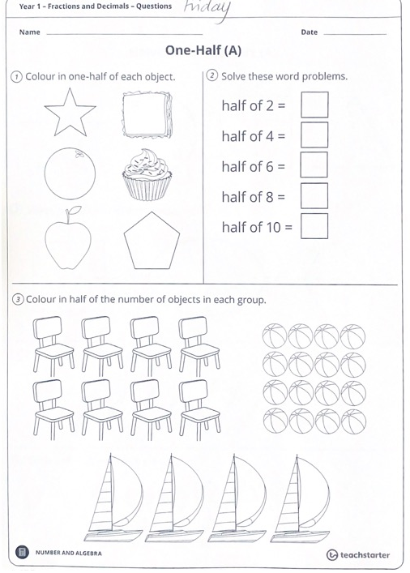
Task 2
Fractions

Slide 11
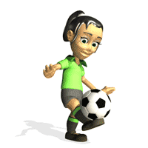
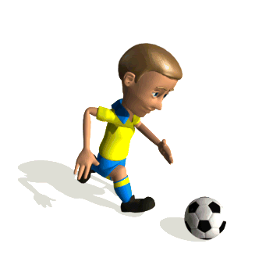
Task 3
PDHPE
Kick a ball back and forwards with a partner. Put out some cones or markers and see if you can run and kick the ball around the markers. If you have a small goal, you can practice kicking some goals. Kick a ball against a wall.

Slide 12
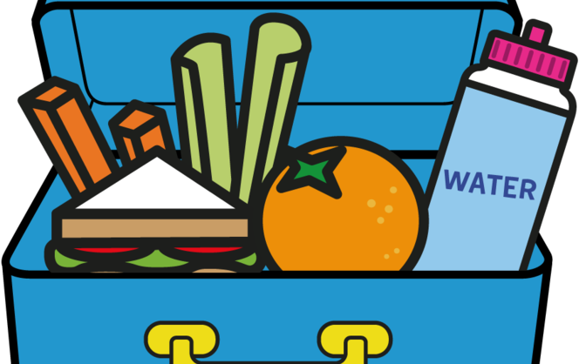
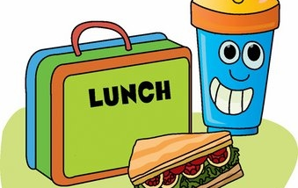
Lunch break (40 minutes)

Slide 13
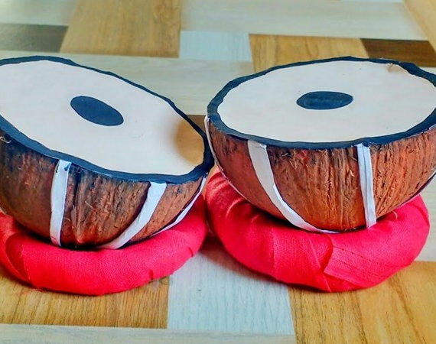
KLA - CAPA
Make a musical instrument using materials or objects from around your home or classroom. Try to choose recycled materials to create your instrument. Consider creating something with the people in your home/class.
Create a composition using only the materials you have created and perhaps some furniture or other things in your house that have unique sounds.

Slide 14
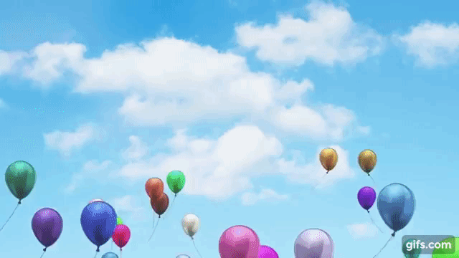
FREE PLAY
Build or construct an object or building using blocks

Slide 15
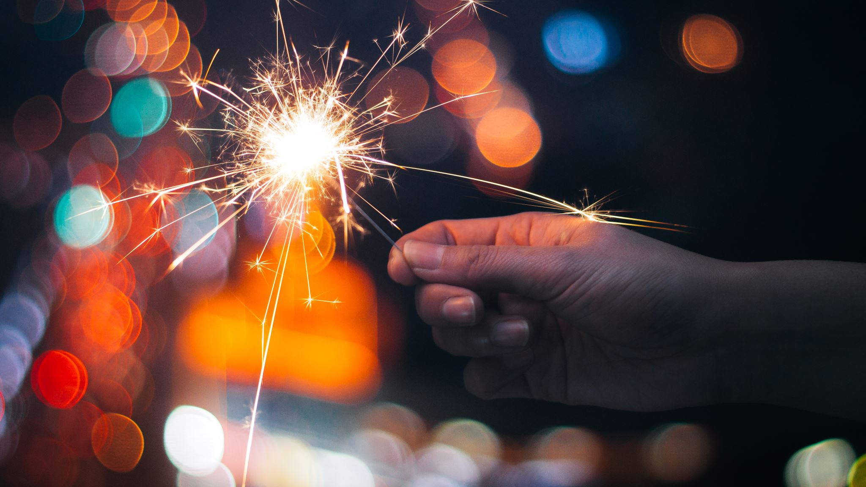
HAPPY WEEKEND!
ENJOY your well-deserved weekend break everyone!

