Slide 1
term 3 week 2
Mrs Fleming
M I S S M O R A T A
M I S S H O L D S W O R T H
M S R O B I N S O N
M R S M A Z L O U M
M I S S U N A L
M R S E N R I G H T

Slide 2
Good morning
STAGE 1
MONDAY 19TH JULY 2021 – WEEK 2
Please make sure you are sending one or two work samples to your classroom teacher via dojo.

Slide 3
WHATS ON TODAY?
Morning Task 1 – Spelling Task 2 – Handwriting Crunch n’ sip Writing NAIDOC 2021 writing
Middle Maths
Activity Worksheet
Final Geography

Slide 4
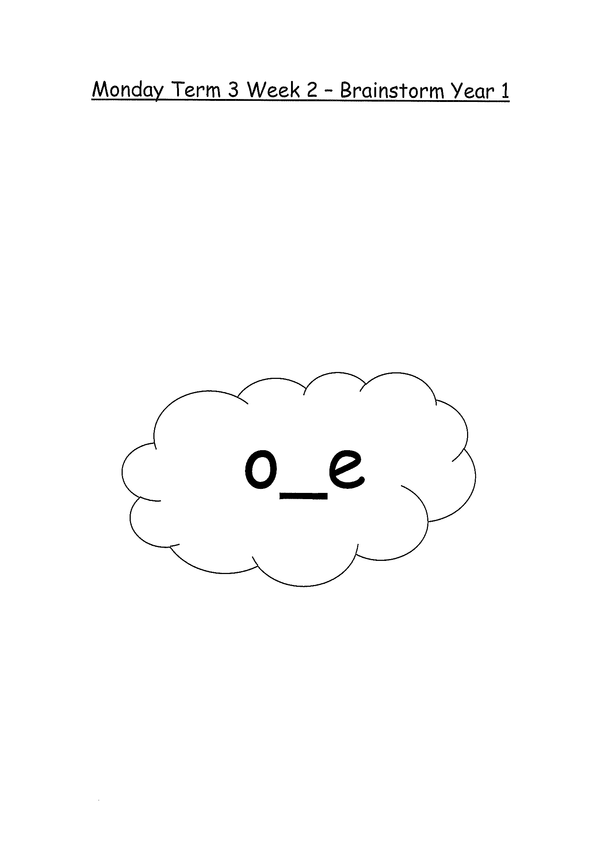
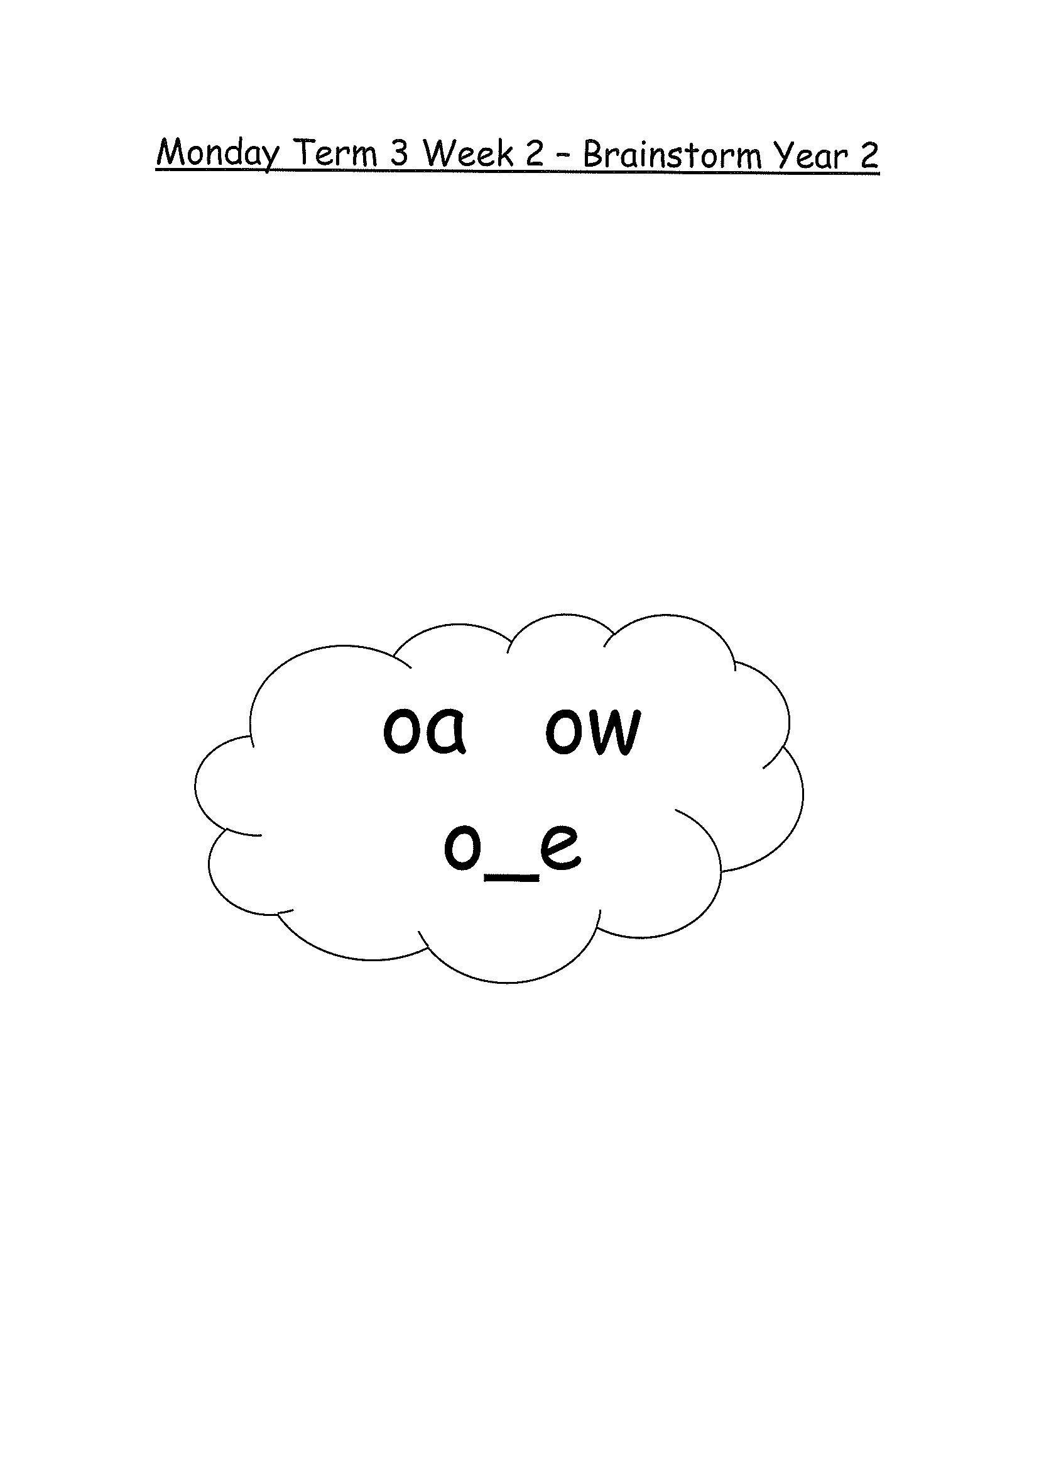
Task 1
Brainstorm a list of words relating to this week’s sound focus on paper.
Complete Jolly Phonics worksheet (in your booklet)

Slide 5
Task 2
Complete the letter “u” in your handwriting books.

Slide 6
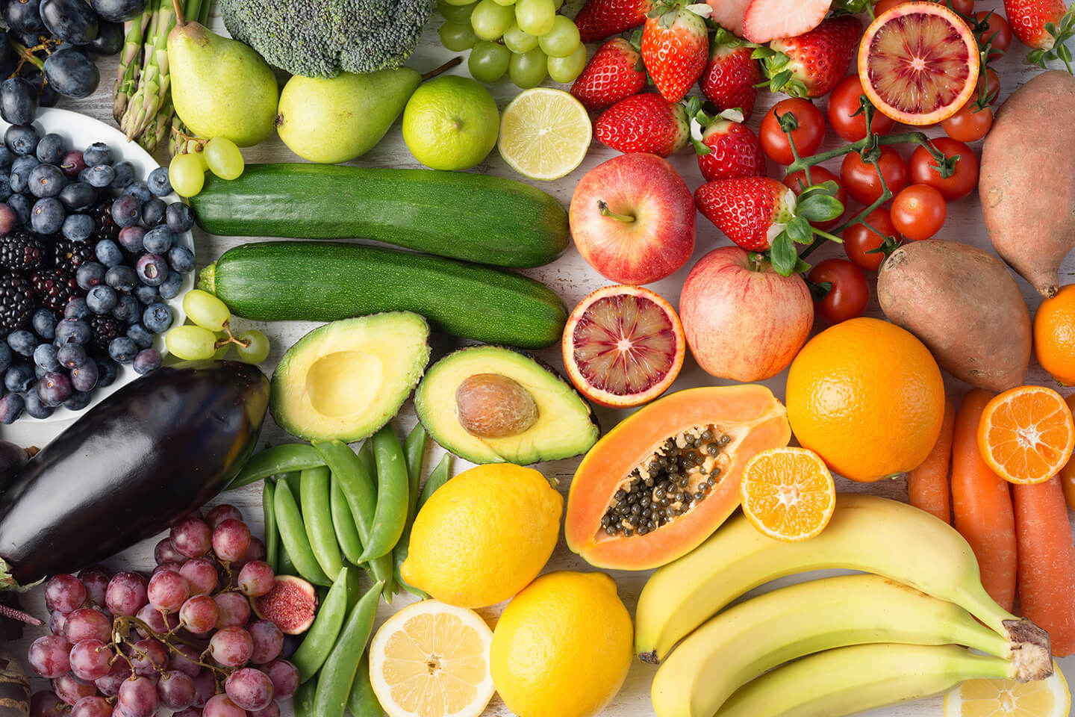
Crunch n’ sip

Slide 7
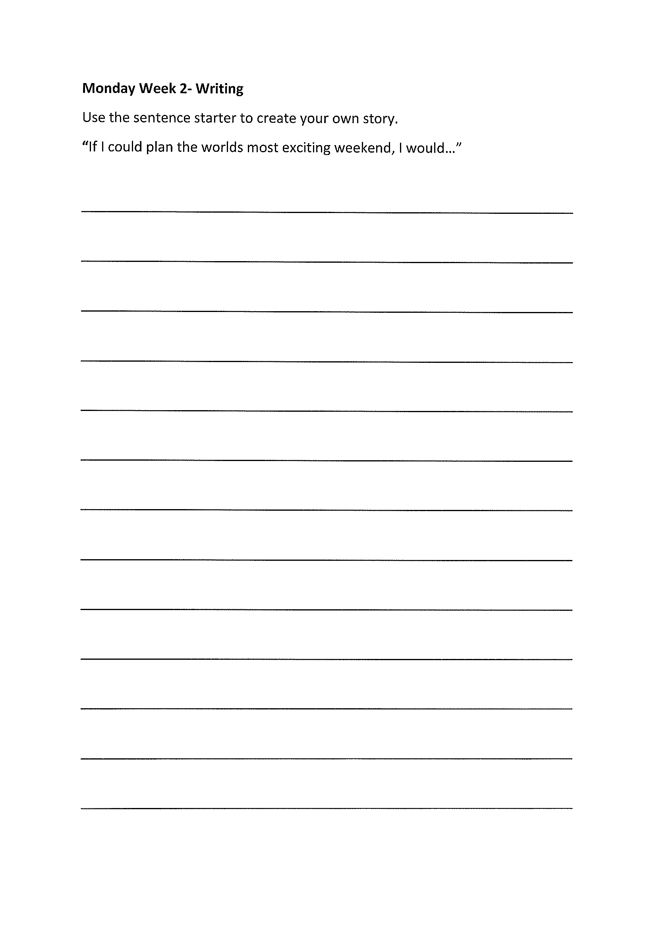
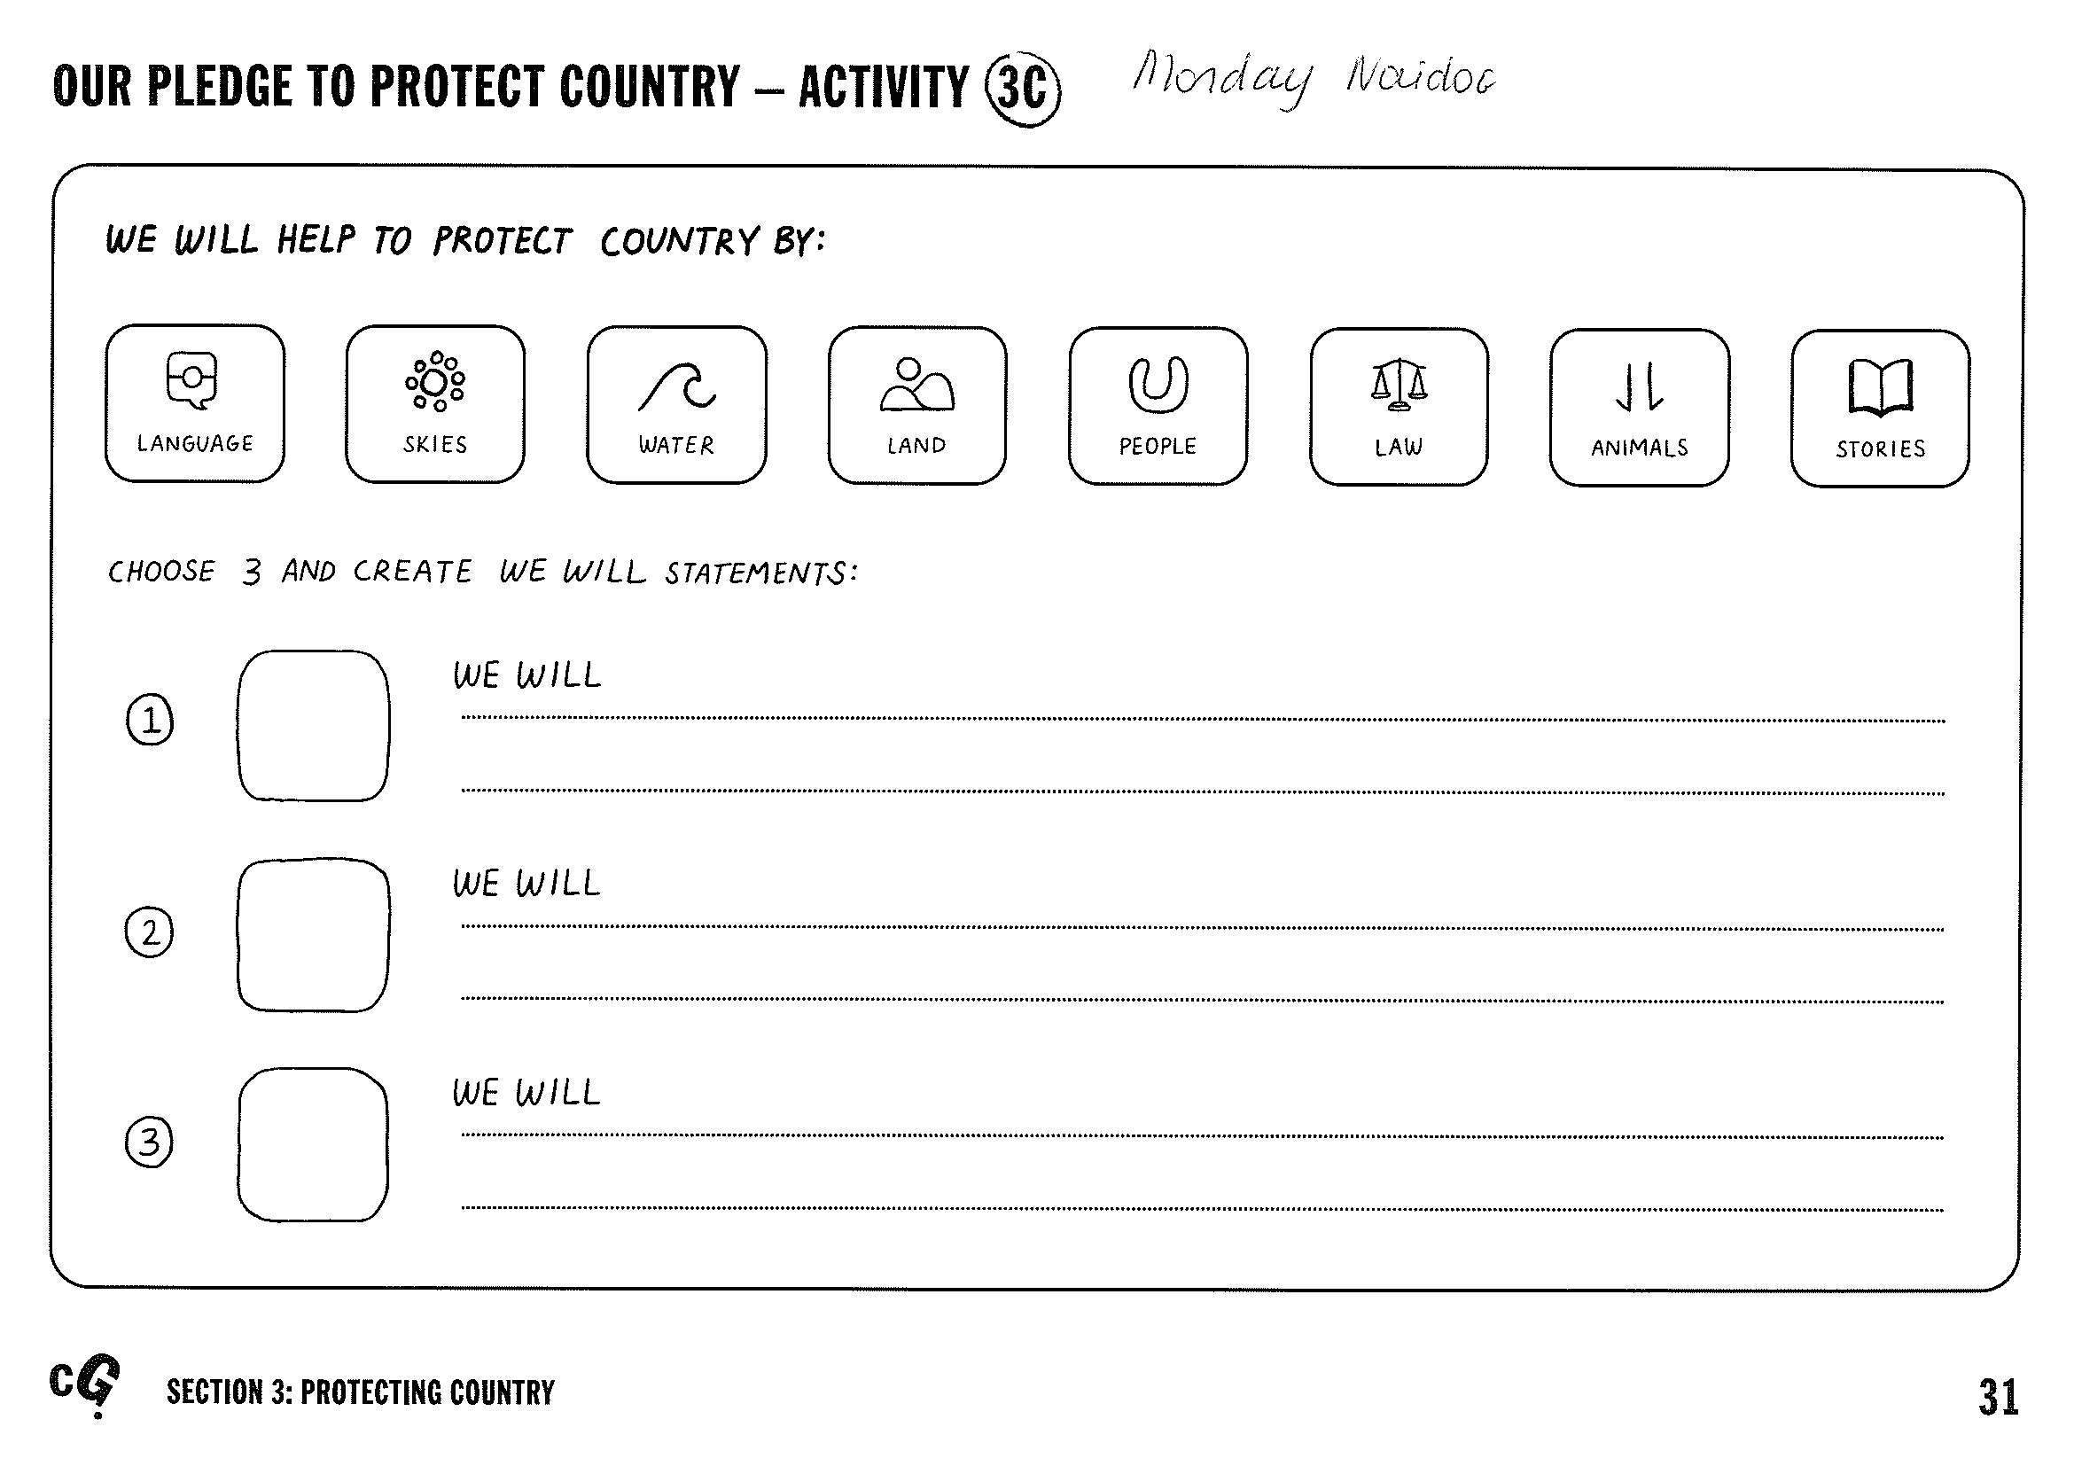
Task 4
Imagine you have been given the chance to plan the worlds most exciting fun weekend).
Then complete the NAIDOC ‘Heal Country’ worksheet.

Slide 8
Recess break (30 minutes)

Slide 9
Mathematics
Task 1
Complete an activity from the maths activity grid

Slide 10
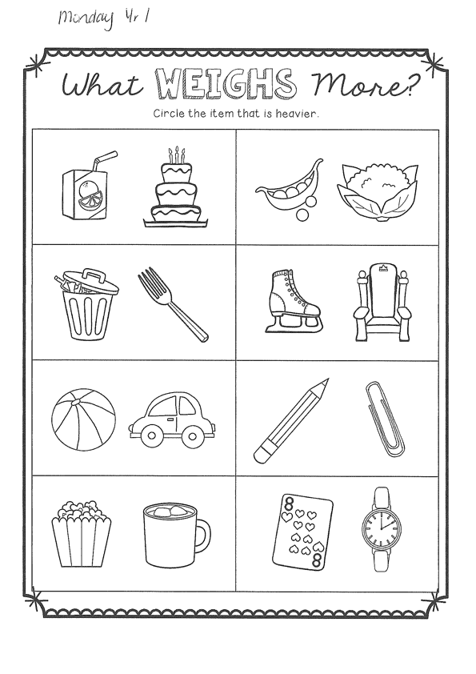
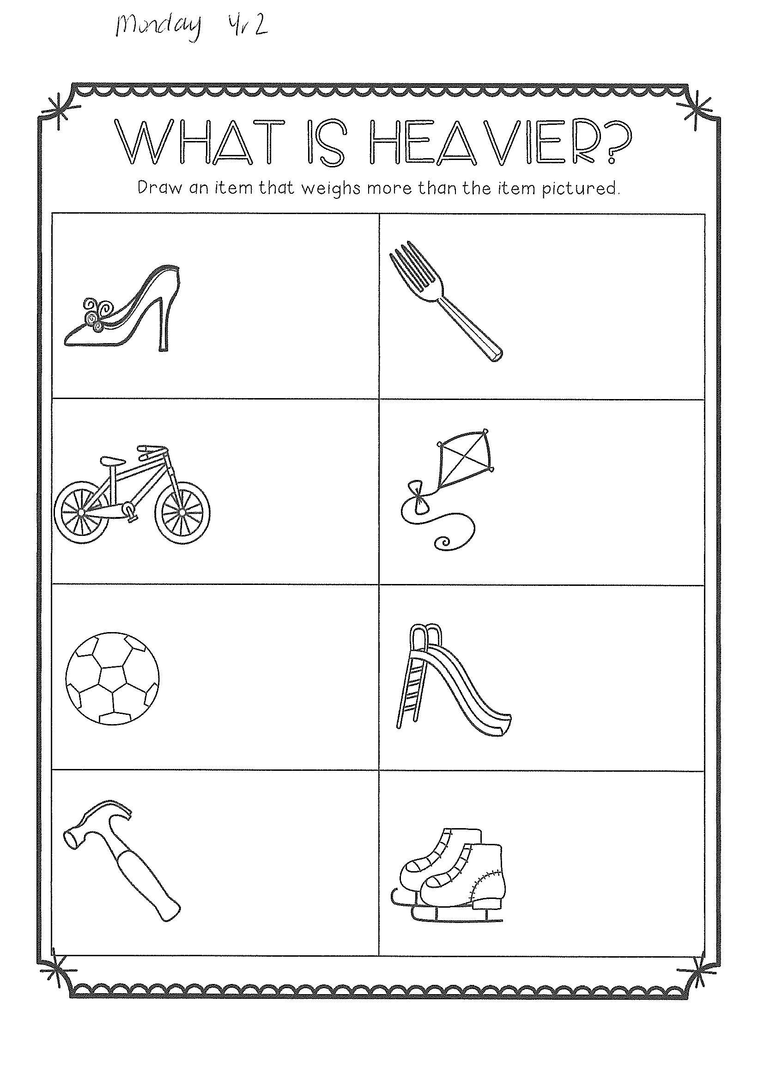
Task 2
M a s s

Slide 11
Lunch break (40 minutes)

Slide 12
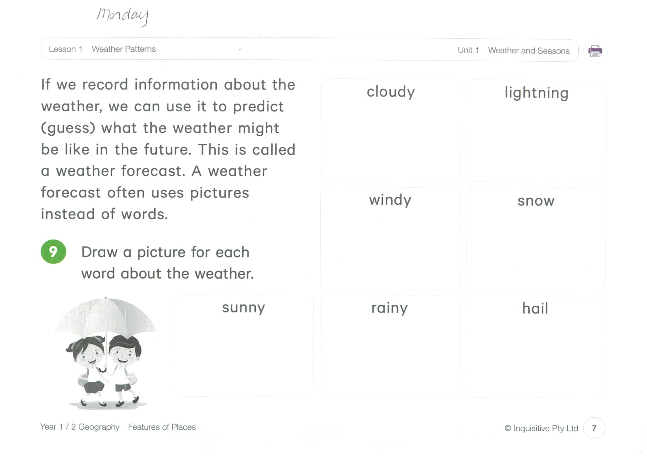
KLA - geography
Watch the video below:
https://www.inquisitive.com/class/92g/login
code = 9484
We are learning about weather and seasons. Complete the worksheet in your pack.

Slide 13
END OF DAY!
ENJOY your well-deserved break everyone!

Slide 14
Good morning
STAGE 1
TUESDAY 20TH JULY 2021 – WEEK 2
Please make sure you are sending one or two work samples to your classroom teacher via dojo.

Slide 15
WHATS ON TODAY?
Morning Task 1 – Spelling Task 2 – Reading Crunch n’ sip Writing Middle Maths
Activity Worksheet
Final Library

Slide 16
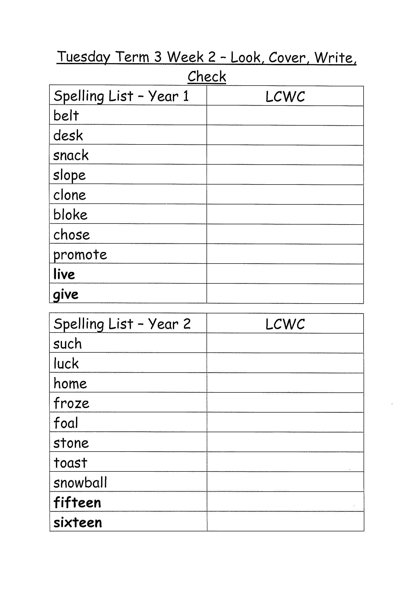
Task 1
Complete the Look, Cover, Write, Check worksheet (in your booklet).
Then complete your tricky word!

Slide 17
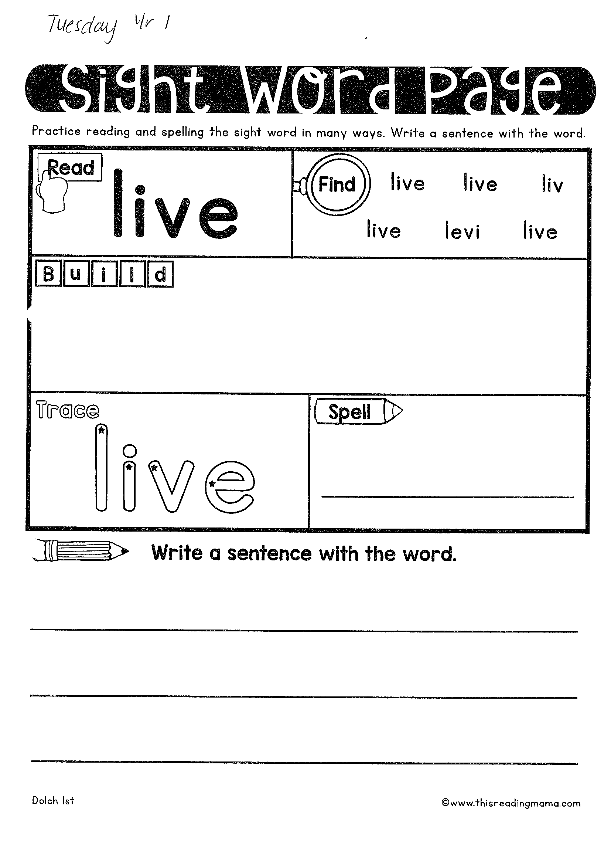
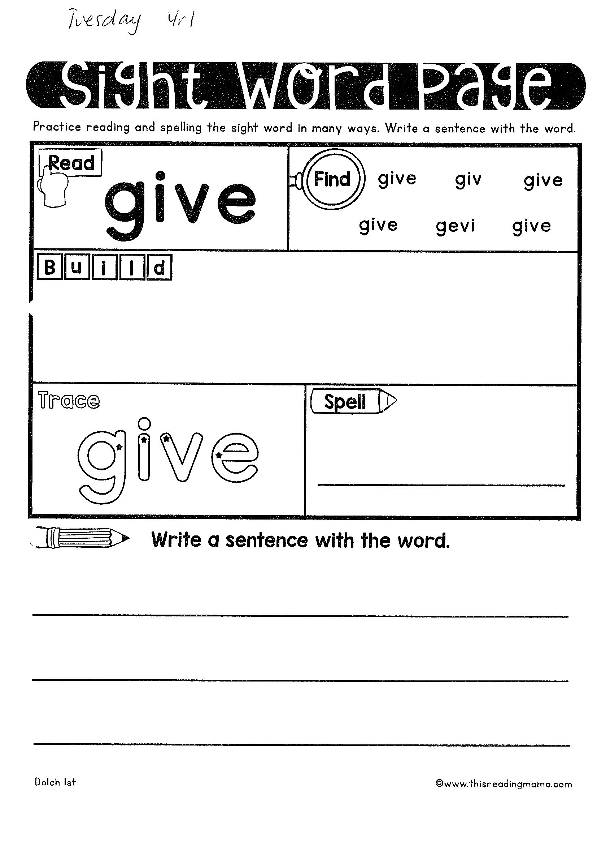
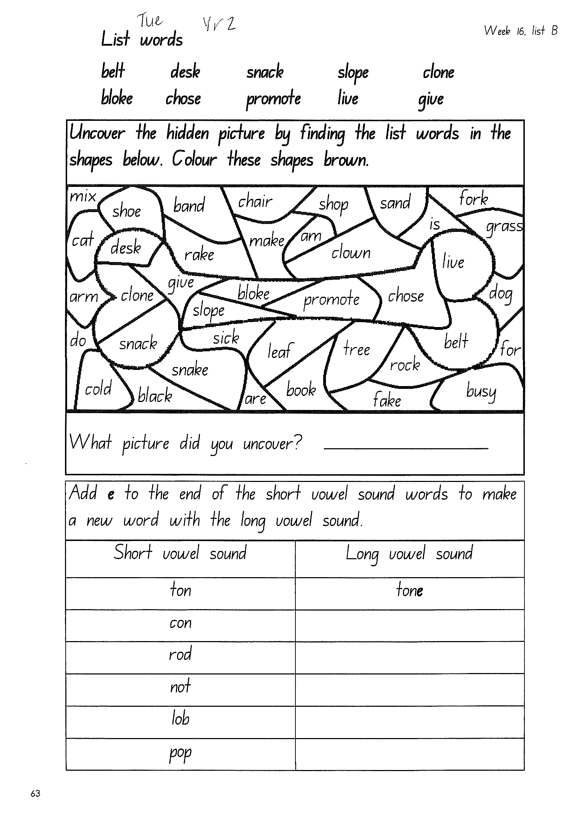

Slide 18
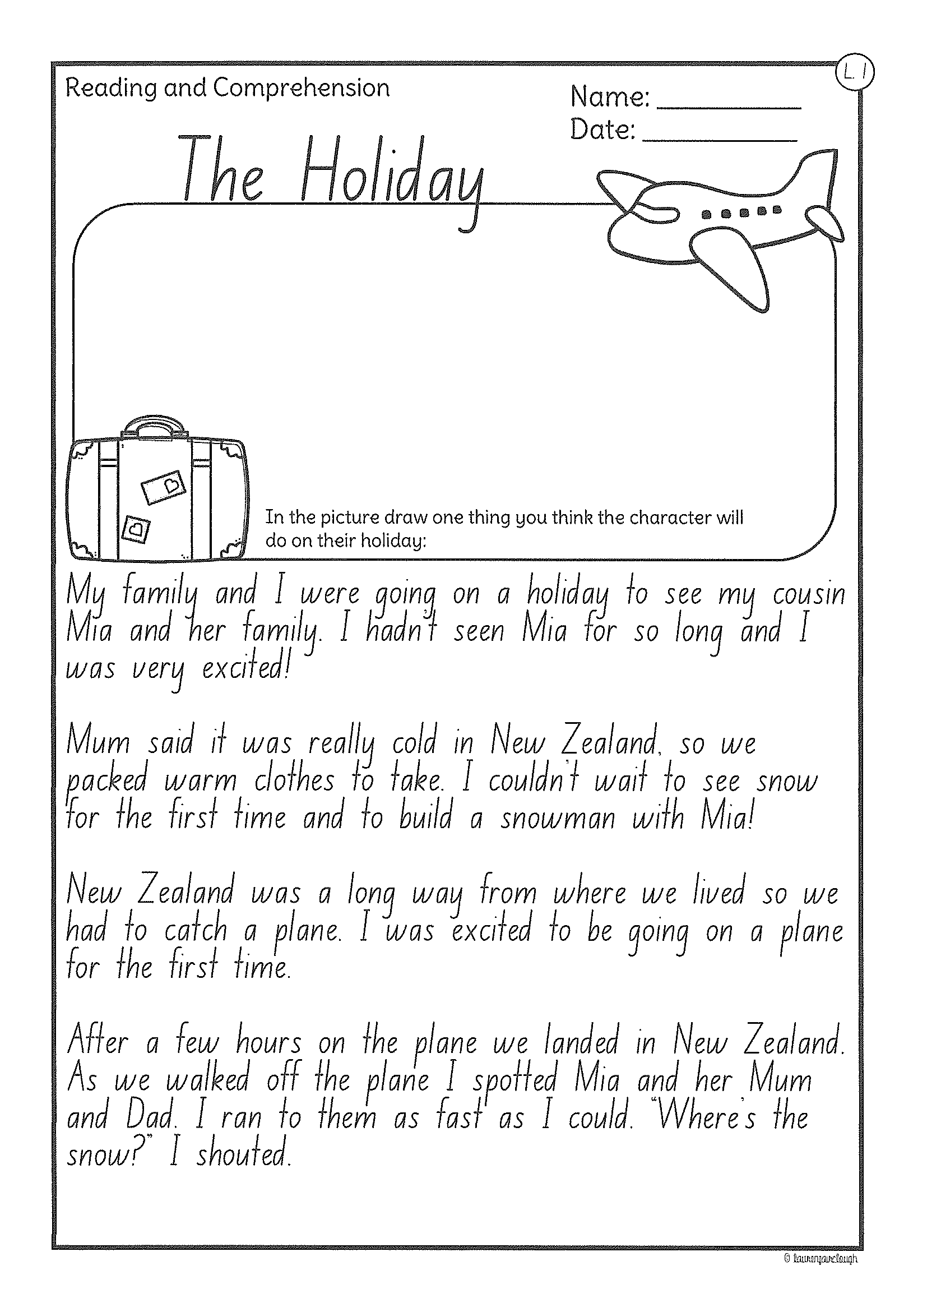
Task 2
Read or get an adult to read ”The Holiday” and answer the questions.

Slide 19
Crunch n’ sip

Slide 20
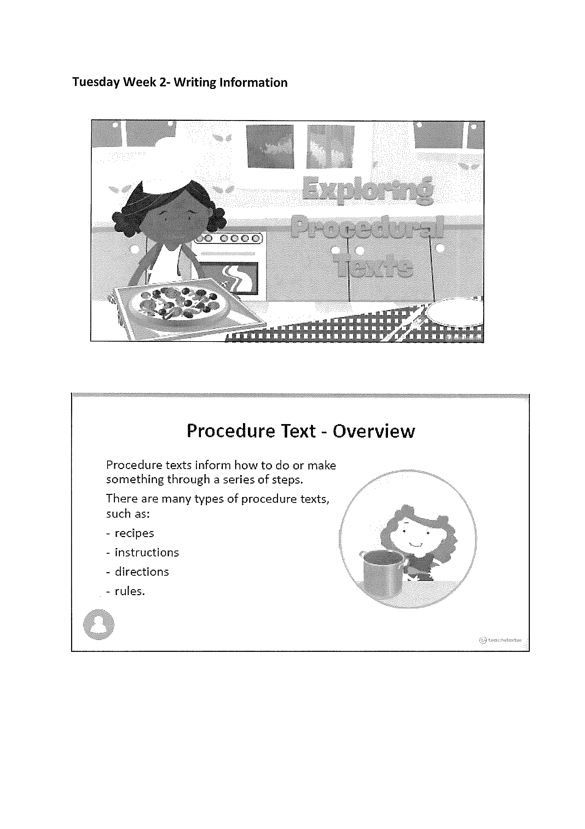
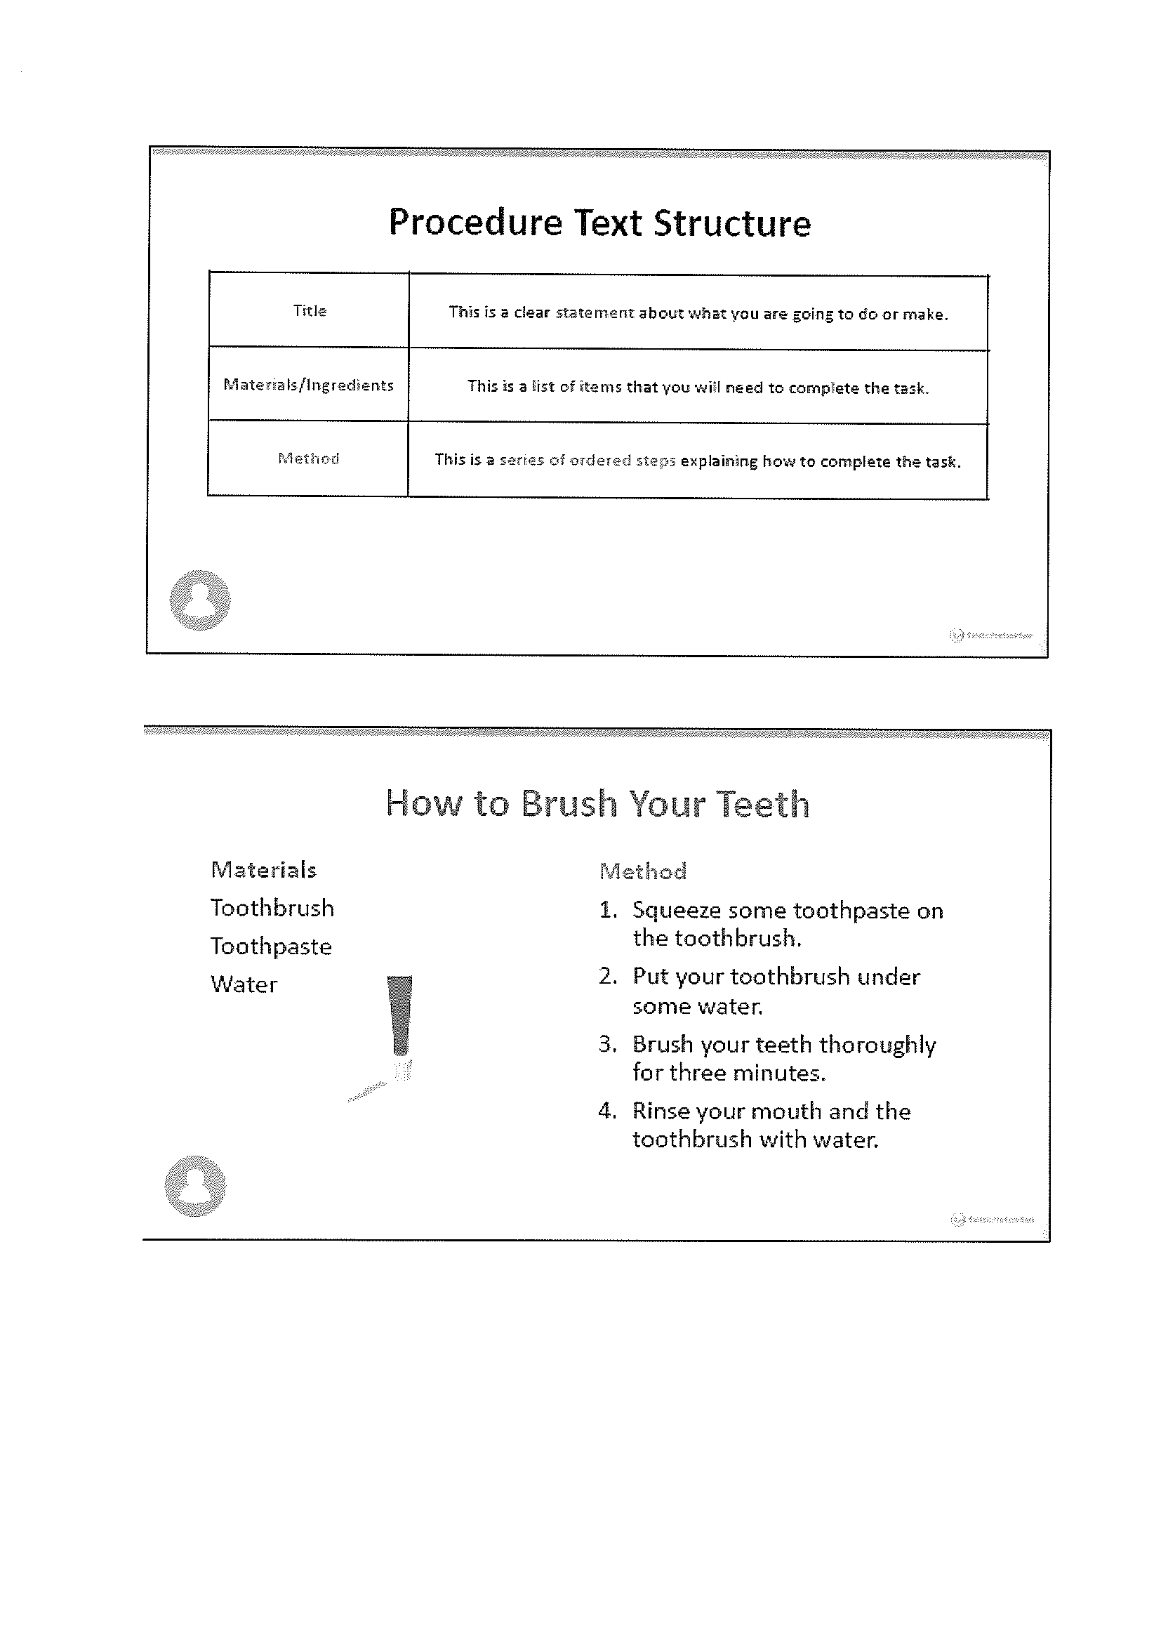
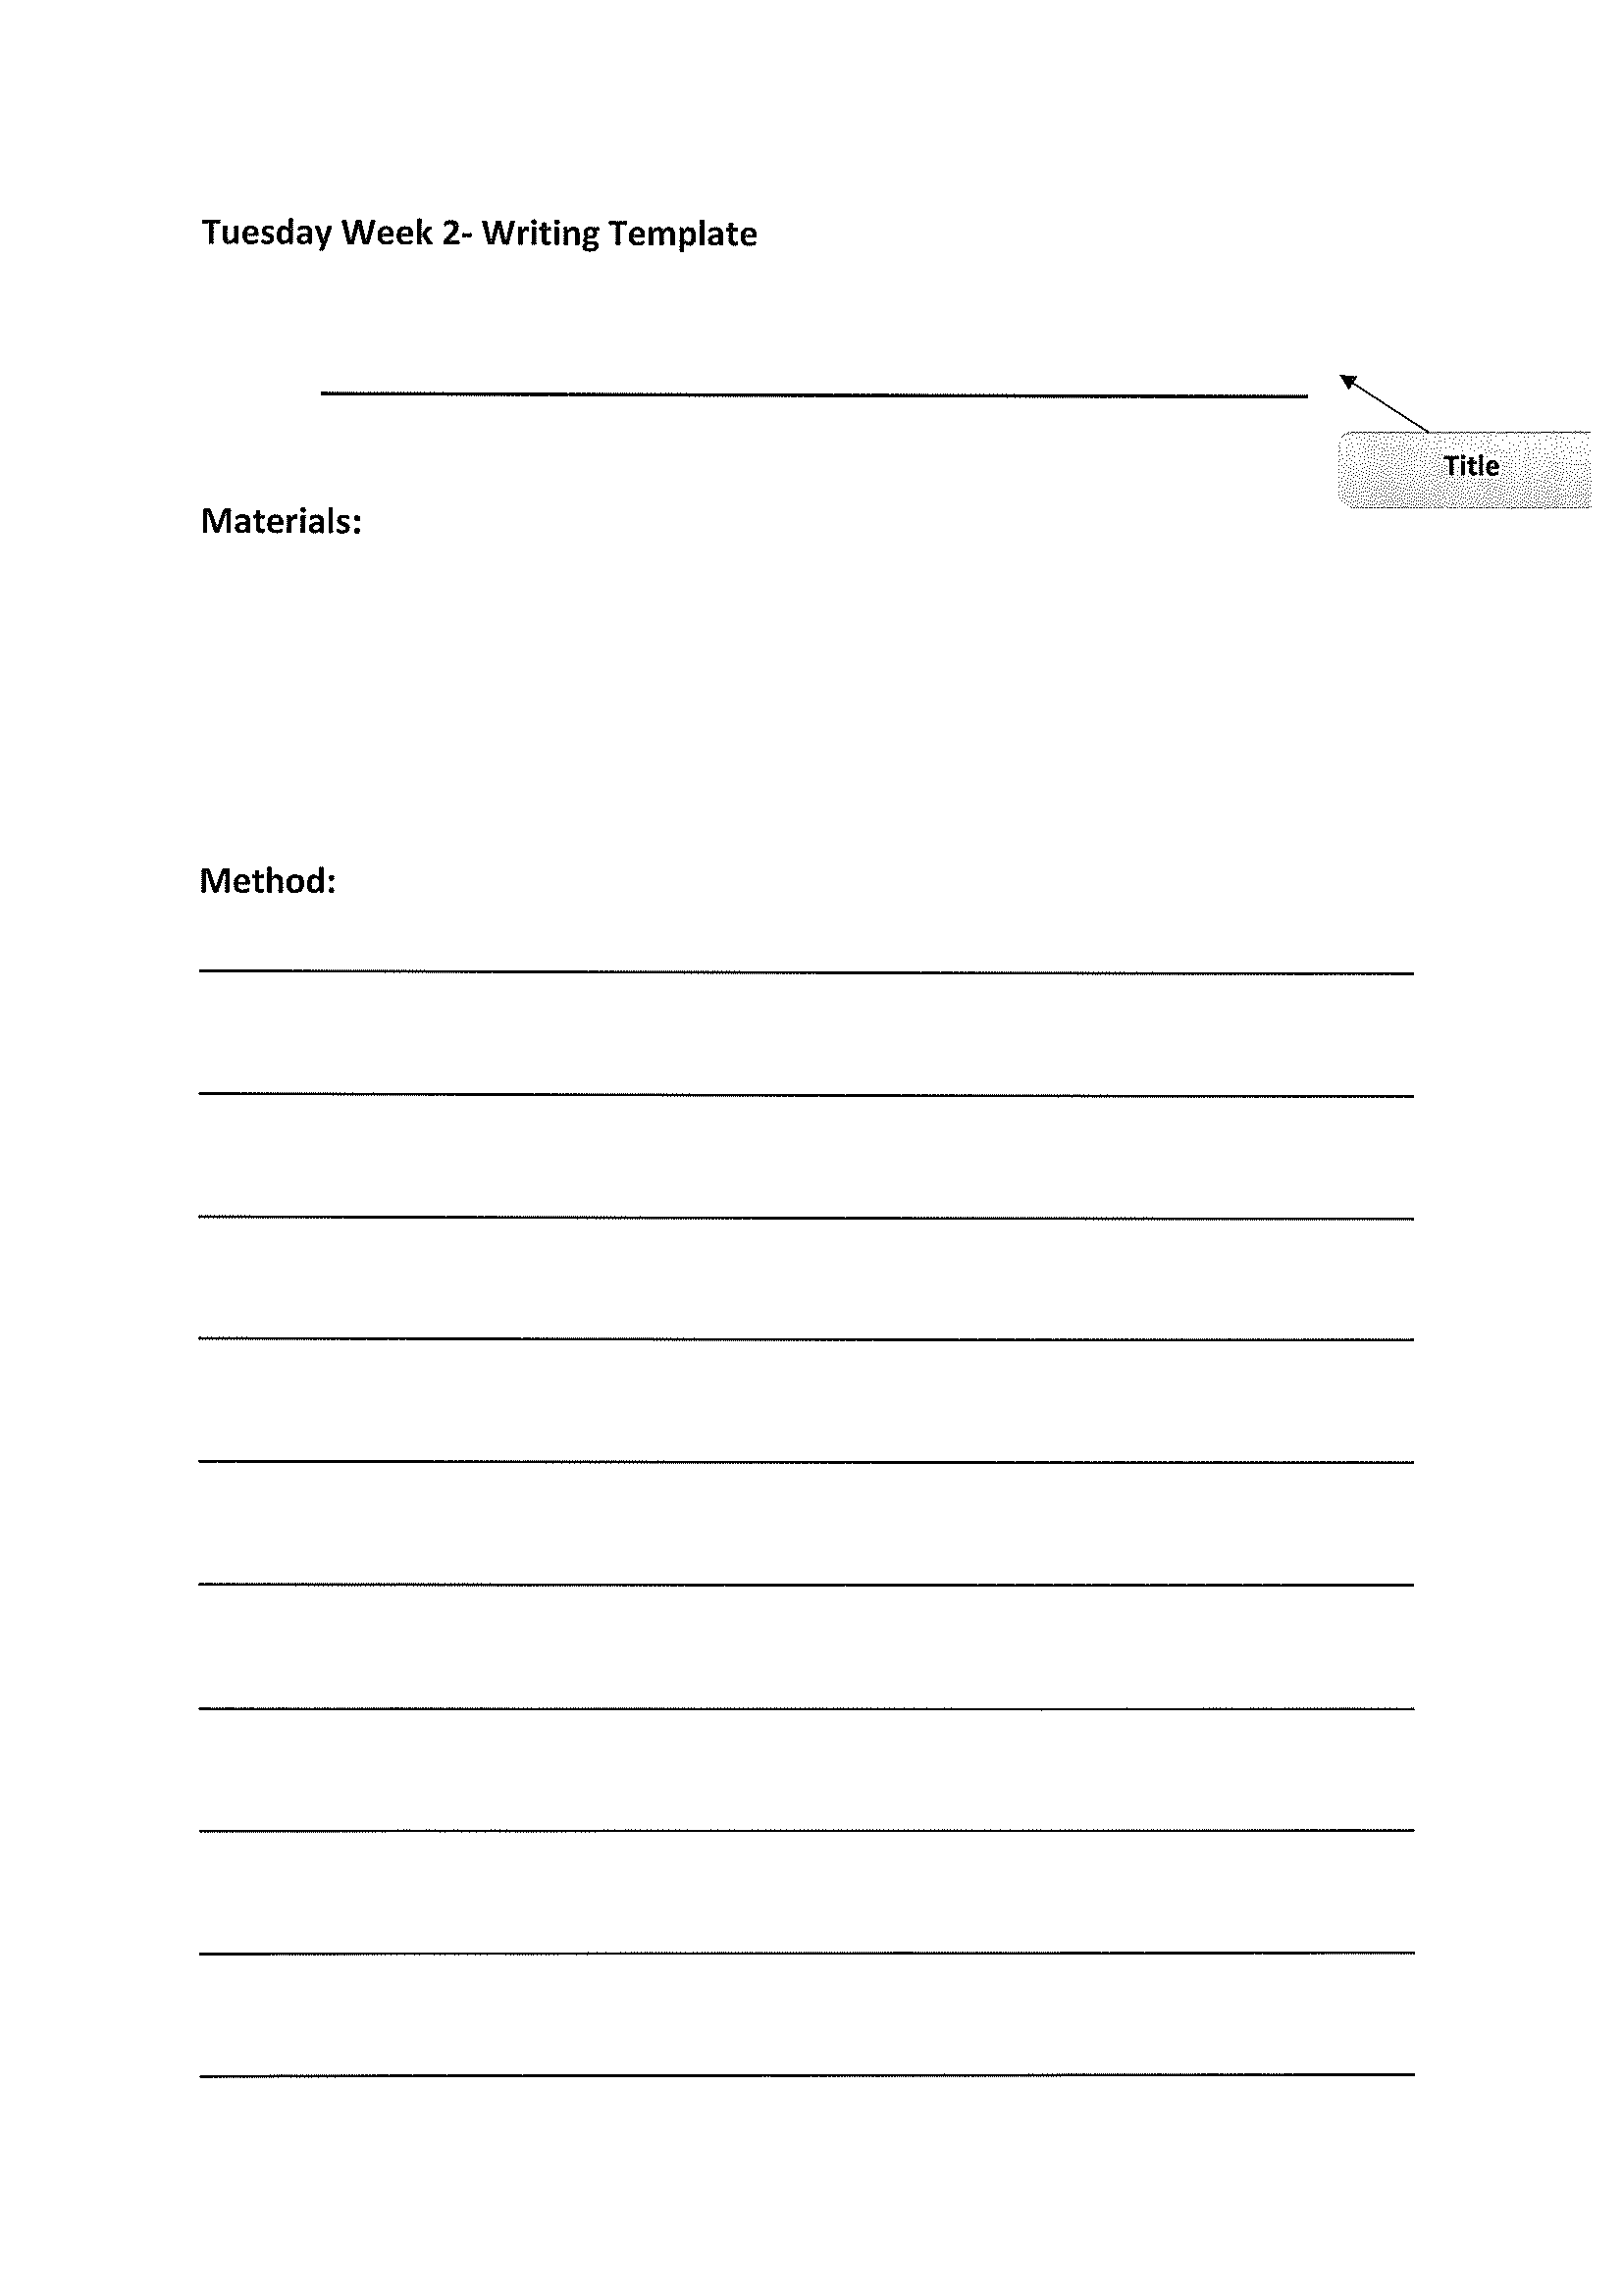
Task 4
Writing a procedural text. Look at and read ‘exploring procedural texts’.
Pay attention to ‘How to brush your teeth examples’.

Slide 21
Recess break (30 minutes)

Slide 22
Mathematics
Task 1
Complete an activity from the maths activity grid

Slide 23
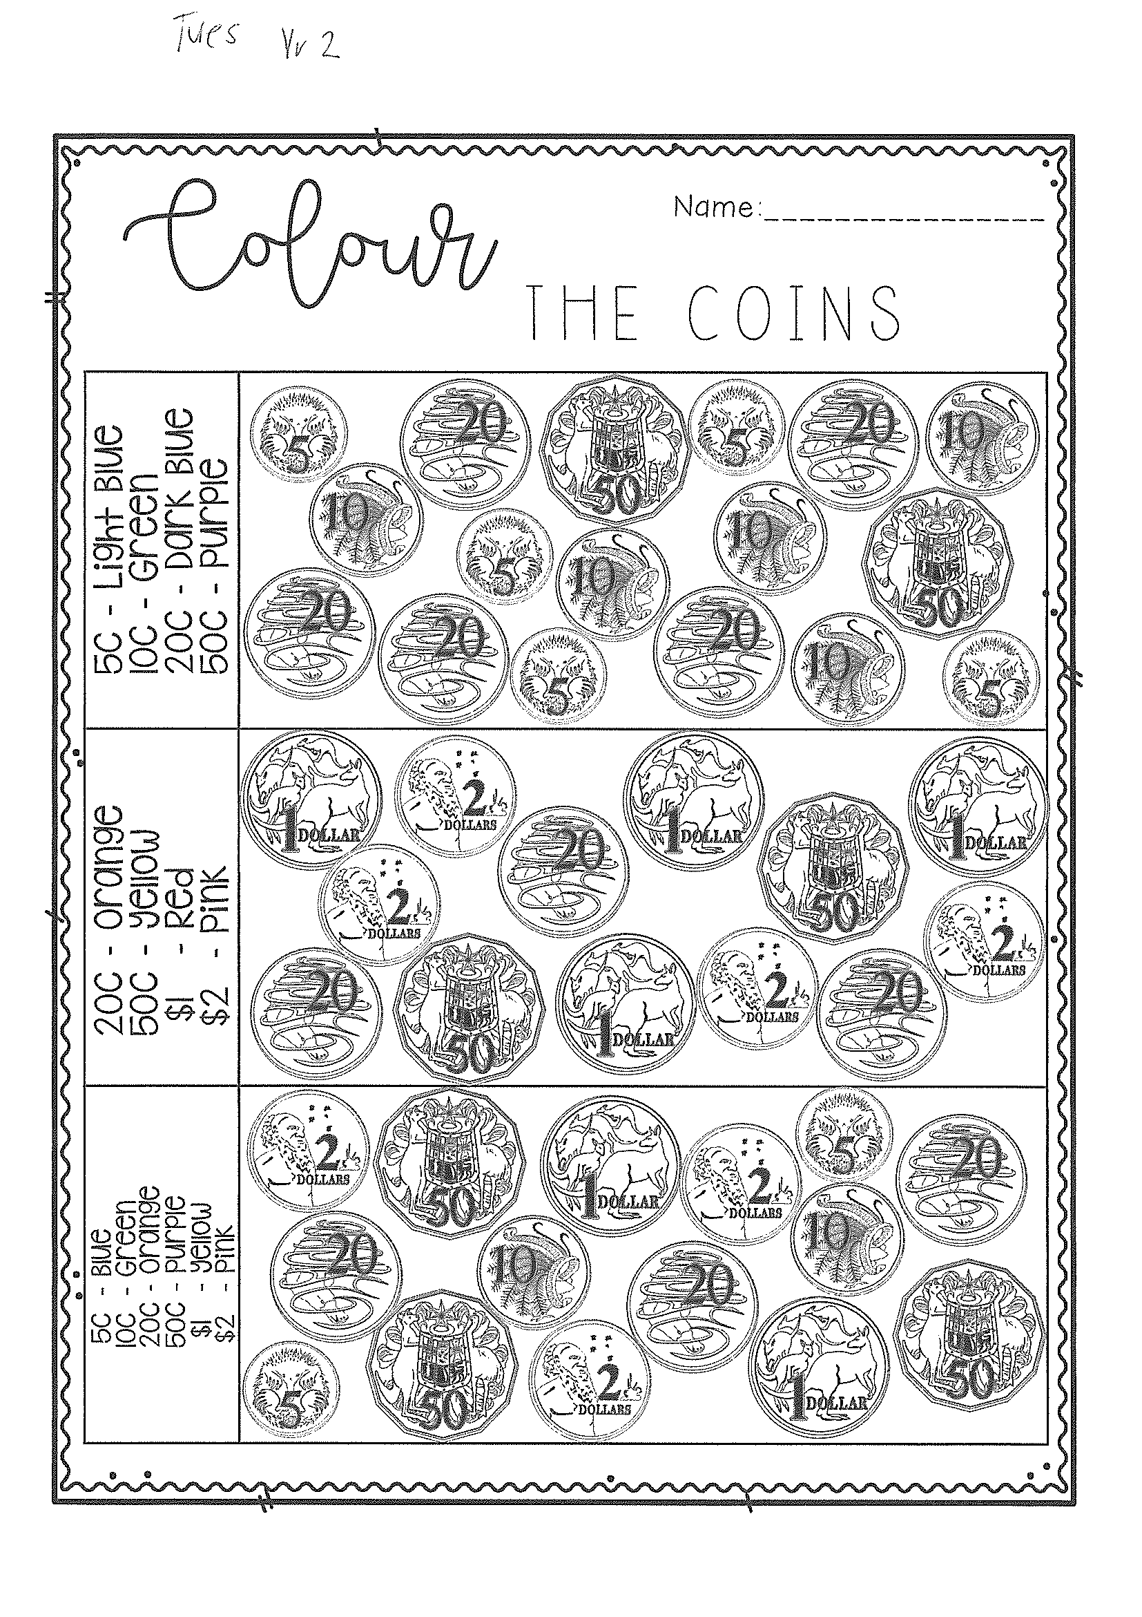
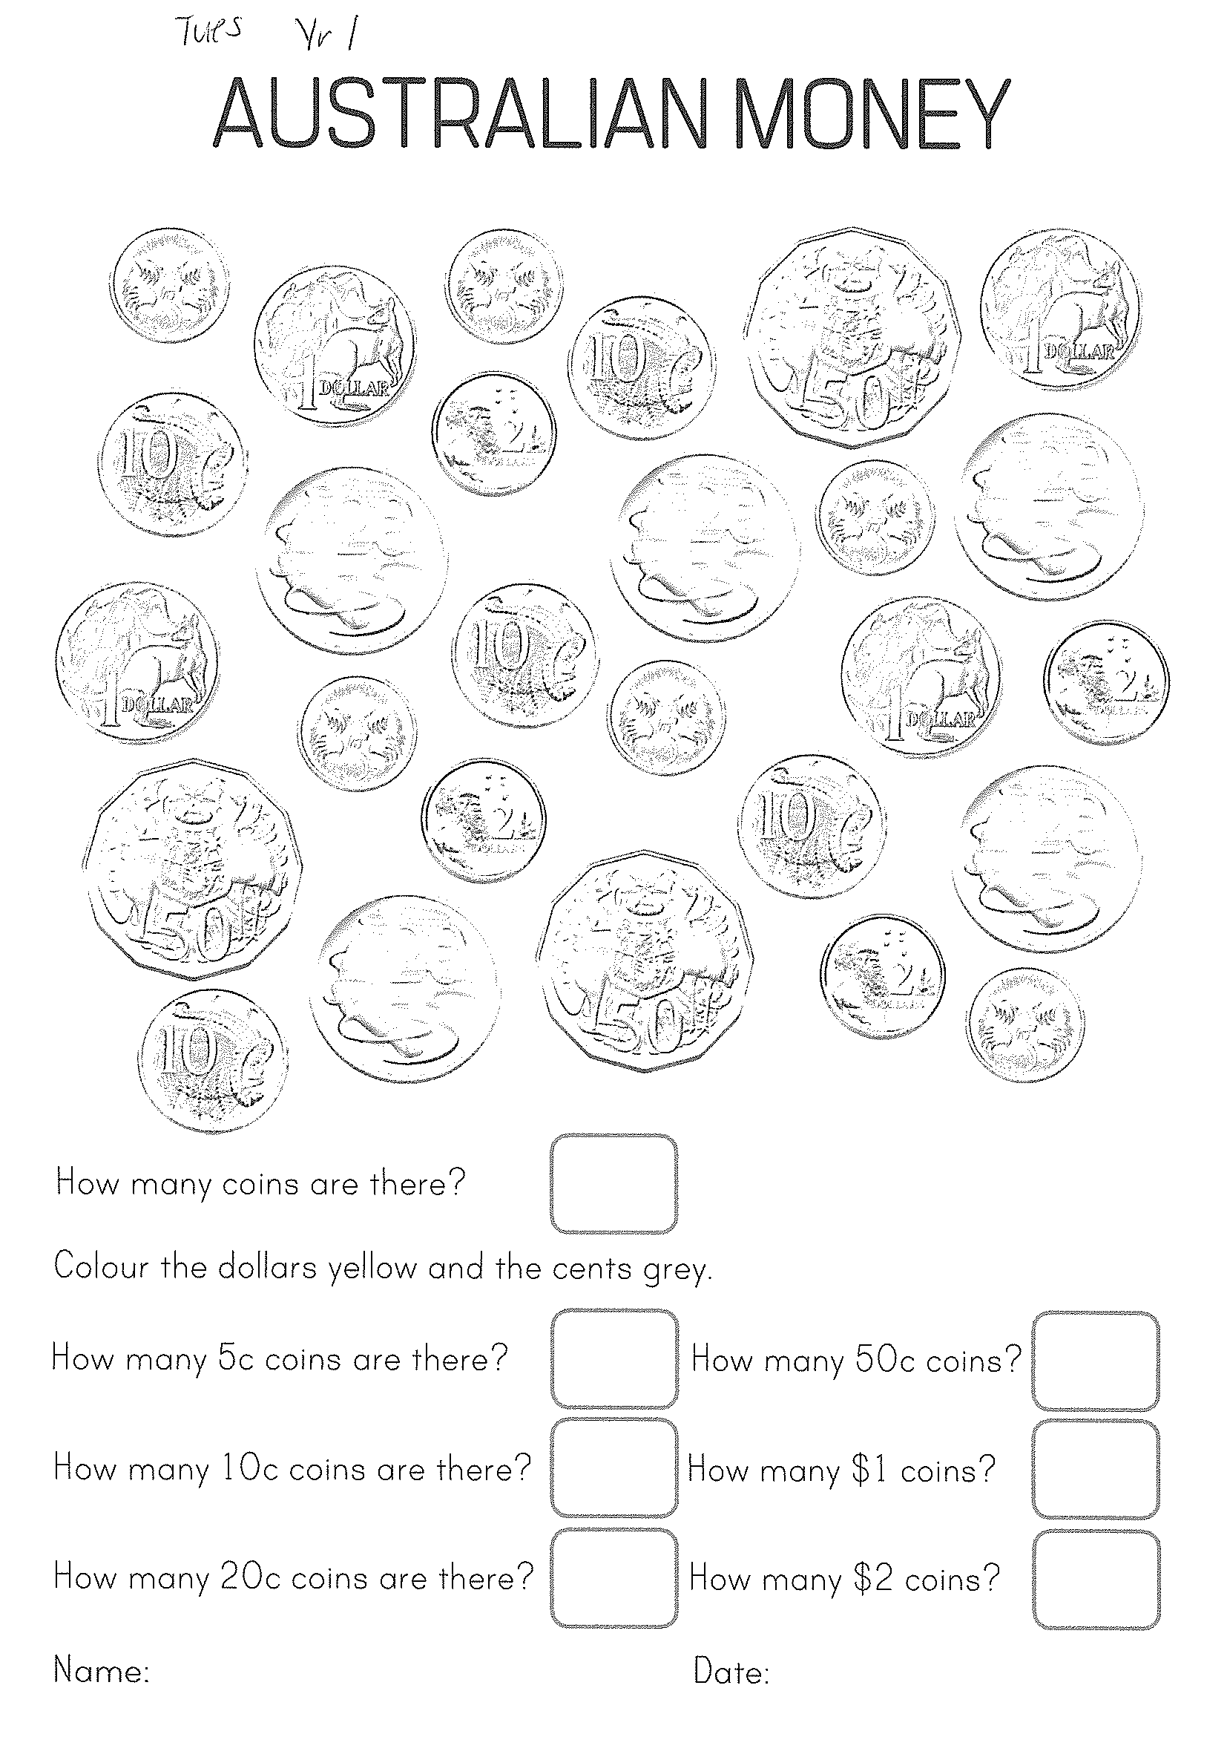
Task 2
M o n e y

Slide 24
Lunch break (40 minutes)

Slide 25
library
Silent reading
Choose one or two activities to complete each week from the red library activity grid.

Slide 26
END OF DAY!
ENJOY your well-deserved break everyone!

Slide 27
Good morning
STAGE 1
WEDNESDAY 21st JULY 2021 – WEEK 2
Please make sure you are sending one or two work samples to your classroom teacher via dojo.

Slide 28
WHATS ON TODAY?
Morning Task 1 – Spelling Task 2 – Reading Crunch n’ sip Writing Middle Maths Fitness
Final Science

Slide 29
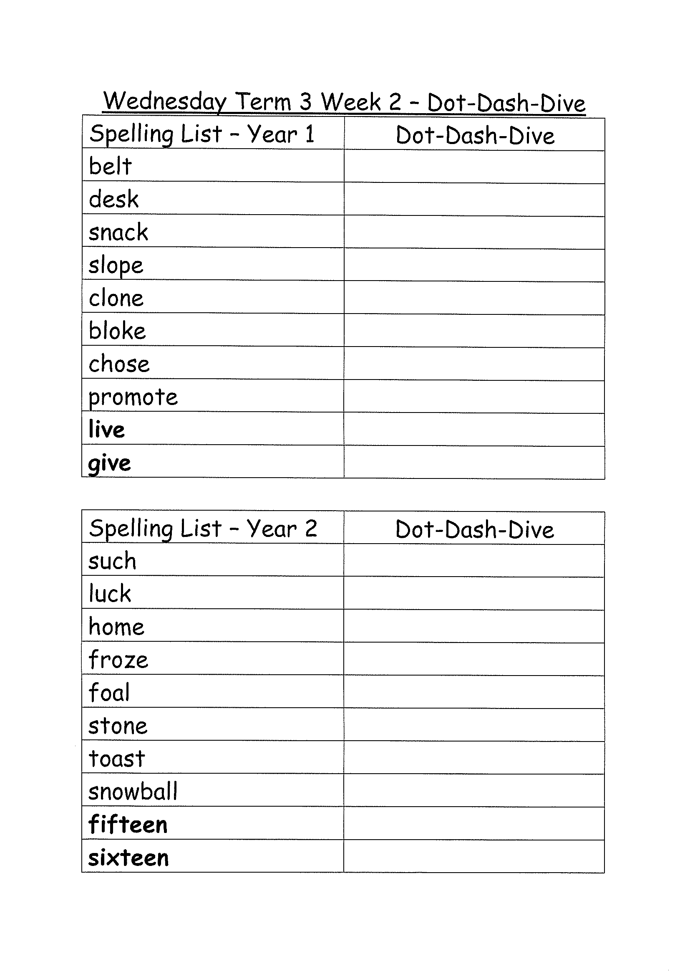
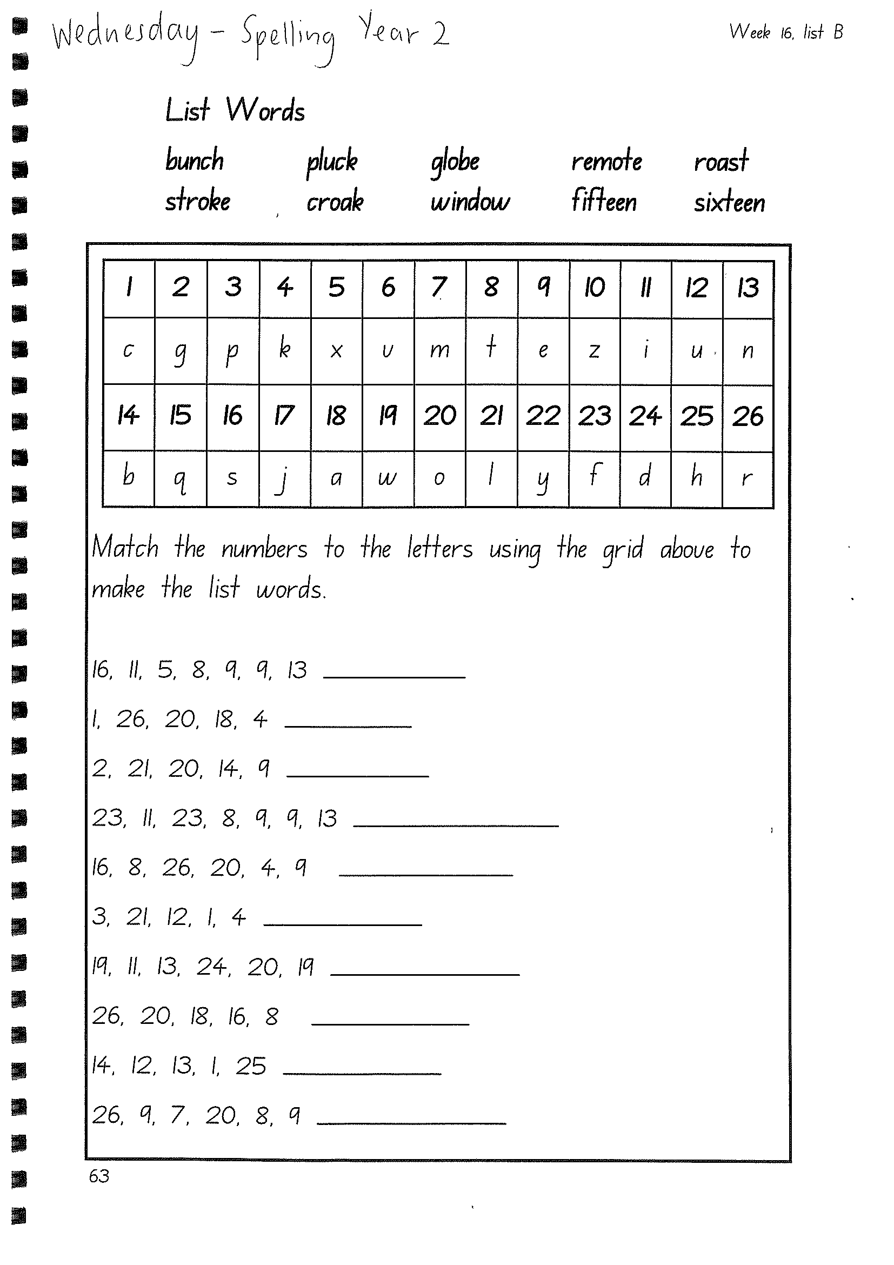
Task 1
Complete dot, dash, dive worksheets.
Video links available in pack.

Slide 30
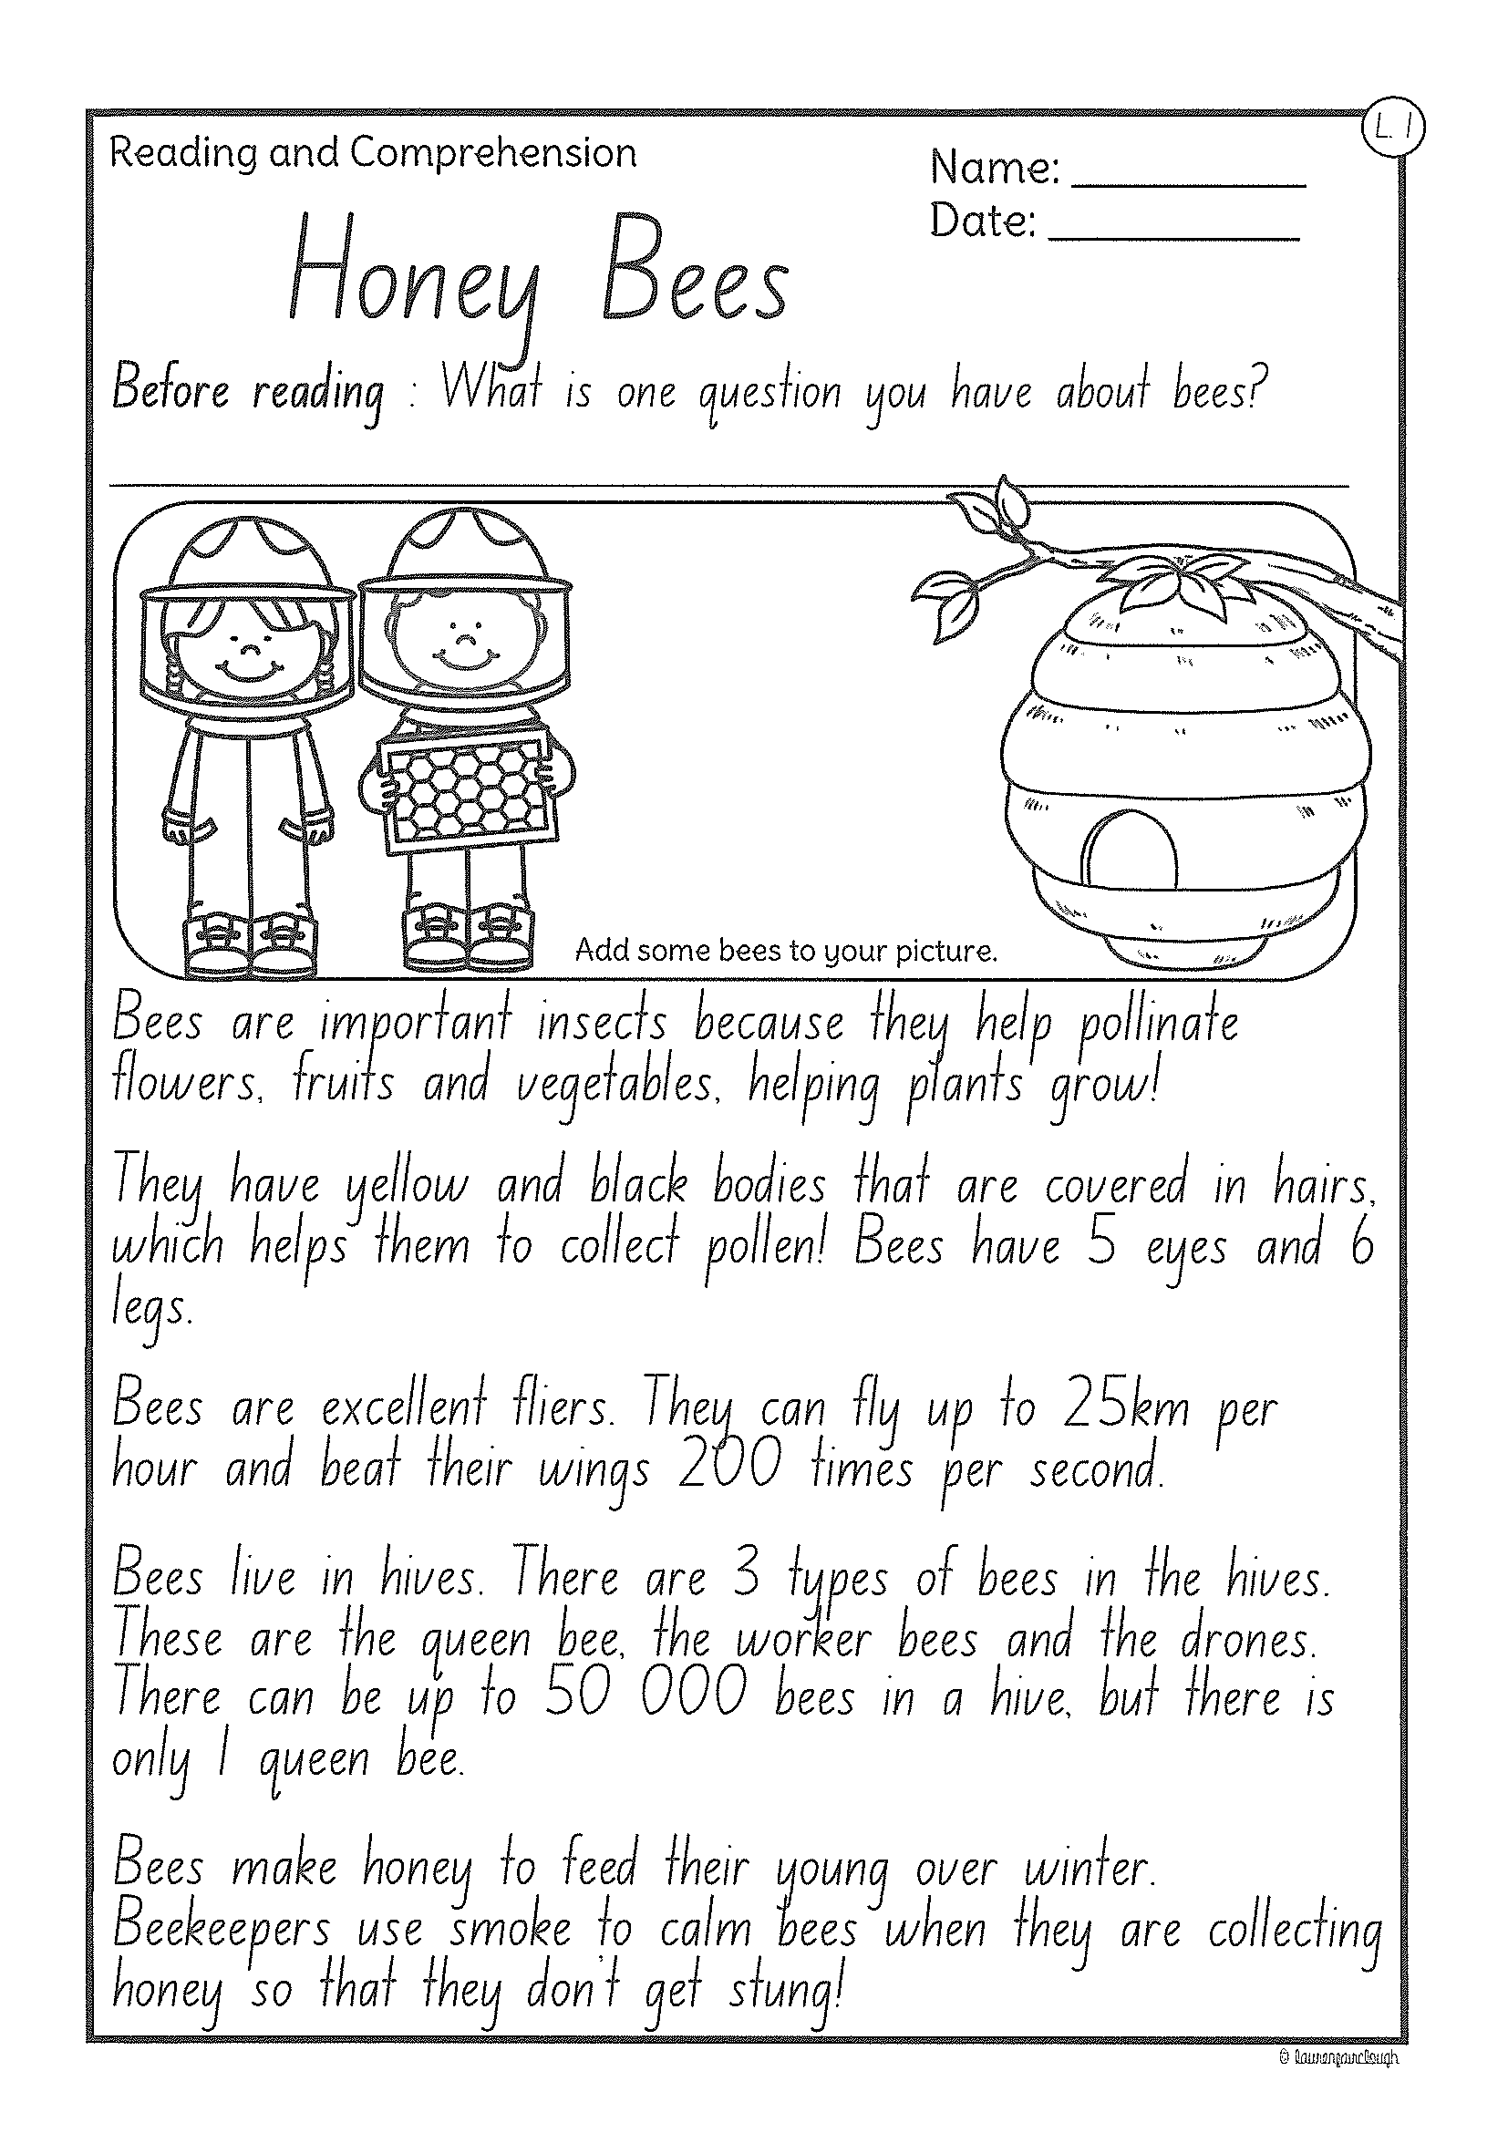
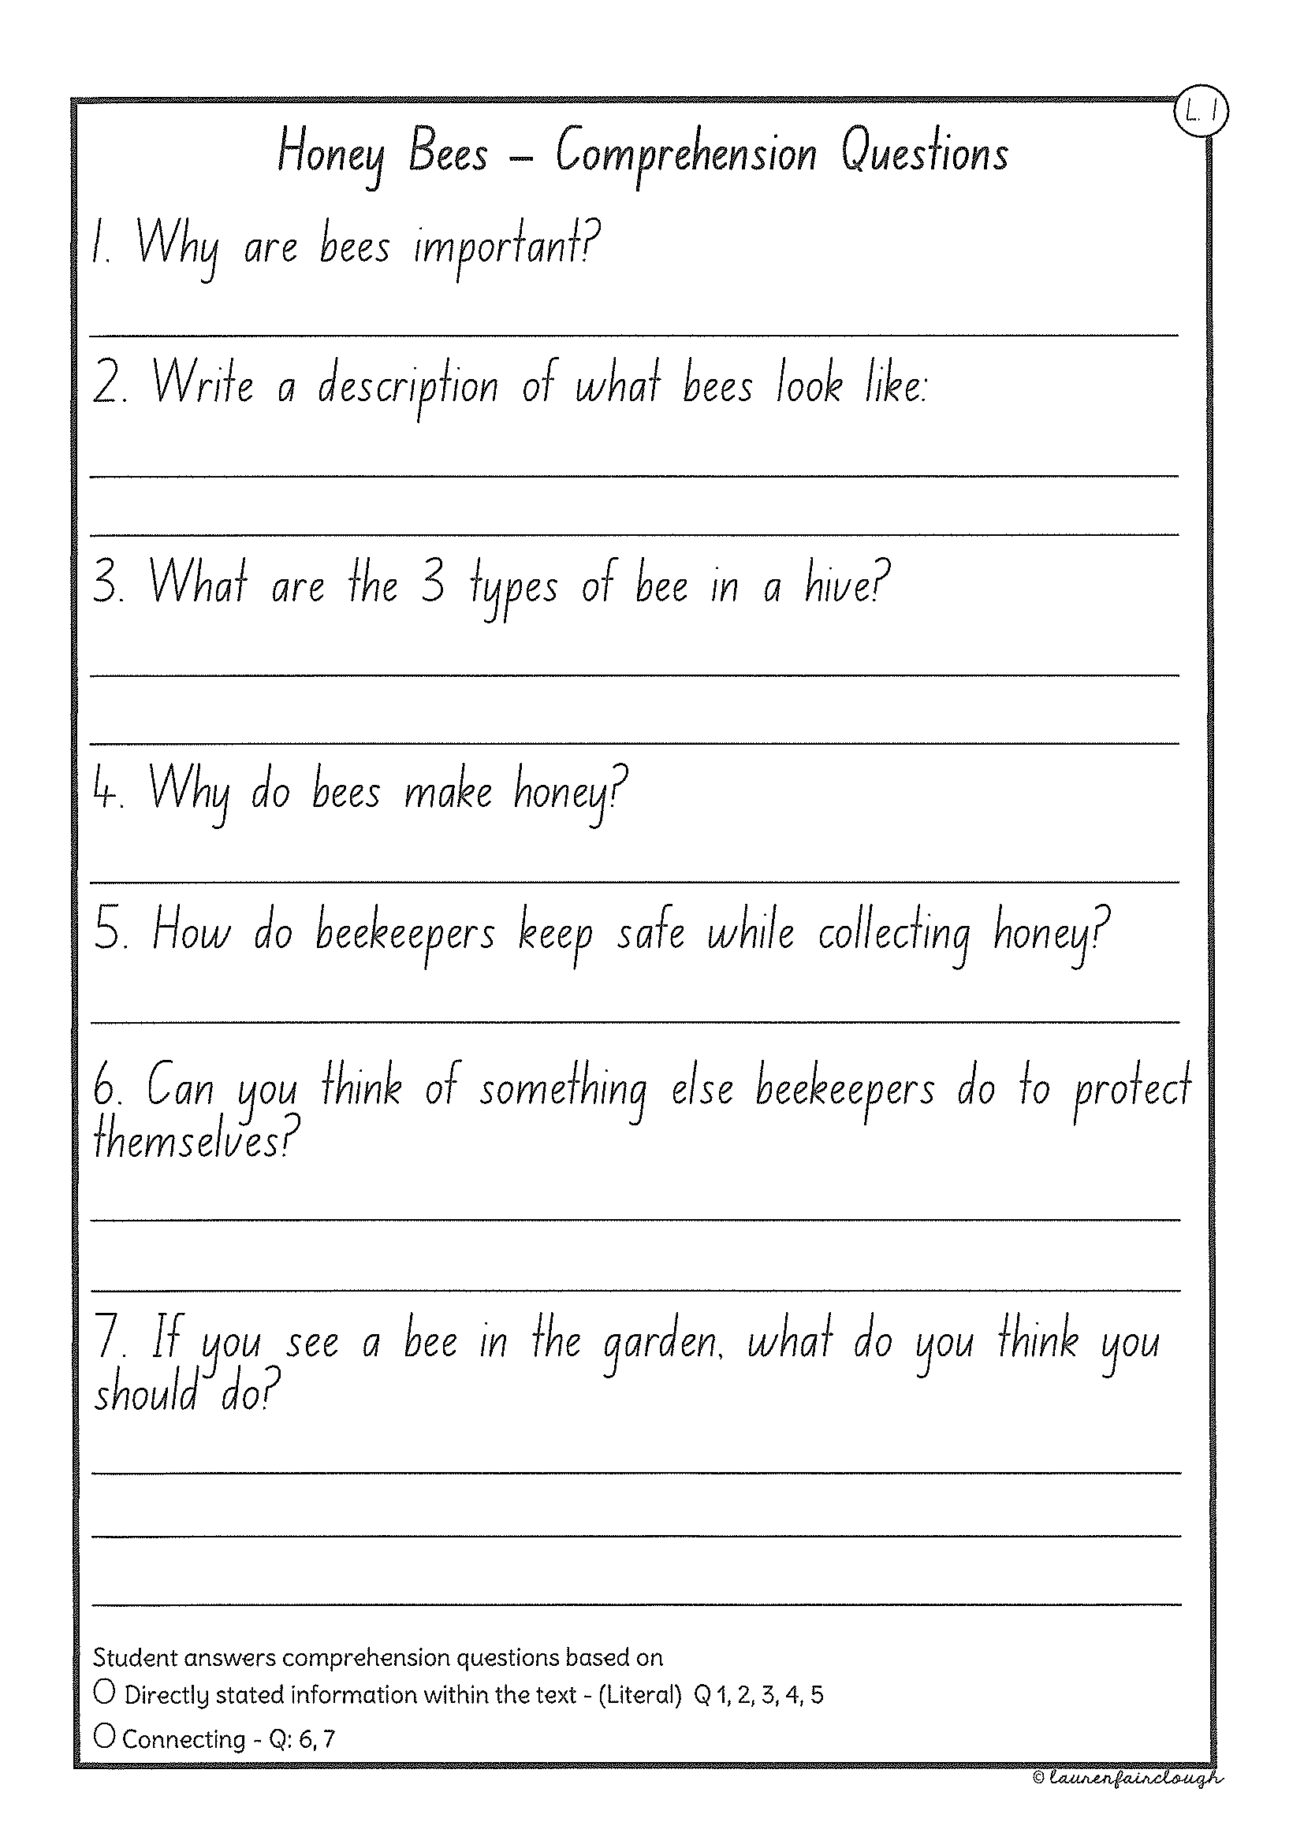
Task 2
Read or get an adult to read ”Honey Bees” and answer the questions.

Slide 31
Crunch n’ sip

Slide 32
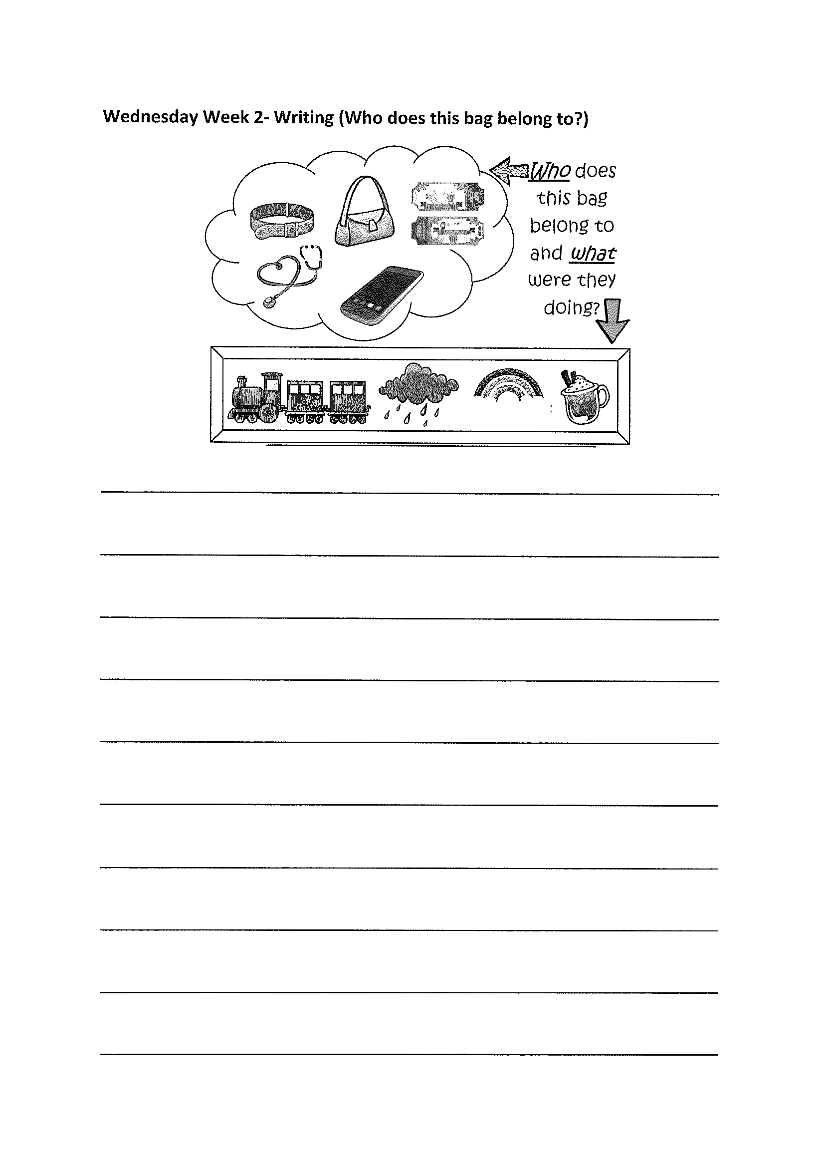
Task 4
Writing – who does this bag belong to?
Look at the questions in your learning pack guide.

Slide 33
Recess break (30 minutes)

Slide 34
Mathematics
Task 1
Complete an activity from the maths activity grid

Slide 35
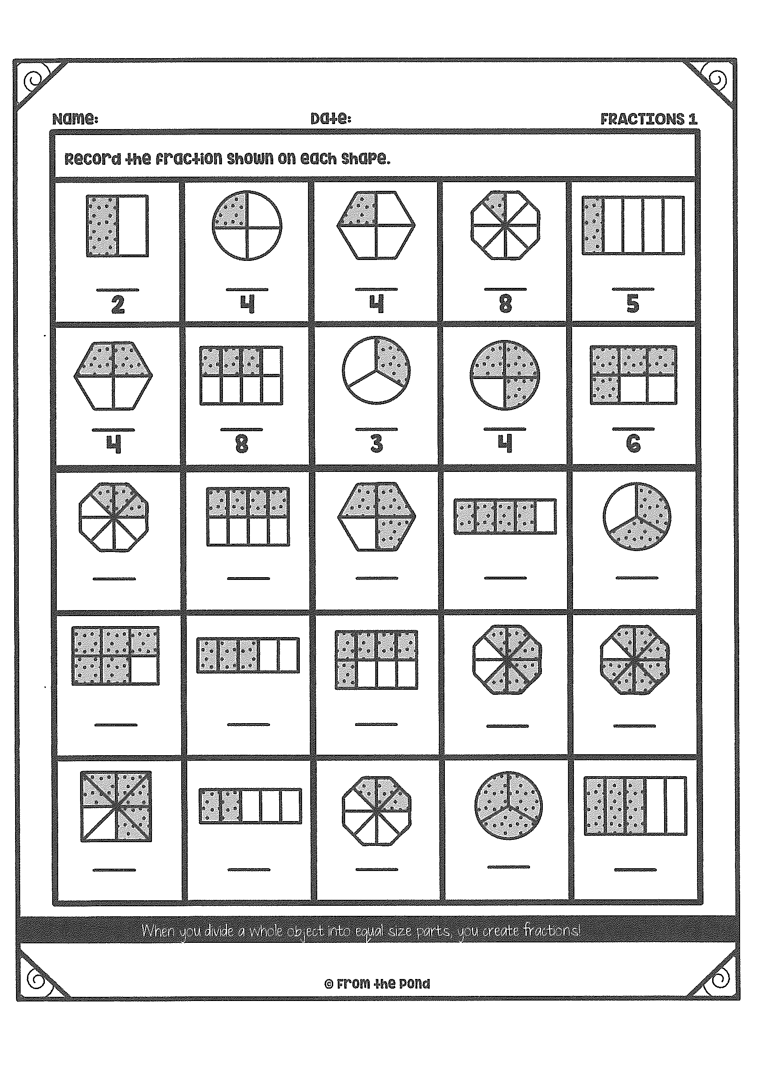
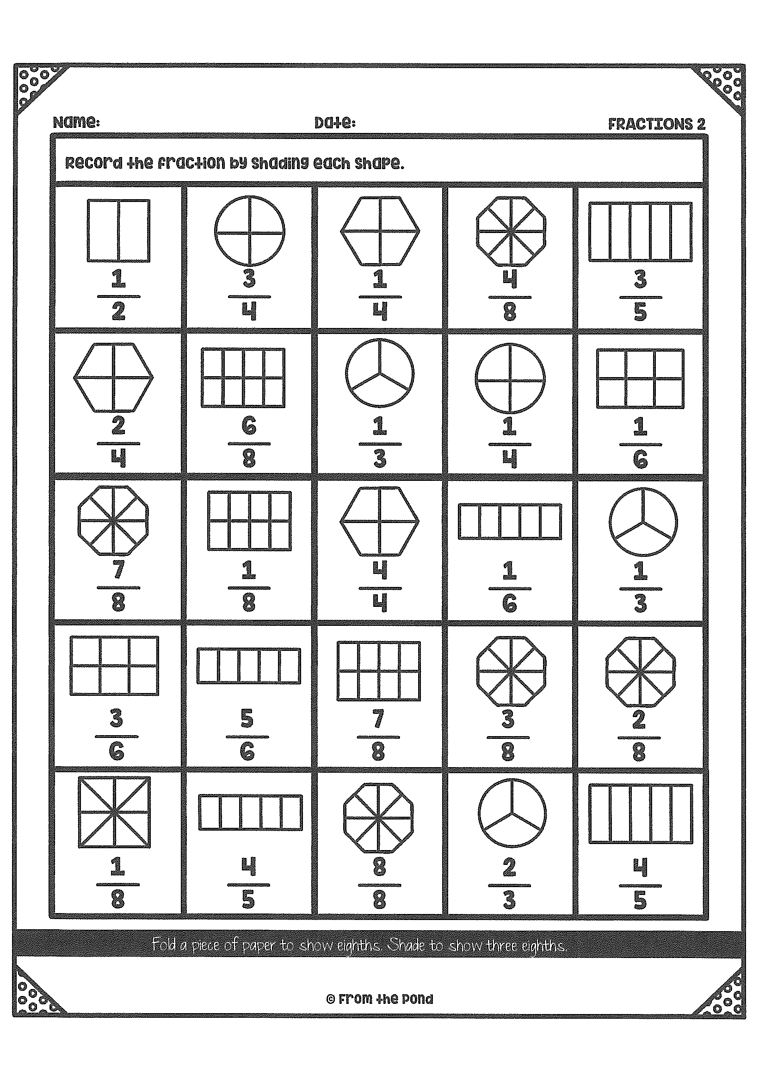
Task 2
F r a c t I o n s
Year 1
Year 2

Slide 36
fitness
Choose an activity from the fitness grid to complete.
Not this one
(in your packs)

Slide 37
Lunch break (40 minutes)

Slide 38
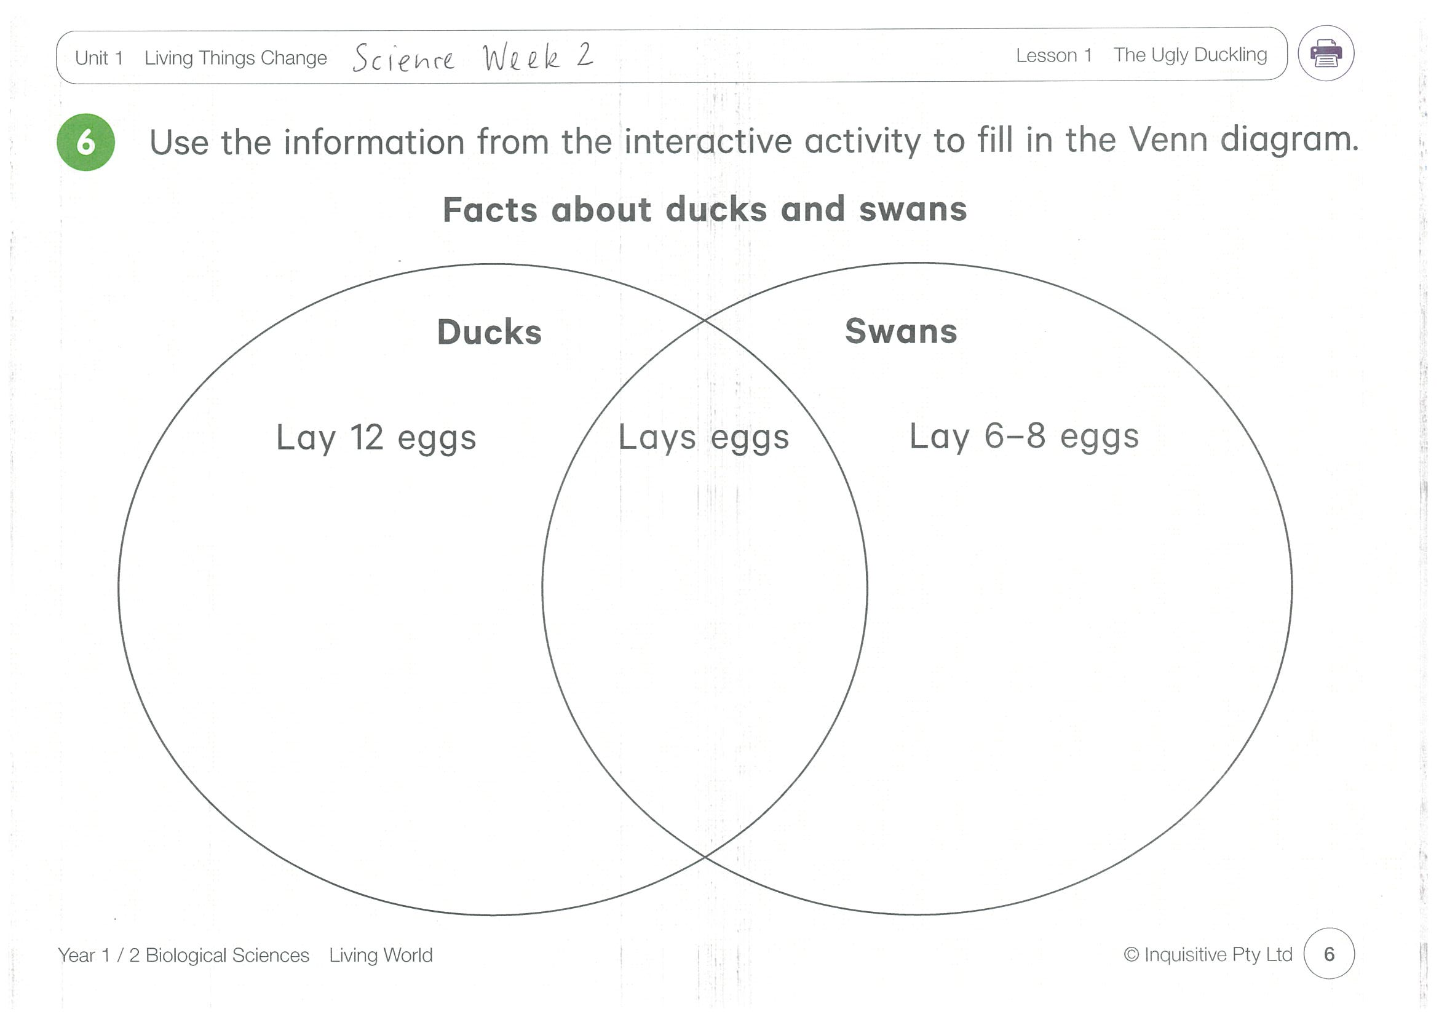
KLA - SCIENCE
Inquisitive link – https://inq.co/class/9wk
access link = 5742
Watch the video on ‘The ugly duckling’ and complete the Venn diagram

Slide 39
END OF DAY!
ENJOY your well-deserved break everyone!

Slide 40
Good morning
STAGE 1
THURSDAY 22nd JULY 2021 – WEEK 2
Please make sure you are sending one or two work samples to your classroom teacher via dojo.

Slide 41
WHATS ON TODAY?
Morning Task 1 – Spelling Task 2 – Reading Crunch n’ sip Writing Middle Maths
Final PDHPE

Slide 42
Task 1
Complete the worksheet. Write your spelling words in alphabetical order. Then write 5 sentences using your spelling words.

Slide 43
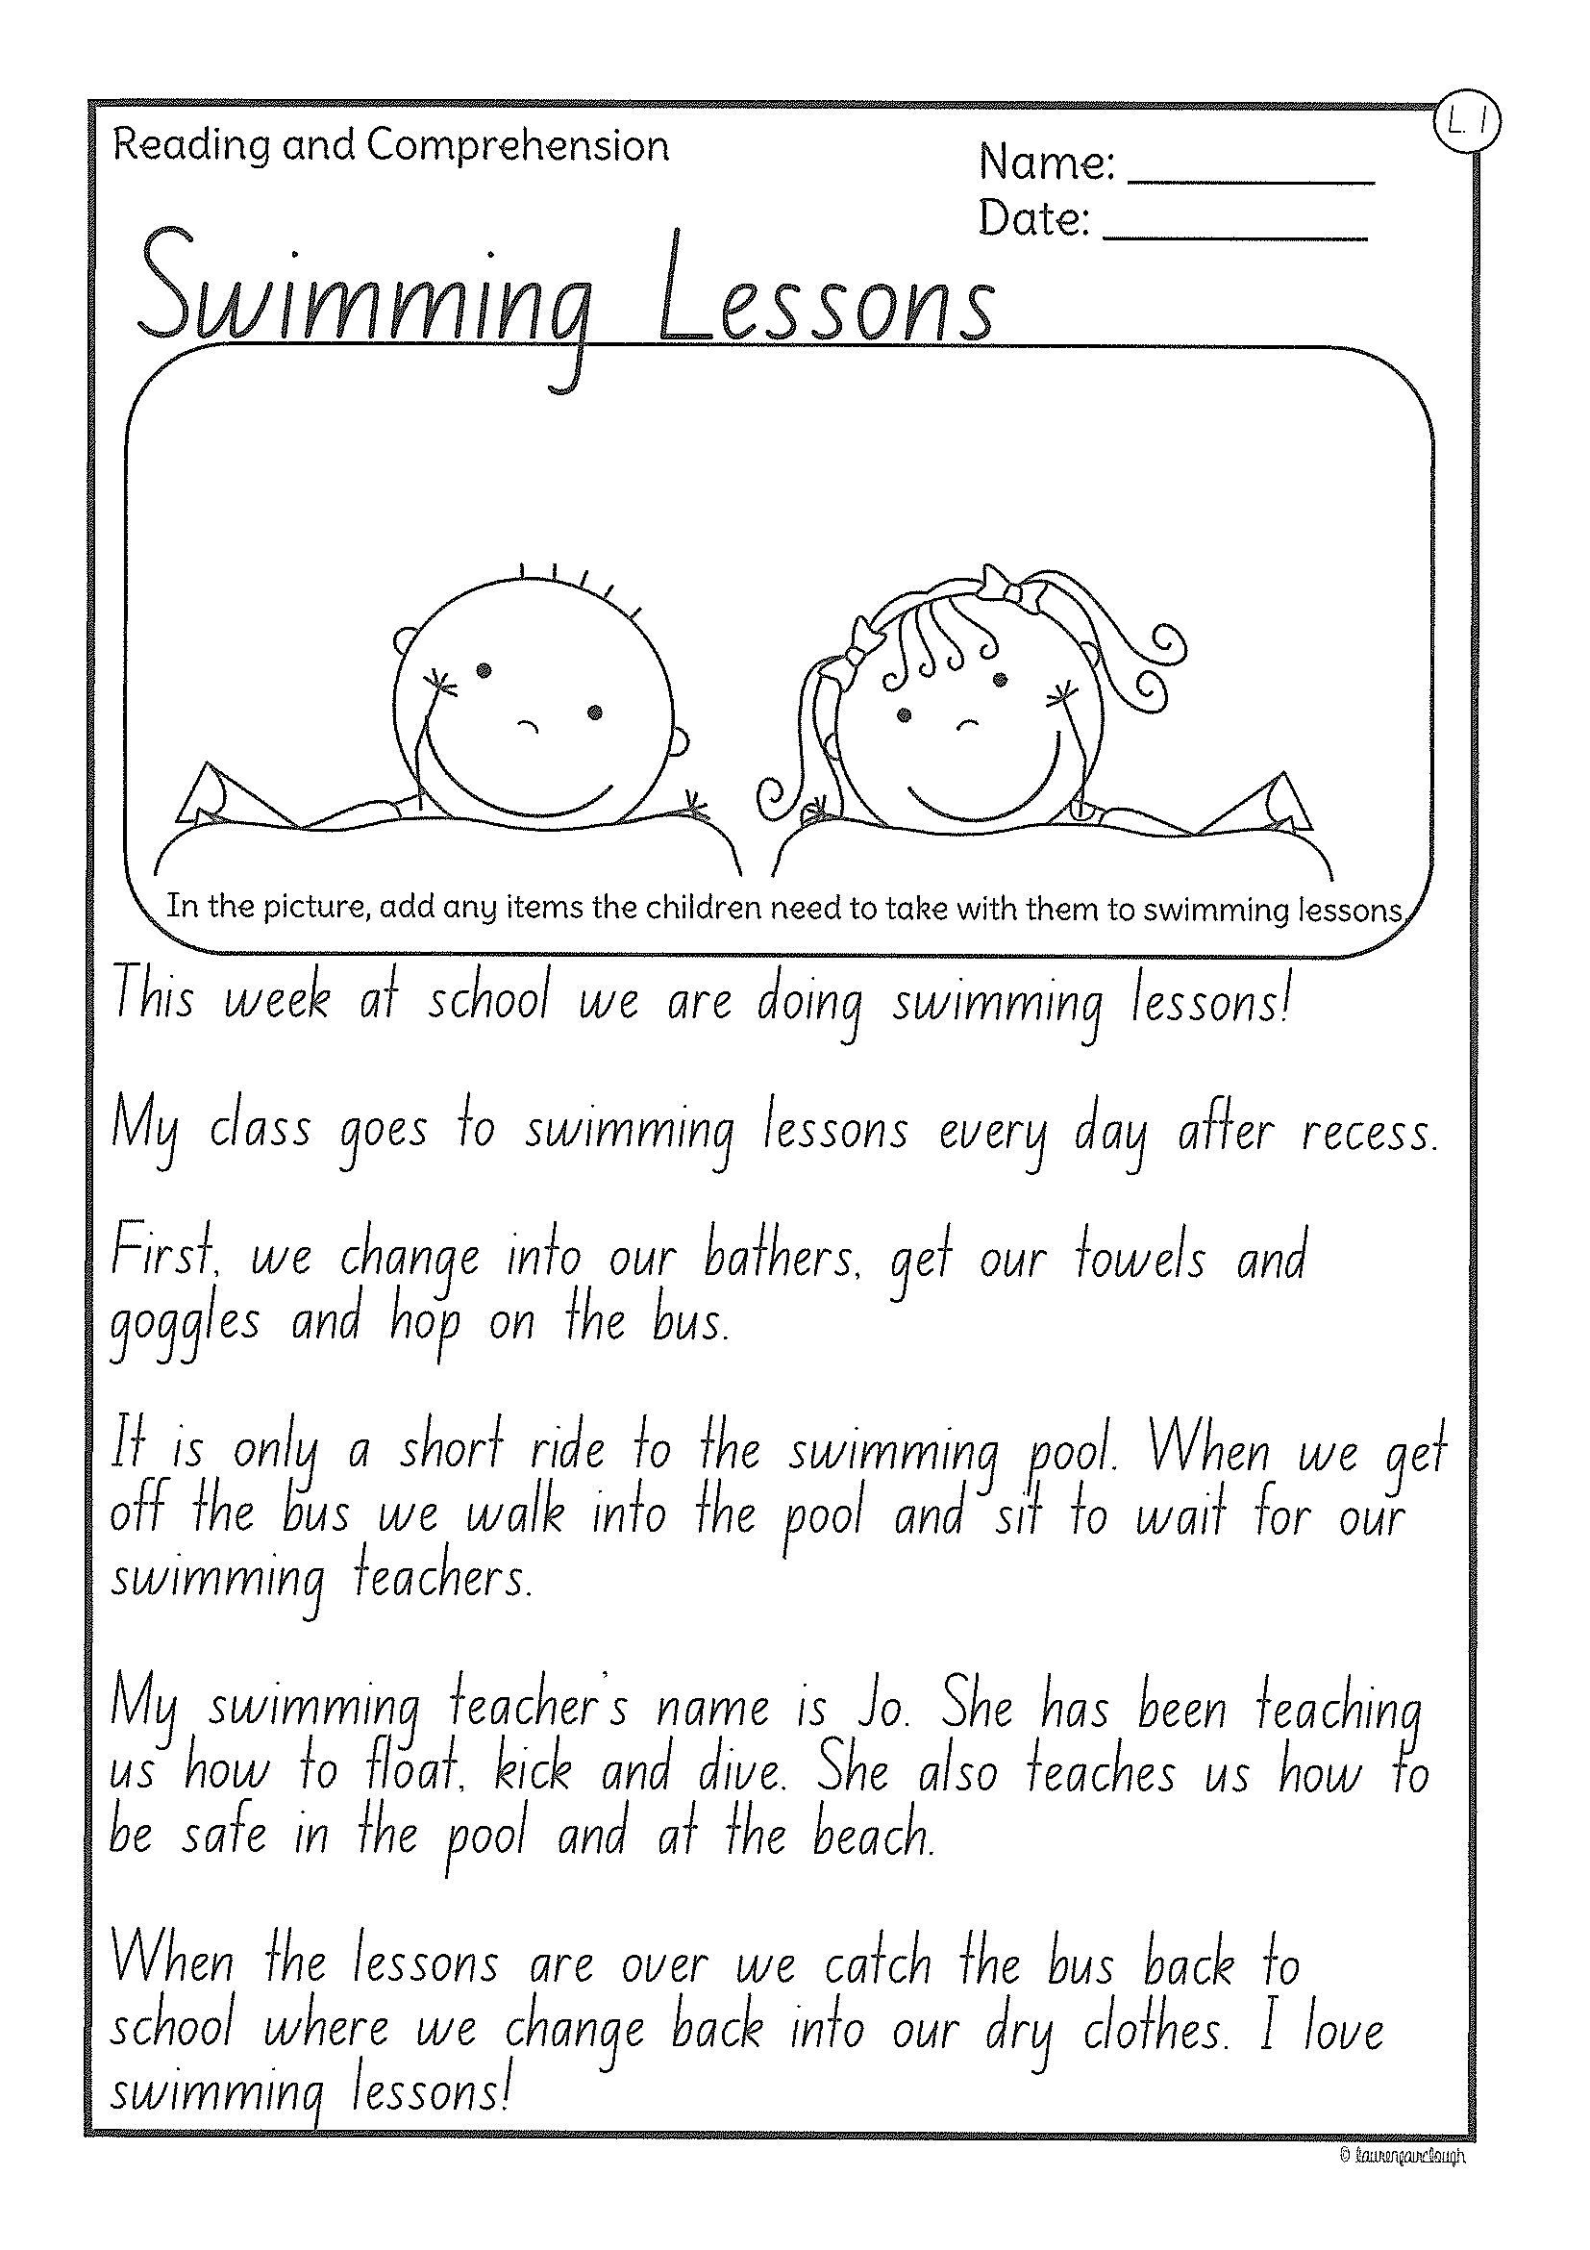
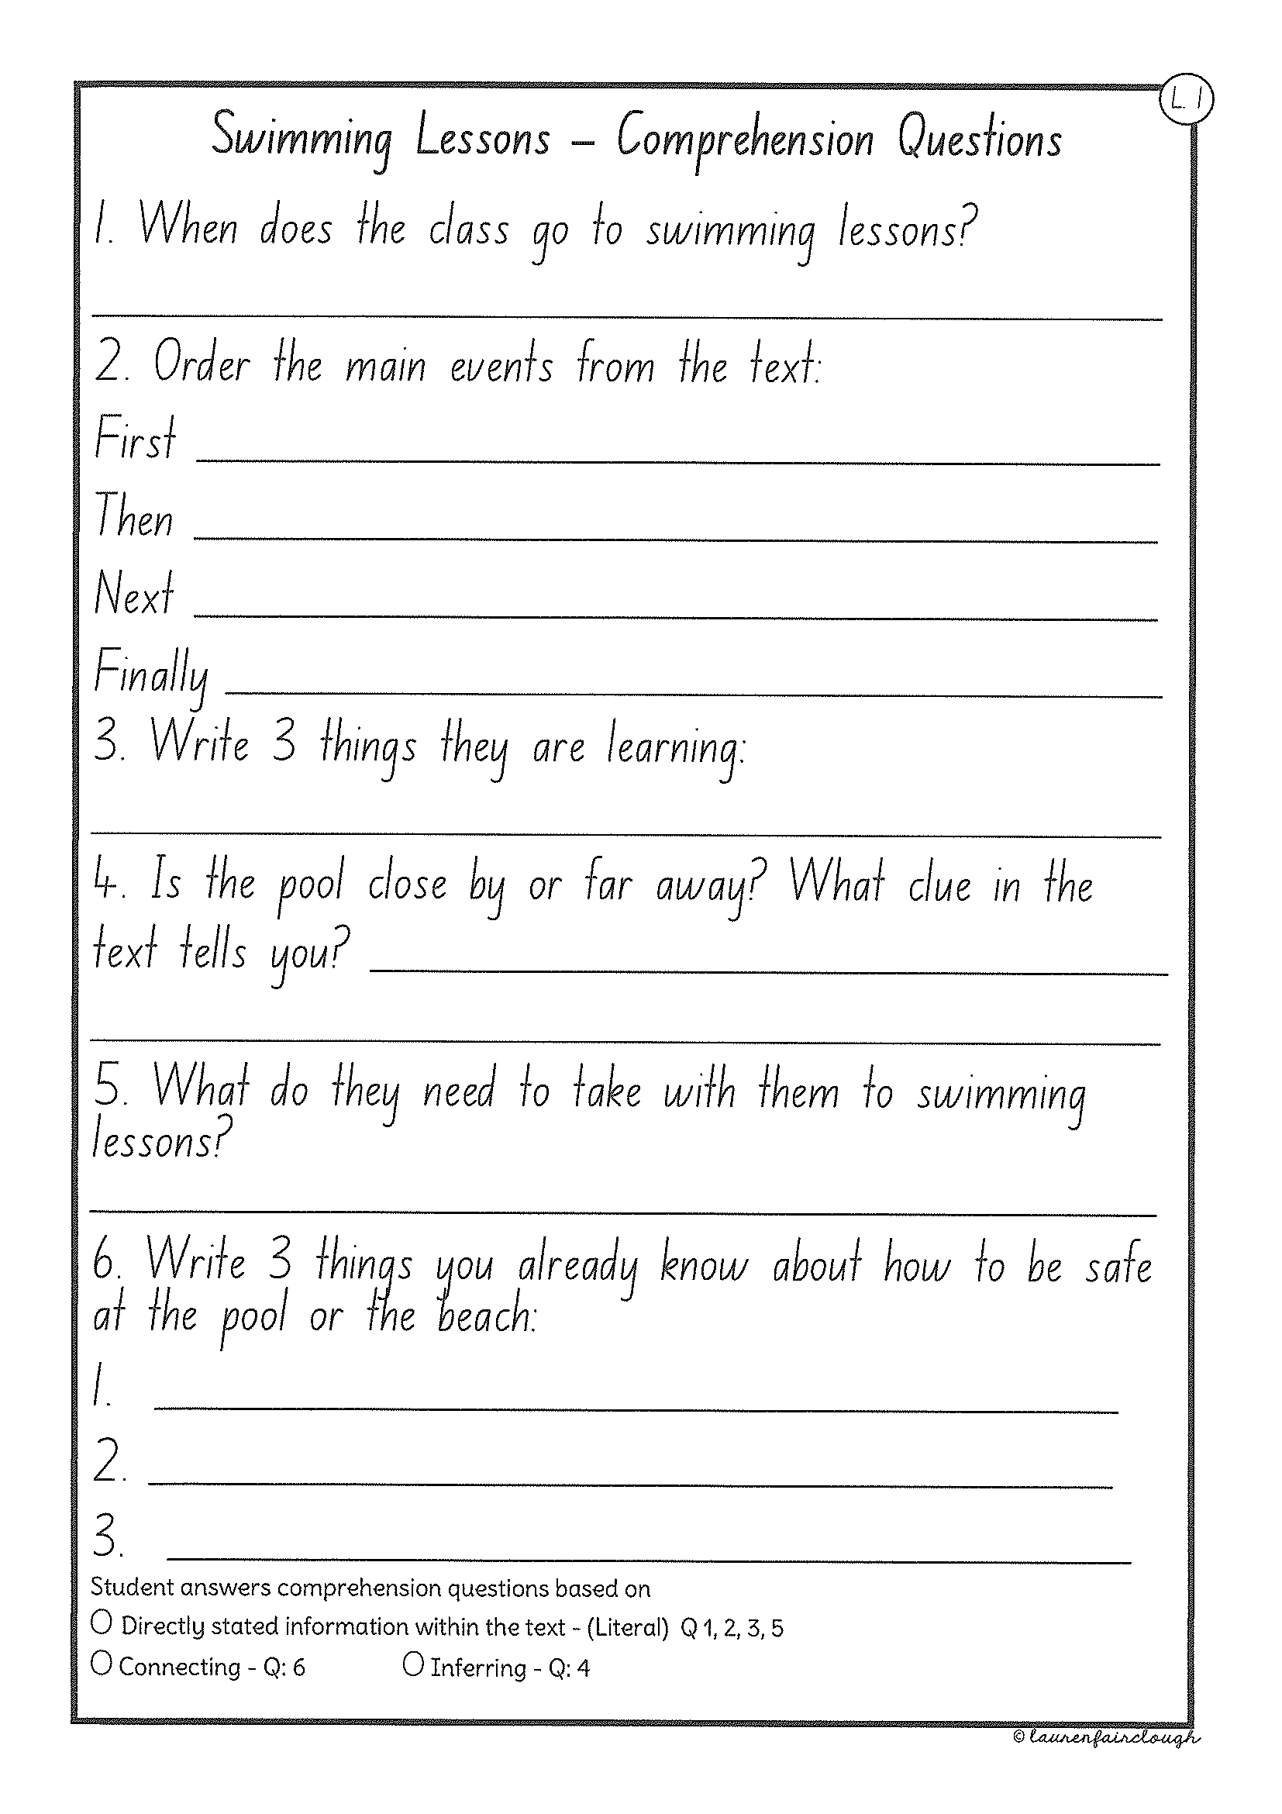
Task 2
Read or get an adult to read ”Swimming Lessons” and answer the questions.

Slide 44
Crunch n’ sip

Slide 45
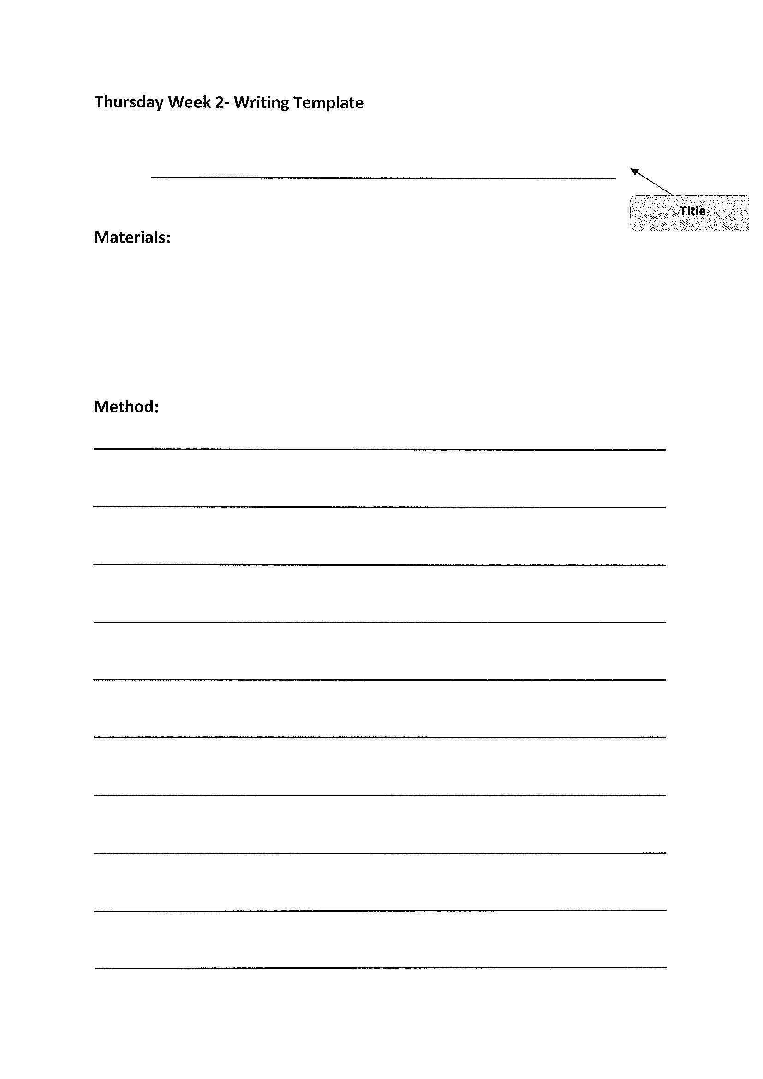
Task 4
Writing – procedural writing
Watch the video
Read through the questions in the learning pack to complete the task.

Slide 46
Recess break (30 minutes)

Slide 47
Mathematics
Task 1
Complete an activity from the maths activity grid

Slide 48
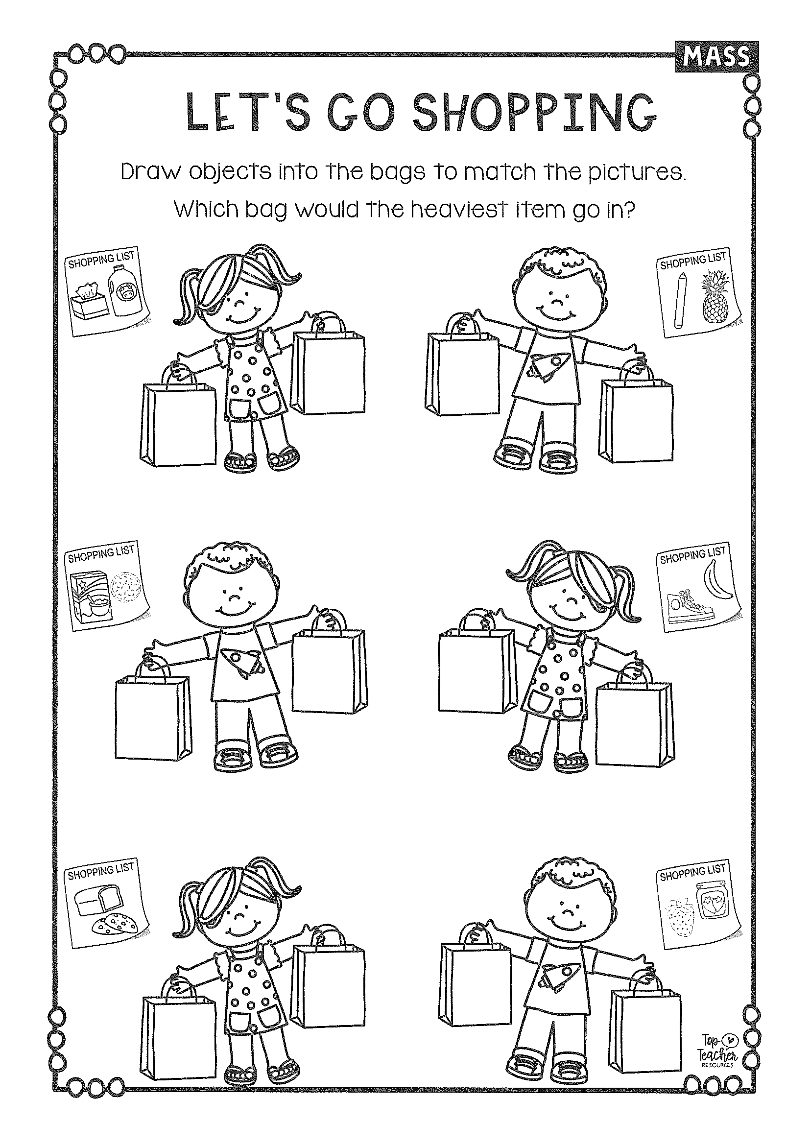
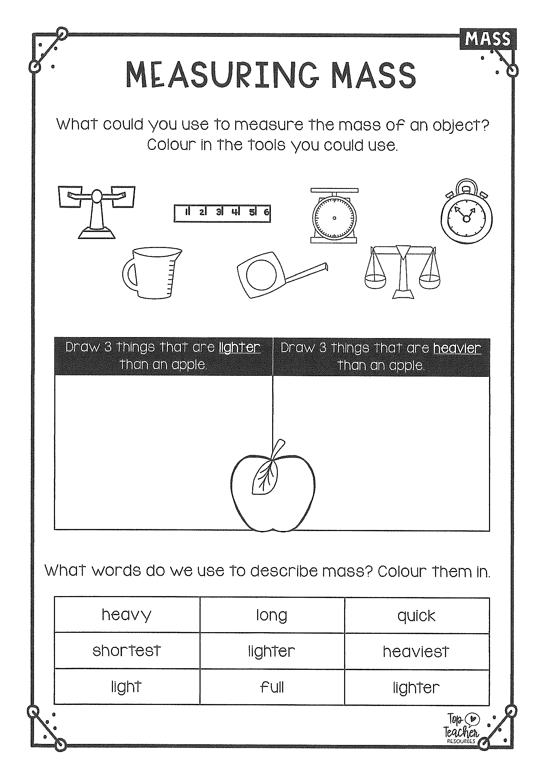
Task 2
m a s s
Year 1
Year 2

Slide 49
Lunch break (40 minutes)

Slide 50
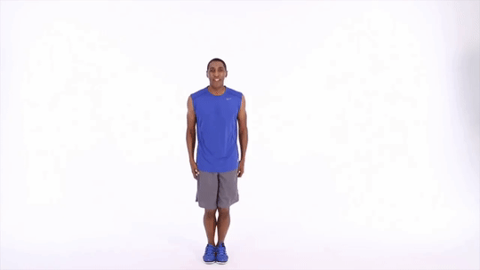
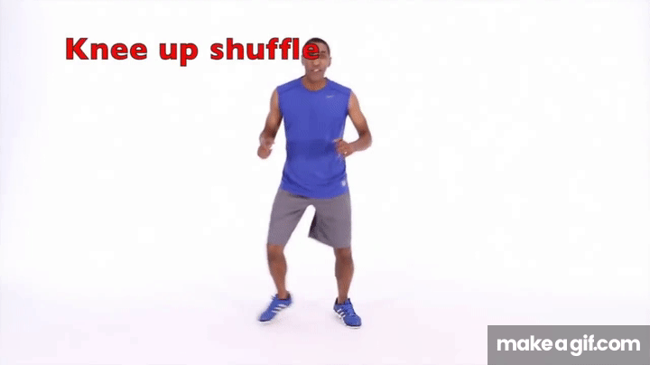
KLA - PDHPE
Visit the Hammondville PS Youtube page to see what goals Mr Withers has set for you this week.
Watch the Fundamental Movement Skills video using the link in the learning pack.

Slide 51
END OF DAY!
ENJOY your well-deserved break everyone!

Slide 52
Good morning
STAGE 1
FRIDAY 23RD JULY 2021 – WEEK 2
Please make sure you are sending one or two work samples to your classroom teacher via dojo.

Slide 53
WHATS ON TODAY?
Morning Task 1 – Grammar Task 2 – Reading Crunch n’ sip Writing Middle Maths
Final PDHPE

Slide 54
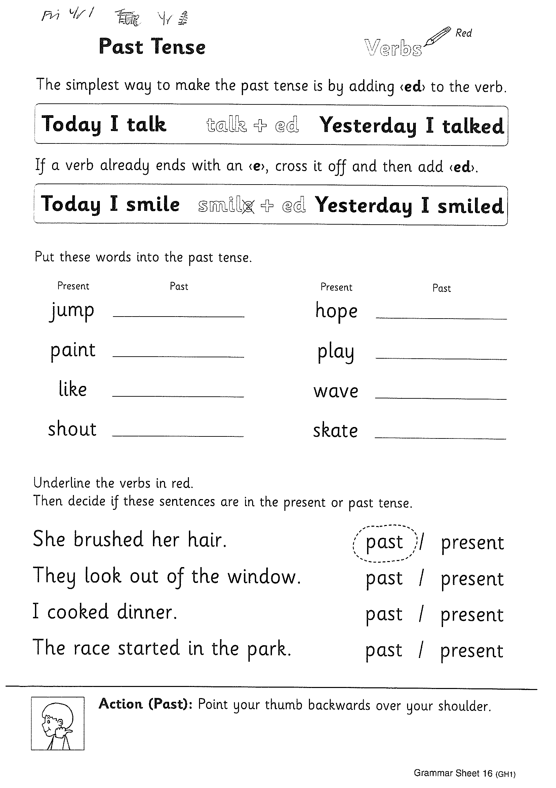
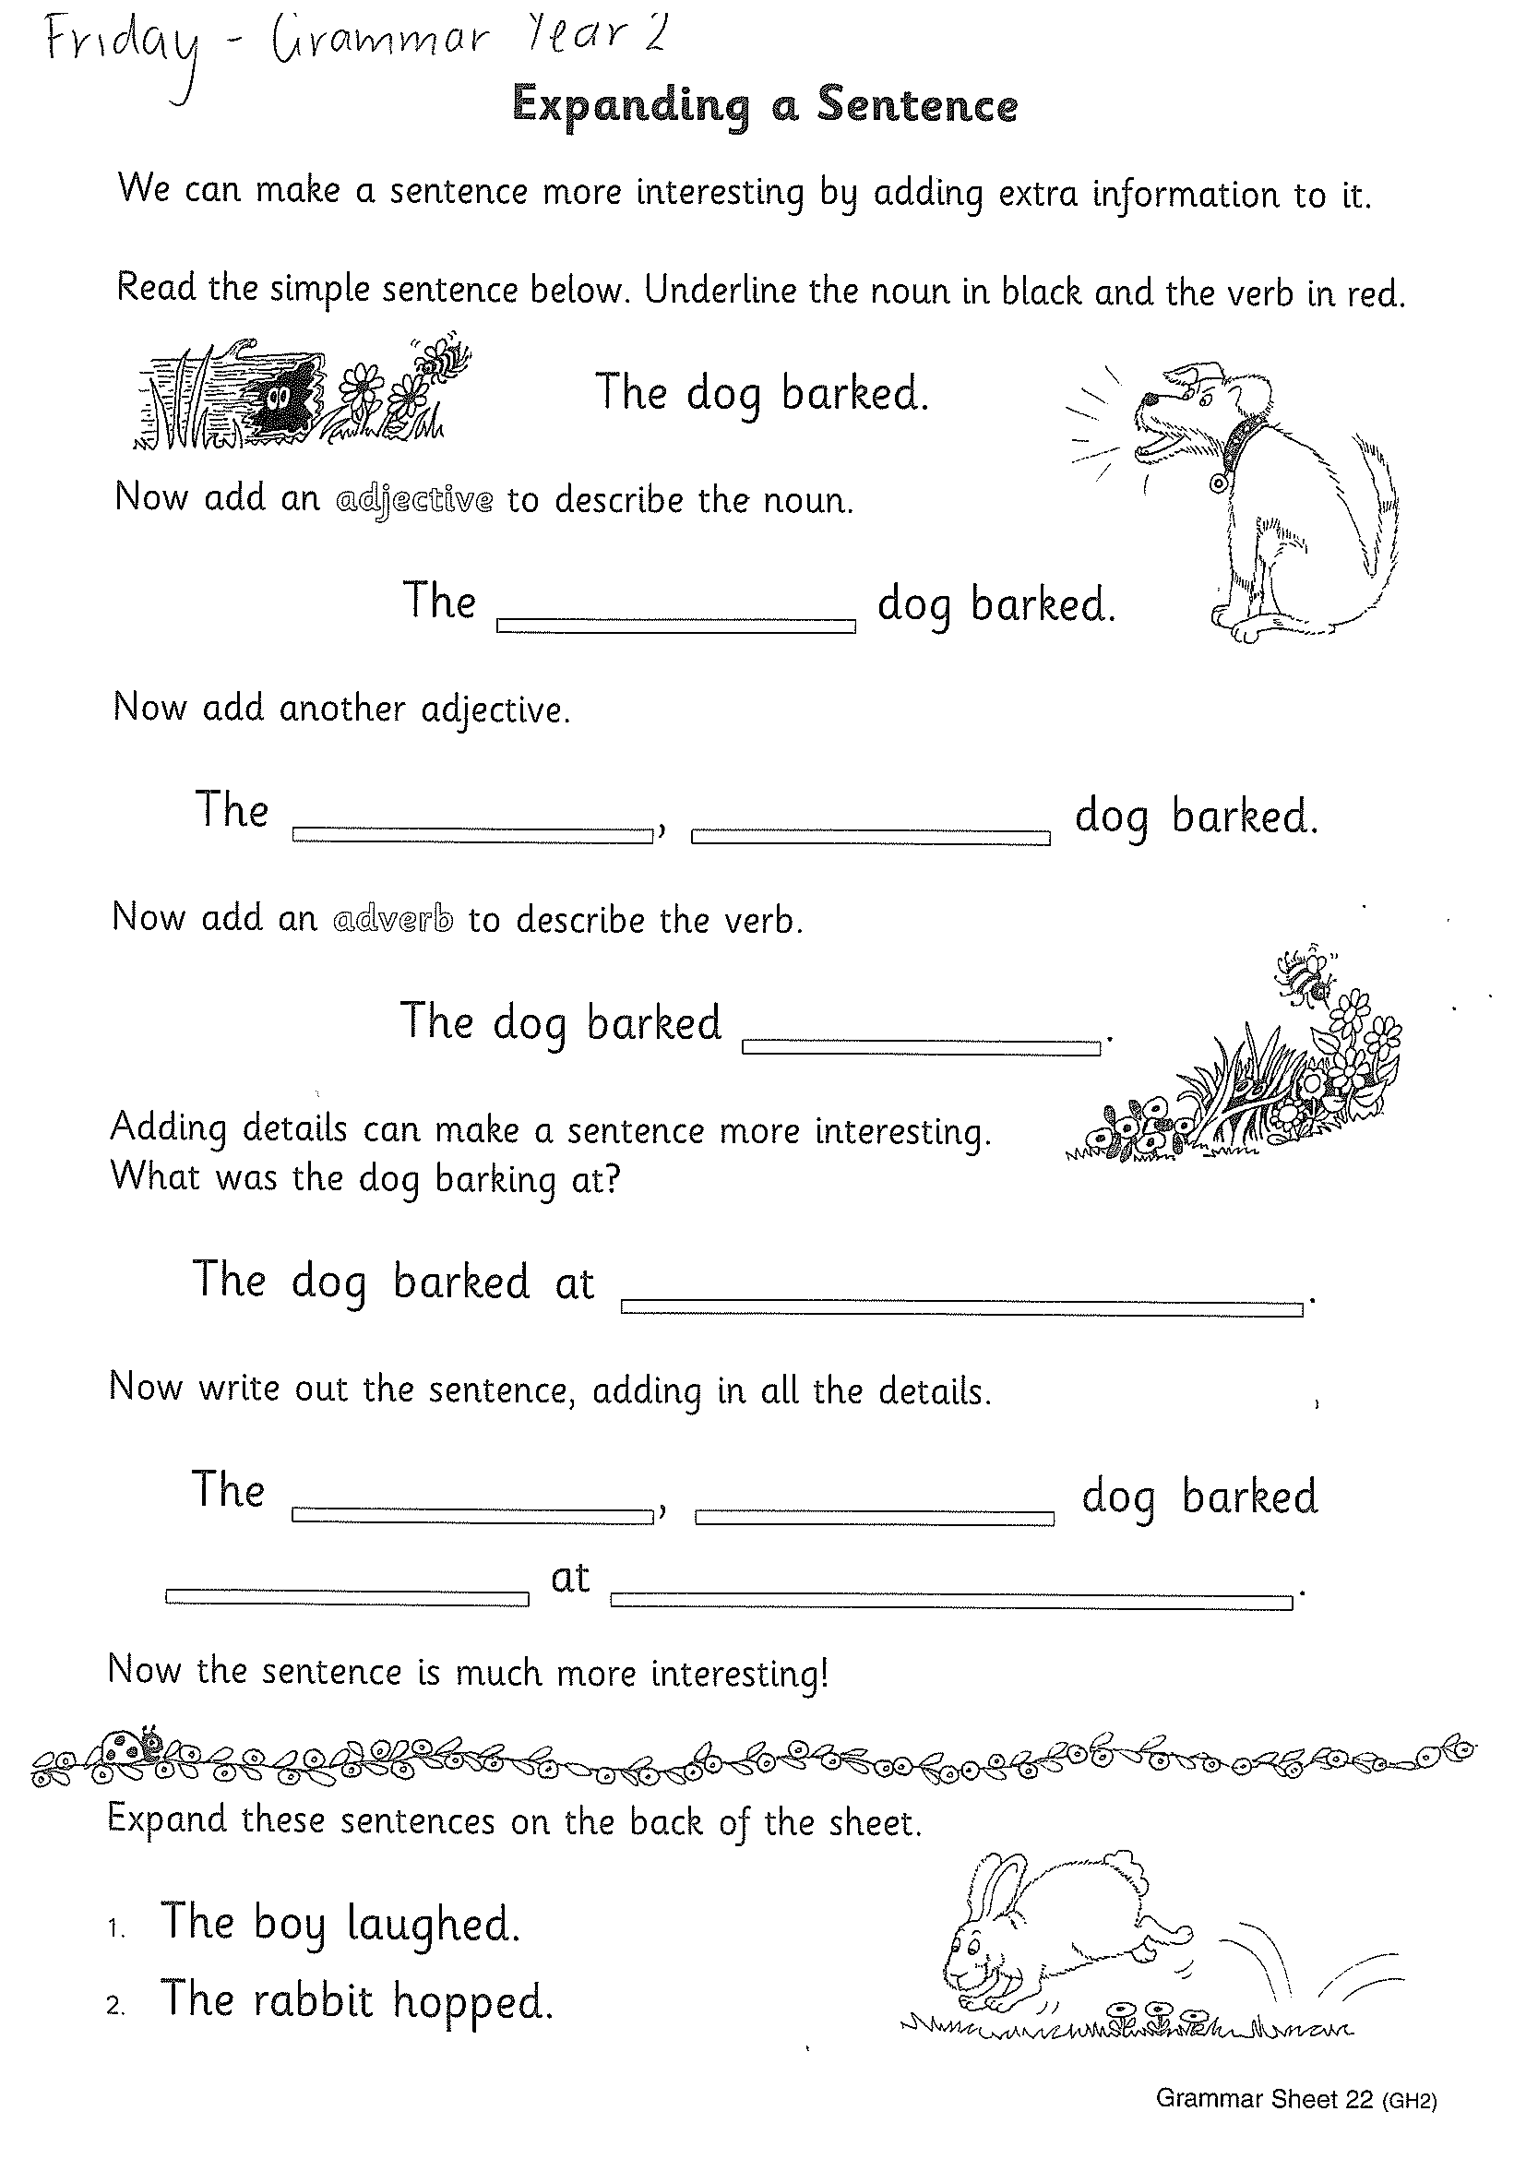
Task 1
Complete the grammar worksheets.
Year 1 – past tense
Year 2 – expanding a sentence

Slide 55
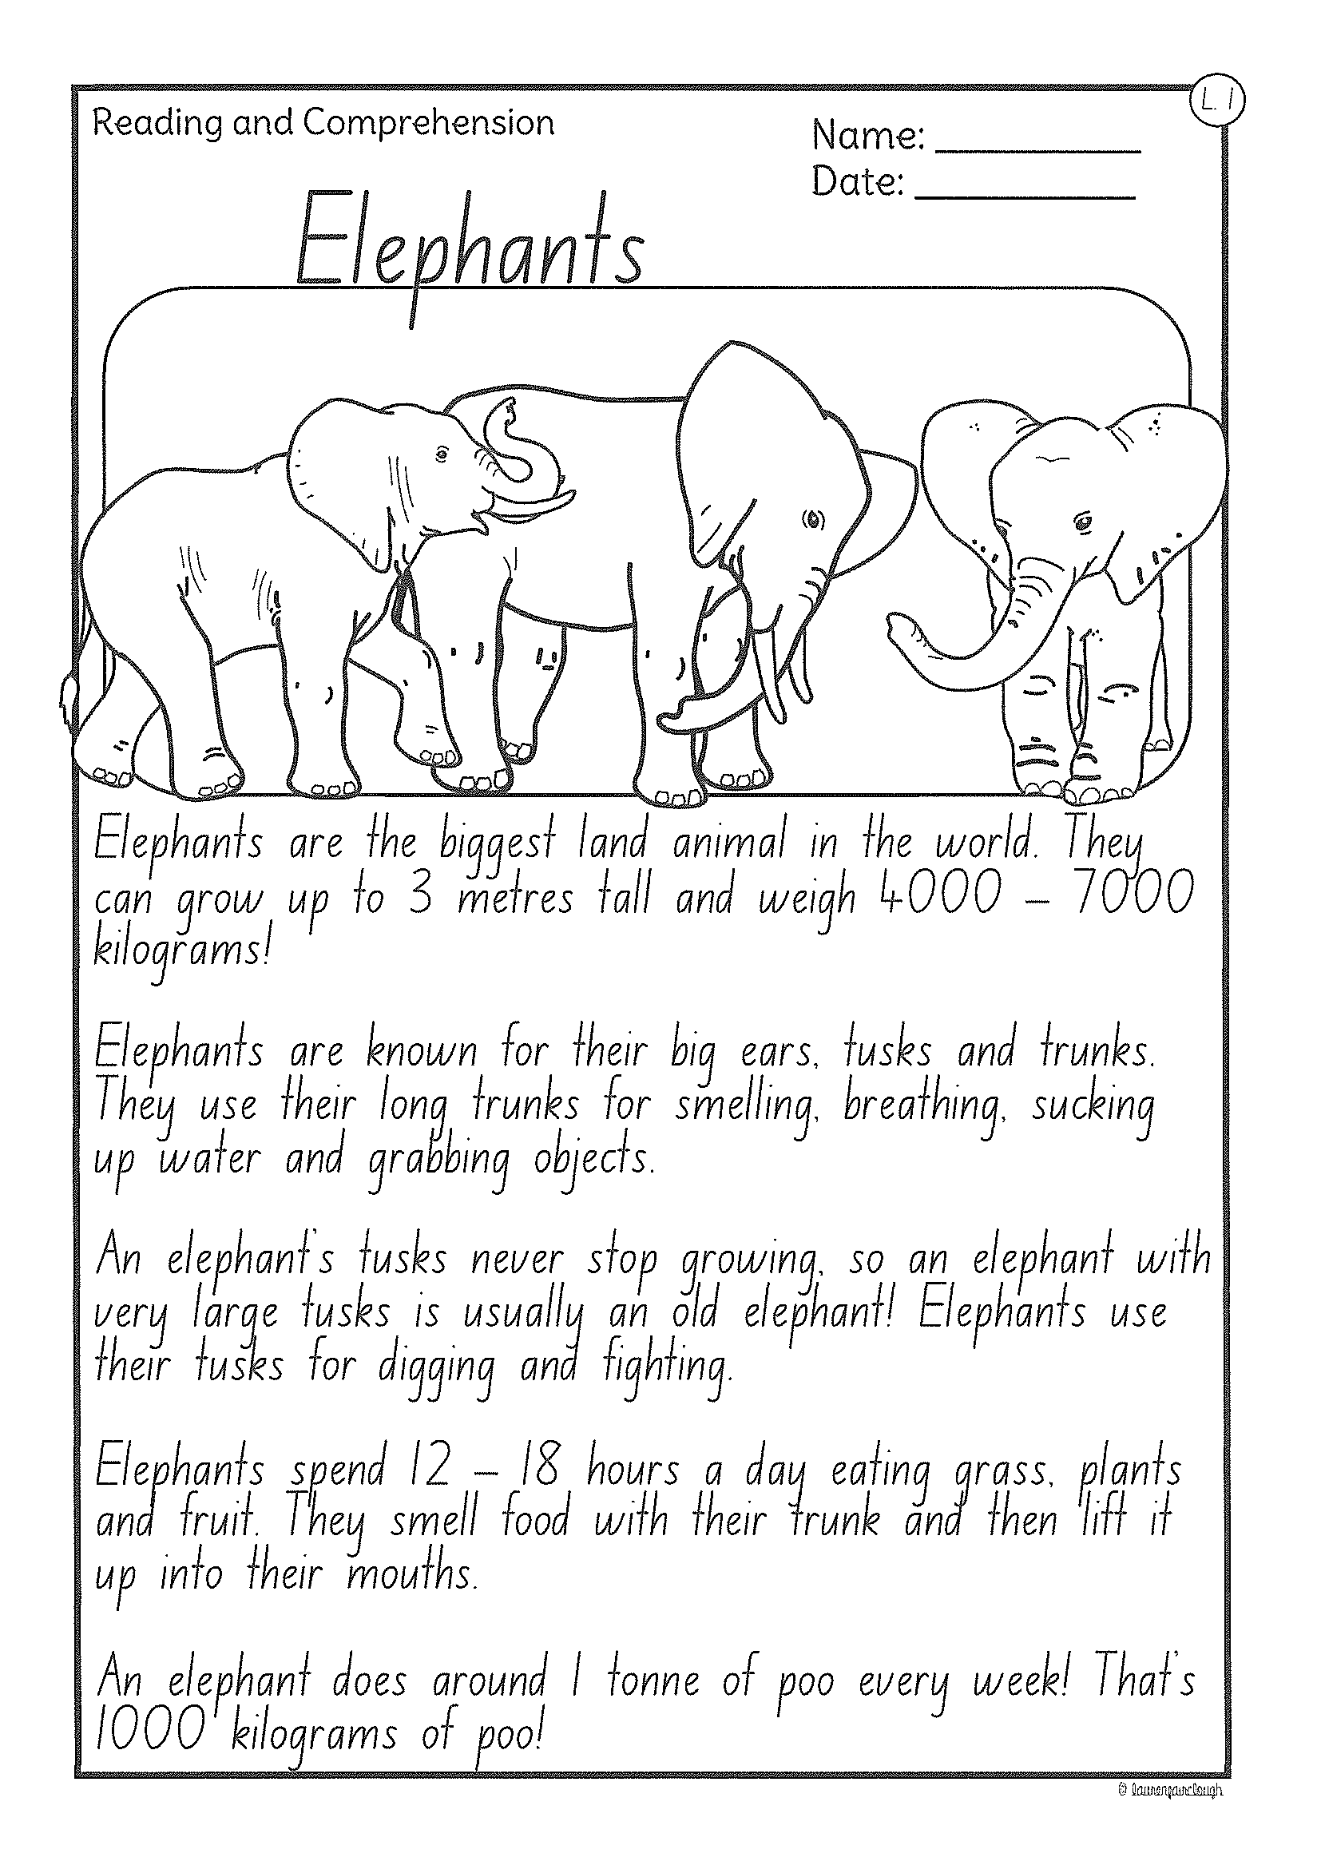
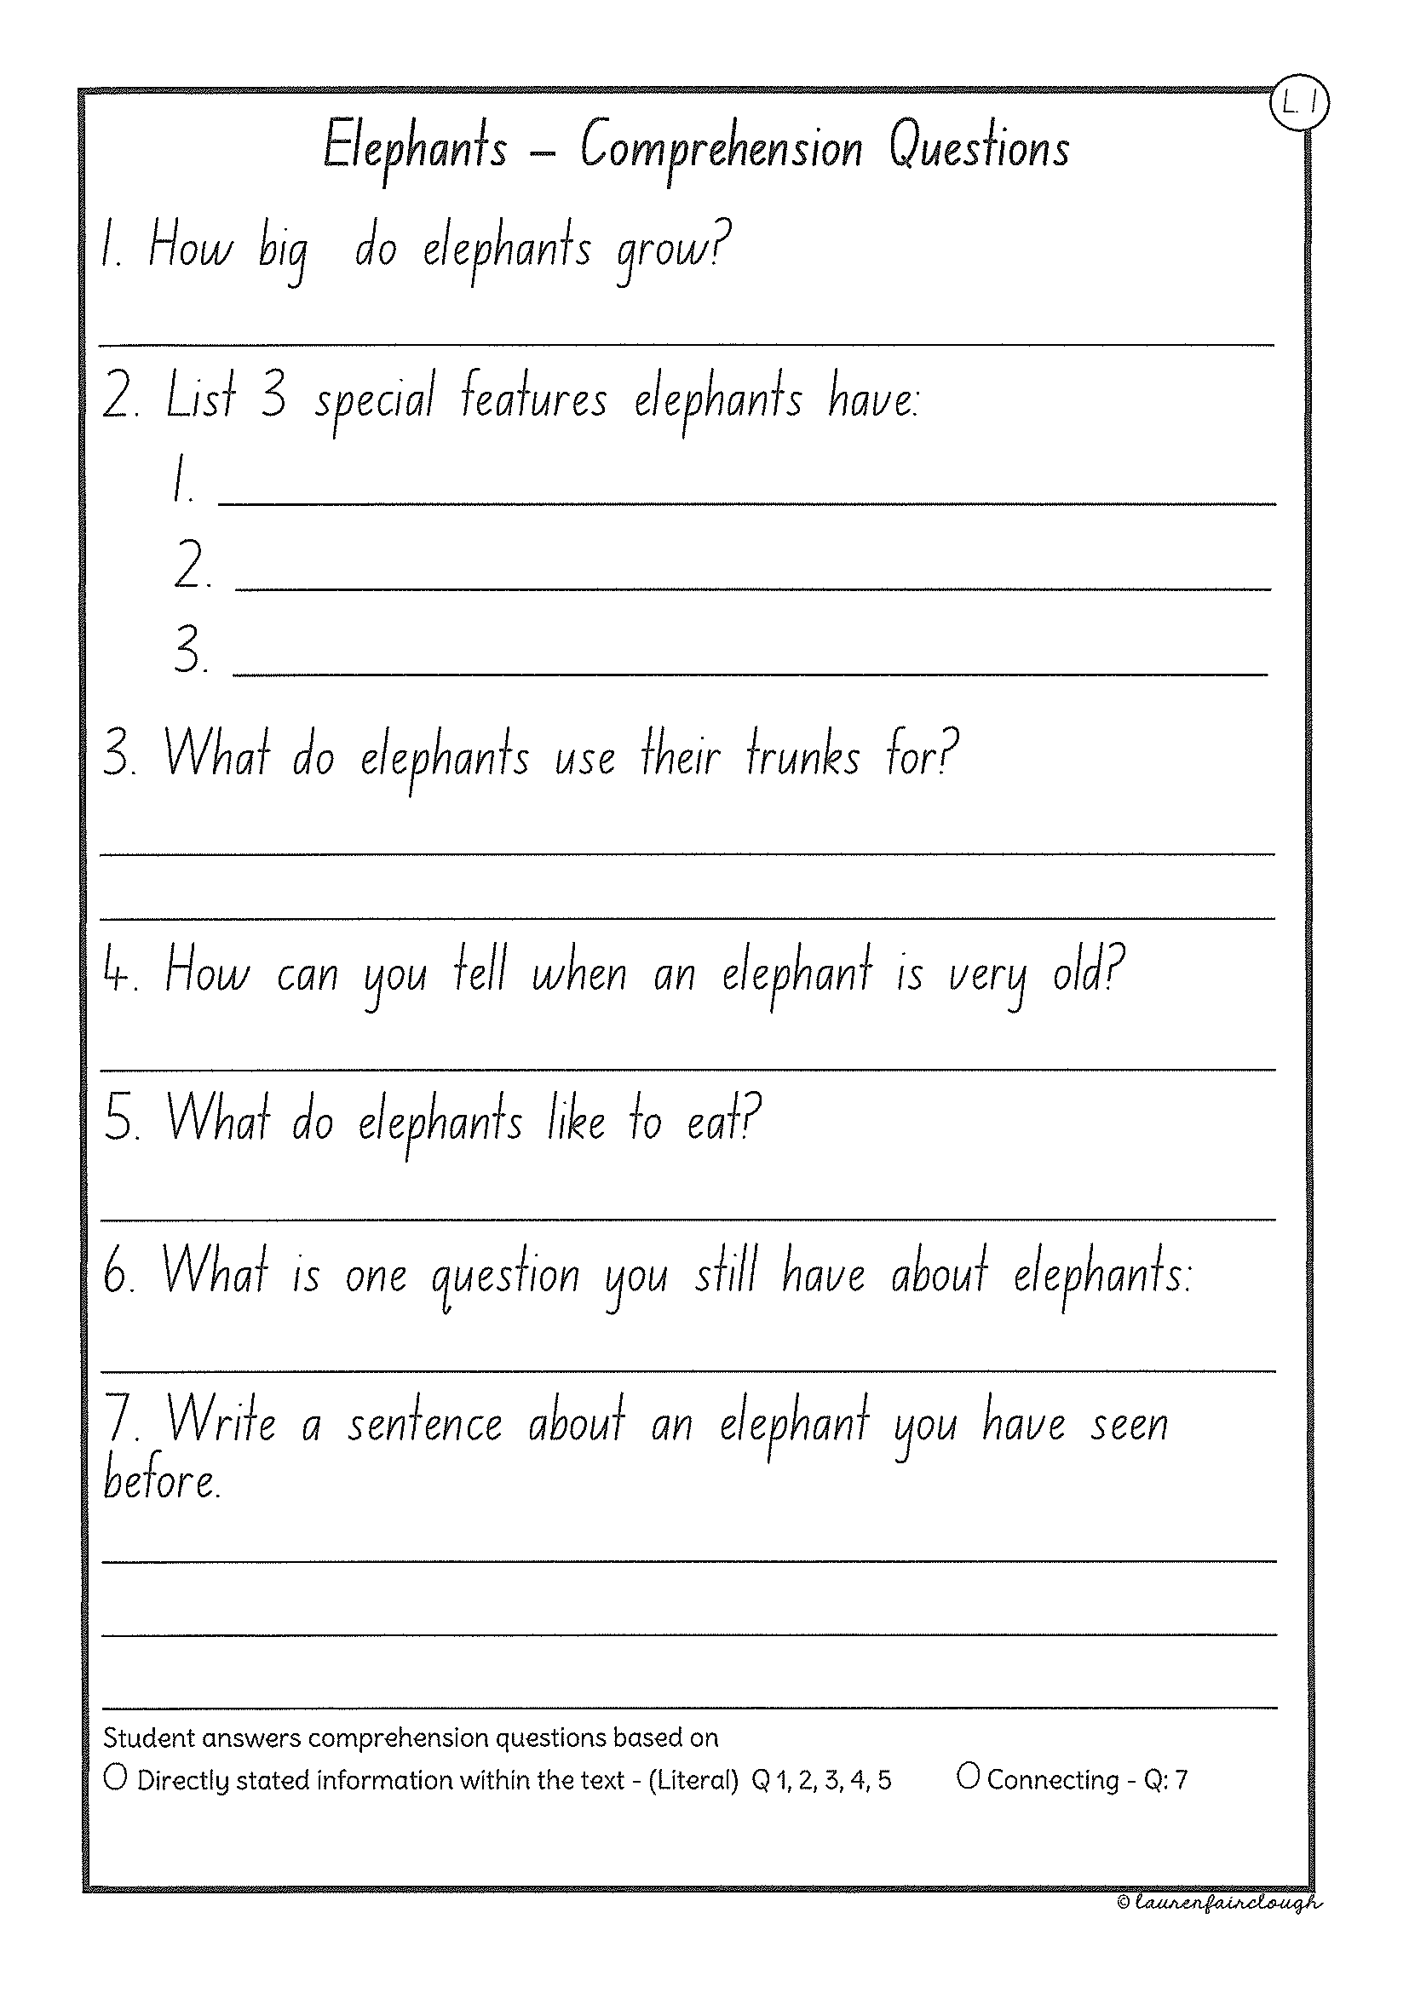
Task 2
Read or get an adult to read ”Elephants” and answer the questions.

Slide 56
Crunch n’ sip

Slide 57
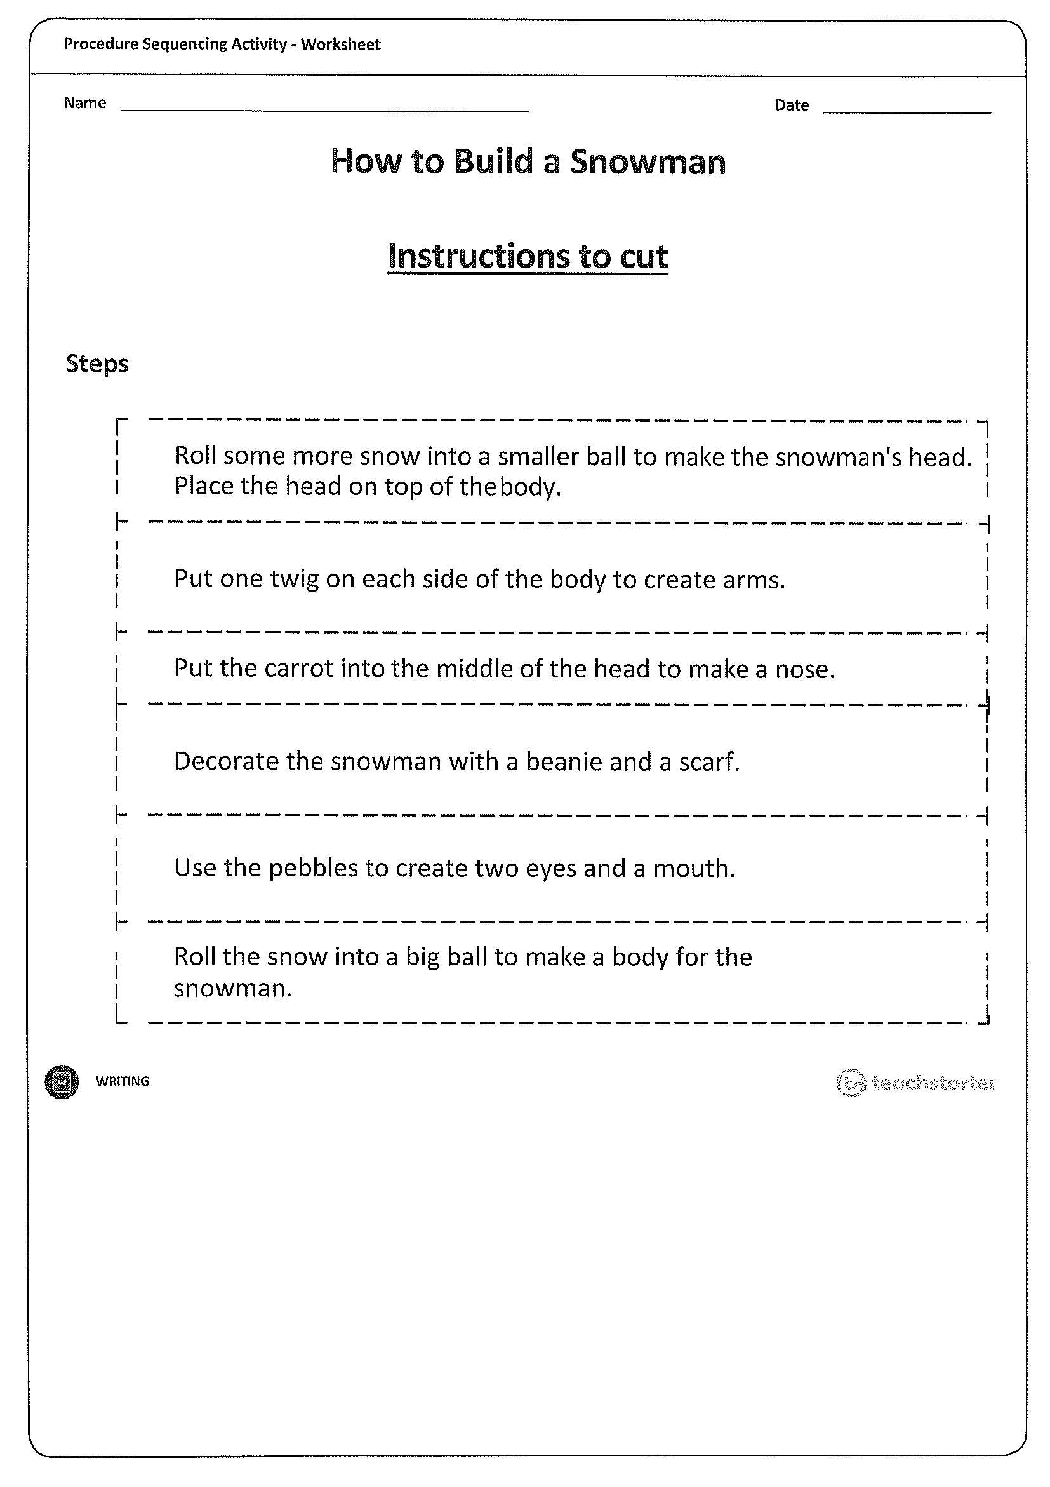
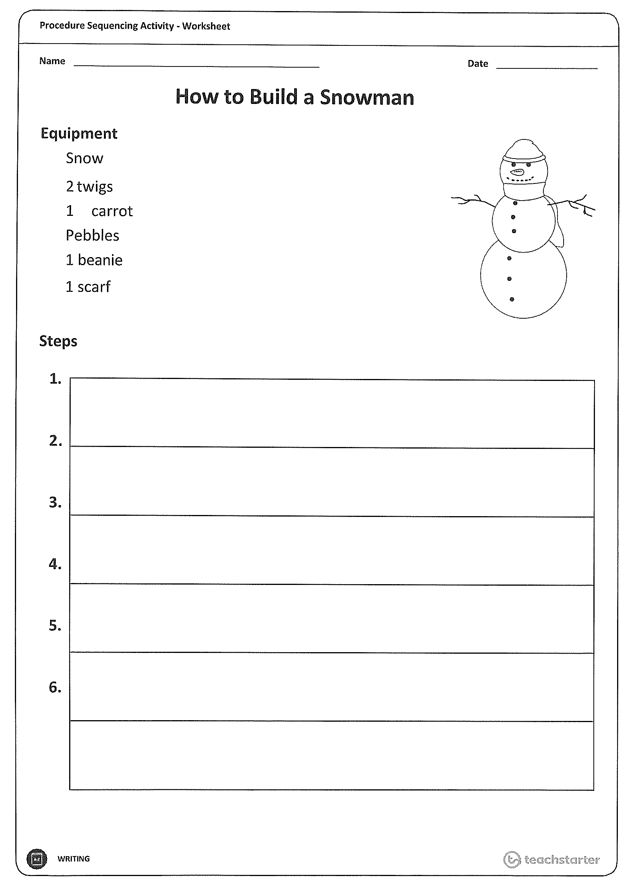
Task 4
Writing – procedural writing on how to build a snowman.
Read through the instructions in the learning pack to complete the task.

Slide 58
Recess break (30 minutes)

Slide 59
Mathematics
Task 1
Complete an activity from the maths activity grid

Slide 60
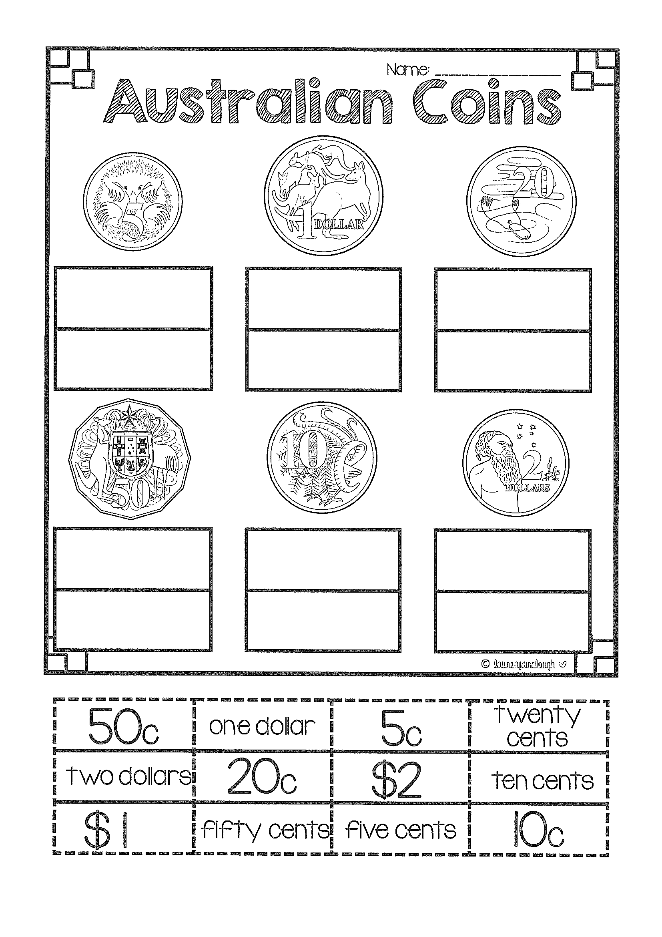
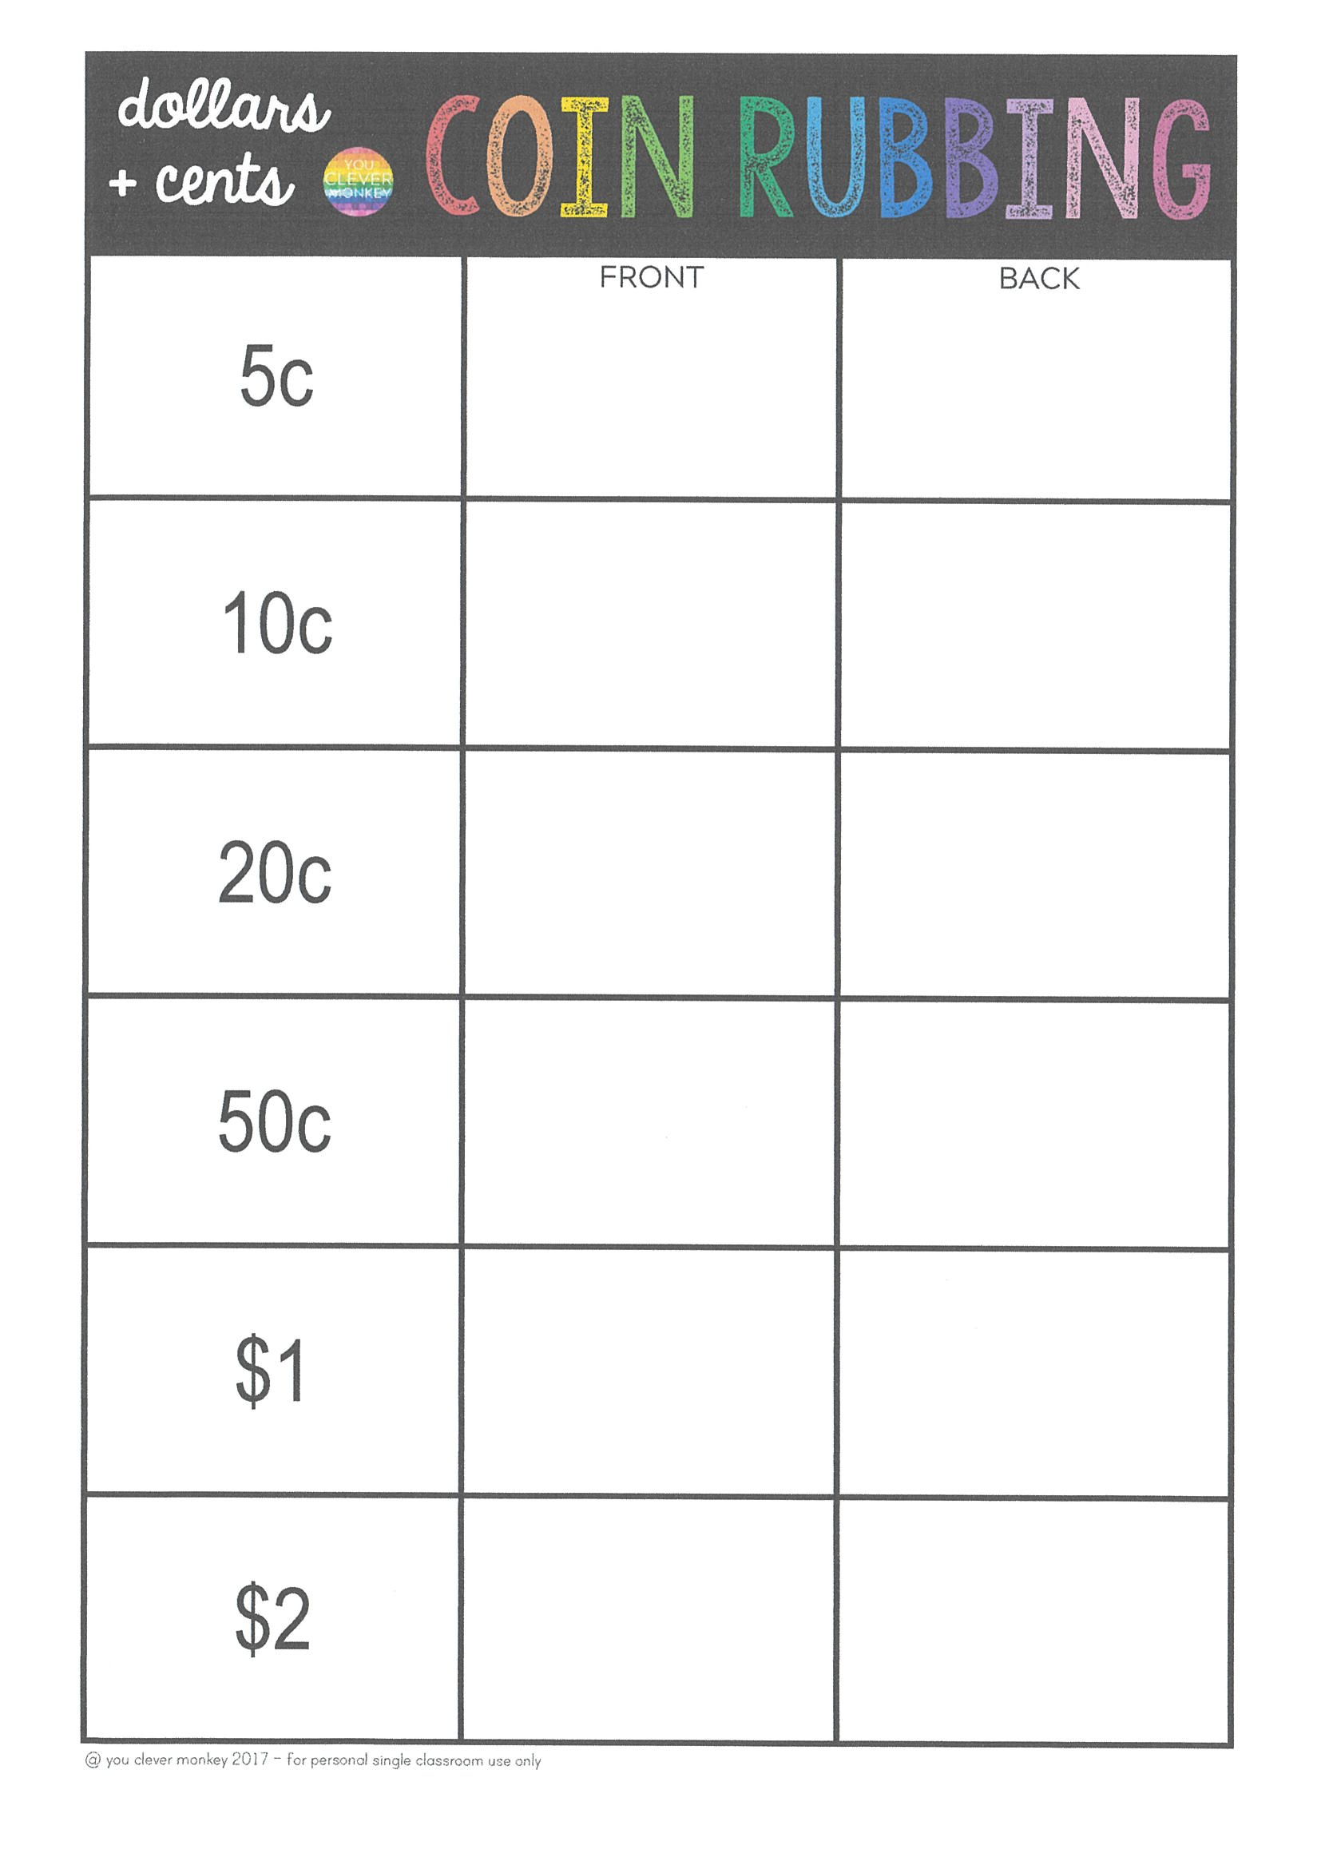
Task 2
M o n e y
Year 1
Year 2

Slide 61
Task 3. fitness
Choose an activity from the fitness grid to complete.
Not this one
(in your packs)

Slide 62
Lunch break (40 minutes)

Slide 63
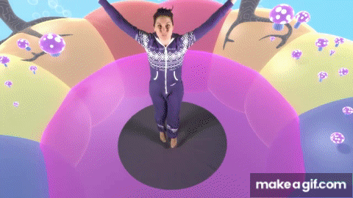
KLA – capa (dance)
DANCE DISCO YOGA
Link provided in learning pack

Slide 64
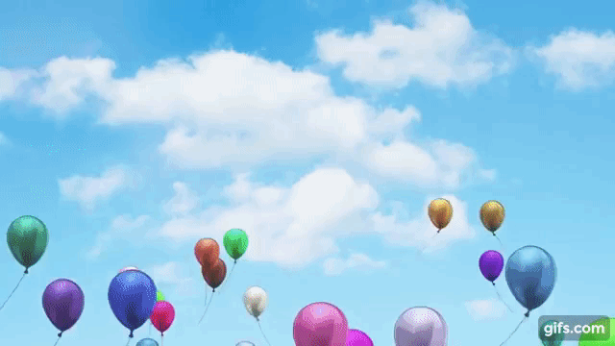
FREE PLAY
Build or construct an object or building using blocks

Slide 65
END OF DAY!
ENJOY your well-deserved break everyone!

