Slide 1
NSW Premier’s Sporting Challenge
Student introduction
10 Week Challenge 2021
Notes:
Note for facilitators –
Prior to presenting, go through PowerPoint presentation and make all necessary changes.

Slide 2
Welcome to the 2021 10 week Challenge!
Primary Launch video
Click play on the video to be part of our virtual launch for the 10 week Challenge.
Or visit our Vimeo page if the video doesn’t work.
Notes:
Use this slide for primary students only.
The video goes for 17 minutes and involves student getting active.
They can do this in a small space near their desks or in a hall.

Slide 3
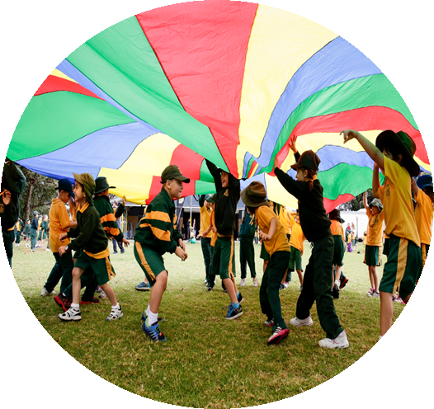
What is it?
The Challenge is designed for you to work together in a team with the shared goal of increasing physical activity levels.
It is an opportunity for active students to be role models for their peers, where students can encourage each other to increase their activity levels as a collective.
Notes:
Note for facilitators –
Change wording to suit the needs of your school and students.

Slide 4
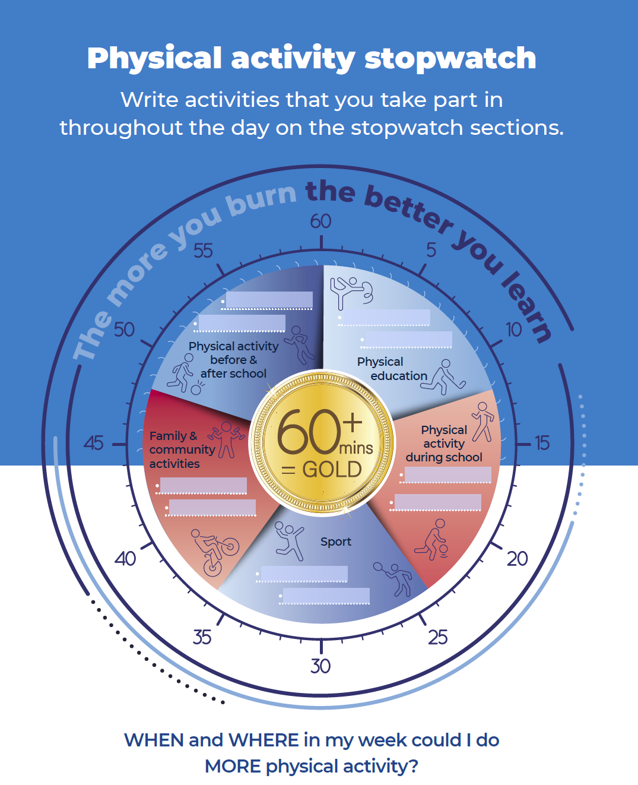
Key dates
Insert school name
Challenge start date | Term 3 Week 1
Challenge end date | Term 3 Week 10
Notes:
Note for facilitators –
Edit table according to your Challenge dates.

Slide 5
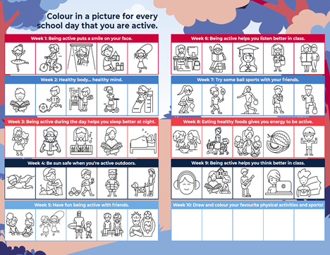
K-2 information
During the 10 week Challenge, we want to be as active and healthy as possible.
Every day we record our physical activity in these log books. Students colour in a picture for every day that they are active.
Notes:
Note for facilitators –
This slide will be used if you are using the K-2 Log Books.
Change wording to suit the needs of your school and students.

Slide 6
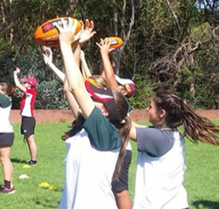
K-2 information
During the 10 week Challenge, we want to be as active and healthy as possible.
Notes:
Note for facilitators –
This slide will be used if you are not using the K-2 Log Books.
Change wording to suit the needs of your school and students.

Slide 7
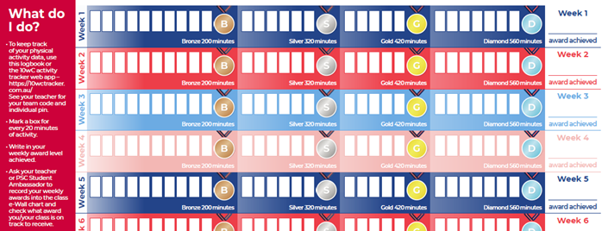
Years 3-6 information
During the 10 week Challenge, we want to be as active and healthy as possible and strive to achieve diamond status. We can record our results using:
log books
class wall chart
e-Wall chart
Each box on the Log Book is 20 minutes of physical activity. For example, if you walk for an hour you can colour in three boxes.
Award | Daily activity time
Bronze | 30 mins per day
Silver | 45 mins per day
Gold | 60 mins per day
Diamond | 80 mins per day
Notes:
Note for facilitators –
This slide will need to be modified if your school has chosen not to use the Log Books.
Change wording to suit the needs of your school and students.

Slide 8
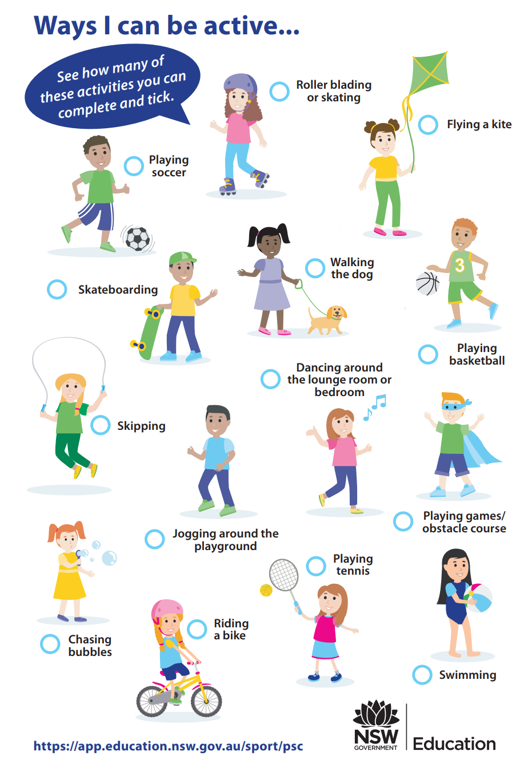
Ways to be active
Notes:
Note for facilitators –
Physical activity doesn’t have to be organised sport. For example, wrestling with siblings, helping in the kitchen, dancing along to the radio or GoNoodle, doing Wii Sports on the Nintendo.

Slide 9
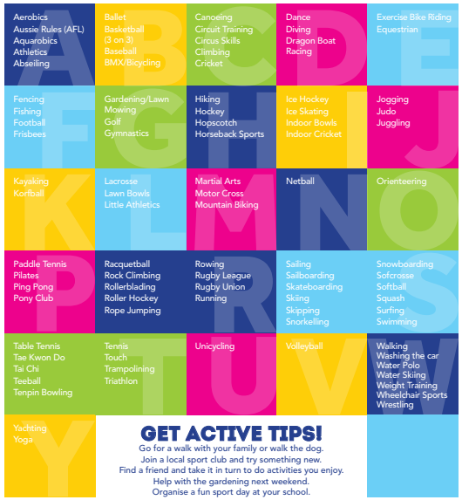

Slide 10
Good luck! Let’s get active!

