Slide 1

STAGE 1
MISS UNAL
MS ROBINSON
MISS MORATA
MRS MAZLOUM/ MRS ENRIGHT
MRS FLEMING
(ASSISTANT PRINCIPAL)
MISS HOLDSWORTH

Slide 2
Good morning
STAGE 1
MONDAY 23RD AUGUST 2021 – WEEK 7
Please make sure you are sending one or two work samples to your classroom teacher via dojo.

Slide 3
WHATS ON TODAY?
Morning
Task 1 - spelling
Task 2 - reading
Crunch n’ sip
Task 3 - writing
Task 4 - handwriting
Middle
Task 1 - Maths Grid
Task 2 - Worksheet
Final
Geography

Slide 4
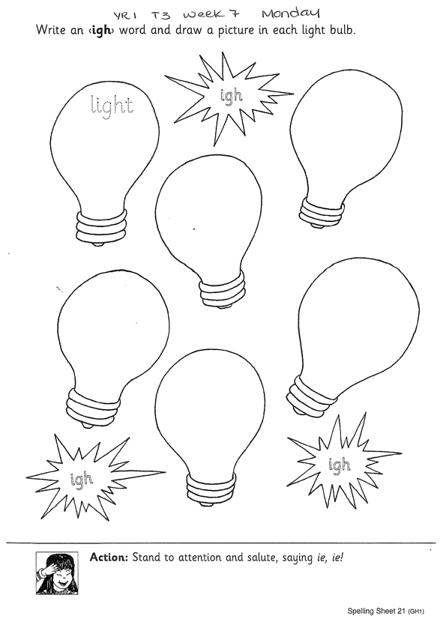
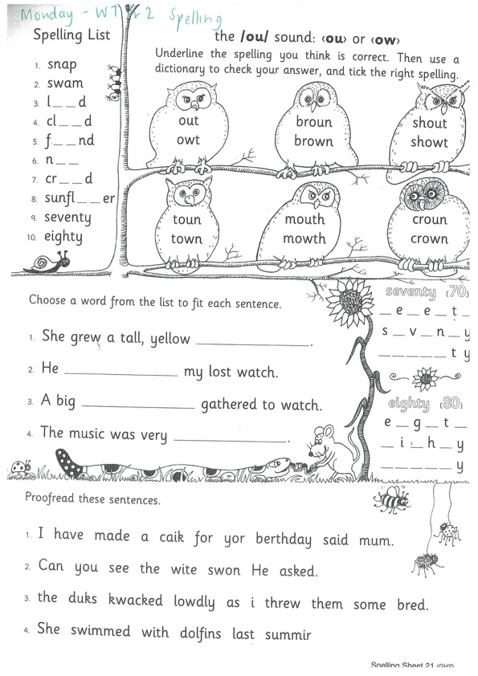
Task 1
Year 1
Year 2
Watch Mrs Warwick’s video’s for the sound of the week. Brainstorm a list of words using the sound focus of the week on a piece of paper.
YEAR 1
https://www.youtube.com/watch?v=kX2nBTWLx2M&feature=youtu.be
YEAR 2
https://www.youtube.com/watch?v=PC-VihitK0s

Slide 5
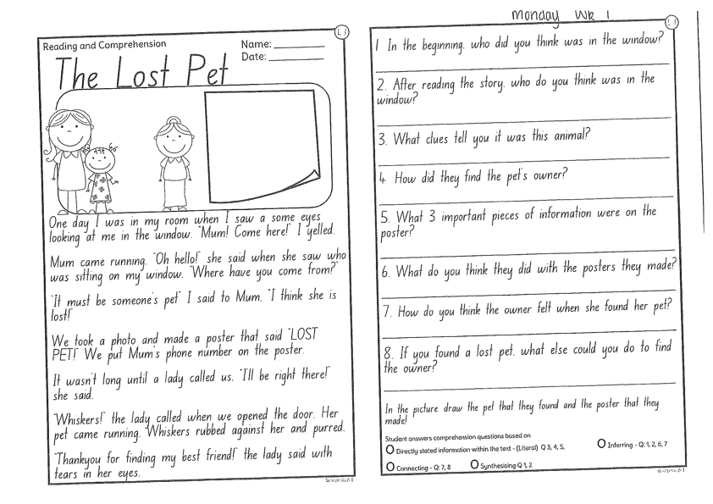
Task 2
Read or get an adult to read ‘The Lost Pet’ and answer the questions.

Slide 6
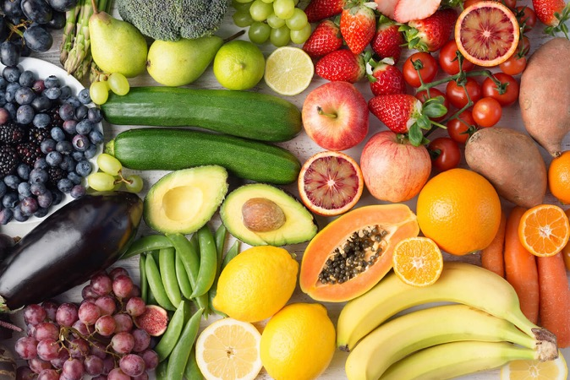
Crunch n’ sip

Slide 7
Task 3
Using the prompt, create an imaginative story of your own. Remember to tell us who is in the story, where they are, what they are doing and try to include a problem and solution!
What’s happening here?
Who is in your story?
What are they doing?
What is the problem? How is it fixed?

Slide 8



Task 4
Complete the letter “g” in your handwriting books.
https://www.youtube.com/watch?v=b-S55JBNXTo

Slide 9

Recess break (30 minutes)

Slide 10
Mathematics
Task 1
Complete an activity from the maths activity grid

Slide 11
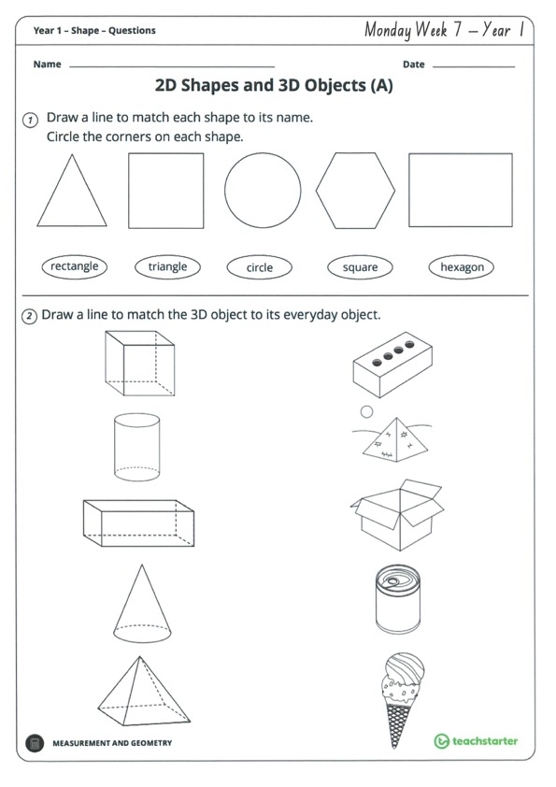
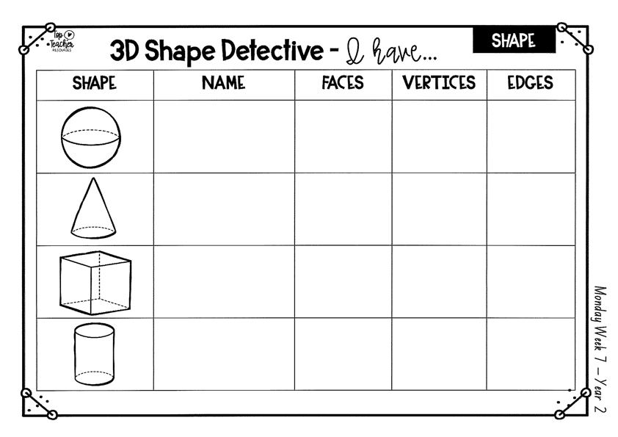
Task 2
Complete the worksheets and then do 3 activities on mathletics or studyladder.
2d and 3d shapes

Slide 12


Lunch break (40 minutes)

Slide 13
KLA - geography
Todays lesson is on ‘Built Features’. These are things that are made by man. Read the ebook and do the fun quiz video. Can you recognise things that are natural, manmade or both? Then complete the worksheet to draw your school. Make sure you include natural and built features. Hint: You can use the google Earth Link to find your school and help you.
http://inq.co/class/9wg
Code: 9484

Slide 14

END OF DAY!
ENJOY your well-deserved break everyone!

Slide 15
Good morning
STAGE 1
TUESDAY 24th AUGUST 2021 – WEEK 7
Please make sure you are sending one or two work samples to your classroom teacher via dojo.

Slide 16
WHATS ON TODAY?
Morning
Task 1 – Spelling
Task 2 – Reading
Crunch n’ sip
Task 3 - Writing
Middle
Task 1 – Maths Grid
Task 2 – Activity Worksheet
Final
Library

Slide 17
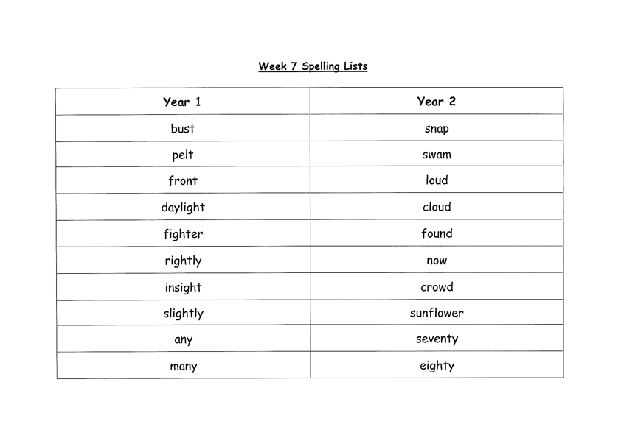
Task 1
Complete the Look, Cover, Write, Check worksheet (on a piece of paper). Write some sentences. Circle any nouns in your sentences.
Then complete your tricky word!

Slide 18
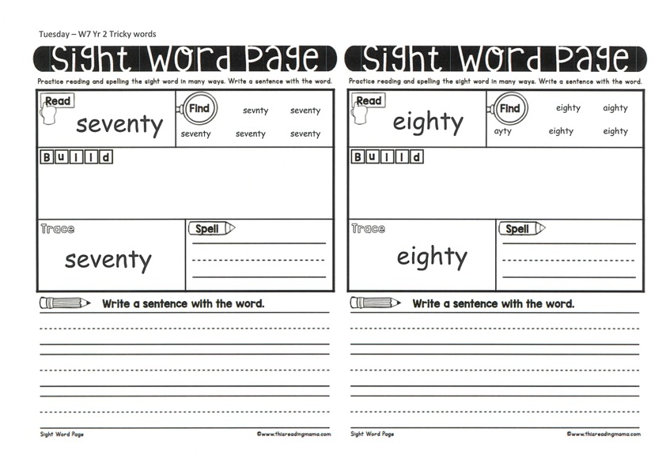
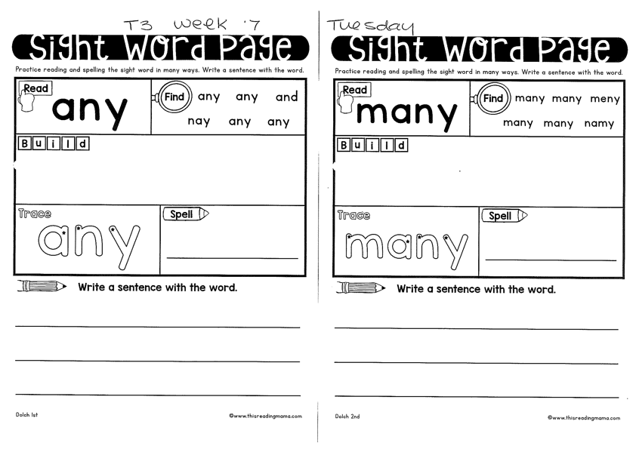
Year 1
Year 2

Slide 19
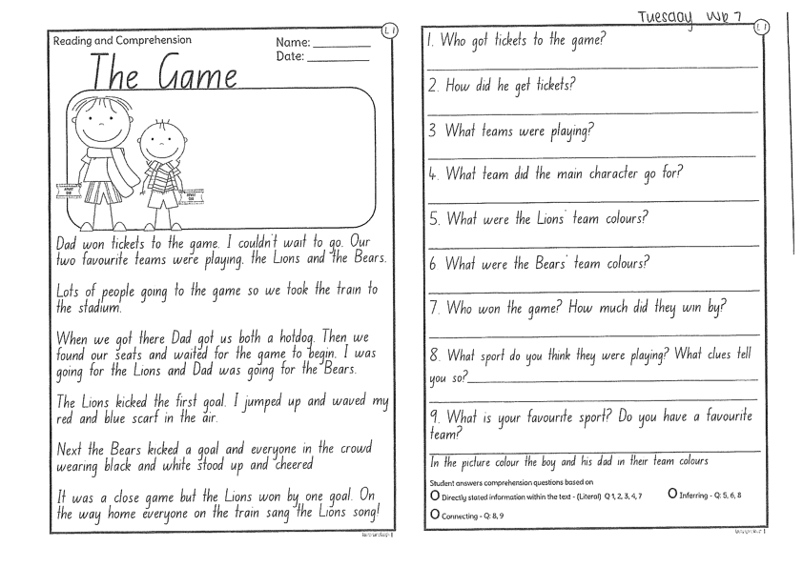
Task 2
Read or get an adult to read “The Game” and answer the questions.

Slide 20
Crunch n’ sip

Slide 21
Task 3
Writing – who does this bag belong to?
Look at the questions in your learning pack guide.

Slide 22
Recess break (30 minutes)

Slide 23
Mathematics
M o n e y
Task 1
Complete an activity from the maths activity grid

Slide 24
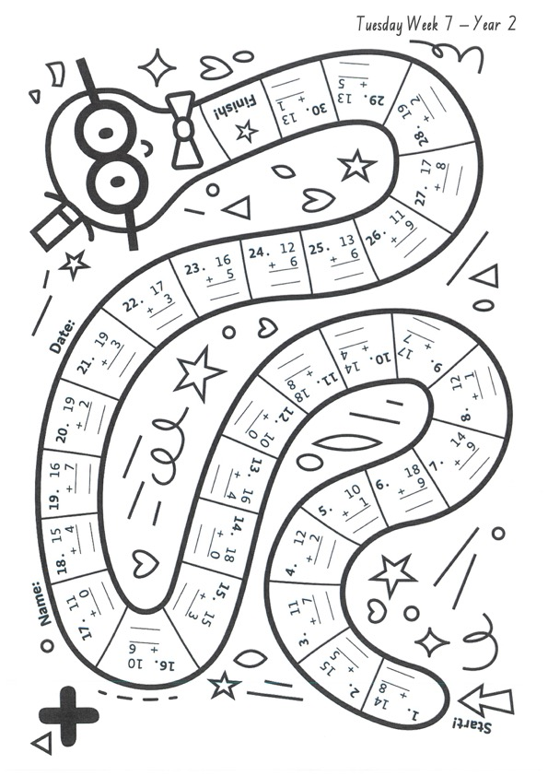
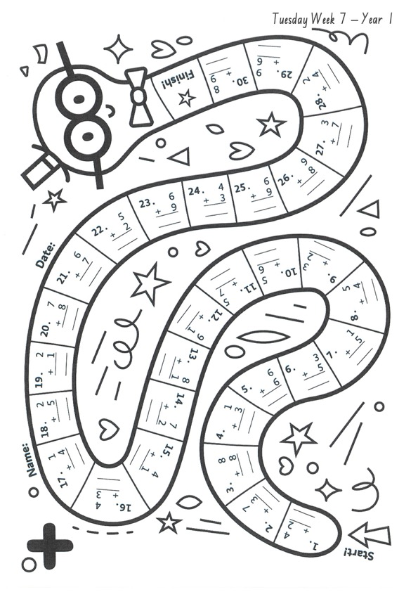
Task 2
Then complete 3 activities on studyladder or mathletic.
Add/sub game

Slide 25
Lunch break (40 minutes)

Slide 26
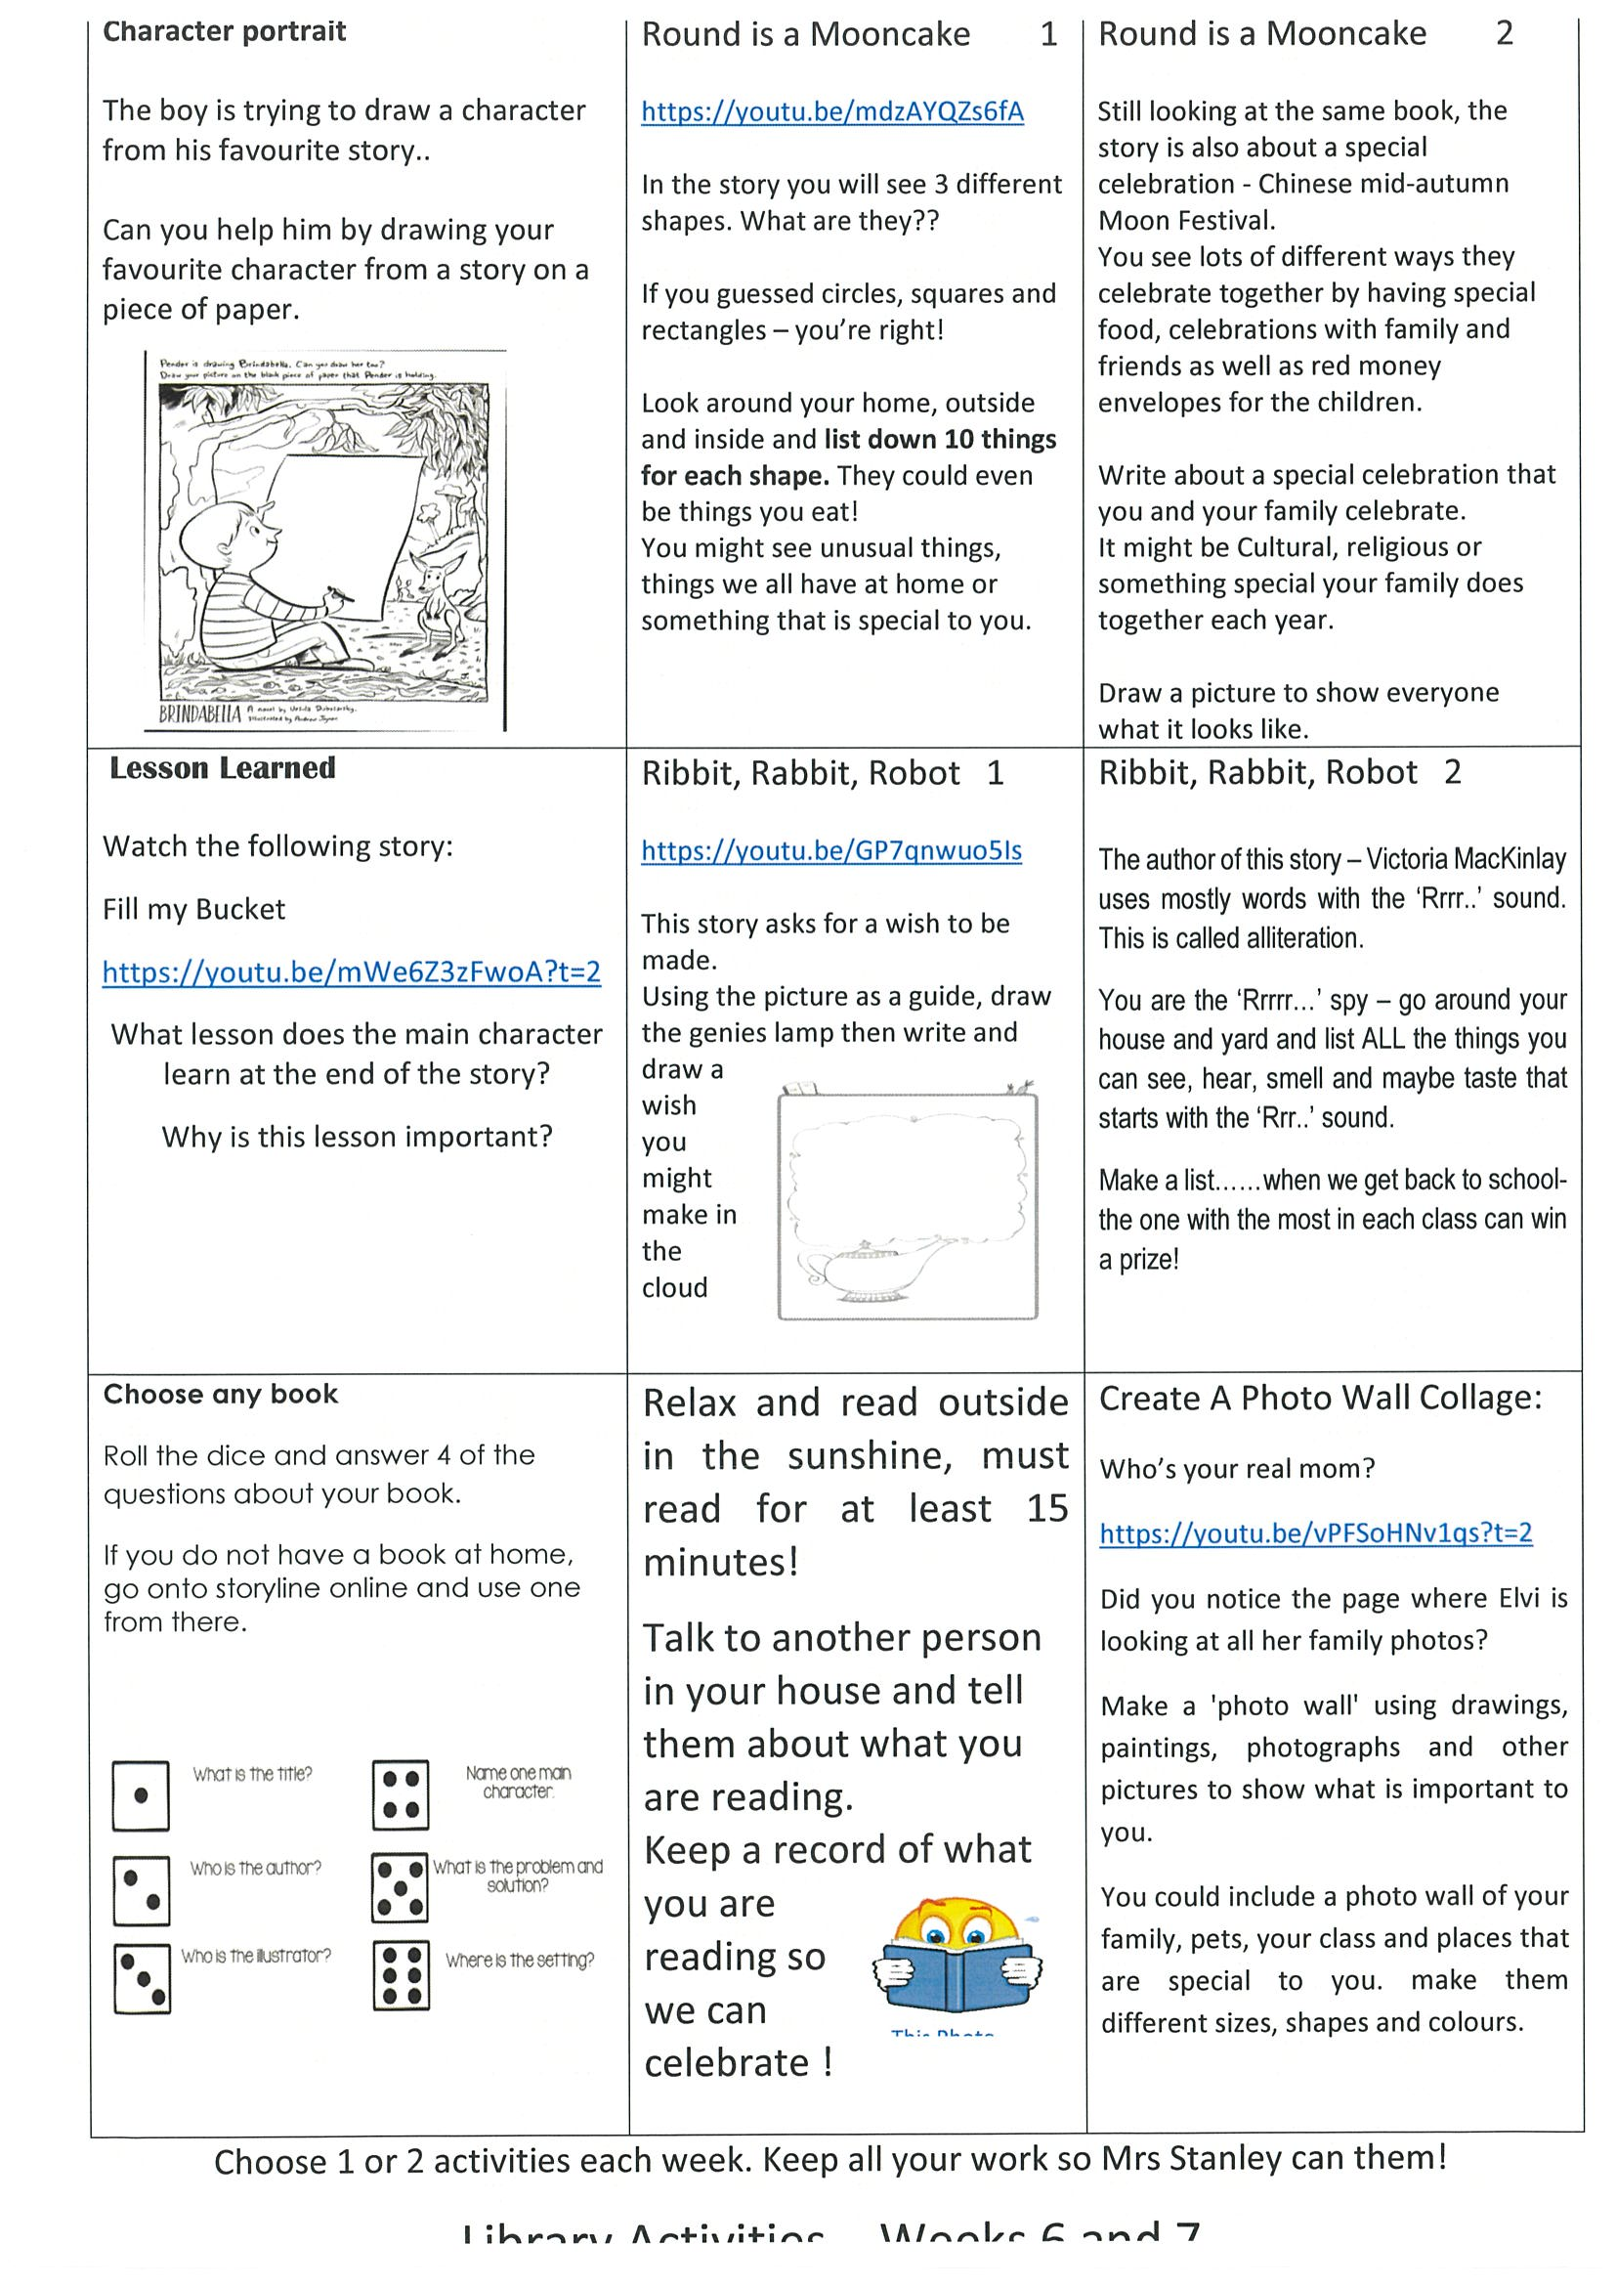
library
Silent reading
Choose one or two activities to complete each week from the NEW library activity grid.

Slide 27
END OF DAY!
ENJOY your well-deserved break everyone!

Slide 28
Good morning
STAGE 1
WEDNESDAY 25TH AUGUST 2021 – WEEK 7
Please make sure you are sending one or two work samples to your classroom teacher via dojo.

Slide 29
WHATS ON TODAY?
Morning
Task 1 – Spelling
Task 2 – Reading
Crunch n’ sip
Task 3 - Writing
Task 4 - Handwriting
Middle
Task 1 – Maths Grid
Task 2 – Worksheet
Task 3 – Fitness
Final
Science

Slide 30
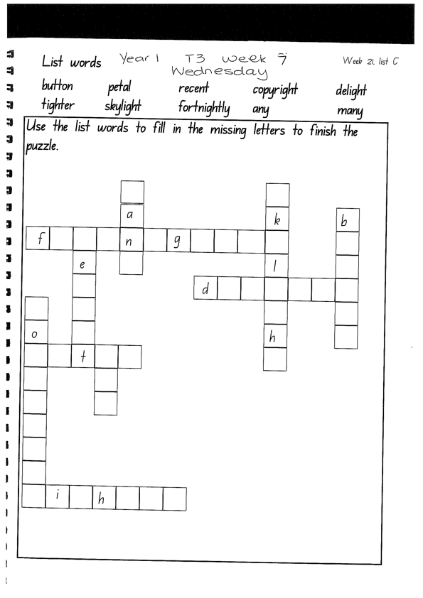
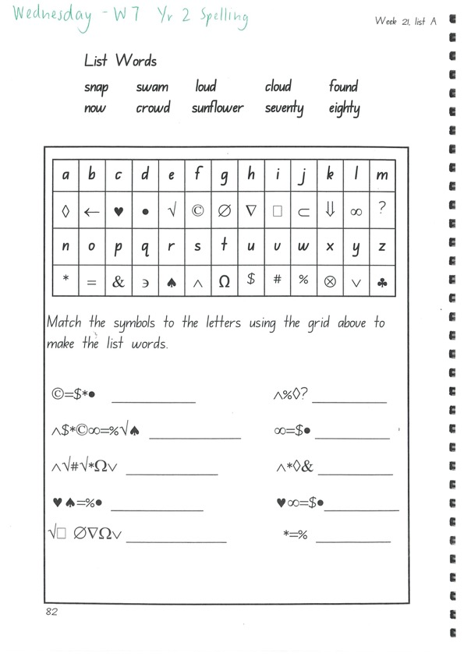
Task 1
Write down your spelling words and dot, dash, dive them on a piece of paper..
Video will be posted on dojo!
Complete spelling tasks.

Slide 31
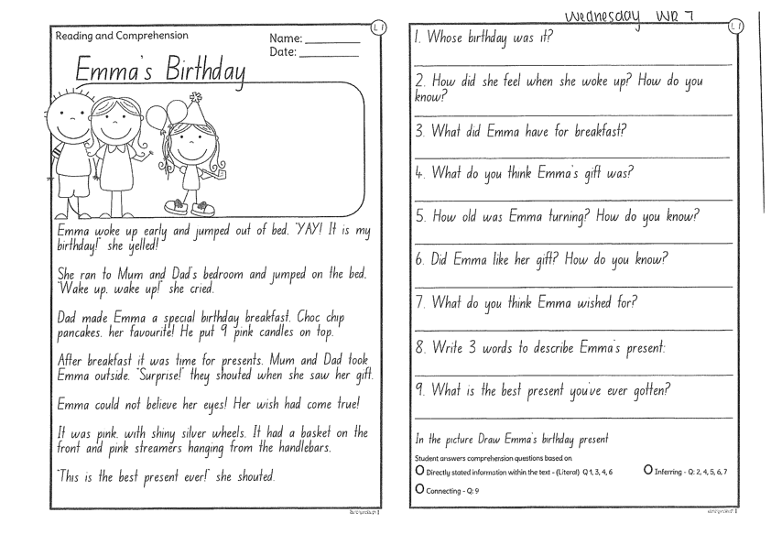
Task 2
Read or get an adult to read ”Emma’s Birthday” and answer the questions.

Slide 32
Crunch n’ sip

Slide 33

Task 3
Writing
Pick one activity around your house to help out with today. E.g. gardening, cooking, riding a bike.
On a piece of paper, write a procedural text telling us how you did it. Remember your title, list of materials and step by step instructions. Start each step with a verb!

Slide 34

Task 4
Complete the letter “d” in your handwriting books.
Https://www.youtube.com/watch?v=dbqCJkt5hUQ

Slide 35
Recess break (30 minutes)

Slide 36
Mathematics
Task 1
Complete an activity from the maths activity grid

Slide 37
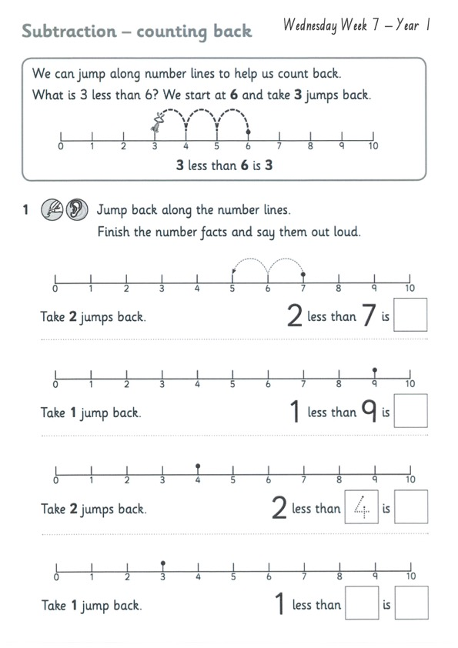
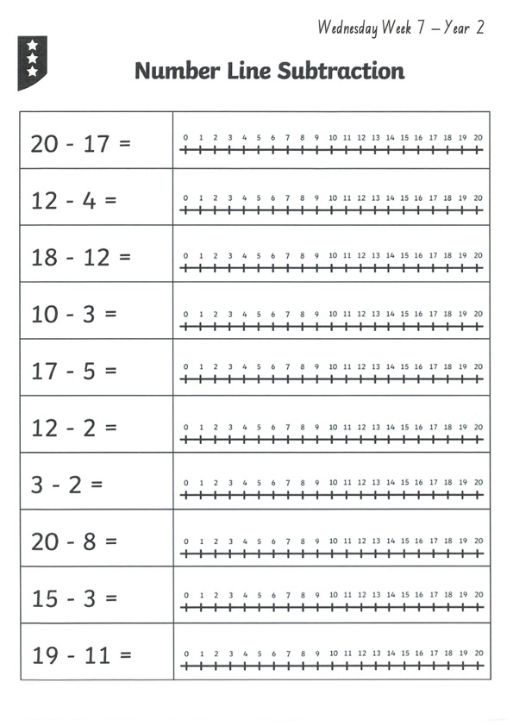
Task 2
subtraction
Year 1
Year 2

Slide 38
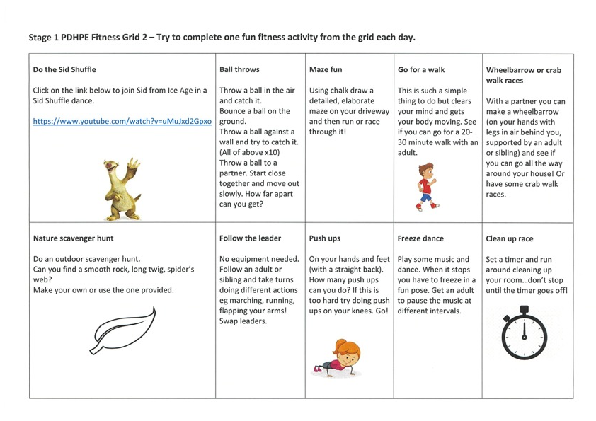

fitness
Choose an activity from the fitness grid to complete.
Not this one
(in your packs)

Slide 39
Lunch break (40 minutes)

Slide 40
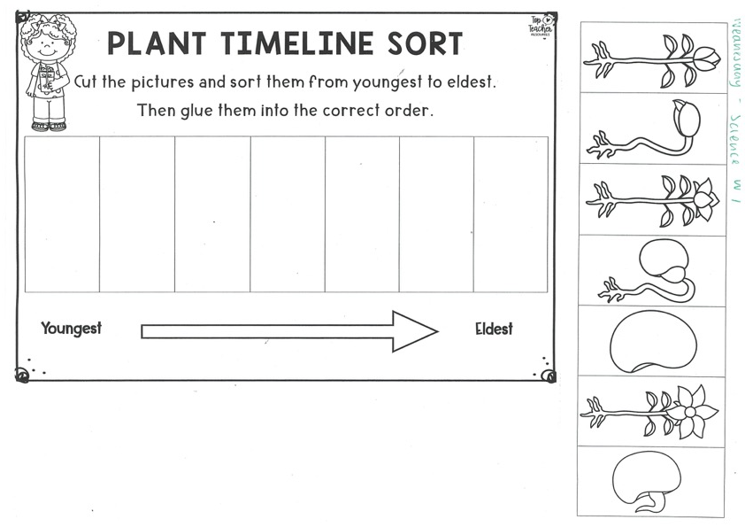
KLA - SCIENCE
Watch the video about the life cycle of a plant:
Https://www.youtube.com/watch?v=tkFPyue5X3Q
Using the worksheet draw or cut and paste the images into the correct order from youngest to eldest.

Slide 41
END OF DAY!
ENJOY your well-deserved break everyone!

Slide 42
Good morning
STAGE 1
THURSDAY 26TH AUGUST 2021 – WEEK 7
Please make sure you are sending one or two work samples to your classroom teacher via dojo.

Slide 43
WHATS ON TODAY?
Morning
Task 1 – Spelling
Task 2 – Reading
Crunch n’ sip
Task 3 - Writing
Middle
Task 1 – Maths Grid
Task 2 – Maths Worksheets
Final
PDHPE

Slide 44
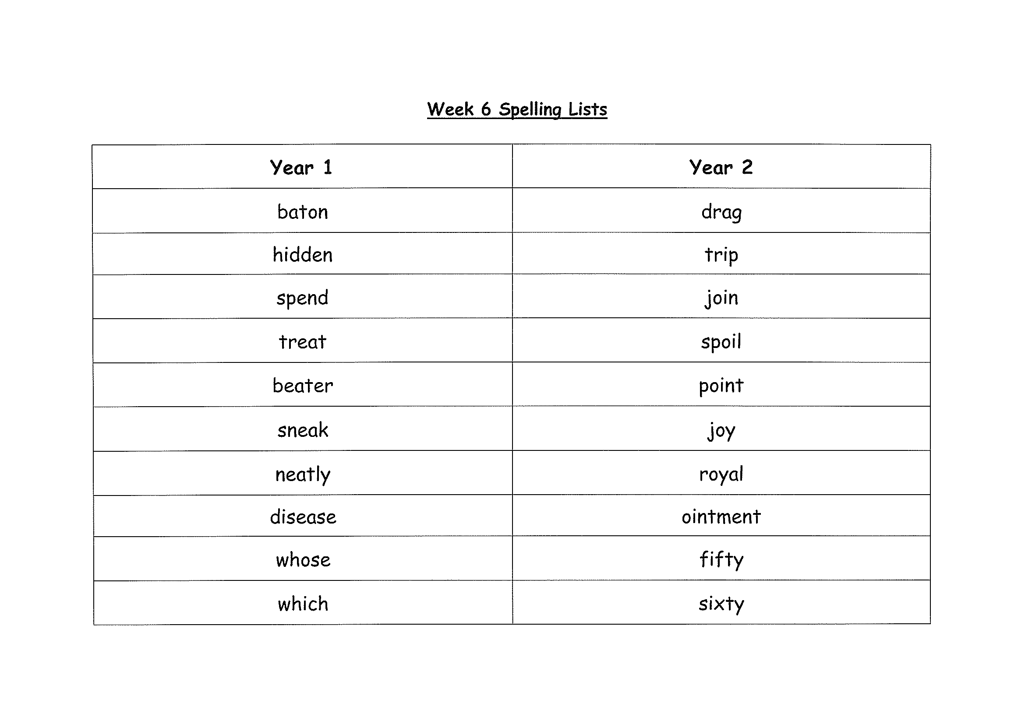
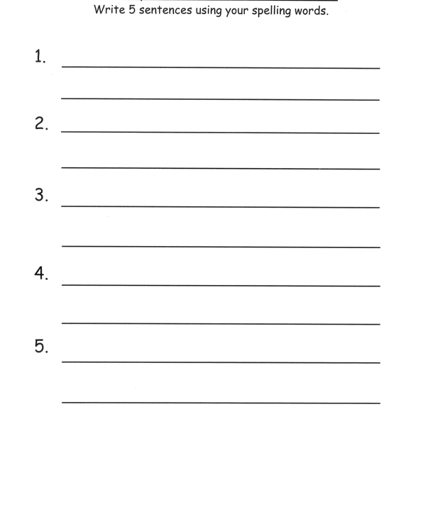
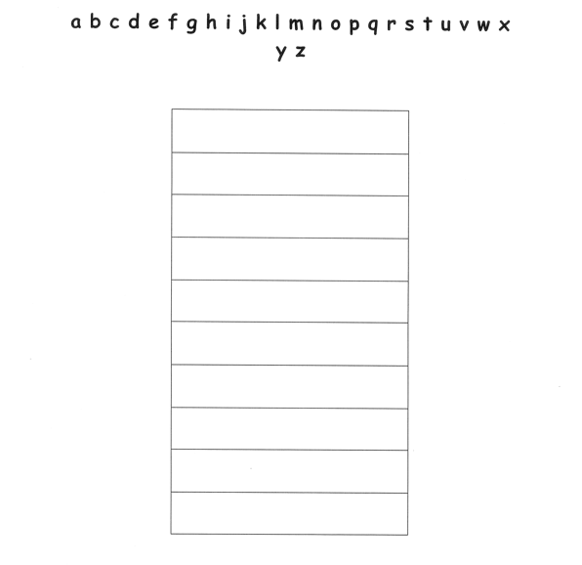
Task 1
Practice your spelling words in alphabetical order on a piece of paper.
Write 5 sentences using your spelling words on a piece of paper. Circle any verbs (action words) in your sentence.

Slide 45
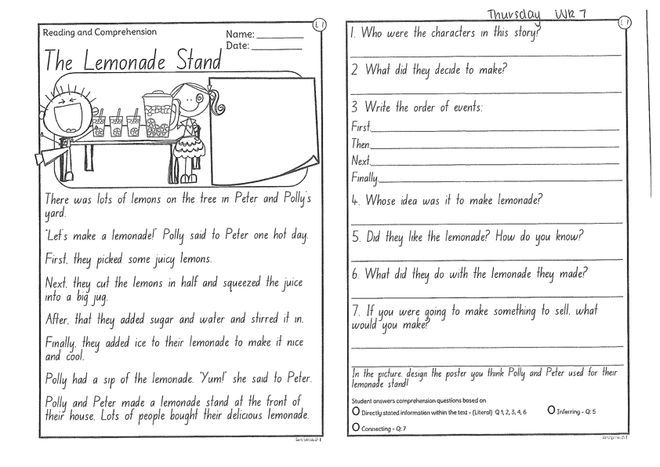
Task 2
Read or get an adult to read ”The Lemonade Stand” and answer the questions.

Slide 46
Crunch n’ sip

Slide 47
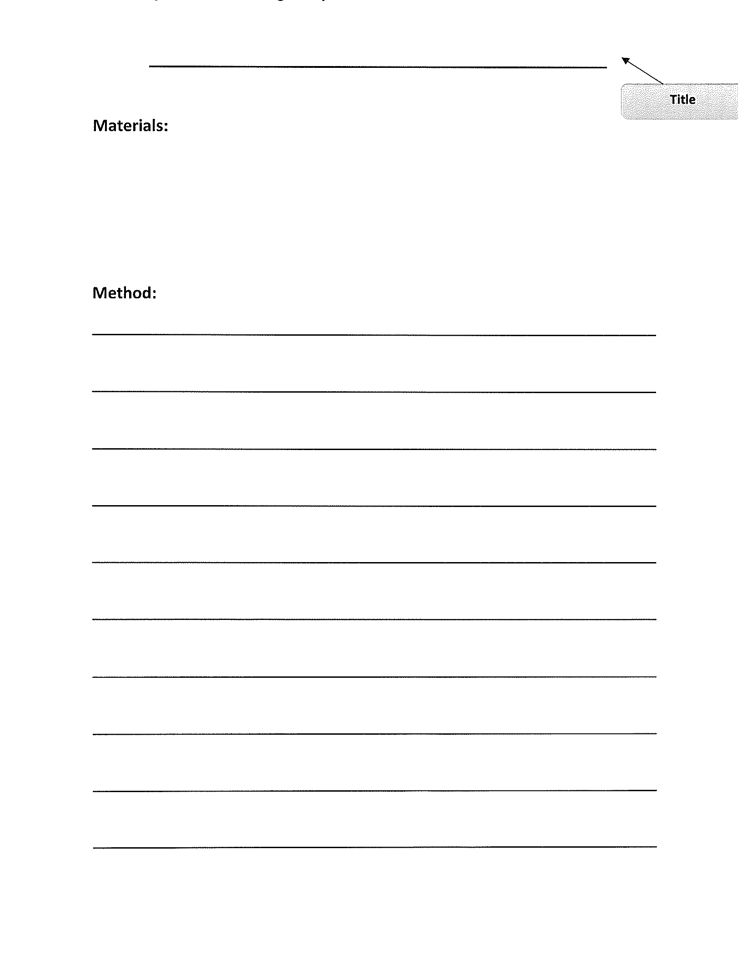
Task 3
Procedural writing
Watch the video of Mrs Mazloum making soup on your Dojo.
On a piece of paper, write your own procedural text on “How to make soup”. Remember to include a title, a list of materials and step by step instructions (method). Don’t forget to start each step with a verb!

Slide 48
Recess break (30 minutes)

Slide 49

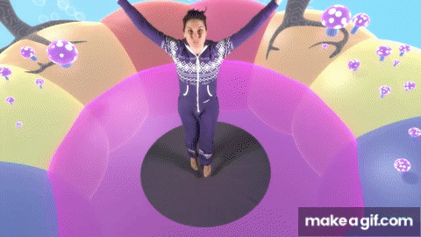
KLA – capa (dance)
AFRICAN DANCE LESSON 2
https://www.youtube.com/watch?v=Ewqq-3xJFdI

Slide 50
Mathematics
Task 1
Complete an activity from the maths activity grid

Slide 51
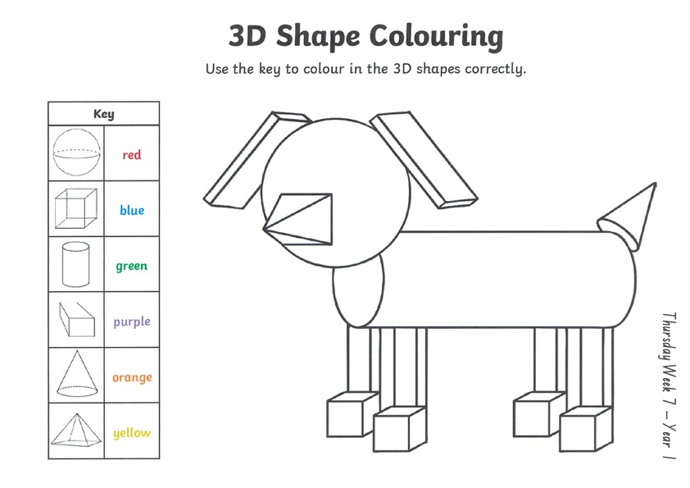
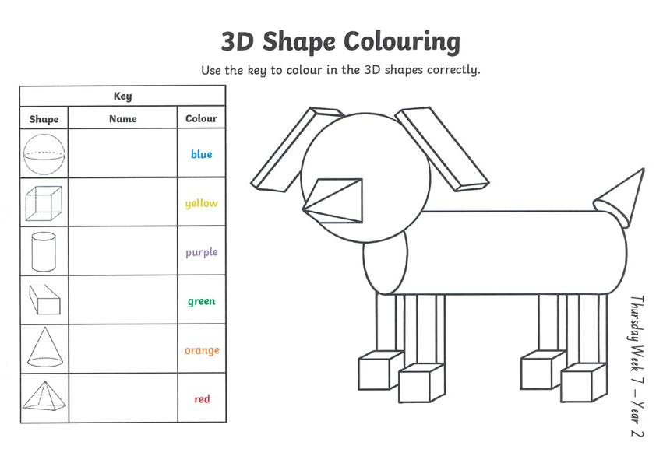
Task 2
Then complete 3 studyladder or mathletics activities
3d shape
Year 1
Year 2

Slide 52
Lunch break (40 minutes)

Slide 53
KLA - PDHPE
Water and Road safety
Playing in water can be fun, but it can also be dangerous if you don’t know the safety rules. These activities will help teach you all you need to know about water safety. Its important to be able to recognise and understand the different signs in an and around the community that help keep you safe. Complete the worksheets.

Slide 54
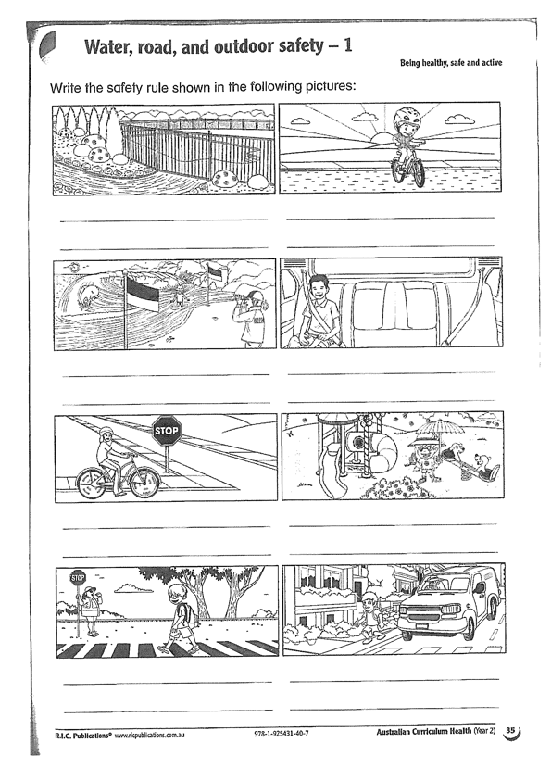
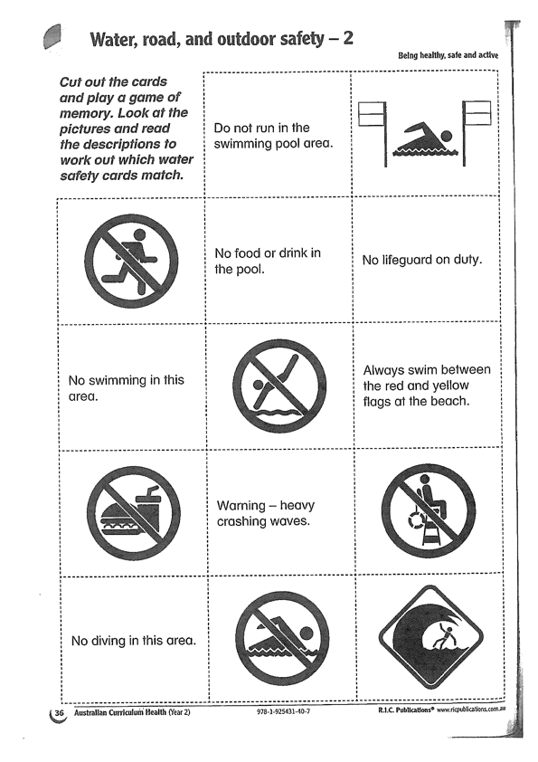

Slide 55
END OF DAY!
ENJOY your well-deserved break everyone!

Slide 56
Good morning
STAGE 1
FRIDAY 27TH AUGUST 2021 – WEEK 7
Please make sure you are sending one or two work samples to your classroom teacher via dojo.

Slide 57



WHATS ON TODAY?
WELL BEING FRIDAY!!
To focus on our well being and unplugging from technology, today is a tech free day. Choose activities from the Friday grid. Submit photos of what you have done to our school Facebook page NOT DOJO.

Slide 59
END OF Week!
ENJOY your well-deserved break everyone!

